Slide 1
ECEN 621-600
“Mobile Wireless Networking”
Course Materials: Papers, Reference Texts: Bertsekas/Gallager, Stuber, Stallings, etc
Grading (Tentative): HW: 20%, Projects: 40%, Exam-1:20%, Exam-II:20%
Lecture notes and Paper Reading Lists: available on-line
Class Website: http://ece.tamu.edu/~xizhang/ECEN621/start.php
Research Interests and Projects: URL:http://ece.tamu.edu/~xizhang
Instructor: Professor Xi Zhang
E-mail: xizhang@ece.tamu.edu
Office: WERC 331

Slide 2
Course Introductions and Contents Overview
Lecture Notes 1.

Slide 3
Computer Communications Networks Architecture
Internet
Backbone
Base Station
Fixed Host
Wireless Cell
Mobile Host
ECEN 621, Mobile Wireless Networks

Slide 4
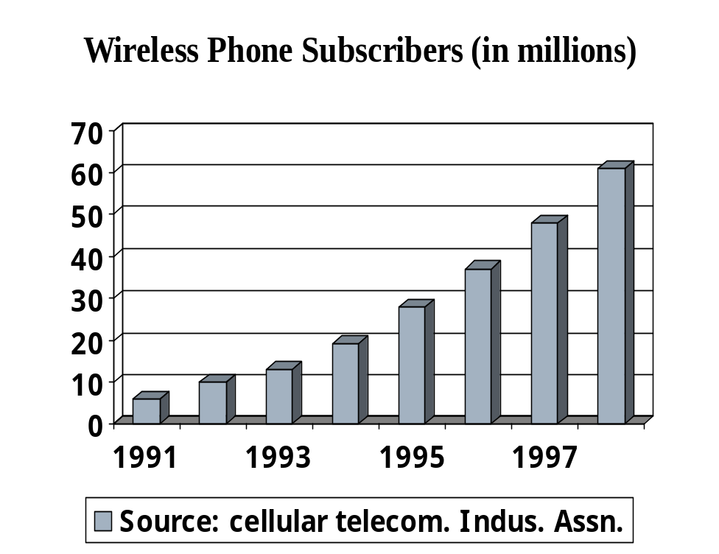
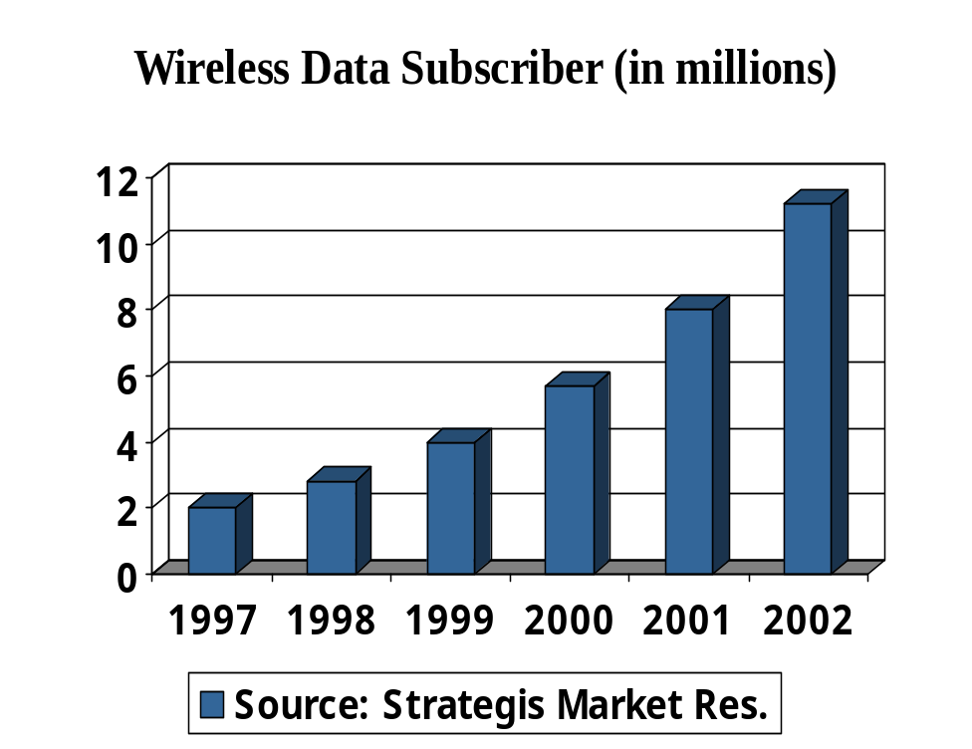
Growth of Wireless Networks Users
ECEN 621, Mobile Wireless Networks

Slide 5
Wireless Internet Wi-Fi Hotspots Space
It is one of the fastest growing industry sectors
  More than 1,000,000 public hotspots by 2007~2008
Almost notebooks will have automatically embedded Wi-Fi card
Go and check the local hotspots online
  www.ezgoal.com/hotspots/
ECEN 621, Mobile Wireless Networks

Slide 6
The Course Description
Only recommended (required) textbooks for this course, but many classic/recent research papers
Read and discuss
  your class participation counts
practice what you have learned
  get your hands dirty: do several term projects
  try to write up research papers
Tips of taking this class
  You are expected to be prepared for each lecture by reading the paper BEFORE coming to the lecture
ECEN 621, Mobile Wireless Networks

Slide 7
Prerequisites
Basic knowledge of calculus
Programming experiences
  familiar with C/C++/UNIX
  useful reference books:
    “Internetworking with TCP/IP, Vol’s I, II, III” by Doug Comer
    “TCP/IP Illustrated, Vol’s 1 & 2” by Stevens
ECEN 621, Mobile Wireless Networks

Slide 8
Course Components
Part-I
  Internet architecture and design philosophy
Part-II
  Wireless communications & networks systems designs
Part-III
  Hybrid wireline and wireless networks
ECEN 621, Mobile Wireless Networks

Slide 9
Start with Internet Architectures
Overview/Review:
Internet protocol stack
TCP/IP protocol
IP and routing algorithms
MAC/Data link protocol
PHY layer algorithms
ECEN 621, Mobile Wireless Networks

Slide 10
Protocol Stack (Internet Philosophy)
Wireless Web, Location Independent Services, etc.
Content adaptation, Consistency, File systems
Wireless TCP
Mobility, Routing, Ad Hoc Networks
QoS
Scheduling, Ch. Allocations
MAC/PHY Cross-Layer
Application Layer
Middleware and OS
Transport Layer
Network Layer
Link & PHY Layers

Slide 11
Packet Switched Networks
Hosts send data in packets
network supports all data communication services by delivering packets
  Web, email, multimedia
Host
Host
video
Application
Host
Web
Host
Host
email
ECEN 621, Mobile Wireless Networks

Slide 12

One network application example
Bob@ece.tamu.edu
Smith@lcs.mit.edu
msg
ECEN 621, Mobile Wireless Networks

Slide 13
What is happening inside ?
email
Bob@ece.tamu.edu
Smith@lcs.mit.edu
msg
Transport
protocol
Transport
protocol
Network
protocol
Network
protocol
Network
protocol
Network
protocol
Physical net
physical net
Physical net
ECEN 621, Mobile Wireless Networks

Slide 14
Layered Network Architecture
network consists of geographically distributed hosts and switches (nodes)
Nodes communicate with each other by standard protocols
A
C
host switch
A
B
C
B
D
physical connectivity
network topology
Protocol layers
ECEN 621, Mobile Wireless Networks

Slide 15
a picture of protocol layers
A
Application (data)
header
data
Transport segment
header
DATA
network packet
header
DATA
tail
Ethernet frame
B
physical connectivity
What’s in the header: info needed for the protocol’s function
ECEN 621, Mobile Wireless Networks

Slide 16
TCP/IP Protocol Suite
IP Protocol: Inter-networking protocol
  RFC791
TCP Protocol: reliable transport protocol
  RFC793
ECEN 621, Mobile Wireless Networks

Slide 17
The picture of the world according to IP
application protocols
TCP UDP
transport
(end-to-end)
transport layer protocols
universal datagram delivery
IP
inter-network layer
subnets
hardware-specific
network technologies
ethernet token-ring FDDI dialup ATM
ECEN 621, Mobile Wireless Networks

Slide 18
TCP: Transmission Control Protocol
a transport protocol
  IP delivers packets “from door to door”
  TCP provides full-duplex, reliable byte-stream delivery between two application processes
Application process
Application process
W
rite
Read
More terminology:
TCP segment
Max. segment
size (MSS)
bytes
bytes
TCP
TCP
Send buffer
Receive buffer
segment
segment
ECEN 621, Mobile Wireless Networks

Slide 19
TCP: major functionalities
Header format
Connection Management
  Open, close
  State management
Reliability management
Flow and Congestion control
  Flow control: Do not flood the receiver’s buffer
  Congestion control: Do not stress the network by sending too much too fast
ECEN 621, Mobile Wireless Networks

Slide 20
TCP header format
0
16
31
IP header
source port
destination port
Data sequence number
acknowledgment number
Hlen unused
u a p r s f
r c s s y i
g k h t n n
window size
checksum
urgent pointer
Options (viable length)
data
ECEN 621, Mobile Wireless Networks

Slide 21
Opening a connection: three-way hand-shake
client
open request(x)
server
Passive open
ack(x+1) + request(y)
ack(y+1)
(now in estab. state)
enter estab. state
ECEN 621, Mobile Wireless Networks

Slide 22
TCP’s Two Major Functional Components
[1] Flow control and congestion control
  Refer to a set of techniques enabling a data source to match its transmission rate to the currently available service rate at the receiver and in the networks.
  Flow Control Mechanism Design Ceriteria
    Simple to implement and use least network resources
    Scales well as the network size increases
    Must be stable and converging to equilibriums
[2] Error Control and Loss Recovery
  Refer to a set of techniques to detect and correct data losses
  Two levels of error control
    Bit-level: inversion of 0 bit to 1, or 1 bit to 0, also called bit corruption => often occur over the mobile and wireless networks
    Packet-level: packet loss, duplications, reordering => often occur and be treated at higher layer protocol, such as TCP, over wired networks.
    Erasure error: the information about the positions of error/loss is available for error control => packet level loss usually be treated as erasure loss by using sequence number.
ECEN 621, Mobile Wireless Networks

Slide 23
Classification of Flow Control Mechanisms
Open-loop control scheme
  Flow control function is achieved without using feedback via the closed-loop channel.
Closed-loop flow control scheme
  Flow control adapt its transmission rate to the bottleneck available bandwidth according to the feedback through the closed-loop channel
    Window-based scheme vs. Rate-based schemes
    Explicit scheme vs. Implicit scheme
    End-to-end scheme vs. Hop-by-Hop scheme
Hybrid schemes
  Mixing open-loop flow control with closed-loop scheme
ECEN 621, Mobile Wireless Networks

Slide 24
TCP Flow Control Categories and Principles
Flow control categories
  Implicit,
  Window-based,
  End-to-End scheme.
TCP Tahoe
  Use timeout to detect packet loss and congestions
TCP Reno
  Use triple-duplicate ACK to same sequence number and timeouts to detect packet loss and congestions
  Use fast retransmissions and fast recovery
    Skip Slow Start phase
TCP Vegas
  Use expected and measured throughputs to detect congestions
ECEN 621, Mobile Wireless Networks

