Slide 1
A3 · KAGGLE CHALLENGE
MULTIMODAL CANCER CLASSIFICATION · 2026
Multimodal Cancer Cell
Classification
30 versions, six diagnosed failures, one breakthrough
A methodological run at the Multimodal Cancer Classification challenge — where each diagnosed failure shaped the next version, and the wins came from reading the losses faithfully.
PUBLIC LB
0.8392
v58 co-attention seed2 · #3 on LB
LIFT VS V19
VERSIONS
+0.094
30
Rafael Tavares Proença
Advanced Deep Learning for Image Processing · 1MD042
Uppsala University · June 4, 2026
BF · 128 × 128
FL · 128 × 128
Notes:
Hello — I'm Rafael. Today I'll walk you through the Multimodal Cancer Cell Classification Challenge: 30+ logged Kaggle versions, five acts of experimentation, and a final architecture push. +0.094 LB lift over the supervised baseline to my best single model: v58's intermediate co-attention fusion (seed2) at 0.8392 -- the new best, holding #3 on the public leaderboard. But this talk is not primarily about the score. The instructor said grading is based on methodology and presentation, not the leaderboard itself. So I'll spend most of the time on what didn't work and why — six diagnosed failures shaped the winning recipe directly. Pacing: 14 slides, ~45 seconds per slide, ~30 seconds buffer for questions.

Slide 2
§1 · THE CHALLENGE
02 / 14
Binary cell classification on paired BF + FL
Two structural facts shape every method choice that follows.
114,302
59,040
38.8%
0.8392
TRAIN CELLS · 12 patients
TEST CELLS · patient-disjoint
POS RATE · pos_weight ≈ 1.58
BEST LB · v58 co-attention
— Per-cell prediction: is the cell from a cancer patient? (weak labels — MAC hypothesis, all cells inherit patient diagnosis)
— Paired inputs: brightfield + fluorescence, 128×128 grayscale
— 12 training patients · ~10k cells each — small N
— Strict patient-disjoint test set — OOD generalisation is the dominant failure mode
— Metric: AUC · 4 submissions/day · public/private LB split
GRADING BASIS (INSTRUCTOR, MAY 14)
“What is done and how that is presented” — methodology over leaderboard score.
A3 · Multimodal Cancer Cell Classification
Uppsala 1MD042 · §1
Notes:
The setup. Per-cell binary classification: is this oral cell from a cancer patient. Inputs are paired brightfield and fluorescence microscopy, both 128 by 128 grayscale. Two structural challenges. First: only 12 training patients. Small-N — every label is a per-patient grouping. Second: the test set has strict patient-disjoint OOD. That second constraint dominates everything that follows. The instructor was explicit on May 14: grading is on methodology and presentation, not on the leaderboard score. Peaking at #1 (and sitting top-3 at submission) is reassuring, but it's not what's being evaluated. The negative results and the diagnostic reasoning behind v46/v47 are.

Slide 3
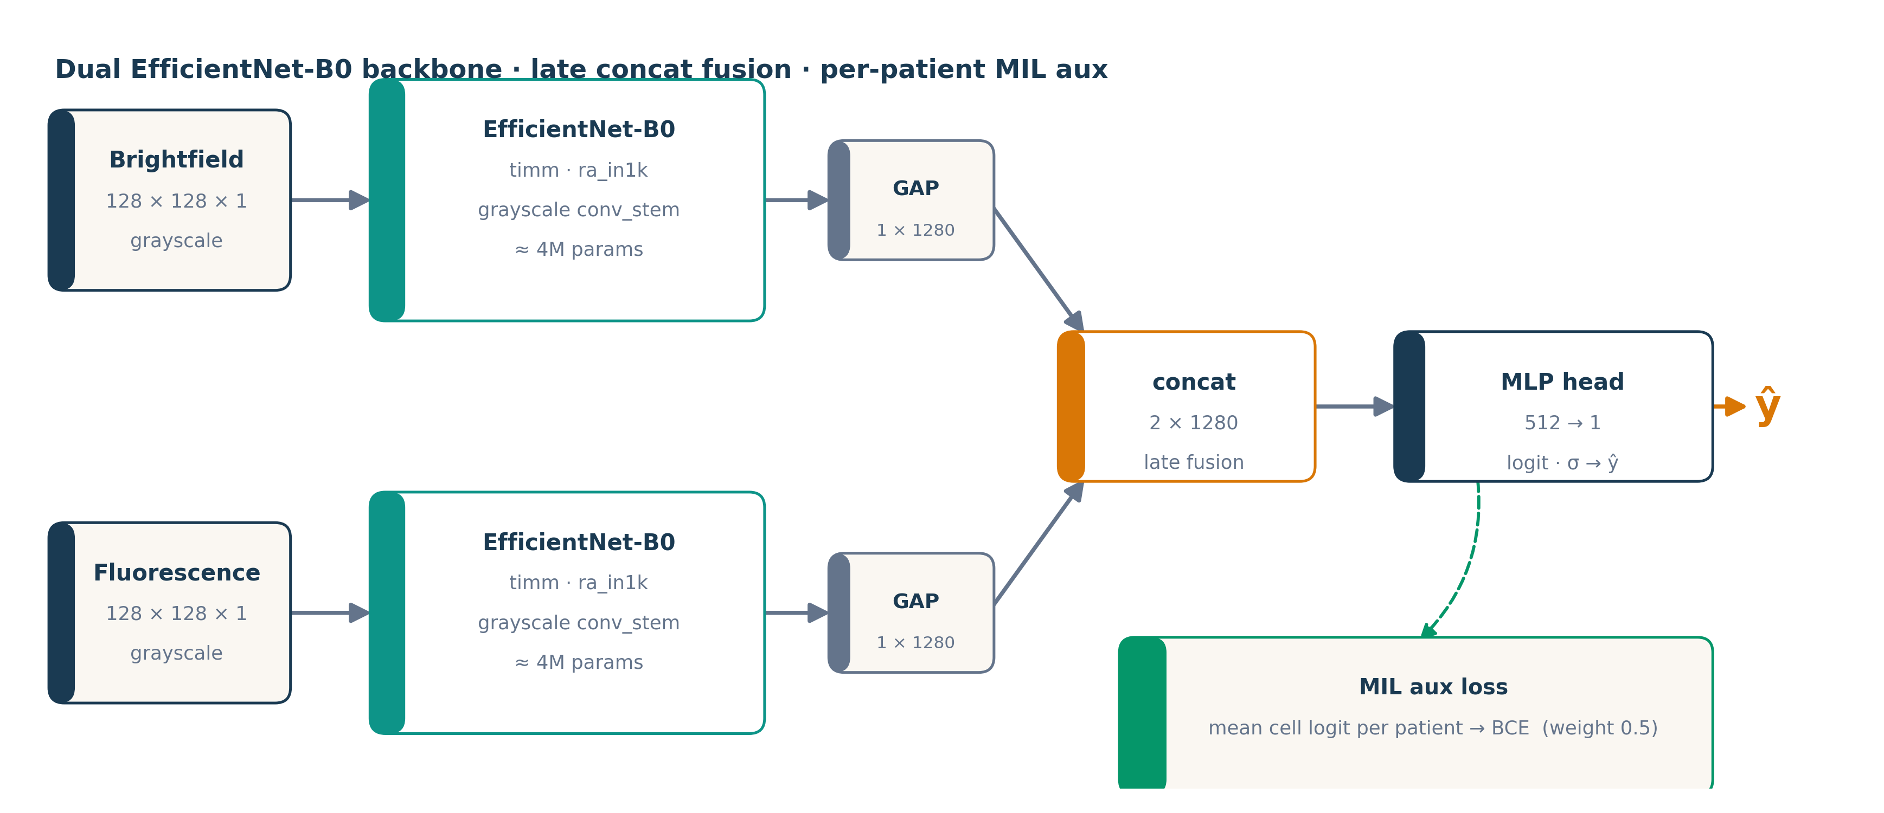
§2 · METHOD
03 / 14
Dual EfficientNet-B0 with patient-MIL aux loss
The interventions that matter sit outside the backbone.
— Late concat fusion feature-level after GAP (v38 early fusion regressed −0.031)
— Per-patient MIL aux mean-pool cell logits per patient, BCE, w=0.5
— AdaBN refresh BN stats on test set (Li 2016)
— Test-set stain norm closes the 19.7 % FL mean gap
— 8-way D4 TTA dihedral group, prob-averaged
Fig. 1 Backbone is unremarkable on purpose. The interesting parts are at training time (MIL) and test time (AdaBN, stain norm).
A3 · Multimodal Cancer Cell Classification
Uppsala 1MD042 · §2
Notes:
Method. Two EfficientNet-B0 backbones, one for brightfield and one for fluorescence, each starting from timm's ra_in1k ImageNet pretrain. Grayscale conv stems, ≈4M params each. Global average pool from each branch, concatenate the two 1280-d features, MLP head, sigmoid. The interesting parts are NOT the backbone — they're the test-time and training-time interventions. (1) Per-patient MIL aux loss: mean cell logits per patient and BCE that against the patient label, weighted 0.5. Regularizes against pure within-patient memorization. (2) AdaBN: one forward pass over the test set in train mode refreshes BatchNorm running stats to the test distribution. (3) Test-set stain normalization: FL test is measurably 19.7 % brighter than FL train; we use TEST mean/std for normalization. (4) 8-way D4 TTA, averaged in probability space. v38 tried early fusion (single 2-channel backbone). Regressed −0.031 LB. Late concat won.

Slide 4
§3 · THE ARC
04 / 14
30 versions, 5 acts, one breakthrough
Each act answered a question. Each result changed the next question.
ACT 1+2
ACT 3
ACT 4
ACT 5A
ACT 5B
v10–v16
v17–v19
v20–v41
v42–v44
v46→v47
Baselines & SSL
EffNet pivot
Regularizer search
Hard pseudo-labels
Soft distillation
0.572
0.7455
0.7563
0.7812
0.8264
SSL collapse
supervised floor
v41 +0.011
v44 +0.025 (Lee 2013)
+0.039 + 0.003 · final pick
HEADLINE +0.094 LB total — the biggest single jump (+0.039) was soft-pseudo distillation (Hinton 2015).
A3 · Multimodal Cancer Cell Classification
Uppsala 1MD042 · §3
Notes:
Five acts, anchored to version numbers. We tracked every Kaggle submission in a LB_HISTORY.md file in the repo, so when I say 'v19' or 'v47' I mean a specific notebook with a specific recipe. Act 1+2: v10-v16, baselines and an ambitious CoMIR-style SSL attempt. v15 scored 0.866 in cross-validation — our highest CV ever — then collapsed to 0.572 on the LB. Act 3: v17-v19, the pivot back to a simple EffNet-B0 recipe. LB 0.7455 supervised floor. Act 4: v20-v41, regularizer search. v41 stacked four L4 regularizers cleanly: +0.011. Act 5A: v42-v44, semi-supervised pivot. v42 SSL collapsed; v44 added Lee 2013 hard pseudo-labels for +0.025. Act 5B: v46-v47, soft distillation. v46 used Hinton 2015 soft pseudo for +0.039 and took #1. v47 iterated with v46 as the new teacher (Xie 2020 noisy student round 2): +0.003 on the ensemble (0.8264) but +0.012 on the best single seed (0.8355). We peaked #1 here; the noise-floor analysis shows the round-2 ensemble gain is statistically zero, and the per-seed dispersion is the real story.

Slide 5
§4 · ACT 2 — THE AMBITION
05 / 14
v15 / v16: best CV I ever saw, worst LB
CoMIR-style cross-modal SSL — and a 29-point generalisation gap.
What we built
0.866
— Two ResNet-18 branches (BF + FL) with projection heads
— NT-Xent contrastive pretrain, τ = 0.1 · 10 epochs
— Supervised fine-tune · 8 epochs · discriminative LR
— 3-fold stratified-group CV hid the failure — two of three folds had val patients similar to train
CV AUC · 3-fold stratified-group · best I'd ever seen
0.572
PUBLIC LB · v15 submission · 29 AUC points of OOD gap
0.943 → 0.503
DIAGNOSIS
Paired (BF, FL) of cell i always share a patient. Contrastive task solved at ≥95 % by encoding patient identity, not cell content.
v16 RESPONSE · 9 careful fixes · LOPO CV — patient-OOF up, LB still random
A3 · Multimodal Cancer Cell Classification
Uppsala 1MD042 · §4
Notes:
Act 2: CoMIR-style cross-modal contrastive SSL. Two ResNet-18 encoders for brightfield and fluorescence, paired images of the same cell as positives, unpaired as negatives. Pretrain 10 epochs, fine-tune 8. The CV came in at 0.866 — our highest ever — so we submitted, expecting ~0.75. We got 0.572. Essentially random. Diagnosis took us a few days. The issue: every cell has exactly one source patient. Paired (BF, FL) of cell i ALWAYS share a patient. Unpaired pairs of i ≠ j USUALLY don't share a patient. So the contrastive task can be solved at ≥95 % accuracy by encoding patient identity rather than cell content. The pretrain backbone optimized that shortcut. The supervised stage memorized within-patient class distributions. Test patients were disjoint. Collapse. v16 was a careful 9-fix response that switched to LOPO CV (12-fold leave-one-patient-out). Patient-level OOF went up to 0.943 — best we'd ever seen. But the public LB stayed at 0.503 — there's a level of OOD that LOPO can't detect. The whole site/protocol differs between train and test.

Slide 6
§5 · ACT 3 — THE PIVOT
06 / 14
v19: drop the SSL, model the test distribution
Five ingredients. None of them are new. Together: +0.174 LB over v15.
0.7455
+0.174
−0.038
PUBLIC LB · v19 · supervised floor · held ~3 weeks
VS V15 SSL collapse → floor
VS prior LB leader · 0.7832 at the time
Five ingredients in v19
— EfficientNet-B0 dual-branch (BF + FL), ImageNet-pretrained, late concat fusion
— Per-patient MIL auxiliary loss — patient-mean-logit BCE, weight 0.5
— AdaBN — refresh BN running stats on the test set (Li 2016)
— Test-set stain normalisation — pixel mean/std from test, not train
— Strong paired augmentation + 8-way D4 group TTA, prob-averaged
TAKE-HOME The win wasn't a new architecture — it was treating the test distribution as the thing to model.
A3 · Multimodal Cancer Cell Classification
Uppsala 1MD042 · §5
Notes:
The pivot. Drop the SSL complexity entirely. Drop the LOPO CV. Train a standard EffNet-B0 with five ingredients that directly model the OOD problem. Five ingredients: dual-branch backbone with late concat fusion. Per-patient MIL aux loss regularizing against within-patient memorization. AdaBN to refresh BN stats to the test distribution. Test-set stain normalization closing the 19.7 % FL mean gap. Strong augmentation plus 8-way dihedral TTA. Public LB 0.7455. Up 0.174 from v15. The new supervised floor that held for three weeks. Take-home: the win came from treating the test distribution as the thing to model. The SSL pipeline tried to learn invariance from scratch and failed. v19 imported invariance via TTA, AdaBN, and stain norm. Cheaper and more effective.

Slide 7
§6 · ACT 4 — THE SEARCH
07 / 14
v41 vs v43: change one thing, not four
v41 · clean stack on top of v19
v43 · four MORE, stacked at once
0.7563
0.7444
+0.011
−0.012
— label smoothing ε = 0.05 L4 standard
— dropout 0.3 → 0.4 classifier head
— paired RRC RandomResizedCrop scale 0.85-1.0
— multiscale TTA 3 scales × 8 D4 = 24-way
— FL-tuned aug CJ 0.5/0.3 + RandomGamma on FL only
— WD bump 1e-4 → 3e-4
— 3-seed × SWA Izmailov 2018 · last 4 epochs
— 40-way TTA 5 scales × 8 D4
RULE →
One or two related variables per submitted version. v46 later reverted the FL-tuned aug + WD bump and recovered +0.079.
A3 · Multimodal Cancer Cell Classification
Uppsala 1MD042 · §6
Notes:
Act 4 had two contrasting experiments — one clean, one cautionary. v41 was the clean win. Four well-motivated L4 textbook additions on top of v19: label smoothing 0.05, dropout 0.3 → 0.4, paired RandomResizedCrop, multiscale TTA. Each component individually defensible, all roughly additive. +0.011 LB to 0.7563. v43 was the cautionary tale. Four MORE changes simultaneously: FL-tuned aug, weight decay bump 1e-4 → 3e-4, 3-seed × SWA ensembling, 40-way TTA. Regressed by 0.012. We could NOT isolate the bad component. Five hours of Kaggle GPU produced no isolable signal. Rule encoded: change one or two related variables per submitted version. v46 later proved this by reverting the FL-tuned aug and the WD bump (keeping the SWA ensemble + extended TTA) and gained +0.079 LB. So the FL aug and the WD bump were the bad components.

Slide 8
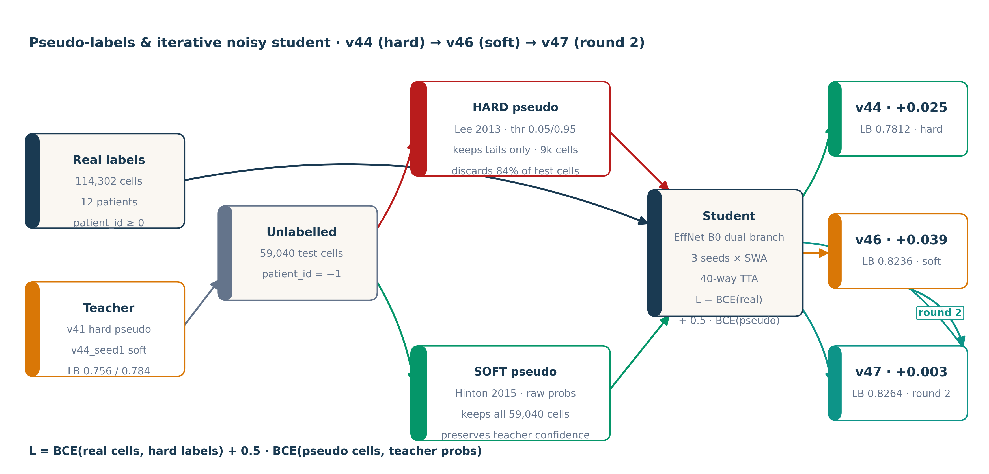
§7 · ACT 5 — THE BREAKTHROUGH
08 / 14
Use the test set itself as training signal
Fig. 2 Same teacher, two ways to use it. Hard discards 84 % of test cells. Soft keeps everything, weighted by teacher confidence. Round 2 uses v46 as the new teacher → v47.
A3 · Multimodal Cancer Cell Classification
Uppsala 1MD042 · §7
Notes:
Act 5 was the breakthrough. Three experiments, +0.067 LB combined. v44 added Lee 2013 hard pseudo-labels. Teacher v41 predicts on the test set. Keep cells where p < 0.05 or p > 0.95 — about 9,350 of 59,040 cells (16 %). Hard 0/1 labels, patient_id = -1 sentinel so MIL skips them. +0.025 LB. v46 was the bigger insight. Hard discards 84 % of test cells. Switch to Hinton 2015 soft-target distillation: use ALL 59,040 cells, target = teacher's raw probability. Preserves what Hinton calls 'dark knowledge' — the directional and magnitude information of teacher uncertainty that hard binarization throws away. Pseudo loss weight 0.5 so real labels still dominate the gradient. +0.039 LB more. v47 was the diminishing-returns check. Xie 2020 iterative noisy student: same recipe as v46 but v46's ensemble (LB 0.8236) is the new teacher. Round 2 of the teacher → student loop. Forecast +0.005-0.020. Observed +0.003. The round-1 step did the bulk of the work; round 2 is mostly a variance reducer (per-seed tr_auc tightened from 0.989-0.993 to 0.993-0.994).

Slide 9
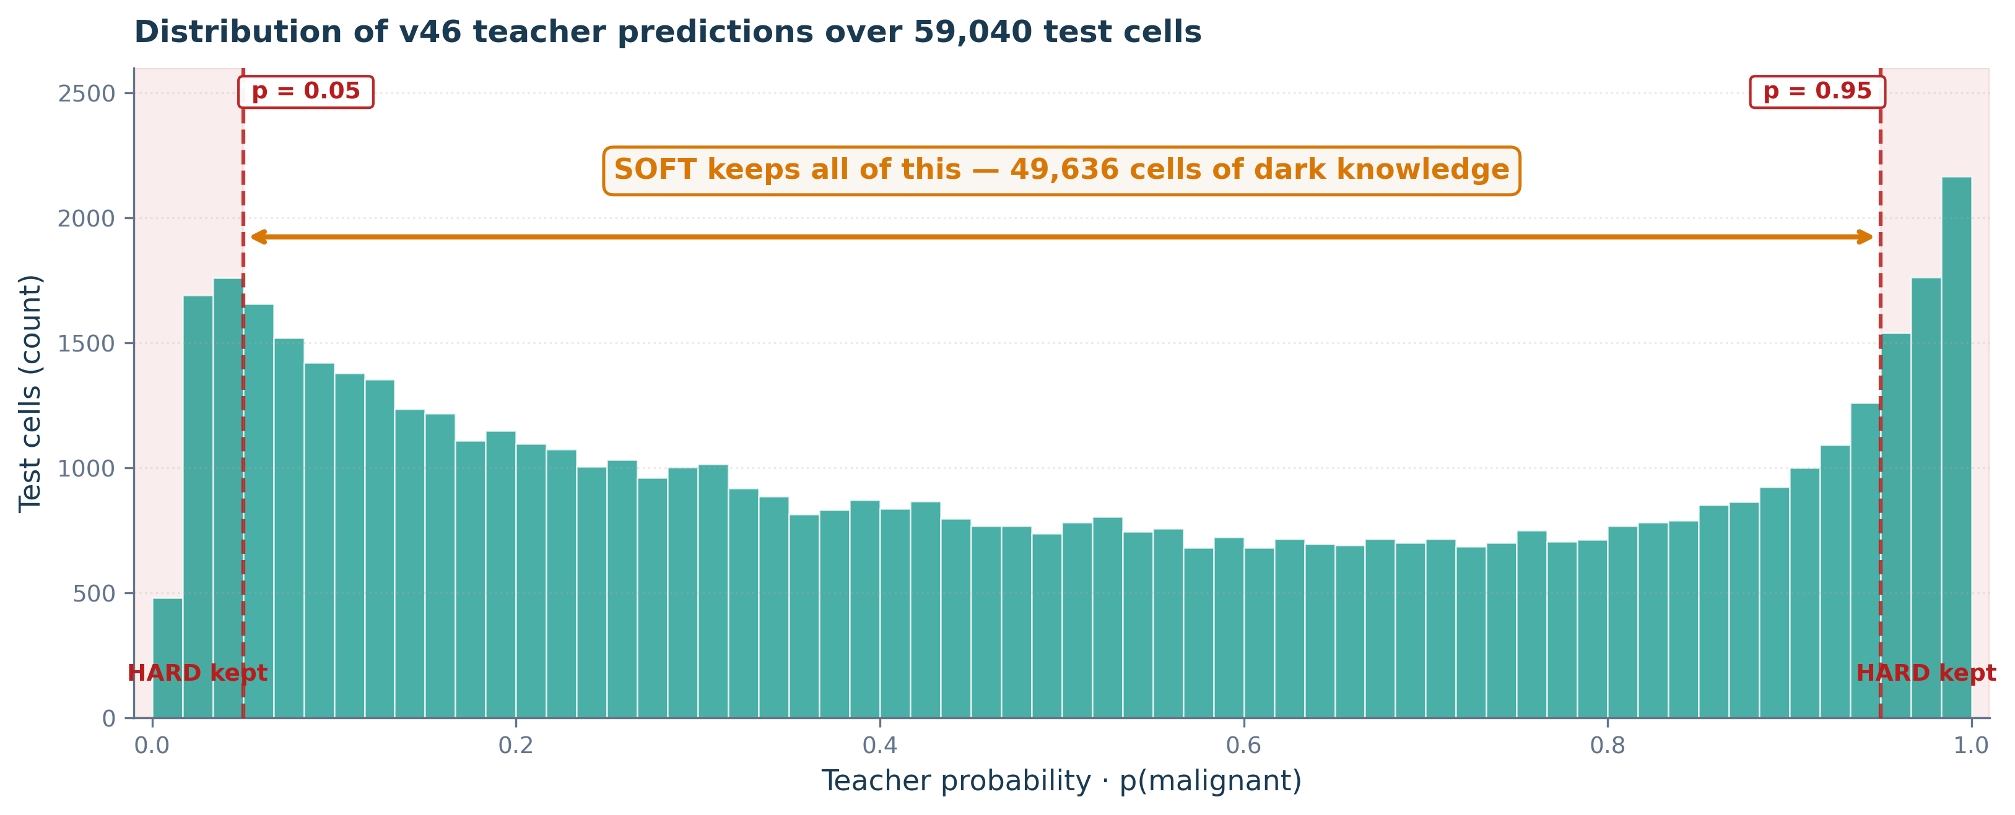
§7 · HARD VS SOFT PSEUDO-LABELS
09 / 14
Hard drops 84% of test cells; soft keeps all
Same teacher. Same predictions. Different way of using them.
METHOD
CELLS USED
Δ LB
baseline v41
114,302
—
v44 · hard
+ 9,350 (16 %)
+0.025
v46 · soft
+ 59,040 (100 %)
+0.039
v47 · round 2
+ 59,040 (100 %)
+0.003
Fig. 3 Distribution of teacher predictions. Red dashed = hard thresholds. Soft keeps every column.
DARK KNOWLEDGE (HINTON 2015)
WHY SOFT ALSO HELPS ROUND 2
A cell labelled p = 0.78 by the teacher carries directional + magnitude information that hard binarisation discards. Soft targets preserve all of it.
v47's +0.003 lift on top of v46's +0.039 is small in mean — but per-seed tr_auc tightened (0.989-0.993 → 0.993-0.994). Round-2 acts as a variance reducer.
A3 · Multimodal Cancer Cell Classification
Uppsala 1MD042 · §7
Notes:
Hard vs soft pseudo-labels, drilled down. Same teacher. Same 59,040 predictions on test cells. Two different ways of using them. The histogram on the right is the actual distribution of v46's predictions across all test cells. The red dashed lines are the hard-pseudo thresholds at p = 0.05 and p = 0.95. The grey tail-shaded regions are where hard pseudo keeps cells — only 9,404 of 59,040, about 16 %. Hinton's 'dark knowledge' lives in the middle 84 %. A cell labelled p = 0.78 by the teacher tells the student more than a hard 1.0 does — it carries directional and magnitude information about teacher uncertainty. Hard binarization throws all that away. v47's round-2 doesn't add much mean (+0.003) but it tightens the per-seed tr_auc band (0.989-0.993 in v46 → 0.993-0.994 in v47). So it acts as a variance reducer — useful for the private-LB shake-out.

Slide 10
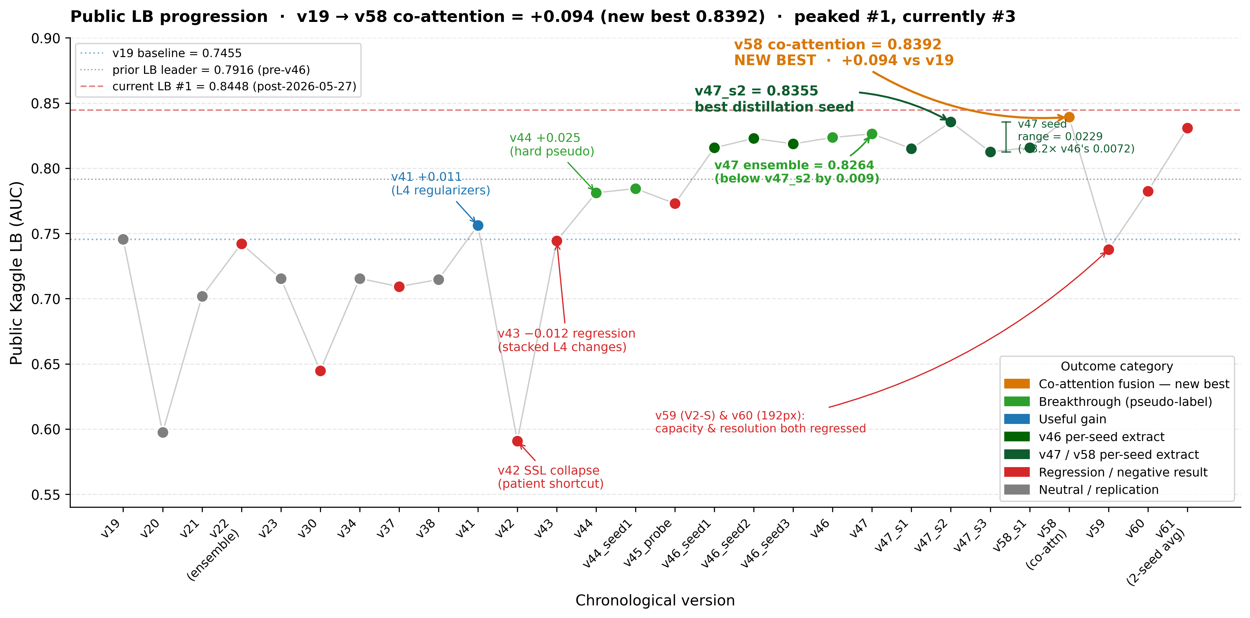
§8 · EVIDENCE
10 / 14
The whole story in one chart
Fig. 4 Public LB across 30+ logged submissions. Amber = co-attention (new best) · green = pseudo-label breakthrough · blue = useful gain · red = regression · grey = neutral. Dashed red = current leader.
A3 · Multimodal Cancer Cell Classification
Uppsala 1MD042 · §8
Notes:
This is the whole story in one image. X-axis: chronological version order. Y-axis: public LB AUC. Color-coding: green for breakthroughs, blue for useful gains, red for regressions, grey for neutral. Read left to right: - v19 at 0.7455 sets the supervised floor (dotted blue line). - v42 at 0.59 is the SSL collapse — took weeks to diagnose. - v43 at 0.7444 is the stacked-changes regression. - v44 at 0.7812 is the hard-pseudo breakthrough. - v45_probe at 0.7729 confirms cross-recipe ensembles fail at 0.025 LB gaps. - v46 at 0.8236 is the distillation breakthrough. - v47 (iterative noisy student round 2, Xie 2020): 0.8264 ensemble, 0.8355 best single seed. We peaked #1 here; two teams later overtook us, so we now sit #3. - The right-edge cluster is the final single-model architecture sweep: v58 intermediate co-attention reached 0.8392 (the new best, amber); v59 (EfficientNetV2-S) and v60 (192px) both regressed; and v61's 2-seed co-attention average (0.8308) landed below the best seed -- ensembling failing yet again. The +0.094 LB lift from v19 (0.7455) to v58's co-attention best (0.8392) is the headline -- the next two slides cover why ensembling never helped, and the co-attention final push that set that best.

Slide 11
§9 · NEGATIVE RESULTS
11 / 14
Six diagnosed failures that shaped the winning recipe
v22
v27
v37 / v38
Cross-recipe ensemble collapse
Held-out val too noisy on N=12
Lian 2024 transfer attempts
Sigmoid-avg of v19 + v21 at a 0.05 LB gap regressed below v19 alone (0.7422 vs 0.7455).
2-patient holdout (pat_5 saturated FL, pat_14 dark FL) selected best_epoch = 0 — untrained.
Heavy FL aug + early fusion both regressed (−0.036, −0.031). Lian's 4-ch ≠ our 1-ch grayscale.
RULE →
Don't ensemble across recipes beyond a 0.02 LB gap.
RULE →
Use public LB as external validator; abandon held-out splits.
RULE →
Re-validate any borrowed ablation on the actual modality.
v42
v43
v45_probe
SSL patient-shortcut collapse
Stacked regulariser regression
Ensemble rule confirmation
CoMIR InfoNCE solved by patient-ID (loss = 0.02 in epoch 1). tr_auc 0.96 · LB 0.59.
Four simultaneous changes on top of v41 → −0.012 LB. No attribution possible.
Sigmoid-avg of v41 + v44 (0.025 LB gap) regressed 0.008 below v44. Pearson 0.936.
RULE →
Cross-modal SSL amplifies patient-grouped shortcuts.
RULE →
One or two related variables per submission.
RULE →
Tightened the rule from §22 to ≤ 0.015 LB gap.
A3 · Multimodal Cancer Cell Classification
Uppsala 1MD042 · §9
Notes:
Six diagnosed failures. Each one fed forward into the v46 / v47 winning recipe. v22: cross-recipe sigmoid-avg at 0.05 LB gap regressed below v19 alone. Rule encoded. v27: held-out 2-patient validation on N=12 selected patients that turned out to be at FL exposure extremes. Best-epoch policy locked onto random init. v37/v38: tried to transfer Lian 2024's modality-specific FL aug and early fusion. Their setup is 4-channel emission stacks at higher resolution; ours is 1-channel grayscale at 128. Didn't transfer. v42: the SSL collapse — patient shortcut. InfoNCE loss was 0.02 by epoch 1, suspicious. Diagnosed: contrastive task solved by encoding patient identity. v43: four-stacked-changes regression. Confounded experiment. No attribution. v45_probe: cross-recipe sigmoid-avg at a tighter 0.025 LB gap. Still regressed. Tightened the rule to ≤0.015 gap. Every one of these has a one-line rule that propagated forward. The wins are the losses, processed.

Slide 12
§10 · ENSEMBLING FAILED
12 / 14
Every ensemble I tried lost to the best single model
0.8264
0.7074
0.7422
3-seed average — BELOW the 0.8355 best single seed
orthogonal feature-GBM blend — CV said 0.82, the LB said this
cross-recipe average (v22) — below v19 (0.7455) alone
— Within-recipe: averaging regresses — confirmed on two recipes. v47's 3-seed mean (0.8264) fell below its best seed (0.8355); v61's 2-seed co-attention mean (0.8308) fell below its best seed (0.8392). Per-seed LB spans ~0.023 on N=12 — the variance is signal-destroying, not noise to average out.
— Cross-model: the stronger member is always pulled down. Symmetric averaging drags toward the weaker member, and on this data the quality gap is always wide (v22, v45_probe, and the GBM blend all regressed).
— Even an orthogonal model couldn't save it. A decorrelated feature-GBM (rank-corr 0.41) looked perfect on paper — but its CV (0.82) did not transfer (LB ~0.60). CV-vs-LB struck the ensemble too.
TAKE-HOME On N=12, variance dominates — any averaging regresses below the best single seed. Submit one, never a blend.
A3 · Multimodal Cancer Cell Classification
Uppsala 1MD042 · §10
Notes:
This is the slide I most want you to remember: on this problem, ENSEMBLING NEVER WORKED. Not once. I tried every flavour and every single one regressed below my best single model. Within-recipe seed averaging: my three v47 seeds average to 0.8264, but the best single seed is 0.8355. I confirmed it a second time on the winning co-attention recipe — v61's two-seed average scored 0.8308, below its best seed 0.8392. The per-seed leaderboard spread is ~0.023 on twelve patients — so wide that averaging doesn't cancel noise, it just drags the lucky draw back down to the mean. Cross-recipe averaging: v22 averaged v19 and v21 and landed at 0.7422, below v19's 0.7455 alone. v45_probe confirmed it. Symmetric averaging always pulls toward the weaker member, and the quality gap between any two of my models is wide enough that it hurts. And the one that should have worked: a gradient-boosted tree on hand-crafted features, genuinely decorrelated from the CNN at rank-correlation 0.41 — textbook ideal ensemble ingredient. Its leave-patients-out CV was 0.82. Blended 50/50 with my best model it scored 0.7074. Its CV simply did not transfer to unseen patients — the exact CV-versus-LB trap that defines this whole project, now sprung on the ensemble itself. The conclusion is clean: with twelve patients, variance dominates everything, and any averaging regresses below the best single draw. My final submission is one well-chosen single model — never a blend.

Slide 13
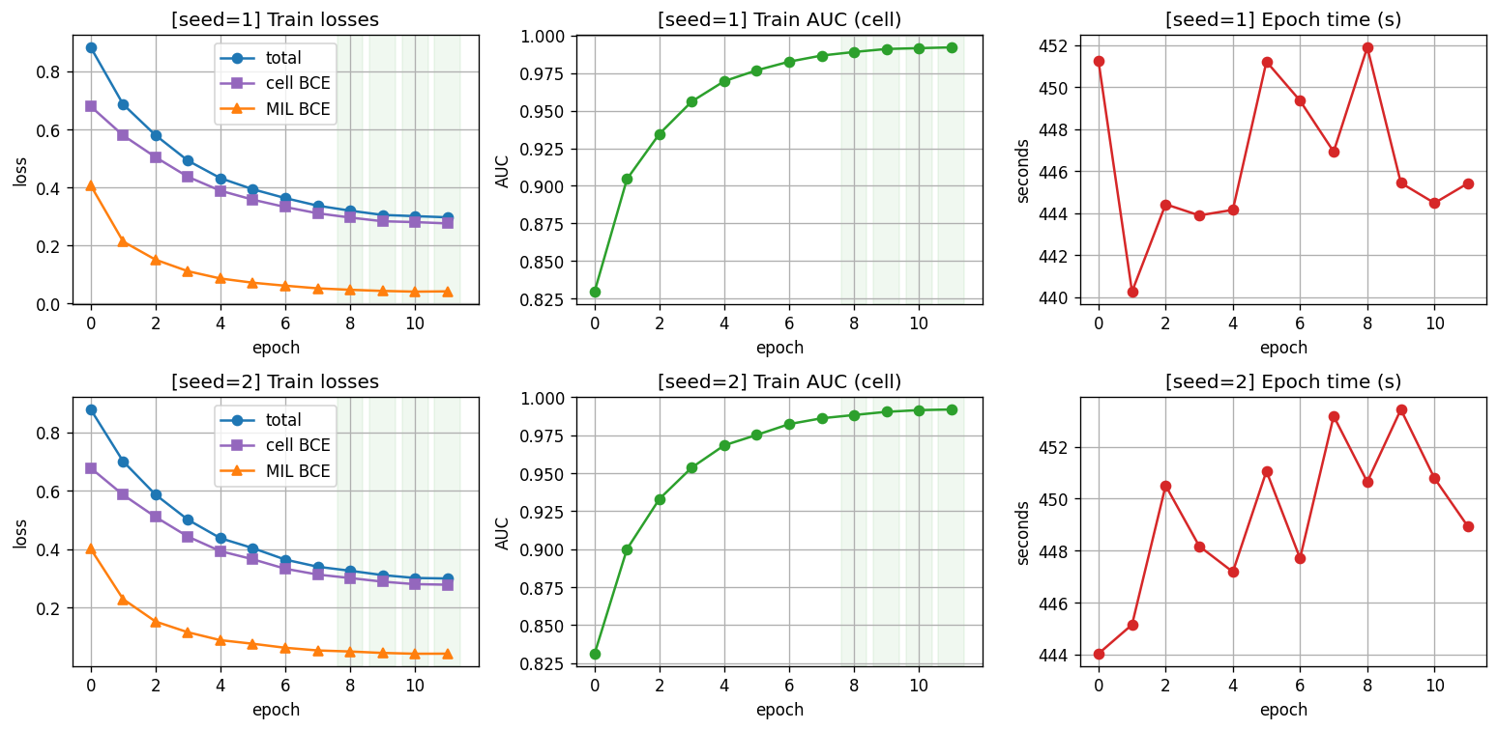
§11 · THE FINAL PUSH
13 / 14
Co-attention broke the plateau — a new best, 0.8392
0.8392 ✓
intermediate CO-ATTENTION (CAFNet-style) — new best, beats v47's 0.8355
0.7823 ✗
higher resolution (192 px) — regressed
0.7376 ✗
more capacity (EfficientNetV2-S) — regressed
Fig. 5 v58 co-attention learning curves — train AUC + loss, 2 seeds, 12 epochs. Clean, no instability.
Of every architecture tried, only fusion design moved the needle — the model is data-bound. Capacity and resolution both hurt.
A3 · Multimodal Cancer Cell Classification
Uppsala 1MD042 · §11
Notes:
The final chapter, after the distillation breakthrough. I swept the remaining architectural levers as single EfficientNet models — no ensembles (those all failed; next slide). Two hurt: bumping capacity to EfficientNetV2-S dropped to 0.7376 (a bigger model overfits 12 patients), and raising input resolution to 192px dropped to 0.7823. Both reinforce the data-bound thesis. One helped: intermediate co-attention fusion — the CAFNet design from the source-dataset paper, applied to EfficientNet-B0. Its best seed reached 0.8392, a new best over v47's 0.8355, and it lifted the mean too. The learning curves (left) show clean training to ~0.99 train AUC with no instability — I had to harden the attention (fp32 + a zero-init ReZero gate) to stop an fp16 NaN. Take-home: fusion design is the one architectural lever that moved the needle here; capacity and resolution did not.

Slide 14
§12 · TAKE-HOME
14 / 14
Five things I'll carry forward
01
Higher CV ≠ higher LB.
v15 had my best CV (0.866) and my worst LB (0.572). On patient-grouped OOD, CV alone is not a signal.
02
Don't stack unvalidated changes.
v43 added four tweaks at once → −0.012 LB with no attribution. One or two related variables per experiment.
03
Seed variance is huge.
Same recipe, different seed: 0.03 LB shift (v19 vs v23). Single-seed A/B claims under 0.03 are noise.
04
On small-N, data is the lever — not architecture.
Four regularisers gained +0.011; soft-pseudo distillation gained +0.042. Even the SOTA co-attention fusion ≈ plain late fusion (0.97 corr, both 0.83). Only co-attention fusion nudged architecture (+0.004 to a new best 0.8392); data was ~10x bigger.
05
Negative results are the methodology.
The v46/v47 winning recipe traces directly to six diagnosed failures. Reading the failures faithfully is what produced the win.
Code & LB history · github.com/rafallex/multimodal-microscopy-distillation
Thank you. Questions?
Notes:
Five things to carry forward. One. Higher CV doesn't mean higher LB. v15 had my best cross-validation, 0.866, and my worst leaderboard, 0.572. If you only have CV, you don't know what you have. On patient-grouped OOD, CV alone is not a signal. Two. Don't stack unvalidated changes. v43 added four tweaks at once on top of v41 and regressed by 0.012 LB. The run cost 5 hours of GPU and produced no isolable signal. I now change at most one or two related variables per submission. Three. Seed variance is huge. v23 was v19 with only the random seed changed. 0.03 LB shift. Most A/B comparisons with deltas under 0.03 are noise, not signal. Four. On 12 patients, dataset size beats regularization. Four textbook regularizers gained 0.011 LB. Soft pseudo + noisy-student round 2 gained 0.042 LB. About 3.8× larger lift from the data lever than the model lever. Five. Negative results are the methodology. The v46 and v47 winning recipes are direct responses to six diagnosed failures: v22, v27, v37, v38, v42, v43, and v45_probe. Reading the failures faithfully is what produced the win. Thanks. Full code and version-by-version LB history at github.com/rafallex/multimodal-microscopy-distillation. Questions?

