Slide 1
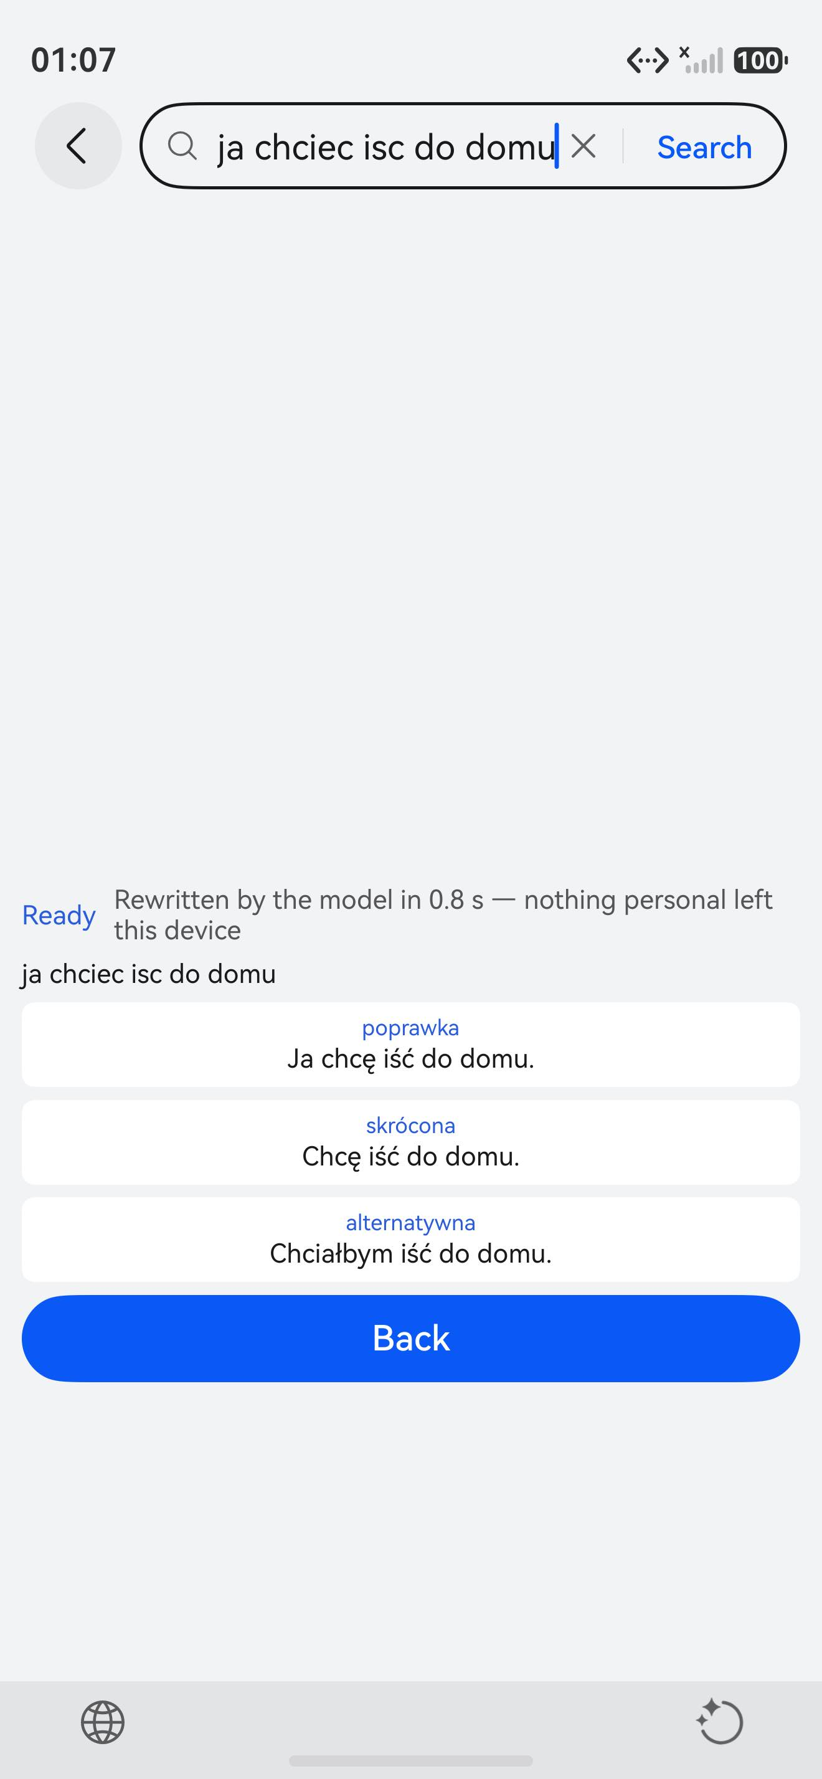
Bridge
A system keyboard that gives people a voice — in every text field on the device.
HackYeah 2026 · OpenHarmony / HarmonyOS · IME Kit + AI
Notes:
Open on the proof frame: this is a third-party app's own search field. Everything else in the deck exists to explain how this one frame is possible.

Slide 2
THE PROBLEM
Typing assumes you can type
12.2M
~1 in 3
5–10%
strokes a year worldwide
stroke survivors live with aphasia
of people live with dyslexia
WHO
National Aphasia Association
European Dyslexia Association
And the assistive answer is an island. Today's 'communicator' apps compose a sentence — but that sentence cannot be sent in a messenger, an e-mail or a banking app. Nobody ships typing help as a system capability, because on closed platforms the input layer is not extensible.
Since 28 June 2025 the European Accessibility Act makes accessible digital products a legal requirement in the EU — this is compliance, not charity.

Slide 3
THE IDEA
Not another app — an input method
Bridge replaces the keyboard itself, so it appears in every text field on the device. No SDK, no per-app integration, nothing for the app to support.
reads and rewrites the field
scrubbed request —
PII stays on the device
Any app's text field
Bridge, the keyboard
The model
messenger, mail, browser — an app that knows nothing about Bridge
InputMethodExtensionAbility — reads and rewrites the editor proxy
any OpenAI-compatible endpoint; the key never leaves the device
applies the chosen one
variants restored locally
One platform capability, taken end to end — rather than five shallow integrations.

Slide 4
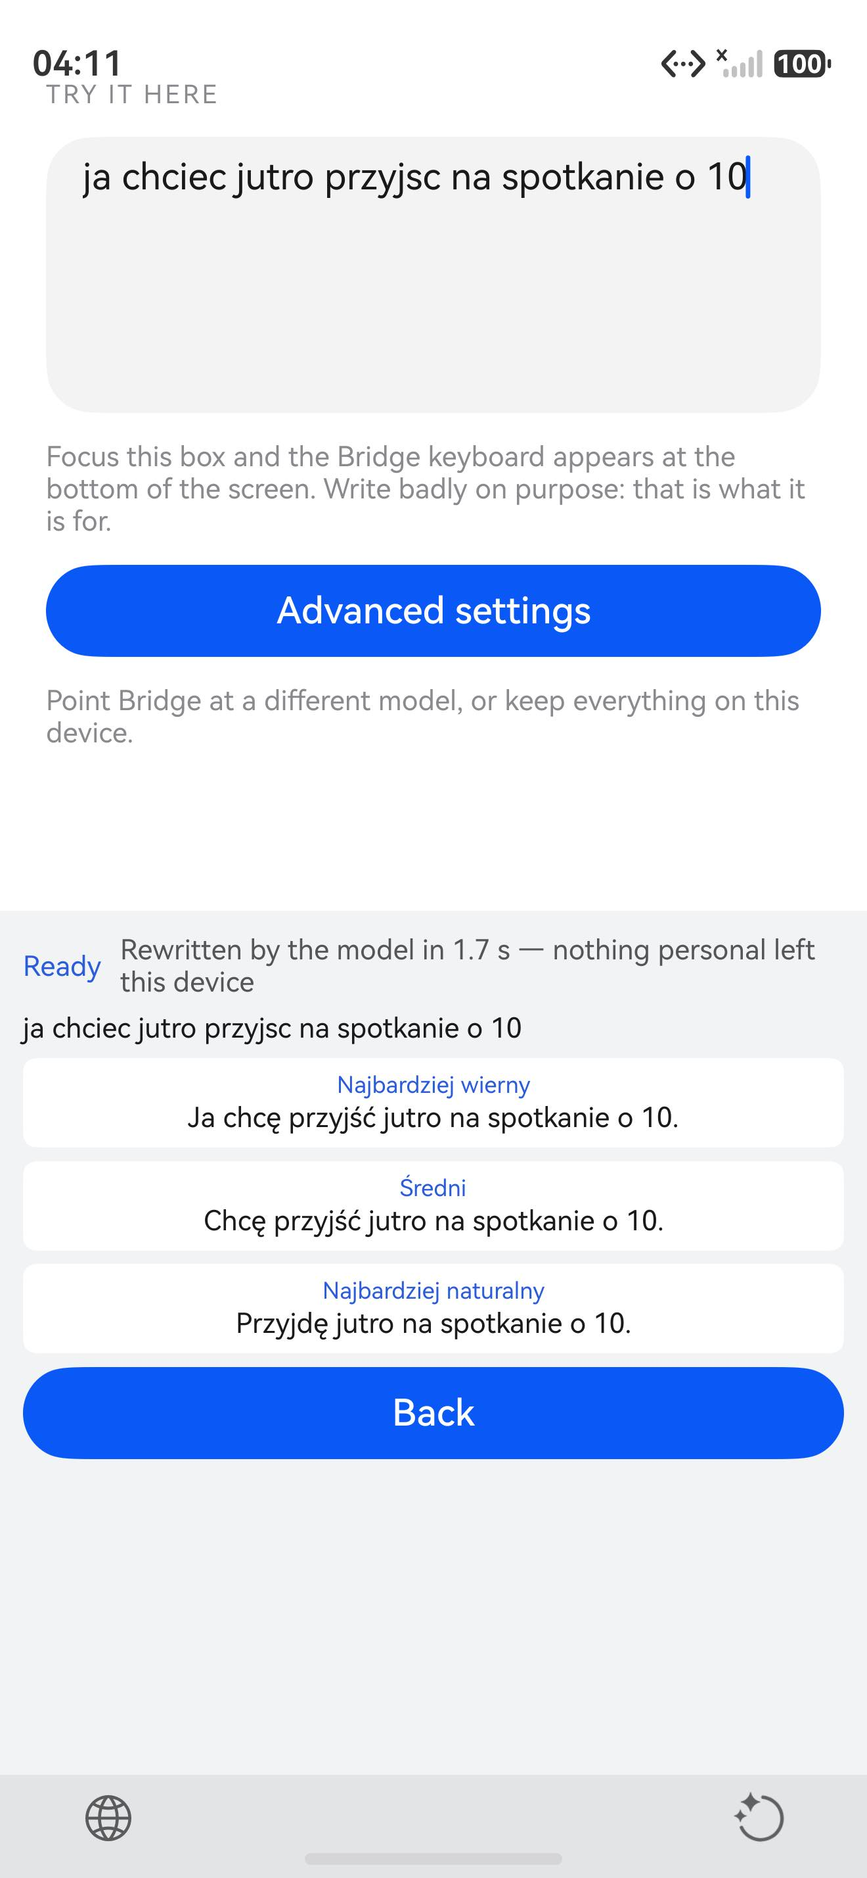
MODE 1 · REWRITE
Type however you can
ja chciec jutro przyjsc na spotkanie o 10
Broken Polish, no diacritics — typed into another app's field. Tap Correct:
MINIMAL
Ja chcę przyjść jutro na spotkanie o 10.
NATURAL
Jutro chcę przyjść na spotkanie o 10.
STYLISH
Jutro przyjdę na spotkanie o 10.
1.5 s observed · tap one and the field contains the corrected sentence — replaced 41 characters, the cursor API used the right way round.

Slide 5
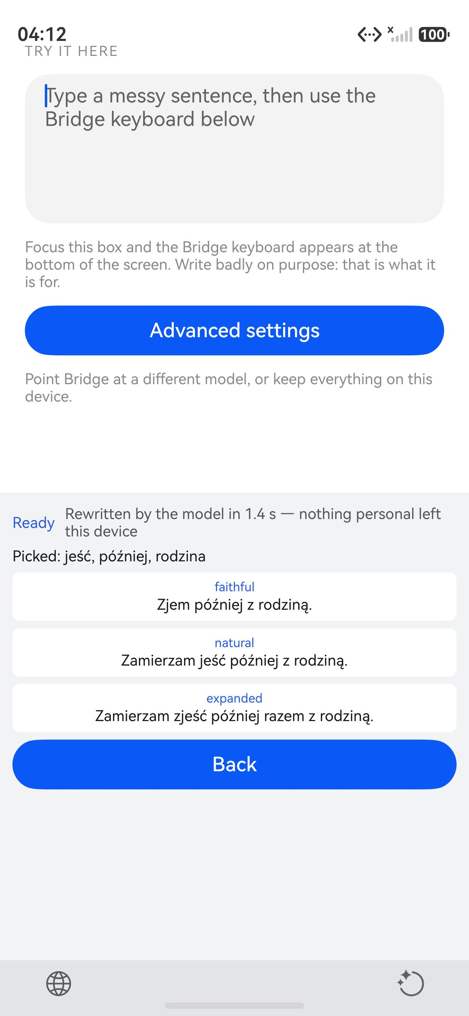
MODE 2 · COMPOSE
Not typing at all is also writing
A non-speaking user picks concepts instead of words:
jeść + później + rodzina
Zjem później z rodziną.
“I will eat later with my family.” — correct Polish aspect and case, composed by the model from the picked concepts.
Nothing was typed. For a user with severe motor impairment or aphasia, three taps produce a grammatical sentence — inside another application's field. The European Accessibility Act makes that a compliance question, not a favour.

Slide 6
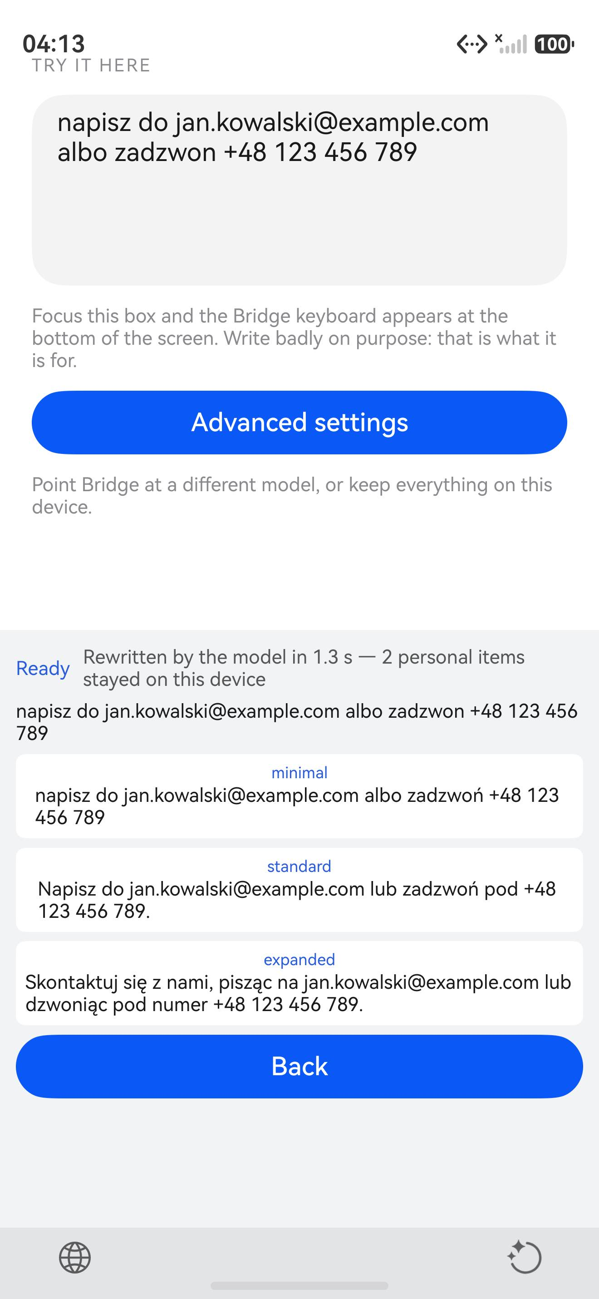
PRIVACY
A privacy event, handled as a feature
1
Scrubbed on the device, before any request
E-mails, phone numbers, PESEL, IBAN and card-like digit runs become placeholders. The model never receives the real values.
2
Said in the user's own terms
The status line reads “2 personal items stayed on this device” — the variants get the values back from the placeholders.
3
Offline is a labelled result, never silence
Unreachable model or offline-only switch: a local rule engine answers, and the keyboard says exactly that.
4
The key never enters the repository
Typed once into the app's settings, stored in device preferences.

Slide 7
EVIDENCE
Verified on the device, not mocked up
1
96 engine tests
platform-agnostic core, strict TypeScript, runs on plain Node
2
Built, signed, installed
an ordinary app: no privileged permissions, no system signing — a .hap a judge can install from the repo
3
Every claim captured on a HarmonyOS 6.1.1 emulator
attach, rewrite, compose, PII withholding, offline fallback — screenshots in docs/evidence/
4
And in a third-party app
the Huawei browser's own search field rewritten in 0.8 s — an app that knows nothing about Bridge
The 81-second demo video is assembled from twelve stills captured with the system snapshot tool and committed to the repository. No screen in it was drawn or simulated.

Slide 8
Type however you can.
Bridge rewrites it.
In every text field on the device — because Bridge is a system component, not an app.
REPOSITORY
INSTALLABLE
DEMO VIDEO
github.com/rafalohaki/harmonyy
dist/bridge-1.0.0-signed.hap — build with scripts/dev-loop.sh
demo/out/bridge-demo.mp4 — 81 s, committed in the repo
HackYeah 2026 · OpenHarmony / HarmonyOS Challenge · API 20+

