Slide 1
Battle of neigborhood
Captsone – week 5

Slide 2
Business goals
Gdansk is one of the most popular tourist destination in Poland
Due to large number of tourist, but also well paid workforce, Gdansk seems to be a good place for people interested in investing in the restaurant industry.
The investor want to open a new dumpling restaurant.
Where is the best place for establishing the restaurant?

Slide 3
Data sources
List of postal codes/streets in Gdansk (webpage):
https://trojmiasto.onet.pl/kod-pocztowy-gdansk-lista-kodow-pocztowych-artykul/7ftd6ws
Detailed locations:
https://geocode.xyz/
Most popular venues (Foursquare API):
https://developer.foursquare.com/docs/api/endpoints

Slide 4
Python packages
Pandas - Library for Data Analysis
NumPy – Library to handle data in a vectorized manner
JSON – Library to handle JSON files
Requests – Library to handle http requests
Matplotlib – Python Plotting Module
Sklearn – Python machine learning Library
Folium – Map rendering Library
BeautifulSoup – Library for parsing HTML sources

Slide 5
Methodology
For each location check the list of 10 most common venues using Forsquare API
Create clusters using machine learning k-means algorithm basing on most common venues
Select a cluster where dumpling restaurant is among the most popular venues
Select all addresses within the cluster where the dumpling restaurant is still not popular

Slide 6
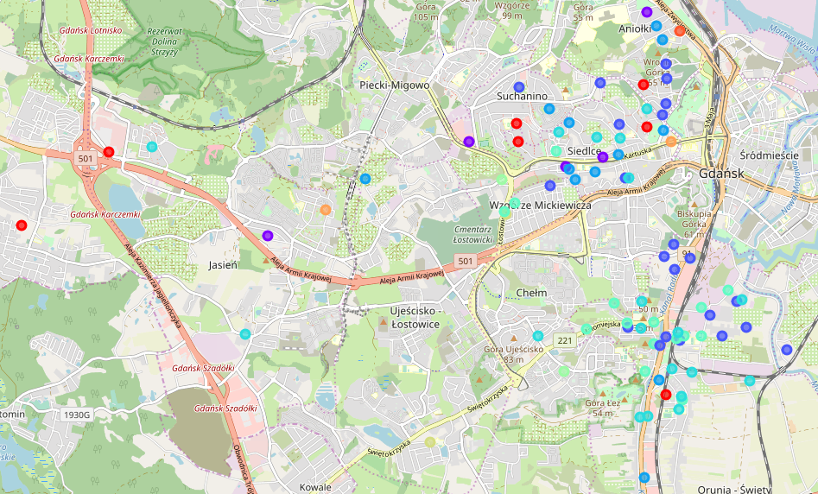
Results
10 clusters based on most common venues among residents was found

Slide 7
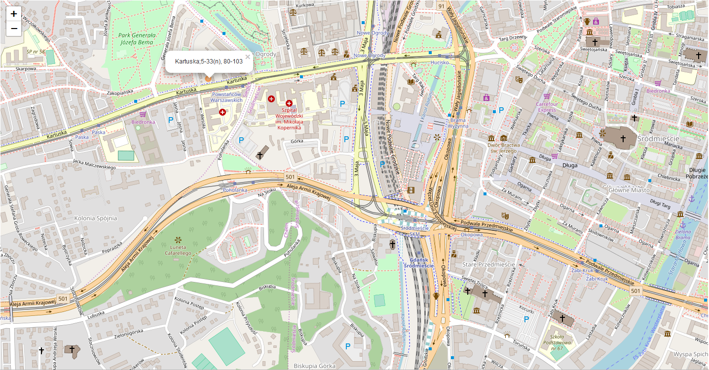
Results
One cluster was selected as best place for new dumpling restaurant
The best address was found

