Slide 1
DEEP LEARNING • SEMESTER PROJECT
AI-Based Car Parts Detection
and Segmentation Using YOLOv8
Detect the car. Segment every part. Show the result — with real predictions, honest numbers, and no invented features.
YOLOv8n-seg
23 part classes
FastAPI + Bootstrap GUI
Rafaqat Ali
Deep Learning Semester Project • October 2026
University / course details:
to be added by the presenter
Notes:
Good morning. This is my deep-learning semester project: car-part detection and segmentation with YOLOv8. In the next few minutes I will show you the real system, the real dataset, the real measured results — and I will be clear about what it does not do yet.

Slide 2
02
THE PROBLEM
Why manual car-part identification is not enough
Before damage, price, or repair can be judged, the system must first know WHERE each part is.
Slow manual inspection
Parts look alike
No usable record
Every car is checked part by part, by eye.
The same car can be described differently by two inspectors.
Photos, notes, and estimates do not line up.
Doors, bumpers, lights, and glass change with angle and light.
A small mirror or side light is easy to miss or mislabel.
Left and right parts must not be confused.
A written note cannot show exactly which part was meant.
There is nothing visual to check, share, or re-measure later.
THE NEED → An automated system that finds the car, segments each visible part, and returns a visual, checkable result.
AI Car Parts Detection • YOLOv8n-seg
2
Notes:
Manual inspection is slow and inconsistent, and parts look alike from different angles. Worse, a written note cannot be checked later. That is why this project starts one step earlier than damage or price: first locate every part, visually.

Slide 3
03
OBJECTIVES
Three objectives — all delivered and testable
Each objective below can be checked by running the project, not just by reading about it.
1 • Detect & segment parts
2 • Annotated predictions
3 • Web demonstration
Fine-tune YOLOv8n-seg on Carparts-Seg.
Output part name, confidence, box, and mask for every visible part.
23 classes, in the dataset's original order.
Return an annotated image with every prediction.
Green overlay = segmentation mask; blue box = car.
JSON output alongside the image for verification.
Bootstrap frontend + FastAPI backend on the student's own machine.
Upload a photo, get parts, confidences, and the annotated image.
Works with the trained model — or honestly reports NOT_TRAINED without it.
SUCCESS TEST → Upload any car photo → parts + confidences + annotated image appear. If the model file is missing, the system says so — it never fakes a result.
AI Car Parts Detection • YOLOv8n-seg
3
Notes:
Three objectives. One, segment parts with a trained model. Two, return an annotated image, not just numbers. Three, demonstrate it through a web page. Notice the honesty rule built into objective three: without the model file, the system reports NOT_TRAINED instead of inventing parts.

Slide 4
04
PROPOSED SOLUTION
From one photo to a labelled, segmented result
Two models work together: a generic car detector for the whole car, and the trained part model for the parts.
1
2
3
4
5
INPUT
›
CAR DETECTION
›
PART SEGMENTATION
›
ANNOTATION
›
RESULT
Car photo
(JPG / PNG / WEBP,
max 20 MB)
Generic YOLOv8n
finds the car
box (COCO)
Trained YOLOv8n-seg
finds parts +
masks (23 classes)
Masks + boxes +
part names +
confidences drawn
Annotated image
+ JSON, shown
in the web GUI
KEY DESIGN FACT → Part segmentation does NOT depend on the car detector: on two rear-view test images the car detector found 0 cars, yet the part model still found 4–5 parts.
Implemented now: car detection • part segmentation • annotated image + JSON • web GUI
NOT in this model: damage detection • make / model recognition • price estimation (all future work)
AI Car Parts Detection • YOLOv8n-seg
4
Notes:
The pipeline has five steps. A photo goes in, a generic detector finds the car, our trained model segments the parts, and the result is an annotated image plus JSON. One design fact matters: the part model works even when the car detector finds nothing — we proved that on two rear-view test images.

Slide 5
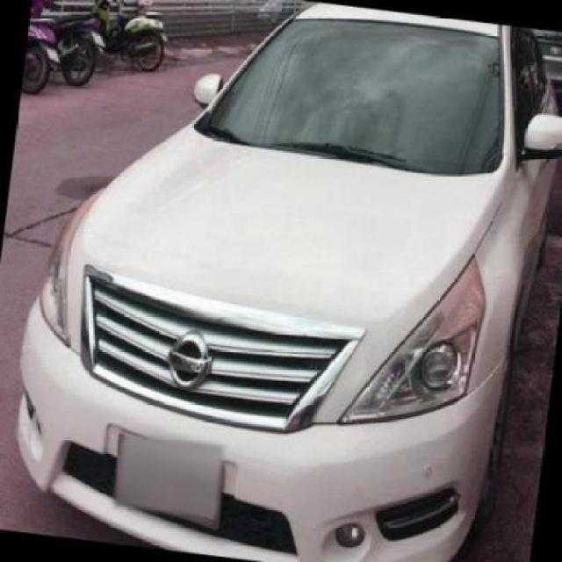
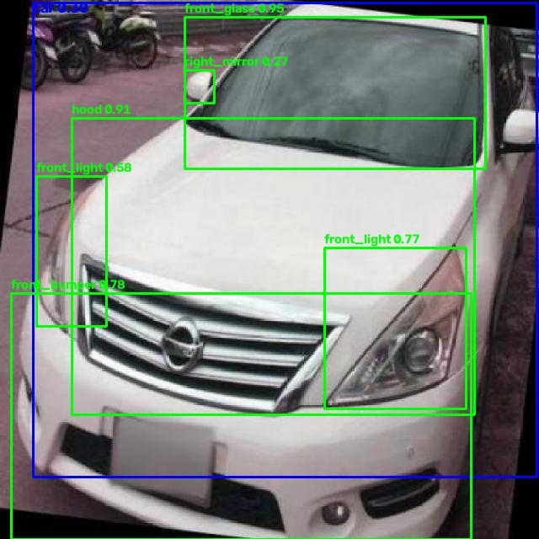
05
DATASET
Carparts-Seg: polygon labels, not boxes
Because the labels are polygons, the correct model is segmentation — a box detector would throw the shapes away.
3,833
3,156 / 401 / 276
23
20,374
images (640 × 640)
train / val / test
part classes
polygon annotations
Sample: test image (left) and the model's annotated output (right)
Honest dataset notes
▸ 135 empty labels quarantined in the training copy only (train 116 / val 12 / test 7) — missing annotations, not background.
▸ Thin classes: tailgate ~101 instances; “object” only ~12 — its score is 0.0 and unreliable.
▸ Licence: commercial rights for the curated set are NOT confirmed — dataset images are not redistributed from the repo.
▸ Missing parts: fenders, roof, grille, and side skirts are not in this dataset.
Front view — front_glass 94.7%, hood 91.5%
AI Car Parts Detection • YOLOv8n-seg
Dataset images: evaluation use only
5
Notes:
The dataset is Carparts-Seg: 3,833 images, 23 classes, over twenty thousand polygon annotations. Because the labels are polygons, we trained a segmentation model. Honest notes: 135 labels were empty, two classes are very thin, and the commercial licence is not confirmed, so dataset images are not redistributed.

Slide 6
06
MODEL ARCHITECTURE
YOLOv8n-seg: detection + a mask for every part
The “n” means nano — the smallest YOLOv8, chosen on purpose so it runs on free Colab and on a CPU laptop.
Object detection (boxes only)
Instance segmentation (this project)
Draws a rectangle around an object.
Answers: what is it, and where is its box?
Cannot show the object's exact shape.
Draws a pixel mask following the object's shape.
Answers: what is it, where is it, and which pixels are it?
That is why a door mask, not just a door box, is the result.
Simplified YOLOv8n-seg flow (backbone → neck → two heads)
Input
640 × 640
Backbone
features
Neck
multi-scale fusion
Box head
class + box
Mask head
pixel mask
›
›
›
›
Pretrained start: yolov8n-seg.pt → fine-tuned on Carparts-Seg → shipped as models/part_detection/best.pt (7.0 MB).
AI Car Parts Detection • YOLOv8n-seg
6
Notes:
Detection draws a box; segmentation draws a mask. We need masks, because the goal is to show exactly which pixels belong to each part. The model is YOLOv8n-seg, the nano version — small on purpose, so it runs on a free Colab GPU and on an ordinary laptop CPU.

Slide 7
07
MODEL TRAINING
Same pattern as a professional run: validate, smoke-test, then train fully
Google Colab notebook: colab/train_colab.ipynb (14 cells) — the earlier 3-epoch notebook is superseded and was not used.
1
2
3
4
5
DATASET IN DRIVE
›
VALIDATION CELL
›
SMOKE TEST
›
FULL TRAINING
›
DRIVE EXPORT
Official ZIP uploaded
to Drive; unzipped
to a Colab copy only
Counts, polygon checks,
empty labels, split
sizes — read first
2 epochs — pipeline
proof only; weights
discarded, never shipped
25 epochs, fresh
YOLOv8n-seg start
(see settings below)
best.pt + metrics +
samples + summary
saved to Drive
Actual training settings (verified from the notebook and run summary)
Tesla T4
25 epochs
Batch 16
640 px
Patience 10
Colab GPU, ~15 GB VRAM
full run (smoke: 2)
8 if out of memory
image size
early stopping
NOTE → Training loss curves (results.png) live in the Colab Drive export and are not in the local project folder, so no curve is shown here rather than a recreated one.
AI Car Parts Detection • YOLOv8n-seg
7
Notes:
Training followed a disciplined pattern: validate first, then a two-epoch smoke test to prove the pipeline, then the full twenty-five epoch run on a Colab T4. I am not showing a loss curve, because the original curves are in the Drive export, not in the local folder — and I will not draw a replacement curve.

Slide 8
08
EVALUATION RESULTS
Test results: strong on large parts, weaker on small ones
All results are from the 25-epoch FULL run. Per-class detail and caveats are on the next lines — and in the report, §7.2.
⚠ ALL RESULTS ARE PRELIMINARY — the shipped test split has 191 unresolved cross-split duplicate candidates (human review incomplete), so these numbers may be optimistic.
62.85%
81.88%
70.82%
59.48%
71.10%
Precision (test)
Recall (test)
Box mAP@50 (test)
Box mAP@50–95 (test)
Mask mAP@50 (test)
Per-class test mAP@50 (box) — honest extremes
▸ Best: front_glass 91.5% • hood 89.5% • front_bumper 87.5%
▸ Weakest: wheel 40.1% • left_mirror 40.6% • object 0.0% (~12 instances, unreliable)
▸ Also verified: local predict.py reproduced Colab samples exactly; API matched predict.py exactly.
AI Car Parts Detection • YOLOv8n-seg
PRELIMINARY — see caveat above
8
Notes:
On the test set: precision about sixty-three percent, recall about eighty-two, box mAP at fifty percent overlap about seventy-one percent, and mask mAP about seventy-one percent. Large parts score above ninety percent; small parts like mirrors and wheels are much weaker. And I must say this out loud: these numbers are preliminary, because duplicate review of the test split is not finished.

Slide 9
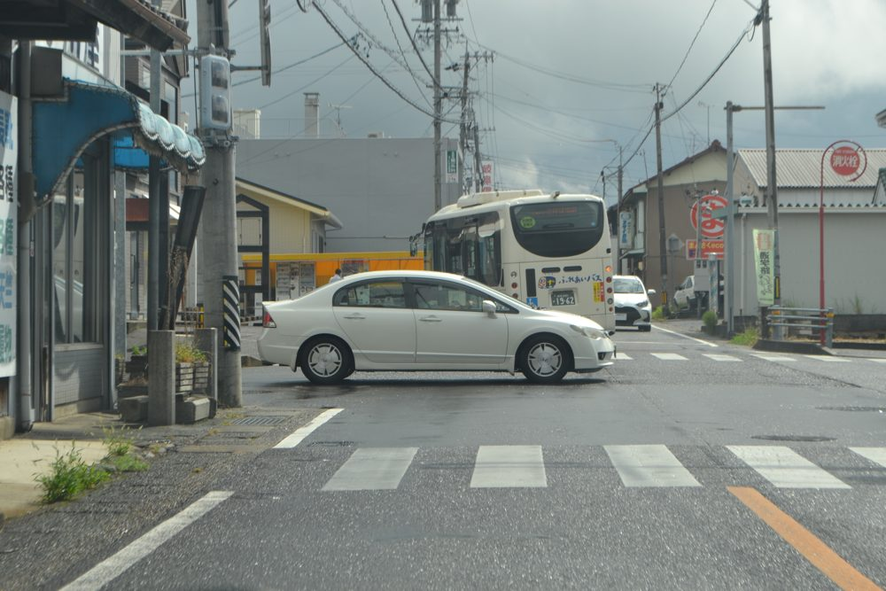
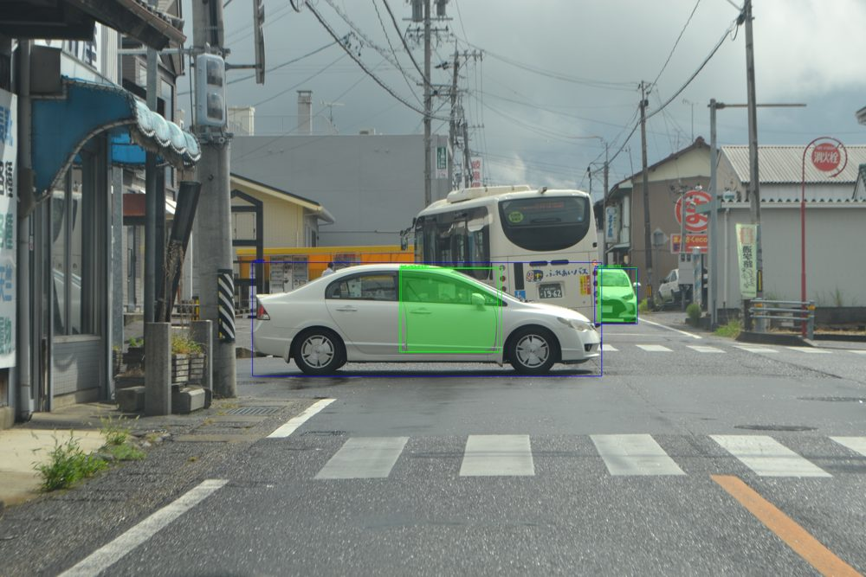
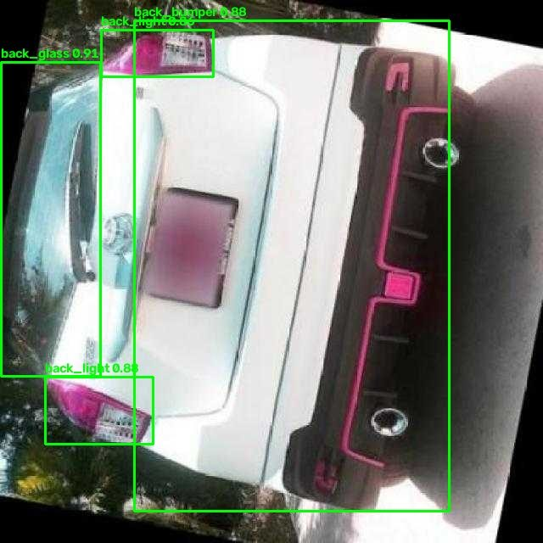
09
ACTUAL PREDICTION RESULTS
Real outputs from the trained model — nothing staged
Green overlay = segmentation mask • Green box = part box • Blue box = whole car • Confidence shown per part.
CC0 Civic photo — input (left) → output (right)
Cars 88.6% + 56.8% • Parts are weak here (28.6% / 28.5% / 26.5%): this photo is out-of-distribution, and that weakness is shown, not hidden.
Carparts test images — annotated outputs
Front: glass 94.7%, hood 91.5% • Rear: glass 90.6%, bumper 88.0% (car detector found 0 cars).
HOW TO READ THESE IMAGES → If a part is not visible in the photo, the system reports it as Not Visible / Cannot Determine — never as “undamaged”.
What the GUI shows for every upload: car table • part table (part / confidence / mask Yes-No / box) • annotated image • damage: NOT IMPLEMENTED • make/model: Unknown
AI Car Parts Detection • YOLOv8n-seg
Dataset test images: evaluation use only
9
Notes:
These are real outputs. On the left, a free Civic photo: the cars are found confidently, but the parts are weak — and I show that weakness rather than hiding it. On the right, test images: front glass at ninety-five percent, hood at ninety-one. And remember the rule: an invisible part is reported as not visible, never as undamaged.

Slide 10
10
SYSTEM ARCHITECTURE & WEB INTERFACE
A real, runnable system — with an accurately stated deployment status
The same code runs three ways: command line, API, and browser GUI. The GUI renders the API's JSON — it never invents a result.
BROWSER GUI
Bootstrap 5
upload + result page
FastAPI
GET /health
POST /predict
predict.py
inference
two models
RESULT
JSON + annotated
image (base64)
›
›
›
What the user sees in the GUI
Deployment status — verified, not assumed
Upload a photo (JPG / PNG / WEBP, max 20 MB).
Prediction result box: cars, parts, confidences, mask Yes/No.
Annotated image with green masks.
Clear NOT IMPLEMENTED notes for damage, make/model, pricing.
Local Windows 10 GUI: TESTED by the owner (image upload works).
Public Vercel frontend: PREPARED, NOT DEPLOYED — no live inference URL exists yet.
Public backend: NOT DEPLOYED. Any “live demo” claim needs a real backend test first.
This deck therefore shows local results, not a live website.
Stack: HTML + CSS + JavaScript + Bootstrap 5 (frontend) • Python + FastAPI (backend) • YOLOv8n-seg + generic YOLOv8n car detector (inference) • No database, no login, no secrets needed.
AI Car Parts Detection • YOLOv8n-seg
10
Notes:
The architecture is simple on purpose: a Bootstrap page talks to a FastAPI backend, which runs the two models and returns JSON plus an annotated image. Deployment status matters, so I state it plainly: the local Windows GUI is tested, but there is no public Vercel demo with live inference yet — that is prepared, not deployed.

Slide 11
11
LIMITATIONS
Limitations first, future work separated
Nothing in the right column exists today. Presenting it as existing would be dishonest to an evaluator.
Limitations (this model, today)
Future work (NOT implemented yet)
Test metrics are PRELIMINARY — 191 duplicate candidates unreviewed.
Small parts are weak: mirrors, side lights, wheel, and “object” (0.0%).
Dataset licence for commercial use is NOT confirmed.
Missing parts: fenders, roof, grille, side skirts are not in the dataset.
No Pakistani-market validation set yet; the Civic sample is Japanese-spec.
Single-model scope: parts only — see the right column.
Phase 2 — damage detection: Dent, Scratch, Crack, Broken Part, Paint Damage (dataset research done; training not started).
Damage-box × part-mask overlap → “damaged part name” in the same GUI.
Leakage-resolved splits + re-evaluation before any final accuracy claim.
Consented Pakistani car collection for local validation.
Later, commercial phase: make/model, PDF reports, insurance pricing — only after the research phases.
Rule used throughout this project: a future feature is labelled FUTURE wherever it appears — never shown as a current capability.
AI Car Parts Detection • YOLOv8n-seg
11
Notes:
Limitations first. The metrics are preliminary, small parts are weak, the dataset licence is unconfirmed, and some parts are missing from the dataset entirely. Future work is separate: damage detection is in research, not training; pricing and make and model recognition belong to a later commercial phase.

Slide 12
Conclusion & project links
What was actually achieved
Project links
▸ A trained YOLOv8n-seg model (23 classes, 25 epochs, T4) that segments real car parts.
▸ Test results, honestly labelled PRELIMINARY: mAP@50 box 70.8%, mask 71.1%.
▸ A runnable system: CLI + FastAPI + Bootstrap GUI, tested locally on Windows 10.
▸ Reproducible evidence: notebook, metrics, sample predictions, and a clean submission package.
▸ Clear boundaries: parts today; damage, make/model, and pricing as future work.
GitHub repository (created by owner):
github.com/rafaqatali-dev/AI-Car-Parts-Detection-YOLOv8
Submission package: prepared; push pending by owner.
Vercel website: frontend prepared — NOT deployed yet.
Project report: draft in the project docs (owner to finalise).
Dataset: Carparts-Seg (official Ultralytics link in the repo README).
Thank you — questions are welcome. The repository contains everything needed to reproduce this demo.
Notes:
To conclude: a trained segmentation model, preliminary but real test numbers, and a runnable system tested locally. The repository link is on screen; the Vercel deployment and the final report are still pending, and I have not claimed otherwise. Thank you — I welcome your questions.

