Slide 1
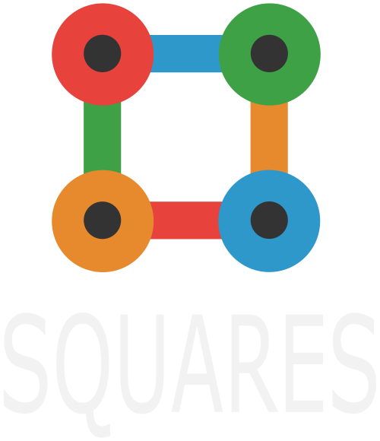

Slide 2
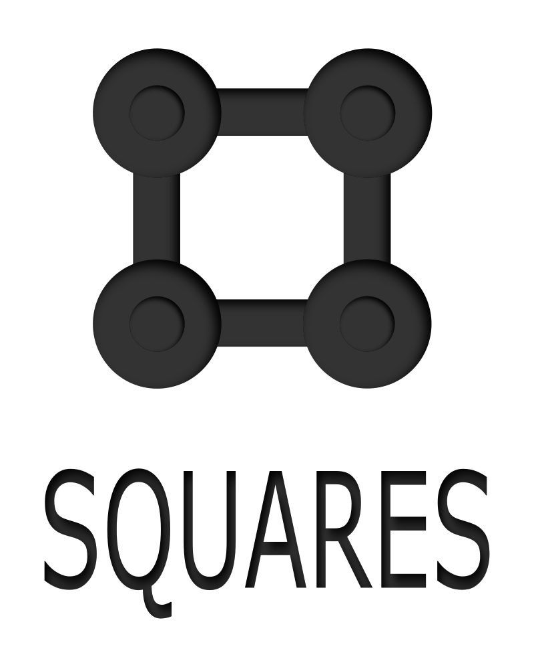
Introduction
We are a group of second of Bachillerato.
The project of this year has been created one app for the google play.
The name of the app is Squares and it has inspired in one simple school game.

Slide 3
Do you know which game is it?

Slide 4
Now you can play from your smartphone

Slide 5
Offline vs Online

Slide 6
Offline

Slide 7
Online

Slide 8
Leaderboards

Slide 9
The app is already in play store

Slide 10

Now that you know the app, you expect to download?

