Slide 1

viewer
Justin Stone, Yvonne Jian, Rafael Robles, Jorge Wassmann
Advanced Programming for Business Analytics

Slide 2
Agenda:
Zillow API and Accessing Data
Objective
Project Summary
Difficulties & Solutions
Accessing Data
Data Selection
Kanaries
PyGWalker
Steamlit and PyGWalker
Demonstration

Slide 3
Objective
Sales Price vs Rental Price
Rental Price Trend
Forecasted Home Value Growth
Interactive Maps
Comparison Between Cities
Rent vs Mortgage

Slide 4
Project Summary
Data Collection
Accessed Zillow's API
Acquired Zillow's Open Datasets
Data Preparation
Selected datasets to use
Performed data cleaning
Data Analysis & Visualization
Defined the structure of dashboard
Developed the interactive dashboard
Used PyGWalker from Kanaries

Slide 5
Difficulties & Solutions
API
Zillow doesn't give API's for their data without a license.
Analyze and clean each individual dataset.
Insufficient Data
Redefined project scope
Acquired external dataset for mortgage
Created common GitHub
Collaboration
Timely communication

Slide 6
Accessing Data:
Accessing Data:
HOME VALUES(Metro & U.S. / State / County / City / ZIP Code / Neighborhood)
ZHVI All Homes (SFR, Condo/Co-op) Time Series, Smoothed, Seasonally Adjusted($)
ZHVI All Homes (SFR, Condo/Co-op) Time Series, Raw, Mid-Tier ($)
ZHVI All Homes- Top Tier Time Series ($)
ZHVI All Homes- Bottom Tier Time Series ($)
ZHVI Single-Family Homes Time Series ($)
ZHVI Condo/Co-op Time Series ($)
ZHVI 1-Bedroom Time Series ($)
ZHVI 2-Bedroom Time Series ($)
ZHVI 3-Bedroom Time Series ($)
ZHVI 4-Bedroom Time Series ($)
ZHVI 5+ Bedroom Time Series ($)

Slide 7
Accessing Data:
HOME VALUES FORECAST (Metro & U.S. / ZIP Code)
ZHVF (Forecast), All Homes (SFR, Condo/Co-op), Smoothed, Seasonally Adjusted, Mid-Tier (MoM%, Q0Q%)
ZHVF (Forecast), All Homes (SFR, Condo/Co-op), Raw, Mid-Tier (MoM%, QoQ%, YoY%)
RENTALS(Metro & U.S. / County / City / ZIP Code)
ZORI (Smoothed): All Homes Plus Multifamily Time Series ($)
ZORI (Smoothed, Seasonally Adjusted): All Homes Plus Multifamily Time Series ($)
ZORI (Smoothed): Single Family Residence Time Series ($)
ZORI (Smoothed, Seasonally Adjusted): Single Family Residence Time Series ($)
ZORI (Smoothed): Multi Family Residence Time Series ($)
ZORI (Smoothed, Seasonally Adjusted): Multi Family Residence Time Series ($)

Slide 8
Accessing Data:
FOR SALE LISTINGS(Metro & U.S.)
For-Sale Inventory (Smooth, All Homes, Monthly) For-Sale Inventory (Smooth, All Homes, Weekly)
For-Sale Inventory (Smooth, SFR Only, Monthly) For-Sale Inventory (Smooth, SFR Only, Weekly)
For-Sale Inventory (Raw, All Homes, Monthly) For-Sale Inventory (Raw, All Homes, Weekly)
For-Sale Inventory (Raw, SFR Only, Monthly) For-Sale Inventory (Raw, SFR Only, Weekly)
New Listings (Smooth, All Homes, Monthly) New Listings (Smooth, All Homes, Weekly)
New Listings (Raw, All Homes, Monthly)
New Listings (Raw, All Homes, Weekly)
Newly Pending Listings (Raw, All Homes, Monthly)
Newly Pending Listings (Raw, All Homes, Weekly)
Newly Pending Listings (Smoothed, All Homes, Monthly)
Newly Pending Listings (Smoothed, All Homes, Weekly)
Median List Price (Smooth, All Homes, Monthly)
Median List Price (Smooth, All Homes, Weekly
Median List Price (Smooth, SFR Only, Monthly)
Median List Price (Smooth, SFR Only, Weekly)
Median List Price (Raw, All Homes, Monthly)
Median List Price (Raw, All Homes, Weekly)
Median List Price (Raw, SFR Only, Monthly)
Median List Price (Raw, SFR Only, Weekly)

Slide 9
Accessing Data:
SALES(Metro & U.S.)
For-Sale Inventory (Smooth, All Homes, Monthly)
For-Sale Inventory (Smooth, All Homes, Weekly)
Sales Count Nowcast (Raw, All Homes)
Median Sale Price (Smooth & Seasonally Adjusted, All Homes, Monthly)
Median Sale Price (Smooth & Seasonally Adjusted, All Homes, Weekly)
Median Sale Price (Smooth, All Homes, Monthly)
Median Sale Price (Smooth, All Homes, Weekly)
Median Sale Price (Raw, All Homes, Monthly)
Median Sale Price (Raw, All Homes, Weekly)
Median Sale Price (Smooth & Seasonally Adjusted, SFR only, Monthly)
Median Sale Price (Smooth & Seasonally Adjusted, SFR only, Weekly)
Median Sale Price (Smooth, SFR only, Monthly)
Median Sale Price (Smooth, SFR only, Weekly)
Median Sale Price (Raw, SFR only, Monthly)
Median Sale Price (Raw, SFR only, Weekly)
Mean Sale-to-List Ratio (Raw, All Homes, Monthly)
Mean Sale-to-List Ratio (Smooth, All Homes, Monthly)
Mean Sale-to-List Ratio (Raw, All Homes, Weekly)
Mean Sale-to-List Ratio (Smooth, All Homes, Weekly)
Median Sale-to-List Ratio (Raw, All Homes, Monthly)
Median Sale-to-List Ratio (Smooth, All Homes, Monthly)

Slide 10
Median Sale-to-List Ratio (Smooth, All Homes, Monthly)
Median Sale-to-List Ratio (Raw, All Homes, Weekly)
Median Sale-to-List Ratio (Smooth, All Homes, Weekly)
Percent of Homes Sold Above List (Raw, All Homes, Monthly)
Percent of Homes Sold Above List (Smooth, All Homes, Monthly)
Percent of Homes Sold Above List (Raw, All Homes, Weekly)
Percent of Homes Sold Above List (Smooth, All Homes, Weekly)
Percent of Homes Sold Below List (Raw, All Homes, Monthly)
Percent of Homes Sold Below List (Smooth, All Homes, Monthly)
Percent of Homes Sold Below List (Raw, All Homes, Weekly)
Percent of Homes Sold Below List (Smooth, All Homes, Weekly)
Mean Sale Price (Smooth & Seasonally Adjusted, All Homes, Monthly)
Mean Sale Price (Smooth & Seasonally Adjusted, All Homes, Weekly)
Mean Sale Price (Smooth, All Homes, Monthly) Mean Sale Price (Smooth, All Homes, Weekly)
Mean Sale Price (Raw, All Homes, Monthly)
Mean Sale Price (Raw, All Homes, Weekly)
Mean Sale Price (Smooth & Seasonally Adjusted, SFR only, Monthly)
DAYS ON THE MARKET(Metro & U.S.)
Mean Days to Pending (Smooth, All Homes, Monthly)
Mean Days to Pending (Smooth, All Homes, Weekly)
Mean Days to Pending (Raw, All Homes, Monthly)
Mean Days to Pending (Raw, All Homes, Weekly)
Median Days to Pending (Smooth, All Homes, Monthly)
Median Days to Pending (Smooth, All Homes, Weekly)
Median Days to Pending (Raw, All Homes, Monthly)
Median Days to Pending (Raw, All Homes, Weekly)
Mean Days to Close (Raw, All Homes, Monthly)

Slide 11
Mean Days to Close (Raw, All Homes, Monthly)
Mean Days to Close (Smooth, All Homes, Monthly)
Mean Days to Close (Raw, All Homes, Weekly)
Mean Days to Close (Smooth, All Homes, Weekly)
Median Days to Close (Raw, All Homes, Monthly)
Median Days to Close (Smooth, All Homes, Monthly)
Median Days to Close (Raw, All Homes, Weekly)
Median Days to Close (Smooth, All Homes, Weekly)
Share of Listings With a Price Cut (Smooth, All Homes, Monthly)
Share of Listings With a Price Cut (Smooth, All Homes, Weekly)
Share of Listings With a Price Cut (Raw, All Homes, Monthly)
Share of Listings With a Price Cut (Raw, All Homes, Weekly)
Share of Listings With a Price Cut (Smooth, SFR Only, Monthly)
Share of Listings With a Price Cut (Smooth, SFR Only, Weekly)
Share of Listings With a Price Cut (Raw, SFR Only, Monthly)
Share of Listings With a Price Cut (Raw, SFR Only, Weekly)
Mean Price Cut ($, Raw, SFR Only, Monthly)
Mean Price Cut ($, Raw, SFR Only, Weekly)
Mean Price Cut ($, Smoothed, SFR Only, Monthly)
Mean Price Cut ($, Smoothed, SFR Only, Weekly)
Mean Price Cut ($, Raw, All Homes, Monthly)
Mean Price Cut ($, Raw, All Homes, Weekly)
Mean Price Cut ($, Smoothed, All Homes, Monthly)
Mean Price Cut (%, Raw, SFR Only, Monthly)
Mean Price Cut (%, Raw, SFR Only, Weekly)
Mean Price Cut (%, Raw, All Homes, Monthly)
Mean Price Cut (%, Raw, All Homes, Weeky)
Mean Price Cut (%, Smoothed, All Homes, Monthly)
Mean Price Cut (%, Smoothed, All Homes, Weekly)
Median Price Cut ($, Raw, SFR Only, Monthly)
Median Price Cut ($, Raw, SFR Only, Weekly)
Median Price Cut ($, Smoothed, SFR Only, Monthly)
Median Price Cut ($, Smoothed, SFR Only, Weekly)
Median Price Cut ($, Raw, All Homes, Monthly)
Median Price Cut ($, Raw, All Homes, Weekly)
Median Price Cut ($, Smoothed, All Homes, Monthly)
Median Price Cut ($, Smoothed, All Homes, Weekly)
Median Price Cut (%, Raw, SFR Only, Monthly)
Median Price Cut (%, Raw, SFR Only, Weekly)
Median Price Cut (%, Smoothed, SFR Only, Monthly)
Median Price Cut (%, Smoothed, SFR Only, Weekly)
Median Price Cut (%, Raw, All Homes, Monthly)
Median Price Cut (%, Raw, All Homes, Weekly)
Median Price Cut (%, Smoothed, All Homes, Monthly)
Median Price Cut (%, Smoothed, All Homes, Weekly)

Slide 12
Mean Price Cut (%, Smoothed, All Homes, Weekly)
Median Price Cut ($, Raw, SFR Only, Monthly)
Median Price Cut ($, Raw, SFR Only, Weekly)
Median Price Cut ($, Smoothed, SFR Only, Monthly)
Median Price Cut ($, Smoothed, SFR Only, Weekly)
Median Price Cut ($, Raw, All Homes, Monthly)
Median Price Cut ($, Raw, All Homes, Weekly)
Median Price Cut ($, Smoothed, All Homes, Monthly)
Median Price Cut ($, Smoothed, All Homes, Weekly)
Median Price Cut (%, Raw, SFR Only, Monthly)
Median Price Cut (%, Raw, SFR Only, Weekly)
Median Price Cut (%, Smoothed, SFR Only, Monthly)
Median Price Cut (%, Smoothed, SFR Only, Weekly)
Median Price Cut (%, Raw, All Homes, Monthly)
Median Price Cut (%, Raw, All Homes, Weekly)
Median Price Cut (%, Smoothed, All Homes, Monthly)
Median Price Cut (%, Smoothed, All Homes, Weekly)
NEW CONSTRUCTION(Metro & U.S.)
New Construction Sales Count (Raw, All Homes, Monthly)
New Construction Sales Count (Raw, SFR only, Monthly)
New Construction Sales Count (Raw, Condo/Co-op only, Monthly)
New Construction Median Sale Price (Raw, All Homes, Monthly)
New Construction Median Sale Price (Raw, SFR only, Monthly)
New Construction Median Sale Price (Raw, Condo/Co-op only, Monthly)
New Construction Median Sale Price Per Square Foot (Raw, All Homes, Monthly)
New Construction Median Sale Price Per Square Foot (Raw, SFR only, Monthly)
New Construction Median Sale Price Per Square Foot (Raw, Condo/Co-op only, Monthly)
New Construction Mean Sale Price (Raw, All Homes, Monthly)
New Construction Mean Sale Price (Raw, SFR only Monthly)
New Construction Mean Sale Price (Raw, Condo/Co-op only, Monthly)

Slide 13
Data Selection:
We ended up selecting the following Datasets:
1.⁠ ⁠RENTALS: ZORI(smoothed): all homes plus multifamily time series / Metro & US
2.⁠ ⁠SALES: median sale price (smooth, all homes, monthly) / Metro & US
3.⁠ ⁠ZHVF (Forecast), All homes (SFR, condo/co-op), raw, mid-tier / Metro & US
4. Mortgage Calculation

Slide 14
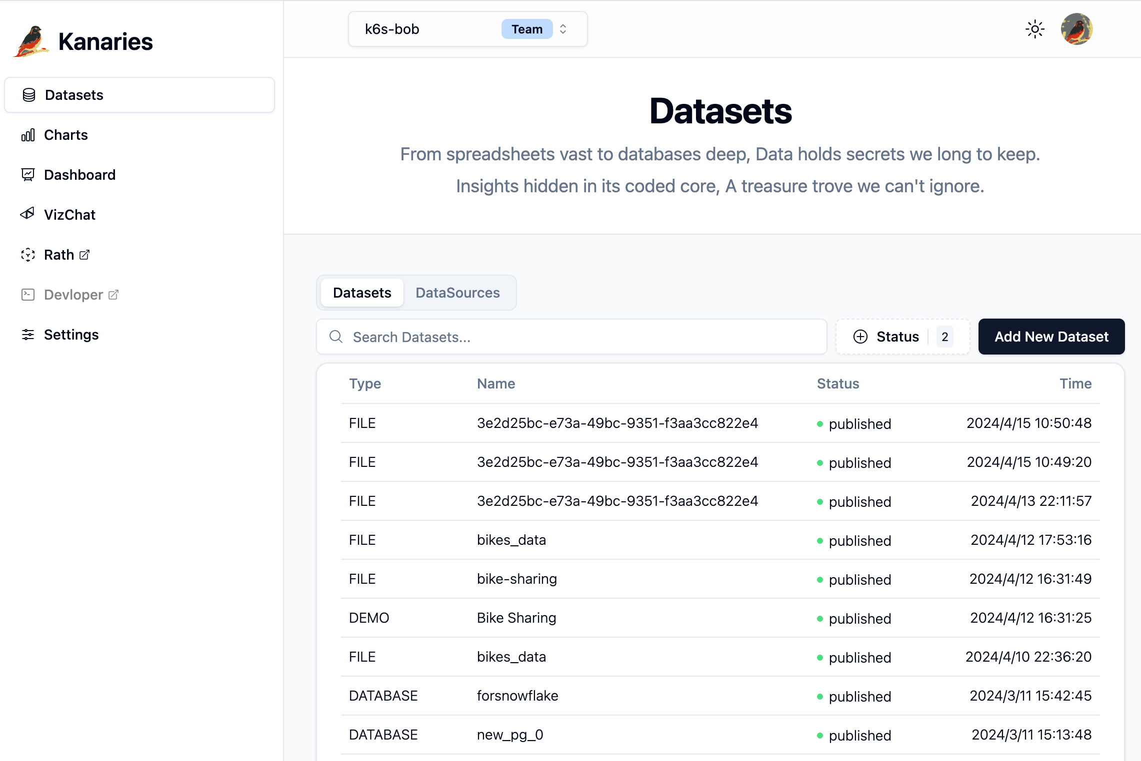
Kanaries:
Kanaries is a software development company that elaborates python libraries and tools for Data Analytics:
Analytics Center: Personal analytic center for managing data, charts and dashboards.
RATH:
Autopilot for exploratory data analysis

Slide 15
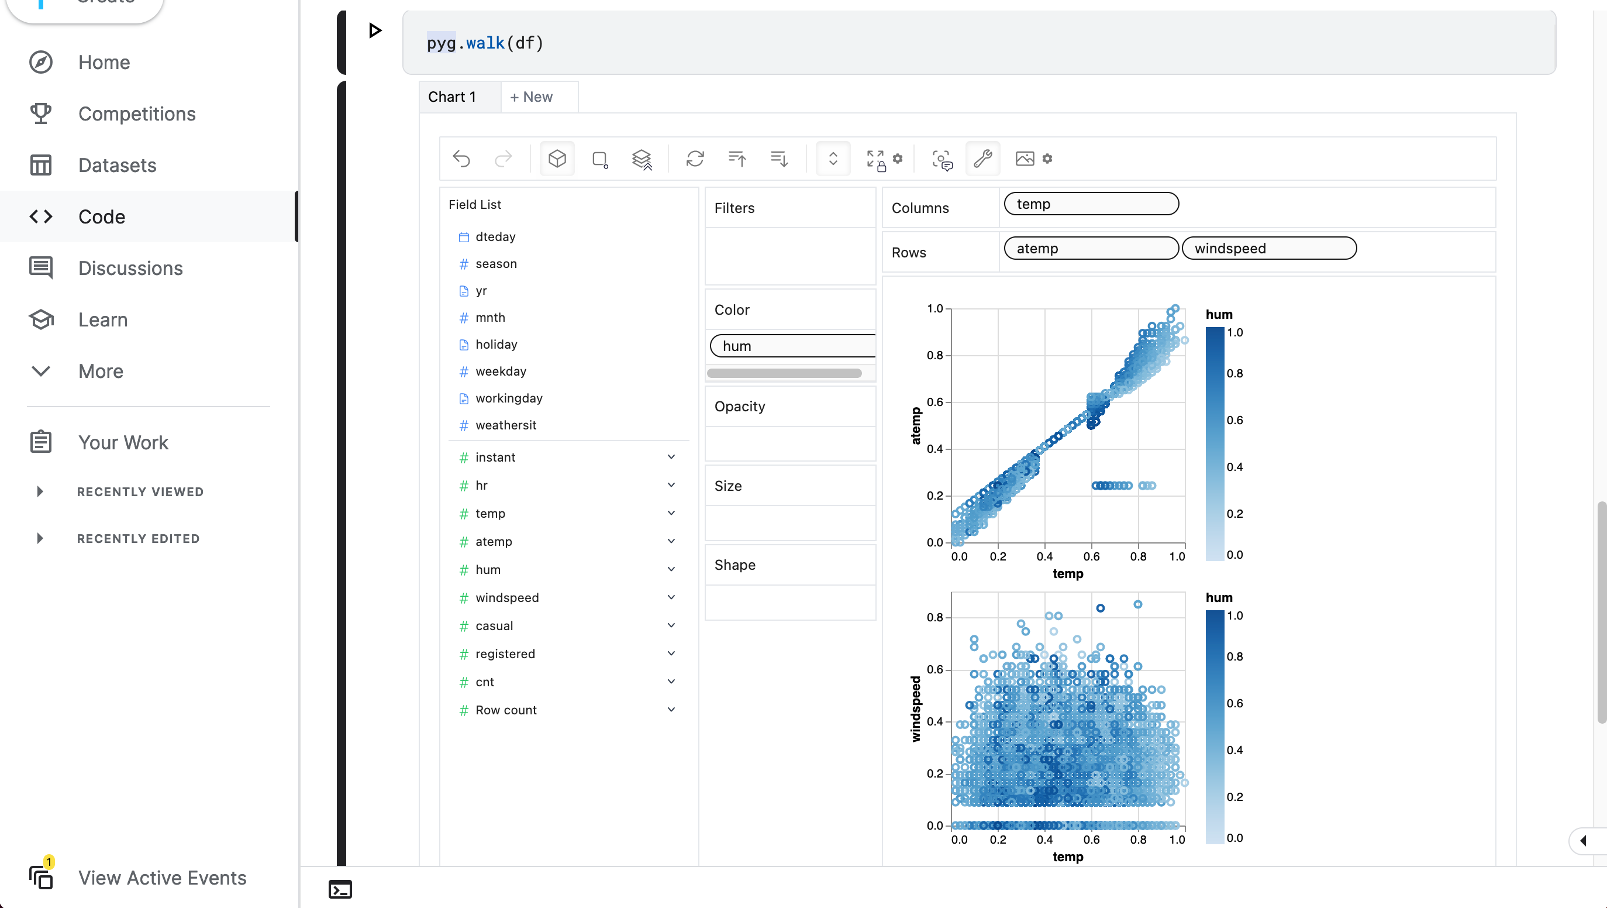
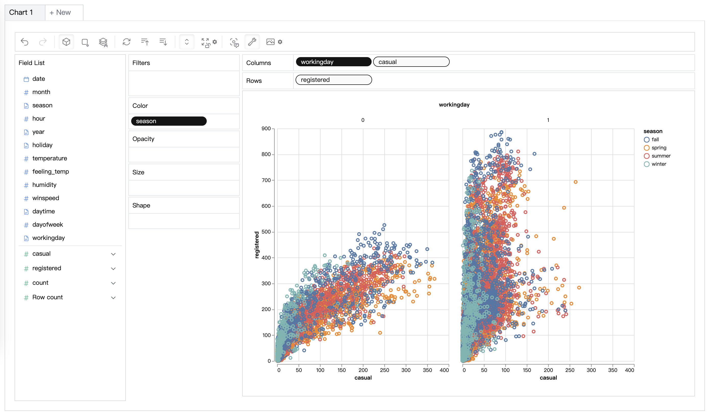
Kanaries:
PyGWalker: PyGWalker turns your data into interactive visualization apps with one line of code, and enables you to share your apps with one click.
Graphic Walker:
Graphic Walker allows users to analyze and visualize data with simple drag-and-drop/chat UI. Easy to embed in your apps just as a component!

Slide 16
PyGWalker:
PyGWalker: A Python Library for Exploratory Data Analysis with Visualization
PyGWalker can simplify your Jupyter Notebook data analysis and data visualization workflow, by turning your pandas dataframe into an interactive user interface for visual exploration.
PyGWalker is named as an abbreviation of "Python binding of Graphic Walker". It integrates Jupyter Notebook (or other jupyter-based notebooks) with Graphic Walker, a different type of open-source alternative to Tableau.
It allows data scientists to analyze data and visualize patterns with simple drag-and-drop operations.

Slide 17
PyGWalker:
Using PyGWalker in Jupyter Notebook
import pandas as pd
import pygwalker as pyg
Load your data as a dataframe, then pass it to pygwalker.
df = pd.read_csv(‘./clean_median_sales.csv’)
walker = pyg.walk(df)
Sometimes your dataframe can be pretty large and causes slow performance of pygwalker.
A simple way to boosting its performance with one extra parameter use_kernel_calc.
pyg.walk(df, use_kernel_calc=True)

Slide 18
Streamlit and PyGWalker:
Streamlit allows you to turn your data scripts into web apps in a matter of minutes, rather than weeks. With Streamlit, you don't have to worry about complex web development or spending endless hours writing code. It's a fast, open-source, and completely free way to create interactive and shareable data applications using Python.
pip install pandas
pip install pygwalker
pip install streamlit

Slide 19
Streamlit and PyGWalker:
Embedding Pygwalker in a Streamlit Application
import pygwalker as pyg
import pandas as pd
import streamlit.components.v1 as components
import streamlit as st
# Adjust the width of the Streamlit page
st.set_page_config(page_title="Use Pygwalker In Streamlit", layout="wide")
# Add Title
st.title("Use Pygwalker In Streamlit")
# Import your data
df = pd.read_csv(‘./clean_median_sales.csv’)
# Generate the HTML using Pygwalker
pyg_html = pyg.to_html(df)
# Embed the HTML into the Streamlit app
components.html(pyg_html, height=1000, scrolling=True)

Slide 20
Streamlit and PyGWalker:
Exploring data with PyGWalker in Streamlit
To launch the Streamlit application and start exploring your data, run the following command in your command prompt or terminal:
streamlit run pygwalker_demo.py
You should see some information displayed:
You can now view your Streamlit app in your browser.
Local URL: http://localhost:8501
Network URL: http://xxx.xxx.xxx.xxx:8501

Slide 21
Demonstration

Slide 22
Thank you
Justin Stone, Yvonne Jian, Rafael Robles, Jorge Wassmann
Advanced Programming for Business Analytics

