Slide 1
AHB2APB Async UVM Verification Environment
Presented by: Team B

Slide 2
Verification Plan
Reset testing
Write testing
Read testing
Non-overlapped and overlapped
Wait, no wait and error response.
Different clocks testing

Slide 3
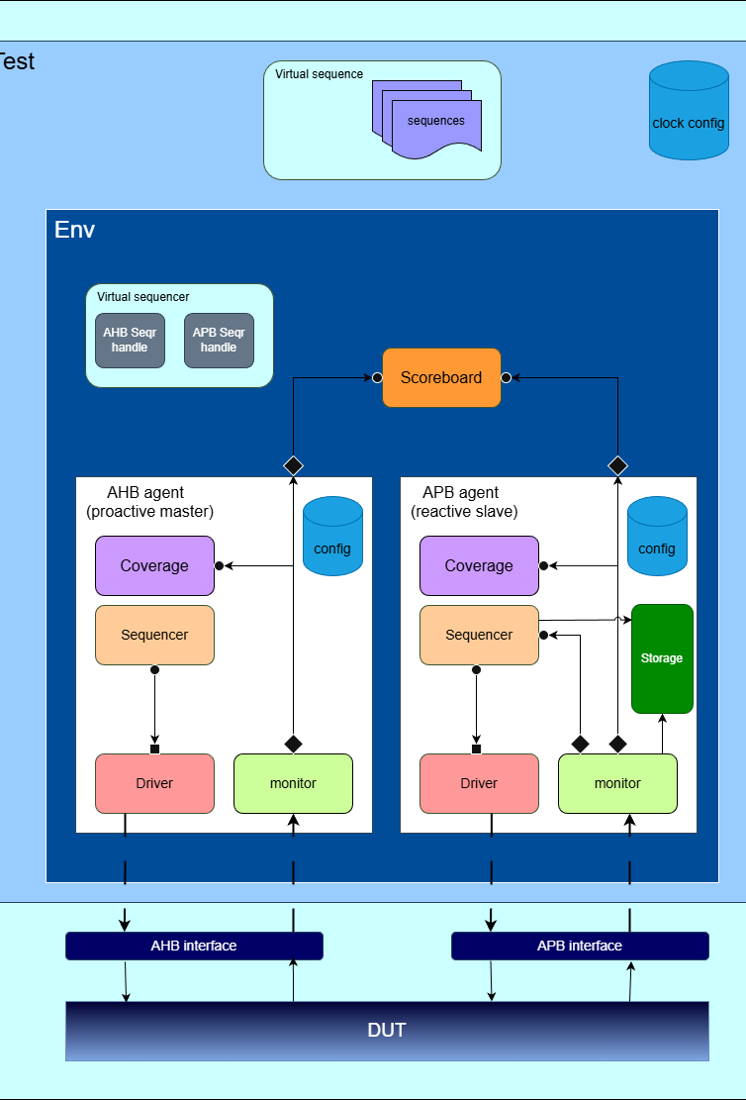
Environment Architecture
Double-interface
Double-agent (master and slave)
Agentic coverage
Virtual sequencer
Common scoreboard

Slide 4
Environment Reset Handle
fork: wait for reset start
Reset behavior
AHB reset-start waiter
APB reset-start waiter
• Either reset starts scoreboard handling.
• Both end waiters finish before every block resumes.
join_any: either waiter completes
env.handle_reset() calls sb.handle_reset()
fork: wait for reset end
AHB reset-end waiter
APB reset-end waiter
join: both waiters complete
sb.cmp.release_reset()

Slide 5
AHB Agent
Agent architecture
Agent configuration object
Item drive
Driver logic
Item monitor
Monitor logic
Sequencer
Coverage class

Slide 6
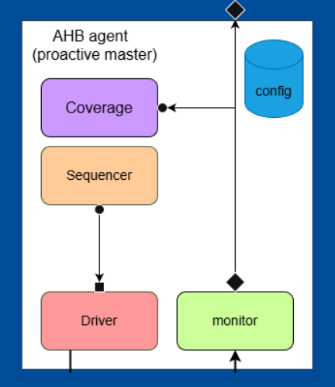
Agent Architecture
Agent
  Optional Coverage Build
  Configurable to be Passive or Active
  Calls Reset Handling Of Children

Slide 7
Agent Configuration Object
Contains:
  Virtual interface handler.
  Coverage enable .
  Active passive variable,
  Stuck threshold for timeout.
  Setters and getters for object fields.

Slide 8
Item monitor
Contains all AHB Interface Signals with some Extra Controlling Signals:
  Is_in_progress: When Asserted Represent that the Current Inputs Still Waits The Response
  Length: Used For Timeout Logic
  Waiting: Monitors The Time Waited Between Transfers
Implements Customized Functions:
  In2string: Convert Inputs to String
  Out2string: Convert Outputs to String
  Convert2string: Convert all Signals to a well documented string
  Reset_item: Resets all signals in the current item

Slide 9
Monitor logic
Capture time (for HSEL = 1)
  HREADY = 1 and the cycle after for read operations to capture data
  If HSEL was De-asserted but there is an input in Progress it will be captured also when HREADY is asserted
If the waited Time For The response Exceeded Stuck Threshold the Item Will Be Reseted

Slide 10
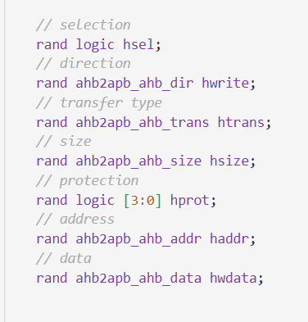
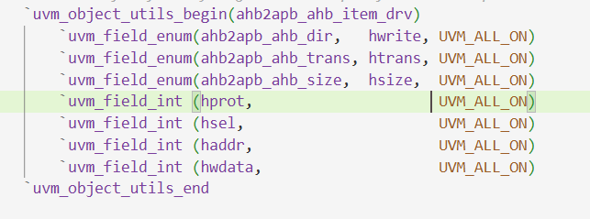
Item drive
Soft constraints.
Utility macros for helper functions:
  Clone, copy, compare, etc……
Conver2string method for printing.
Item fields:

Slide 11
Item drive
Soft constraints.
Utility macros for helper functions:
  Clone, copy, compare, etc……
Conver2string method for printing.
Item fields:

Slide 12
Driver structure
drive_transactions
drive_transaction
handle_reset
try_next_item: an item goes to drive_transaction, no item means idle
Forks data_phase(prev_item) with addr_phase(item), then prev_item = item
Kills the drive process and restores default pin values
T1
T2
T3
T4
A addr
B addr
C addr
Address phase
A data
B data
C data
Data phase

Slide 13
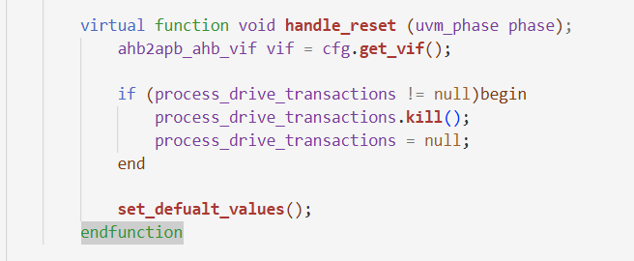
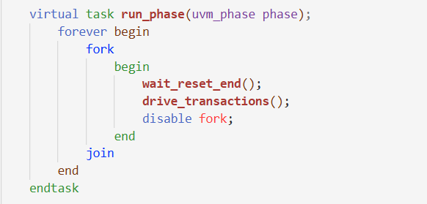
Driver reset handling
Killing driving process.
Driving default values.
But how the driver Recovers?

Slide 14
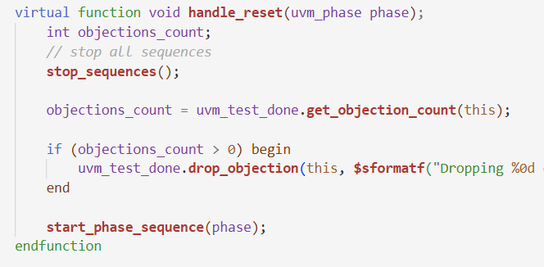
Sequencer reset handling
Stop all running sequences.
Drop all objections
Starts a new phase

Slide 15
AHB Sequences
Read transfer with no overlapping
Write transfer with no overlapping
Read transfer with overlapping
Write transfer with overlapping
Random read-write transfers

Slide 16
Agent architecture
Agent configuration object
Item drive
Driver logic
Item monitor
Monitor logic
Sequencer
Coverage class
Memory
APB Reactive Slave Agent

Slide 17
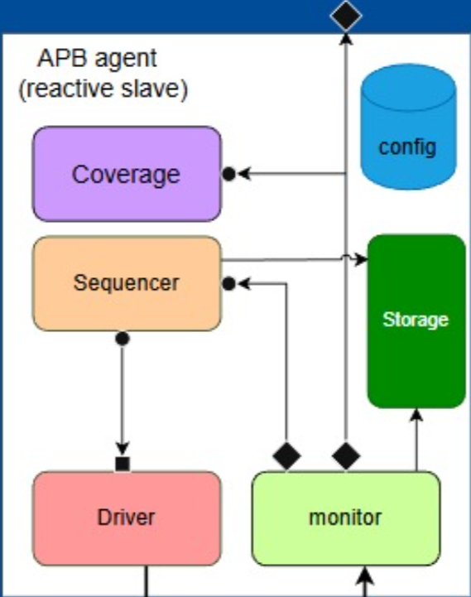
Agent Architecture
Agent
  Driver
  Monitor
  Sequencer
  Storage
  Optional Coverage Build
  Configurable
  Calls Reset Handling Of Children

Slide 18
Agent Configuration Object
Contains:
  Virtual interface handler.
  Coverage enable .
  Active passive variable,
  Stuck threshold for timeout.
  Setters and getters for object fields.
  Tasks that handles rest.

Slide 19
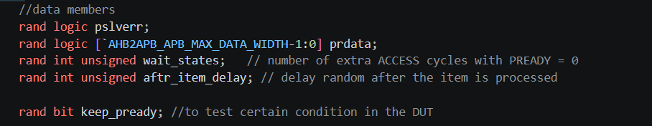
Driver Sequence Item
Item fields:

Slide 20
Driver structure
drive_transactions
drive_transaction
End of transaction
Initializes output signals to idle values, then fetches the next sequence item using get_next_item().
Waits for item.wait_states clock cycles, then drives PREADY to be equal 1 to end waiting for the transaction in the master, PSLVERR, and PRDATA.
Wait exactly 1 clock cycle, then go back to idle state then item_done()
IDLE
WAIT
RESPONSE
1 CLK
IDLE
Control phase
0
0
1
1
0
PREADY

Slide 21
APB Monitor Item
paddr, pwrite, pprot, pstrb
pwdata
prdata, pslverr
is_in_progress
wait_cycle_cnt
in2string
out2string
do_compare
convert2string

Slide 22
APB Setup, Access and completion
Setup
Access
PSEL = 1 and PENABLE = 0. PADDR, PWRITE and PWDATA are valid.
PSEL = 1 and PENABLE = 1. The completer holds PREADY low to add wait states.
Completion
PREADY = 1. PRDATA and PSLVERR are valid only in this cycle.
While PREADY is low, the address, control and write data signals must stay stable.

Slide 23
APB Monitor
Setup
Completion
PSEL = 1 and PENABLE = 0.
PSEL, PENABLE and PREADY are all high.
request_aport.write(item_mon);
scoreboard_aport.write(item_done);
memory.write(paddr, pwdata, pstrb);
Goes to request_fifo in the sequencer.
Goes to the scoreboard. Writes without PSLVERR also go to the memory.

Slide 24
APB Sequencer
ahb2apb_apb_sequencer
// Receives monitor transactions
uvm_analysis_export #(item_mon) request_export;
// Requests received from the monitor
uvm_tlm_analysis_fifo #(item_mon) request_fifo;
Request_export.connect(
request_fifo.analysis_export);

Slide 25



APB Connections
ahb2apb_apb_monitor
ahb2apb_apb_sequencer
Sends transactions
request, at Setup
request_fifo
request_aport
request_export
uvm_tlm_analysis_fifo
Receives requests through an analysis export
completed transfer
scoreboard_aport
slave_agent_aport
ahb2apb_scoreboard
analysis_imp: write(item_done)
Also writes completed writes to memory

Slide 26
APB Memory
ahb2apb_apb_mem
protected bit [7:0] mem [int unsigned];
init()
write(addr, data, strb)
read(addr)
dump()
init()
write(addr, data, strb)
read(addr)
dump_to_file()
if (!vif.PRESETn) memory.init();
memory.write(item_done.paddr, item_done.pwdata, item_done.pstrb);
seq_item_res.prdata = p_sequencer.memory.read(seq_item_req.paddr);
memory.dump_to_file();

Slide 27
APB Memory
ahb2apb_apb_mem
protected bit [7:0] mem [int unsigned];
init()
write(addr, data, strb)
read(addr)
dump_to_file()
if (!vif.PRESETn) memory.init();
memory.write(item_done.paddr, item_done.pwdata, item_done.pstrb);
seq_item_res.prdata = p_sequencer.memory.read(seq_item_req.paddr);
memory.dump_to_file();

Slide 28
APB Sequences
OKAY response with no wait states
OKAY response with random wait states
Randomized APB response with error injection

Slide 29
UVM Scoreboard
Approach
Architecture
Predictors
Filters
Comparator
Example
Reset handle
Item movement

Slide 30
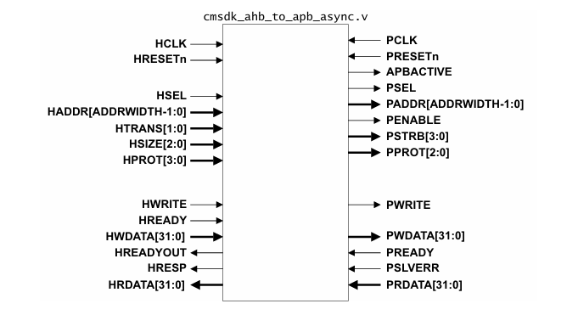
Approach
The AHB monitor supplies requests and bridge responses.
The APB monitor supplies bridge requests and slave responses.
Each predictor models outputs on the opposite interface.
Select actual bridge outputs for FIFO-based comparison.

Slide 31
Approach
1
2
The AHB monitor supplies requests and bridge responses.
The APB monitor supplies bridge requests and slave responses.
Each predictor models outputs on the opposite interface.
Select actual bridge outputs for FIFO-based comparison.
4
3

Slide 32
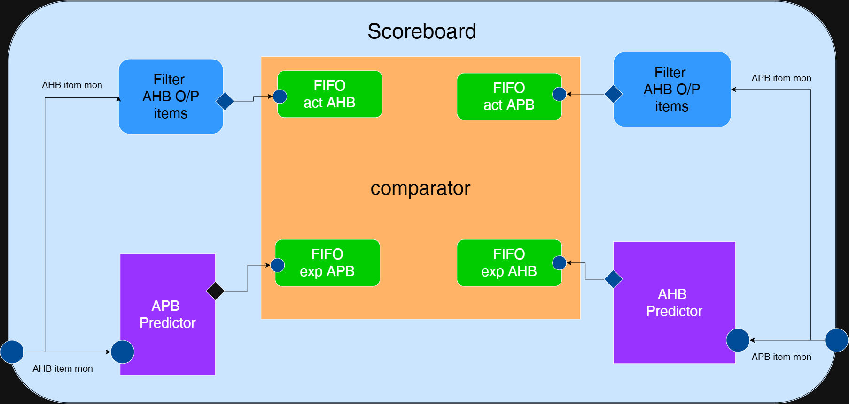
Architecture

Slide 33
Item movement
Cross-interface data flow
AHB → APB
APB → AHB
AHB monitor → APB predictor → expected APB FIFO
APB monitor → APB output filter → actual APB FIFO
Comparator checks expected vs. actual APB
APB monitor → AHB predictor → expected AHB FIFO
AHB monitor → AHB output filter → actual AHB FIFO
Comparator checks expected vs. actual AHB
Monitor strategy: two publications per transaction
is_in_progress = 1
is_in_progress = 0
A phase-aware monitor item is consumed by the APB predictor (AHB stream) or APB actual-output filter (APB stream).
A complementary monitor item is consumed by the AHB predictor (APB stream) or AHB actual-output filter (AHB stream).

Slide 34
APB predictor
APB field | Implemented prediction
PSEL | HSEL && (HTRANS == NONSEQ or SEQ)
PADDR | Word-aligned HADDR
PWRITE | HWRITE
PPROT | {~HPROT[0], 1'b0, HPROT[1]}
PWDATA | HWDATA on writes, retained data_mem on reads “last PWDATA sent”
PSTRB | Byte write | 0001 << HADDR[1:0]
 | Halfword write | 0011 << {HADDR[1], 1'b0}
 | Word write | 1111
 | Read / other size | 0000
Keys for sending to expected APB FIFO:
PSEL & item.is_in_progress

Slide 35
AHB predictor
APB field | Implemented prediction
HREADYOUT | PREADY
HRESP | PSLVERR & PREADY, cast to the response enum
HRDATA | PRDATA
Key for sending to expected AHB FIFO:
!(item.is_in_progress)

Slide 36
Filters
AHB Filter
APB Filter
Clone the item to another item to prevent the monitor to edit on it
Condition on sending: “output detection”
!i(tem.is_in_progress) && HTRANS != IDLE
Clone the item to another item to prevent the monitor to edit on it
Condition on sending: “output detection”
Item.is_in_progress

Slide 37
Comparator | Parallel comparing & Reporting
fork: start both branches
End-of-test report
APB branch
AHB branch
AHB matched / mismatched
APB matched / mismatched
Total checks, matches and errors
get(expected APB)
get(actual APB)
get(expected AHB)
get(actual AHB)
Compare
Pass ||| Fail
APB match ||| APB error
Compare
Pass ||| Fail
AHB match ||| AHB error
PASS: total errors == 0
FAIL: total errors > 0
join: wait for both branches
Mismatch log prints expected
and actual output values.
Loop
Notes:
Source: ahb2apb_sb_comparator(4).sv, check_items and report_phase. Both branches execute concurrently under fork/join. Each gets expected then actual. join waits for both branches before the next check_items call. report_phase runs at the end of simulation, not after every pair. PASS means zero recorded mismatches, including when no checks ran.

Slide 38
Example: write transaction walkthrough
1
AHB monitor publishes request-phase item
2
APB predictor calculates PSEL / PADDR / PWRITE / PWDATA / PSTRB
3
APB monitor publishes output-phase item
4
APB filter forwards actual output; comparator matches FIFO pair
5
APB monitor publishes response-phase item
6
AHB predictor calculates HRDATA / HREADYOUT / HRESP
7
AHB filter forwards actual output; comparator matches FIFO pair
Notes:
Source: ahb2apb_sb_comparator(4).sv, check_items and report_phase. Both branches execute concurrently under fork/join. Each gets expected then actual. join waits for both branches before the next check_items call. report_phase runs at the end of simulation, not after every pair. PASS means zero recorded mismatches, including when no checks ran.

Slide 39
Reset handler operation
Reset callback
scoreboard.handle_reset()
Clear APB predictor memory
prd_apb.data_mem = 0
cmp.handle_reset()
active_reset = 1
Flush expected FIFOs
AHB and APB
run_phase detects reset
wait(!compare_is_in_porgress)
join_any / disable fork
Wait for reset release
cmp.release_reset(): active_reset = 0
Comparison loop resumes
Reset release requires an external caller “env”.
Needed to handle are the comparator as monitor will stop sending
Notes:
Sources: scoreboard handle_reset and comparator handle_reset, release_reset and run_phase. External reset dispatch is not supplied. The scoreboard calls cmp.handle_reset then clears predictor data_mem. run_phase waits for active_reset and for the shared comparison flag to clear, then join_any/disable fork stops the worker. The shared flag is not a robust handshake for both parallel branches. Actual FIFOs and counters are not cleared. Only the comparator release_reset is shown.

Slide 40
Reset handler operation
Func: Check_Items
Forever
wait(!active_reset)
fork
fork
APB branch
AHB branch
Comparison branch
Reset-watcher branch
get(expected APB)
get(actual APB)
get(expected AHB)
get(actual AHB)
Forever
Check_items
Wait(reset_active)
Wait(!compare_in_progress)
Compare
Compare
join_any: always the reset watcher finishes first
join
endfunctions
Notes:
Source: ahb2apb_sb_comparator(4).sv, check_items and report_phase. Both branches execute concurrently under fork/join. Each gets expected then actual. join waits for both branches before the next check_items call. report_phase runs at the end of simulation, not after every pair. PASS means zero recorded mismatches, including when no checks ran.

Slide 41
Reset handler operation
Func: Check_Items
Forever
wait(!active_reset)
fork
fork
APB branch
AHB branch
get(expected APB)
get(actual APB)
get(expected AHB)
get(actual AHB)
Comparison branch
Reset-watcher branch
Forever
compare_in_progress=1
compare_in_progress=1
Check_items
Wait(reset_active)
Wait(!compare_in_progress)
Compare
Compare
compare_in_progress=0
compare_in_progress=0
join_any: always the reset watcher finishes first
join
endfunctions
Notes:
Source: ahb2apb_sb_comparator(4).sv, check_items and report_phase. Both branches execute concurrently under fork/join. Each gets expected then actual. join waits for both branches before the next check_items call. report_phase runs at the end of simulation, not after every pair. PASS means zero recorded mismatches, including when no checks ran.

Slide 42
Assertions
APB assertions
Bridge assertions
AHB assertions

Slide 43
APB Assertions
Bridge Assertions | AHB ↔ APB Handshake
ahb2apb_apb_assertions.sv + ahb2apb_apb_assertions_macros.sv
ahb2apb_assertions.sv + ahb2apb_assertions_macros.sv
Reset and known signals
PRESETn and APBACTIVE known; reset checks PSEL, PENABLE, PADDR, PWRITE, PPROT, PSTRB, PWDATA and APBACTIVE are zero. APB bus signals checked against X/Z.
Setup → access
PSEL implies PENABLE low in setup and PENABLE high next cycle; rising PENABLE requires PSEL.
Wait states
PENABLE must stay high until PREADY is observed.
Stable transaction fields
PADDR, PWDATA, PWRITE, PSTRB and PPROT must stay stable from setup through completion.
Completion and fixed bit
Rising PREADY requires PSEL and PENABLE; PPROT[1] must remain stable. Matching cover properties track assertion exercise.

Slide 44
APB Assertions
Bridge Assertions | AHB ↔ APB Handshake
AHB Assertions
ahb2apb_apb_assertions.sv + ahb2apb_apb_assertions_macros.sv
ahb2apb_assertions.sv + ahb2apb_assertions_macros.sv
ahb2apb_ahb_assertions.sv + ahb2apb_ahb_assertions_macros.sv
Transfer definitions
ahb_start = HSEL && HTRANS[1] && HREADY; apb_done = PREADY && PENABLE && PSEL.
AHB request → APB activity
After ahb_start, PSEL must eventually assert; APBACTIVE must eventually assert.
APB completion → AHB response
After apb_done, HREADYOUT must eventually assert; APBACTIVE must deassert on the next PCLK.
Error propagation
PSLVERR must eventually propagate to HRESP.
AHB stall and clock checks
After ahb_start, HREADYOUT must deassert on next HCLK; HCLK/PCLK checked for unknown values. Corresponding cover checks included.

Slide 45
AHB Assertions
ahb2apb_ahb_assertions.sv + ahb2apb_ahb_assertions_macros.sv
Reset & known values
HRESETn known; on reset HREADYOUT=1, HRESP=0, HTRANS=IDLE.. At any time, HSEL, HTRANS, HADDR, HREADY, HREADYOUT and HRESP cannot be X/Z.
Valid transaction controls
When HTRANS is not IDLE, HPROT, HSIZE and HWRITE must be known.
Read/write data validity
HWDATA must be known during a write data phase until ready; HRDATA must be known on successful read completion (or HRESP indicates error).
Error response sequencing
A rising HRESP requires HREADYOUT low, then rising on the next clock, followed by HRESP falling.
Wait-state stability
HADDR, HTRANS, HSIZE, HWRITE stable when stalled; HWDATA stable through write-data wait states.

Slide 46
Coverage Approach
Reset during access coverage
AHB coverage
APB coverage
Sampling one time at item_end

Slide 47
AHB Coverage
APB Coverage
ahb2apb_ahb_coverage.sv
ahb2apb_apb_coverage.sv
Only sample when HTRANS is not IDLE (except for HTRANS itself)
PSTRB (only sampled in write operations
The rest of signals when HTRANS is IDLE are not sampled as when HTRANS is IDLE, the rest of signals are neglected by the bridge.
Cover the PSTRB combinations that corresponds to the legal HSIZE and HADDR[1:0] only and consider any other combination as an illegal bin.
HTRANS
PPROT[2] and PPROT[0]
Cover IDLE and NONSEQ states and all the transitions between them and cover BUSY and SEQ as illegal bins as there are no HBURST in the AHB interface.
Cover only the least and most bits from PPROT as PPROT[1] signal is not used (covered in APB assertions)
HADDR[1:0], HSIZE and HPROT[1:0]
PADDR[1:0]
Cover all combinations of the least 2 bits of HADDR to cover all offsets. Cover all HSIZE legal possibilities. Cover all combinations of the least HPROT as the most 2 bits are not used.
Cover the least 2 bits of PADDR to ensure they are always 2'b00 and any other value is illegal.
HWRITE and HRESP
PWRITE and PSLVERR
Cover HWRITE signal to ensure that there are WRITE and READ operations and cover that all combinations of 2 back2back transactions. Cover HRESP signal to ensure that there are OKAY and ERROR responses and cover that all combinations of back2back responses.
Cover PWRITE signal to ensure that there are WRITE and READ operations and cover that all combinations of 2 back2back transactions. Cover PSLVERR signal to ensure that there are OKAY and ERROR responses and cover that all combinations of back2back responses.
Cross coverage from AHB points
Cross coverage from APB points
Implement a cross coverpoint between HWRITE, HADDR and HSIZE to cover that all legal combinations between the 3 signals are covered. Implement a cross coverpoint between HWRITE and HPROT. Implement a cross coverpoint between HWRITE and HRESP.
Implement a cross coverpoint between PWRITE and PPROT. Implement a cross coverpoint between PWRITE and PSLVERR.

Slide 48
APB Coverage
ahb2apb_apb_coverage.sv
PSTRB (only sampled in write operations
Cover the PSTRB combinations that corresponds to the legal HSIZE and HADDR[1:0] only and consider any other combination as an illegal bin.
PPROT[2] and PPROT[0]
Cover only the least and most bits from PPROT as PPROT[1] signal is not used (covered in APB assertions)
PADDR[1:0]
Cover the least 2 bits of PADDR to ensure they are always 2'b00 and any other value is illegal.
PWRITE and PSLVERR
Cover PWRITE signal to ensure that there are WRITE and READ operations and cover that all combinations of 2 back2back transactions. Cover PSLVERR signal to ensure that there are OKAY and ERROR responses and cover that all combinations of back2back responses.
Cross coverage from APB points
Implement a cross coverpoint between PWRITE and PPROT. Implement a cross coverpoint between PWRITE and PSLVERR.

Slide 49
Virtual Sequences
Base virtual sequence
Virtual sequence 1
Virtual sequence 2
Virtual sequence n

Slide 50
Virtual Sequences: turning the verification plan into sequences
Non-overlapped write + no wait okay response
Overlapped write + wait okay response
Non-overlapped read + no wait okay response
Non-overlapped read + wait okay response
Non-overlapped write + wait okay response
Overlapped read + wait okay response
Write and read + wait okay response
Write and read + wait okay and error response

Slide 51
Virtual Sequences
AHB sequence
APB sequence
Virtual sequence

Slide 52
Virtual Sequences
AHB sequence
APB sequence
Param. Virtual sequence
Num_iter

Slide 53
Testing Approach
Base test
Main test
Parameterized clock
Reset
Virtual sequence 1
Virtual sequence 2
Virtual sequence n
Reset during sequence
Repeat with different clocks

Slide 54
Testing Approach
Base test
Main test
Parameterized clock
Reset
Virtual sequence 1
Virtual sequence 2
Virtual sequence n
Reset during sequence
Repeat with different clocks

Slide 55
Reset During Sequence
Reset
Assert and deassert reset at different times async according to AHB clock
Assert and deassert reset at different times async according to APB clock
Sequence
Start sequence
Repeat after the sequence is killed by reset
Repeat the process 100 times

Slide 56
Clock Testing
Main test
Parameterized clock
Same clock
Double clock
Phase shift
Inherit parameterized class
Override parameters
set the clock config variables
Put the clock config in config_db
The tb get the clock config
Generate the clocks and run main test

Slide 57
Clock Testing
Main test
Parameterized clock
Same clock
Double clock
Phase shift
Inherit parameterized class
Override parameters
set the clock config variables
Put the clock config in config_db
The tb get the clock config
Generate the clocks and run main test

Slide 58
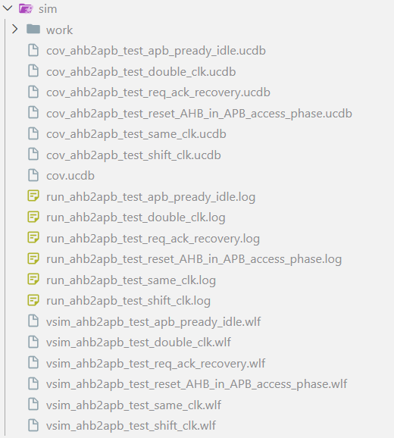
Automation
A Makefile-driven QuestaSim flow for repeatable multi-test simulation and coverage collection
1 CLEAN
2 COMPILE
3 RUN TESTS
4 MERGE
5 REPORT
→
→
→
→
Remove old sim outputs
RTL + AHB/APB agents
+ testbench
Execute each test
with a random seed
Combine per-test
UCDB databases
Generate HTML + text
coverage reports
What the automation handles
Test-list driven
Per-test artifacts
The TESTS variable defines the regression. Make creates one run target per test.
Separate transcript logs, waveform files and UCDB files make failures easier to isolate.
1

Slide 59
Specific Test cases
Case 1 : Reset AHB side while APB transfer is ongoing.
Case 2: Reset APB side after an AHB transfer.
Case 3: Keeping Pready high for one extra cycle after transfer ends.

Slide 60
Coverage exclusion
Toggle excludes
HTRANS[0]
HSIZE[2]
Synchronizer enable
PPROT[1]
PADDR[1:0]
Branch & statement excludes
All default branches.
All xx states.
Expression excludes

Slide 61
Coverage Results
100% reported coverage across the listed RTL and functional coverage metrics
AHB-side controller
Branches: 36 / 36
Expressions: 30 / 30
Statements: 47 / 47
Toggle bins: 416 / 416
FSM: 4 states, 9 transitions covered
APB-side controller
Branches: 40 / 40
Expressions: 9 / 9
Statements: 40 / 40
Toggle bins: 384 / 384
FSM: 3 states, 4 transitions covered
Functional coverage
AHB agent: 57 / 57 bins
13 coverpoints and crosses
APB agent: 38 / 38 bins
10 coverpoints and crosses
Reset and transaction scenarios covered
AHB-to-APB Asynchronous Bridge | UVM Verification Results
1

Slide 62
Assertion Results & Takeaways
Protocol checking and regression coverage summary
Assertion group
Checks
Failures
Reported coverage
Bridge-level checks
8
0
100%
APB protocol checks
23
0
100%
AHB protocol checks
21
0
100%
AHB-to-APB Asynchronous Bridge | UVM Verification Results
2

Slide 63
Thank You

