Slide 1


VIRTUAL ROOM - 54
Order Book System

Slide 2



Slide 3
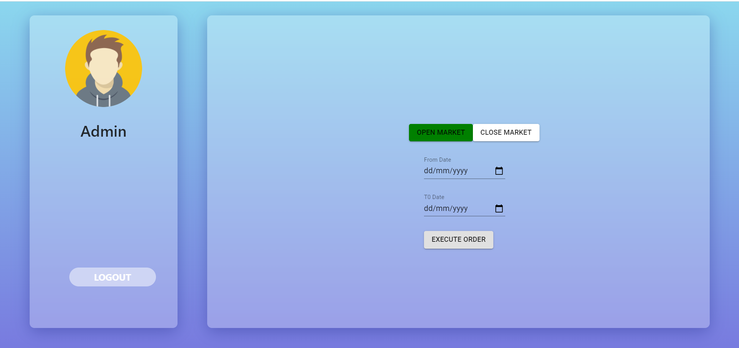

Slide 4
