Slide 1
Collections Framework

Slide 2
Collections
A collection —is simply an object that groups multiple elements into a single unit.
A collections framework is a unified architecture for representing and manipulating collections.
Interfaces
Implementations
Algorithms

Slide 3
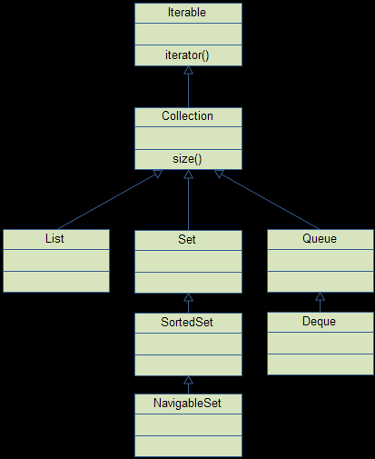
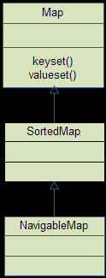
Over View of Collections Hierarchy

Slide 4
Set
A Set is a Collection that cannot contain duplicate elements
Set implementations: HashSet, TreeSet, and LinkedHashSet.
int size();
boolean isEmpty();
boolean contains(Object element);
boolean add(E element);
boolean remove(Object element);
Iterator<E> iterator();
// Bulk operations
boolean containsAll(Collection<?> c);
boolean addAll(Collection<? extends E> c);
boolean removeAll(Collection<?> c); // optional boolean retainAll(Collection<?> c); // optional void clear();
s1.containsAll(s2) -- Subset
s1.addAll(s2) - Union
s1.retainAll(s2) – Intersection
s1.removeAll(s2)

Slide 5
Sample
package com.cisco.collections.sample;
import java.util.HashSet;
import java.util.Set;
public class SampleSet {
public static void main(String args[]){
Set<String> s= new HashSet<String>();
s.add("one") ;
s.add("two") ;
s.add("one") ;
for (String ele:s){
System.out.println("s=="+ele) ;
}
}

Slide 6
List
A List is an ordered Collection (sometimes called a sequence).
Positional access — manipulates elements based on their numerical position in the list
Search — searches for a specified object in the list and returns its numerical position
Iteration — extends Iterator semantics to take advantage of the list's sequential nature

Slide 7
Apis
public interface List<E> extends Collection<E> {
// Positional access
E get(int index);
// optional
E set(int index, E element);
// optional
boolean add(E element);
// optional
void add(int index, E element);
// optional
E remove(int index);
// optional
boolean addAll(int index, Collection<? extends E> c);
// Search
int indexOf(Object o);
int lastIndexOf(Object o);
// Iteration
ListIterator<E> listIterator();
ListIterator<E> listIterator(int index);
// Range-view
List<E> subList(int from, int to);
}

Slide 8
MAPs
A Map is an object that maps keys to values. A map cannot contain duplicate keys
public interface Map<K,V> {
// Basic operations
V put(K key, V value);
V get(Object key);
V remove(Object key);
boolean containsKey(Object key);
boolean containsValue(Object value);
int size();
boolean isEmpty();

Slide 9
// Bulk operations
void putAll(Map<? extends K, ? extends V> m);
void clear();
// Collection Views
public Set<K> keySet();
public Collection<V> values();
public Set<Map.Entry<K,V>> entrySet();
// Interface for entrySet elements
public interface Entry {
K getKey();
V getValue();
V setValue(V value);
}
}

Slide 10
Implementation
: HashMap, TreeMap, and LinkedHashMap
HashTable
for (Map.Entry<KeyType, ValType> e : m.entrySet()) System.out.println(e.getKey() + ": " + e.getValue());
The Collection view methods allow a Map to be viewed as a Collection in these three ways:
keySet — the Set of keys contained in the Map.
values — The Collection of values contained in the Map. This Collection is not a Set, because multiple keys can map to the same value.
entrySet — the Set of key-value pairs contained in the Map. The Map interface provides a small nested interface called Map.Entry, the type of the elements in this Set.

Slide 11
Auto-boxing/unboxing
List<Integer> ints = new ArrayList<Integer>();
ints.add( 1 ); // auto-boxing to new Integer( 1 )
ints.add( 2 );
ints.add( 3 );
for ( int num : ints ) // Auto-unboxing using obj.intValue()
System.out.println( num );

Slide 12
Generics
Generics enable types (classes and interfaces) to be parameters when defining classes, interfaces and methods.
public class Box {
private Object object;
public void set(Object object) { this.object = object; }
public Object get() { return object; }
}
/**
* Generic version of the Box class.
* @param <T> the type of the value being boxed
*/
public class Box<T> {
// T stands for "Type"
private T t;
public void set(T t) { this.t = t; }
public T get() { return t; }
}

Slide 13
Exercises
1 Write a method that takes a string and returns the number of unique characters in the string. It is expected that a string with the same character sequence may be passed several times to the method. Since the counting operation can be time consuming, the method should cache the results, so that when the method is given a string previously encountered, it will simply retrieve the stored result.
2 Write a program which creates a concordance of characters occurring in a string (i.e., which characters occur where in a string). Read the string from the command line.
Running the program:
>java Concordance Hello World {d=[9], o=[4, 6], r=[7], W=[5], H=[0], l=[2, 3, 8], e=[1]}

Slide 14
3. Develop banking system.
A XYZ bank maintains Two types of accounts Savings and Current account. System needs to support Open, close, deposit, withdrawal operations.
Use collections to list the customers and do not allow duplicate account number.
Provide a facility to retrieve Balance statement for customer with a given savings account #.

