Slide 1
JDBC –
Java DataBase
Connectivity
CC-IT

Slide 2
What is JDBC?
“An API that lets you access virtually any tabular data source from the Java programming language”
    JDBC Data Access API – JDBC Technology Homepage
We’ll focus on accessing Oracle databases

Slide 3
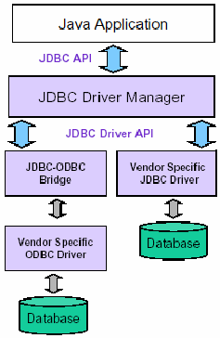
General Architecture
What design pattern is implied in this architecture?
What does it buy for us?
Why is this architecture also multi-tiered?

Slide 4
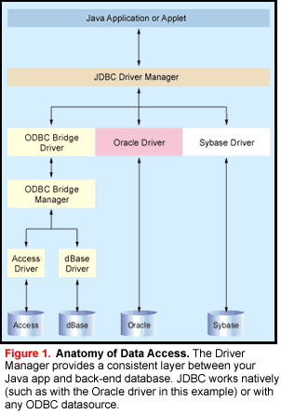

Slide 5
Basic steps to use a database in Java
1.Establish a connection
2.Create JDBC Statements
3.Execute SQL Statements
4.GET ResultSet
5.Close connections

Slide 6
1. Establish a connection
import java.sql.*;
Load the vendor specific driver
  Class.forName("oracle.jdbc.driver.OracleDriver");
    What do you think this statement does, and how?
    Dynamically loads a driver class, for Oracle database
Make the connection
  Connection con = DriverManager.getConnection( "jdbc:oracle:thin:@oracle-prod:1521:OPDEV", username, passwd);
    What do you think this statement does?
    Establishes connection to database by obtaining
    a Connection object

Slide 7
2. Create JDBC statement(s)
Statement stmt = con.createStatement() ;
Creates a Statement object for sending SQL statements to the database

Slide 8
Executing SQL Statements
String createLehigh = "Create table Lehigh " +
"(SSN Integer not null, Name VARCHAR(32), " + "Marks Integer)";
stmt.executeUpdate(createLehigh);
//What does this statement do?
String insertLehigh = "Insert into Lehigh values“ + "(123456789,abc,100)";
stmt.executeUpdate(insertLehigh);

Slide 9
Get ResultSet
String queryLehigh = "select * from Lehigh";
ResultSet rs = Stmt.executeQuery(queryLehigh);
//What does this statement do?
while (rs.next()) {
int ssn = rs.getInt("SSN");
String name = rs.getString("NAME");
int marks = rs.getInt("MARKS");
}

Slide 10
Close connection
stmt.close();
con.close();

Slide 11
Transactions and JDBC
JDBC allows SQL statements to be grouped together into a single transaction
Transaction control is performed by the Connection object, default mode is auto-commit, I.e., each sql statement is treated as a transaction
We can turn off the auto-commit mode with con.setAutoCommit(false);
And turn it back on with con.setAutoCommit(true);
Once auto-commit is off, no SQL statement will be committed until an explicit is invoked con.commit();
At this point all changes done by the SQL statements will be made permanent in the database.

Slide 12
Handling Errors with Exceptions
Programs should recover and leave the database in a consistent state.
If a statement in the try block throws an exception or warning, it can be caught in one of the corresponding catch statements
How might a finally {…} block be helpful here?
E.g., you could rollback your transaction in a
catch { …} block or close database connection and free database related resources in finally {…} block

Slide 13
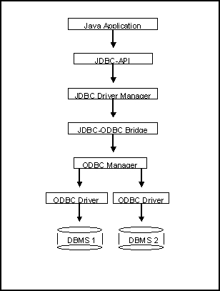
Another way to access database
(JDBC-ODBC)
What’s a bit different
about this architecture?
Why add yet
another layer?

Slide 14
Sample program
import java.sql.*;
class Test {
public static void main(String[] args) {
try {
Class.forName("sun.jdbc.odbc.JdbcOdbcDriver"); //dynamic loading of driver
String filename = "c:/db1.mdb"; //Location of an Access database
String database = "jdbc:odbc:Driver={Microsoft Access Driver (*.mdb)};DBQ=";
database+= filename.trim() + ";DriverID=22;READONLY=true}"; //add on to end
Connection con = DriverManager.getConnection( database ,"","");
Statement s = con.createStatement();
s.execute("create table TEST12345 ( firstcolumn integer )");
s.execute("insert into TEST12345 values(1)");
s.execute("select firstcolumn from TEST12345");

Slide 15
Sample program(cont)
ResultSet rs = s.getResultSet();
if (rs != null) // if rs == null, then there is no ResultSet to view
while ( rs.next() ) // this will step through our data row-by-row
{ /* the next line will get the first column in our current row's ResultSet
as a String ( getString( columnNumber) ) and output it to the screen */
System.out.println("Data from column_name: " + rs.getString(1) );
}
s.close(); // close Statement to let the database know we're done with it
con.close(); //close connection
}
catch (Exception err) { System.out.println("ERROR: " + err); }
}
}

Slide 16

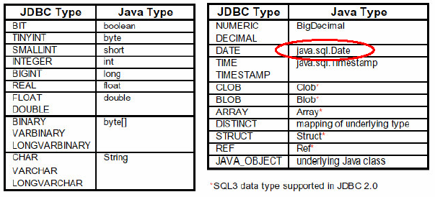
Mapping types JDBC - Java

Slide 17
JDBC 2 – Scrollable Result Set
…
Statement stmt =
con.createStatement(ResultSet.TYPE_SCROLL_INSENSITIVE,
ResultSet.CONCUR_READ_ONLY);
String query = “select students from class where type=‘not sleeping’ “;
ResultSet rs = stmt.executeQuery( query );
rs.previous(); / / go back in the RS (not possible in JDBC 1…)
rs.relative(-5); / / go 5 records back
rs.relative(7); / / go 7 records forward
rs.absolute(100); / / go to 100th record
…

Slide 18
JDBC 2 – Updateable ResultSet
…
Statement stmt =
con.createStatement(ResultSet.TYPE_FORWARD_ONLY,
ResultSet.CONCUR_UPDATABLE);
String query = " select students, grade from class
where type=‘really listening this presentation☺’ “;
ResultSet rs = stmt.executeQuery( query );
…
while ( rs.next() )
{
int grade = rs.getInt(“grade”);
rs.updateInt(“grade”, grade+10);
rs.updateRow();
}

Slide 19
Metadata from DB
A Connection's database is able
to provide schema information
describing its tables,
its supported SQL grammar,
its stored procedures
the capabilities of this connection, and so on
  What is a stored procedure?
  Group of SQL statements that form a logical unit and perform a particular task
This information is made available through
a DatabaseMetaData object.

Slide 20
Metadata from DB - example
…
Connection con = …. ;
DatabaseMetaData dbmd = con.getMetaData();
String catalog = null;
String schema = null;
String table = “sys%”;
String[ ] types = null;
ResultSet rs =
dbmd.getTables(catalog , schema , table , types );
…

Slide 21
JDBC – Metadata from RS
public static void printRS(ResultSet rs) throws SQLException
{
ResultSetMetaData md = rs.getMetaData();
// get number of columns
int nCols = md.getColumnCount();
// print column names
for(int i=1; i < nCols; ++i)
System.out.print( md.getColumnName( i)+",");
/ / output resultset
while ( rs.next() )
{ for(int i=1; i < nCols; ++i)
System.out.print( rs.getString( i)+",");
System.out.println( rs.getString(nCols) );
}
}

Slide 22
JDBC and beyond
(JNDI) Java Naming and Directory Interface
  API for network-wide sharing of information about users, machines, networks, services, and applications
  Preserves Java’s object model
(JDO) Java Data Object
  Models persistence of objects, using RDBMS as repository
  Save, load objects from RDBMS
(SQLJ) Embedded SQL in Java
  Standardized and optimized by Sybase, Oracle and IBM
  Java extended with directives: # sql
  SQL routines can invoke Java methods
  Maps SQL types to Java classes

Slide 23
Statements
A Statement is an interface that represents a SQL statement. You execute Statement objects, and they generate ResultSet objects, which is a table of data representing a database result set. You need a Connection object to create a Statement object.
There are three different kinds of statements:
  Statement: Used to implement simple SQL statements with no parameters.
  PreparedStatement: (Extends Statement.) Used for precompiling SQL statements that might contain input parameters. See Using Prepared Statements for more information.
  CallableStatement: (Extends PreparedStatement.) Used to execute stored procedures that may contain both input and output parameters. See Stored Procedures for more information.

Slide 24
Prepared Statements
The advantage to this is that in most cases, this SQL statement is sent to the DBMS right away, where it is compiled. As a result, the PreparedStatement object contains not just a SQL statement, but a SQL statement that has been precompiled. This means that when the PreparedStatement is executed, the DBMS can just run the PreparedStatement SQL statement without having to compile it first.nt object instead.

Slide 25
Example
The following creates a PreparedStatement object that takes two input parameters:
String updateString = "update " + dbName + ".COFFEES " + "set SALES = ? where COF_NAME = ?"; updateSales = con.prepareStatement(updateString);
updateSales.setInt(1, e.getValue().intValue()); updateSales.setString(2, e.getKey());
updateSales.executeUpdate();

Slide 26
Collable Statement
The interface used to execute SQL stored procedures. The JDBC API provides a stored procedure SQL escape syntax that allows stored procedures to be called in a standard way for all RDBMSs.
{?= call <procedure-name>[<arg1>,<arg2>, ...]} {call <procedure-name>[<arg1>,<arg2>, ...]}
IN parameter values are set using the set methods inherited from PreparedStatement. The type of all OUT parameters must be registered prior to executing the stored procedure; their values are retrieved after execution via the get methods provided here.

Slide 27
JDBC
JDBC Data Access API – JDBC Technology Homepage
  http://docs.oracle.com/javase/tutorial/jdbc/basics/sqldatalink.html
JDBC Database Access – The Java Tutorial
  http://java.sun.com/docs/books/tutorial/jdbc/index.html
JDBC Documentation
  http://java.sun.com/j2se/1.4.2/docs/guide/jdbc/index.html
java.sql package
  http://java.sun.com/j2se/1.4.2/docs/api/java/sql/package-summary.html
JDBC Technology Guide: Getting Started
  http://java.sun.com/j2se/1.4.2/docs/guide/jdbc/getstart/GettingStartedTOC.fm.html
JDBC API Tutorial and Reference (book)
  http://java.sun.com/docs/books/jdbc/

