Slide 1
META LLAMA 3.1

Slide 2
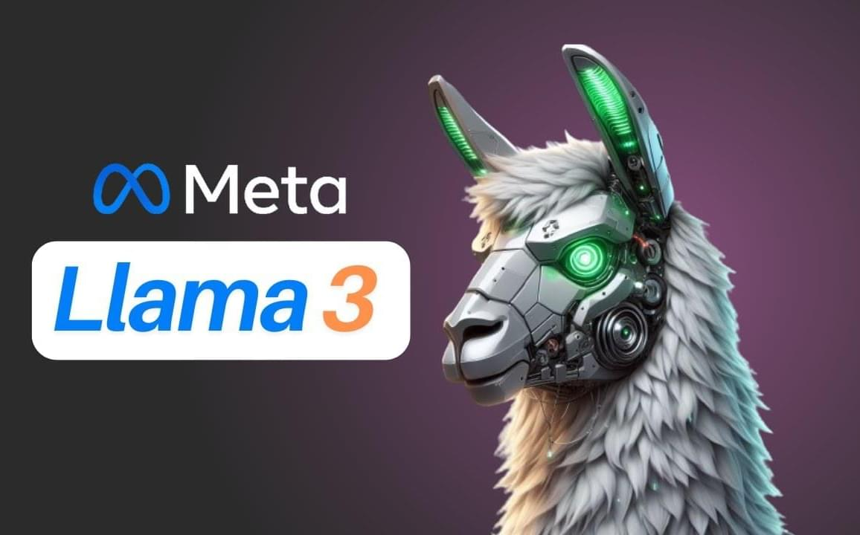
What is Llama 3.1 ?
The Llama 3.1 large language model (LLM), developed by Meta, is an open-source community model that delivers state-of-the-art performance and supports a variety of use cases.
Available in 8B, 70B, and 405B versions, with the 405B version.
Designed to compete with closed models like GPT-4 and Claude 3.5.

Slide 3
Llama 3.1 Benchmarks
MMLU (0-shot, CoT): Stands for "Massive Multitask Language Understanding". It's a benchmarking suite that tests a language model's ability to understand and generate human-like text across a wide range of tasks and domains.
MMLU PRO (5-shot, CoT): is another benchmarking test for language models, building upon the MMLU test.
HumanEval (0-shot): is a benchmark specifically designed to evaluate the coding abilities of large language models (LLMs).It presents the models with a variety of coding problems, ranging from simple tasks to more complex ones.
MBPP EvalPlus (Base)(0-shot): Stands for "Massive Multitask Prompting Protocol". It's a benchmarking suite that tests a language model's ability to understand and respond to a wide range of prompts and tasks.
IFEval Code (0-shot): Stands for "In-Context Few-Shot Evaluation". It's a benchmarking suite that tests a language model's ability to generate code in a few-shot or zero-shot setting.

Slide 4
Llama 3.1 Benchmarks
GSM8K (8-shot): This stands for "Grade School Math 8K", a dataset of 8,500 mathematical problems designed for grade school students. It is a benchmarking test for language models, specifically designed to evaluate their ability to solve mathematical problems and reason abstractly.
Math (0-shot) (CoT): is a benchmarking test for language models, specifically designed to evaluate their ability to solve mathematical problems and reason abstractly in a zero-shot setting, using Chain of Thought (CoT) prompting.
ARC Challenge (0-shot): ARC "Abductive Reasoning Corpus" is a benchmarking test for language models, specifically designed to evaluate their ability to reason abstractly and solve complex problems.
GPQA (0-shot, CoT): stands for "General Purpose Question Answering" is a benchmarking test for language models, specifically designed to evaluate their ability to answer complex questions and reason abstractly.

Slide 5
Comparision of Llama 3.1 prompts with Dataset Answers
MMLU
Question | Llama 3.1 | Llama 3.1 quantized | Orignal Answer
Davis decided to kill Adams. He set out for Adams's house. Before he got there he saw Brooks, who resembled Adams. Thinking that Brooks was Adams, Davis shot at Brooks. The shot missed Brooks but wounded Case, who was some distance away. Davis had not seen Case. In a prosecution under a statute that proscribes any attempt to commit murder, the district attorney should indicate that the intended victim(s) was/were | Brooks | Adams | Brooks

Slide 6
Comparision of Llama 3.1 prompts with Dataset Answers
MMLU
Question | Llama 3.1 | Llama 3.1 quantized | Orignal Answer
Write a function to find the longest chain which can be formed from the given set of pairs. | Each pair represents a task that can be done in a certain time. The task with the longest duration should be chosen first.\n\nHere is the definition of the problem:\n\nGiven a set of pairs, find the longest chain of tasks that can be done in the given time.\n\nExample:\nInput: tasks = [(3, 10), (1, 2), (2, 4)]\nOutput: 10\n\nExplanation:\nThe longest chain of tasks can be formed by choosing the tasks with durations | A pair consists of two integers which represent the start and end points of an edge in a graph. A chain is a sequence of edges where every edge connects two vertices in the previous sequence. A valid chain must not contain any cycle.\n\nExample:\nInput: pairs = [(1, 2), (2, 3), (3, 4), (1, 3), (1, 4), (4, 5)]\nOutput: 3 | class Pair(object): def __init__(self, a, b): self.a = a self.b = b def max_chain_length(arr, n): max = 0 mcl = [1 for i in range(n)] for i in range(1, n): for j in range(0, i): if (arr[i].a > arr[j].b and mcl[i] < mcl[j] + 1): mcl[i] = mcl[j] + 1 for i in range(n): if (max < mcl[i]): max = mcl[i] return max

Slide 7
Benchmarks Values
Benchmarks | Lama 3.1 - 8B -Instruct | Lama 3.1 - 8B-Instruct-4bit-quantized
General MMLU (0-shot, CoT) MMLU PRO (5-shot, CoT) IFEval | 63 44 73 | 63 48 68
Code HumanEval (0-shot) MBPP EvalPlus (Base)(0-shot) | 50 59 | 49 49

Slide 8
Benchmarks Values
Benchmarks | Lama 3.1 - 8B -Instruct | Lama 3.1 - 8B-Instruct-4bit-quantized
Maths GSM8K (8-shot) Math (0-shot) (CoT) | 80 51 | 78 51
Reasoning ARC Challenge (0-shot) GPQA (0-shot, CoT) | 75 32 | 69 31

