Slide 1
Assignment 4 Writeup
Name: Rafayel Veziryan

Slide 2
Table 1
Seq2Seq Results
Put your results from training before and after hyperparameter tuning here.
Results for default configuration using RNN |  | Results for default Configuration Using LSTM
Training Loss | 4.6057 | Training Loss | 4.3546
Training Perplexity | 100.052 | Training Perplexity | 77.8356
Validation Loss | 4.5238 | Validation Loss | 4.2345
Validation Perplexity | 92.186 | Validation Perplexity | 69.0297
Result for your Best Model using RNN after hyperparameter tuning |  | Resut for your Best Model using LSTM after hyperparameter tuning
Training Loss | 4.04 | Training Loss | 4.01
Training Perplexity | 56.9 | Training Perplexity | 55.45
Validation Loss | 4.21 | Validation Loss | 4.2
Validation Perplexity | 67.48 | Validation Perplexity | 67
Your best model configuration for RNN after hyperparameter tuning |  | Your best model configuration for LSTM after hyperparameter tuning
Batch size = 64, LR = 0.001, OR Epochs = 100 |  | Batch size = 64, LR = 0.001, Epochs = 100

Slide 3
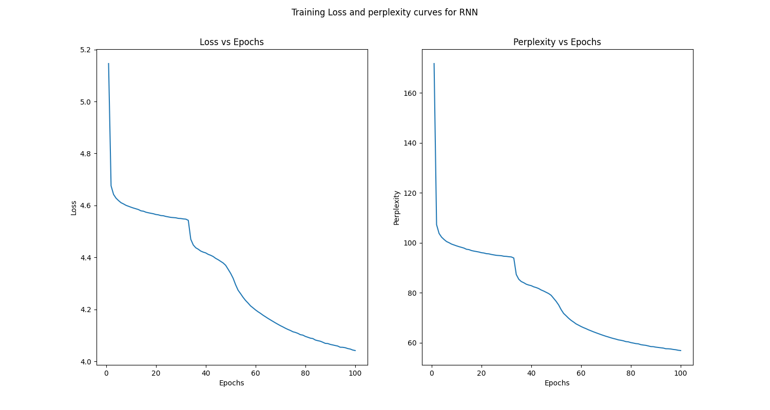
Seq2Seq Curves
Put the plots for loss and perplexity curves (training & validation) for your configuration with default setting and for your best model here. Use additional slides as necessary.

Slide 4
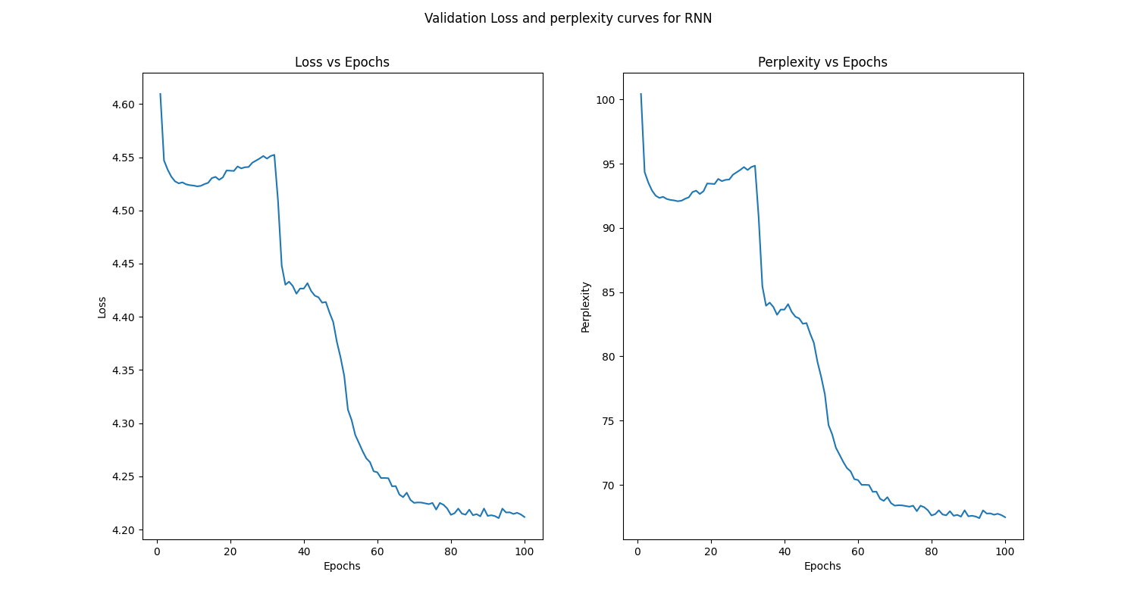
RNN Validation loss and perplexity curves

Slide 5
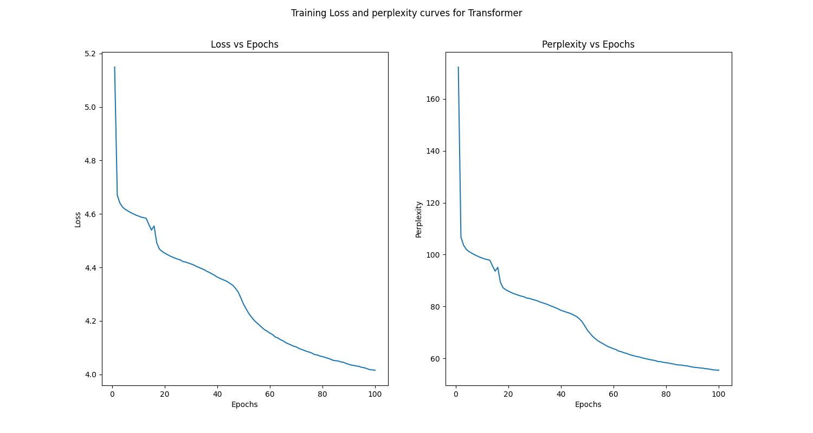
LSTM training loss and perplexity curves

Slide 6
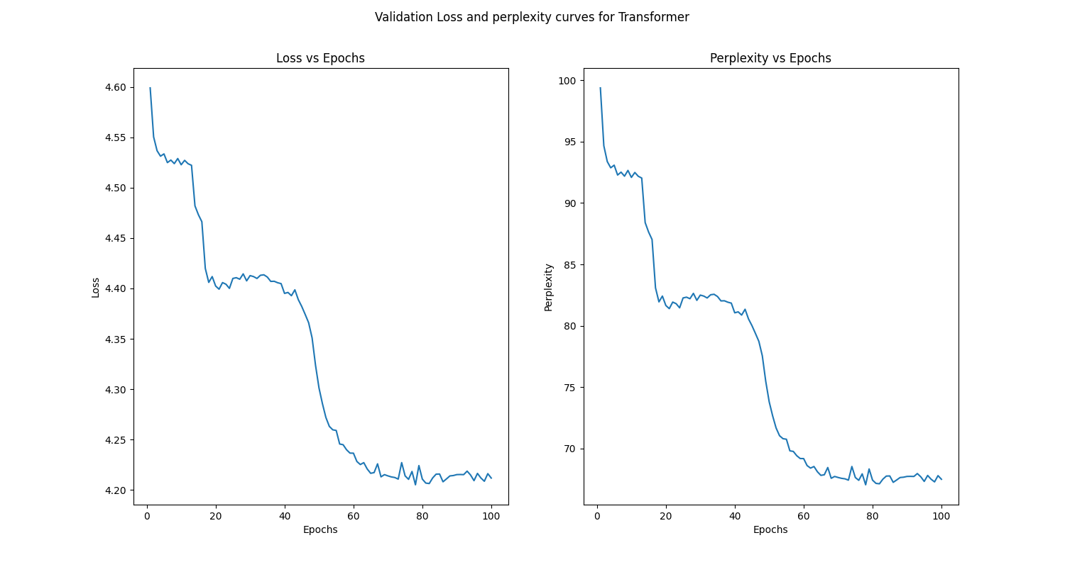
LSTM validation loss and perplexity curves

Slide 7
Seq2Seq Explanation
Explain what you did here and why you did it to improve your model performance. Compare and explain the differences when using LSTM vs RNN. You may use another slide if needed.
I implemented seq2seq model with RNN and LSTM cells. During model improvement used grid search method for finding better hyperparameters such as learning rate, batch size and number of epochs, to affect model efficiency, we also can experiment taking new optimizer and learning rate scheduler, we should research which optimizer and learning rate scheduler can match with our task. The first obvious difference between RNN and LSTM is RNN has simple recurrent connection to itself, while LSTM has more complex architecture with input, forgot and ouptut gates. RNNs have fewer parameters as compared with LSTM. Using LSTM we can take much more information thanks to their architecture and more parameters.

Slide 8
Transformer Results
Table 2
Put your results from training before and after hyperparameter tuning here.
Results for default configuration with sine/cosine encoding
Training Loss | 8.3351 | Validation Loss | 8.4074
Training Perplexity | 4167.62 | Validation Perplexity | 4473.809
Result for your Best Model
Training Loss | 8.232 | Validation Loss | 8.37
Training Perplexity | 3760.43 | Validation Perplexity | 4323
Your best model configuration after hyperparameter tuning
Batch size = 32, learning rate = 0.001, epoch number = 100

Slide 9
Results for default configuration with learnable positional encoding
Training Loss | 8.3347 | Validation Loss | 8.411
Training Perplexity | 4165.9118 | Validation Perplexity | 4496.3348

Slide 10
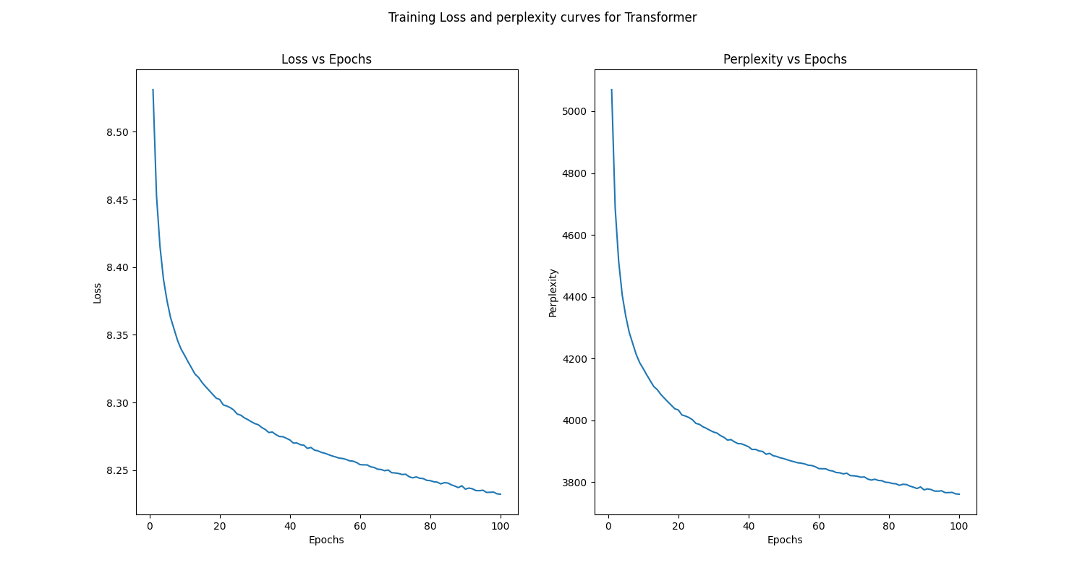
Transformer Curves
Put the plots for loss and perplexity curves (training & validation) for your configuration with default setting and for your best model here. You may use additional slides if needed.

Slide 11
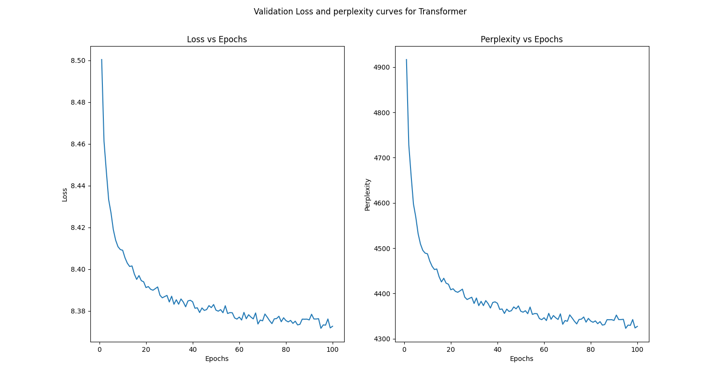

Slide 12
Transformer Explanation
Explain what you did here and why you did it to improve your model performance. You may use another slide if needed.
I implemented transformer encoder block with sine/cosine and learnable positional encoding for machine translation task. For this model I also used grid search method to find much better hyperparameters such as batch size, learning rate and number of epochs. To improve model efficiency we also can modify optimizer and learning rate scheduler.

Slide 13
Transformer Translation Results
Table 3
Put translation results for your best model (1st 9 sentences) here
Input sentence | Back translation
'<sos>' 'a' 'man' 'cooking' 'burgers' 'on' 'a' 'black' 'grill' '.' <eos>' '<pad>' '<pad>' '<pad>' '<pad>' '<pad>' '<pad>' '<pad>' '<pad>' '<pad>' | 'man' 'guy' 'cake' 'sheet' 'sheet' 'cooking' 'leaning' 'leans' 'red' 'big' 'grill' 'black' 'grill' 'tree' 'black' 'black' '.' 'black' '<eos>' 'a'
'<sos>' 'a' 'man' 'and' 'woman' 'fishing' 'at' 'the' 'beach' '.''<eos>' '<pad>' '<pad>' '<pad>' '<pad>' '<pad>' '<pad>' '<pad>' '<pad>''<pad>' | 'man' 'and' 'and' 'glasses' 'wife' 'woman' 'fishing' 'fishing' 'at' 'at' 'beach' 'beach' 'beach' 'beach' 'beach' 'beach' 'beach' 'beach' 'beach' 'beach'
'<sos>' 'a' 'man' 'in' 'a' 'harness' 'climbing' 'a' 'rock' 'wall' '<eos>' '<pad>' '<pad>' '<pad>' '<pad>' '<pad>' '<pad>' '<pad>' '<pad>''<pad>' | 'man' 'machine' 'hole' 'machine' 'rock' 'climbing' 'climbing' 'climbing' 'climbing' 'wall' 'face' 'stone' 'wall' 'wall' 'rock' 'rock' 'wall' 'wall' 'stone' 'rock'
'<sos>' 'a' 'cute' 'baby' 'is' 'smiling' 'at' 'another' 'child' '.' '<eos>' '<pad>' '<pad>' '<pad>' '<pad>' '<pad>' '<pad>' '<pad>' '<pad>' <pad>' | 'another' 'another' 'friend' 'baby' 'smiling' 'smiles' 'another' 'child' 'who' 'child' 'child' 'child' 'child' 'child' 'child' 'another' 'another' 'another' 'another' 'another'
'<sos>' 'a' 'female' 'playing' 'a' 'song' 'on' 'her' 'violin' '.' '<eos>' '<pad>' '<pad>' '<pad>' '<pad>' '<pad>' '<pad>' '<pad>' '<pad>' '<pad>' | 'female' 'happy' 'sniffing' 'plays' 'plays' 'song' 'sand' 'her' 'violin' 'violin' 'violin' 'violin' 'violin' 'her' 'her' 'her' 'her' 'her' 'her' 'her'
'<sos>' 'a' 'person' 'on' 'a' 'snowmobile' 'in' 'mid' 'jump' '.' '<eos>' '<pad>' '<pad>' '<pad>' '<pad>' '<pad>' '<pad>' '<pad>' '<pad>' '<pad>' | 'person' 'person' 'bed' 'onto' 'bicycle' 'bicycle' 'mid' 'middle' 'jump' 'middle' 'jump' 'jump' 'the' 'the' 'the' 'them' 'grass' 'jump' 'them' 'middle'
'<sos>' 'three' 'men' 'competing' 'in' 'a' 'hurdle' 'race' '.' '<eos>' '<pad>' '<pad>' '<pad>' '<pad>' '<pad>' '<pad>' '<pad>' '<pad>' '<pad>' '<pad>' | 'men' '3' '3' 'perform' 'competing' 'competing' 'race' 'well' 'competing' 'competing' 'match' 'match' 'match' 'other' 'other' 'match' 'match' 'at' 'match' 'other'
'<sos>' 'people' 'play' 'in' 'a' 'fountain' 'at' 'twilight' '.' '<eos>' '<pad>' '<pad>' '<pad>' '<pad>' '<pad>' '<pad>' '<pad>' '<pad>' '<pad>' '<pad>' | 'people' 'fountain' 'playing' 'shorts' 'surfing' 'surfing' 'shaving' 'in' 'fountain' 'fountain' 'fountain' 'fountain' 'a' 'fountain' 'fountain' 'in' '.' '.' '<eos>' 'the'
'<sos>' 'the' 'three' 'children' 'are' 'in' 'a' 'cage' '.' '<eos>' '<pad>' '<pad>' '<pad>' '<pad>' '<pad>' '<pad>' '<pad>' '<pad>' '<pad>' '<pad>' | 'that' 'bucket' 'three' 'three' 'children' 'rustic' 'inside' 'inside' 'inside' 'booth' 'room' 'inside' 'inside' 'inside' 'inside' 'room' 'watching' '<eos>' '<eos>' 'market'

Slide 14
LSTM Translation Results
Table 4
Put translation results for your best model (1st 9 sentences) here
Input sentence | Back translation
‘'<sos>' 'a' 'man' 'cooking' 'burgers' 'on' 'a' 'black' 'grill' '.' '<eos>' '<pad>' '<pad>' '<pad>' '<pad>' '<pad>' '<pad>' '<pad>' '<pad>' '<pad>' | '<sos>' 'a' 'man' 'is' 'a' 'a' '<unk>' 'a' 'a' '.' '.' '<eos>' '<eos>' '<eos>' '<eos>' '<eos>' '<eos>' '<eos>' '<eos>' '<eos>'
'<sos>' 'a' 'man' 'and' 'woman' 'fishing' 'at' 'the' 'beach' '.''<eos>' '<pad>' '<pad>' '<pad>' '<pad>' '<pad>' '<pad>' '<pad>' '<pad>''<pad>' | '<sos>' 'a' 'man' 'and' 'a' 'are' 'are' 'on' 'the' '.' '<eos>' '<eos>' '<eos>' '<eos>' '<eos>' '<eos>' '<eos>' '<eos>' '<eos>' '<eos>'
'<sos>' 'a' 'man' 'in' 'a' 'harness' 'climbing' 'a' 'rock' 'wall' '<eos>' '<pad>' '<pad>' '<pad>' '<pad>' '<pad>' '<pad>' '<pad>' '<pad>''<pad>' | '<sos>' 'man' 'man' 'in' 'climbing' 'climbing' 'climbing' 'a' 'rock' '.' '<eos>' '<eos>' '<eos>' '<eos>' '<eos>' '<eos>' '<eos>' '<eos>' '<eos>' '<eos>'
'<sos>' 'a' 'cute' 'baby' 'is' 'smiling' 'at' 'another' 'child' '.' '<eos>' '<pad>' '<pad>' '<pad>' '<pad>' '<pad>' '<pad>' '<pad>' '<pad>' <pad>' | '<sos>' 'a' 'smiling' 'baby' 'is' 'a' 'a' 'a' '.' '.' '<eos>' '<eos>' '<eos>' '<eos>' '<eos>' '<eos>' '<eos>' '<eos>' '<eos>' '<eos>'
'<sos>' 'a' 'female' 'playing' 'a' 'song' 'on' 'her' 'violin' '.' '<eos>' '<pad>' '<pad>' '<pad>' '<pad>' '<pad>' '<pad>' '<pad>' '<pad>' '<pad>' | '<sos>' 'a' 'woman' 'playing' 'a' 'guitar' 'guitar' 'a' 'the' '.' '<eos>' '<eos>' '<eos>' '<eos>' '<eos>' '<eos>' '<eos>' '<eos>' '<eos>' '<eos>'
'<sos>' 'a' 'person' 'on' 'a' 'snowmobile' 'in' 'mid' 'jump' '.' '<eos>' '<pad>' '<pad>' '<pad>' '<pad>' '<pad>' '<pad>' '<pad>' '<pad>' '<pad>' | '<sos>' 'a' 'person' 'on' 'a' 'a' 'a' 'a' 'a' 'a' 'a' 'a' '.' '.' '<eos>' '<eos>' '<eos>' '<eos>' '<eos>' '<eos>'
'<sos>' 'three' 'men' 'competing' 'in' 'a' 'hurdle' 'race' '.' '<eos>' '<pad>' '<pad>' '<pad>' '<pad>' '<pad>' '<pad>' '<pad>' '<pad>' '<pad>' '<pad>' | '<sos>' 'three' 'men' 'are' 'a' 'on' 'a' 'a' '.' '.' '<eos>' '<eos>' '<eos>' '<eos>' '<eos>' '<eos>' '<eos>' '<eos>' '<eos>' '<eos>'
'<sos>' 'people' 'play' 'in' 'a' 'fountain' 'at' 'twilight' '.' '<eos>' '<pad>' '<pad>' '<pad>' '<pad>' '<pad>' '<pad>' '<pad>' '<pad>' '<pad>' '<pad>' | '<sos>' 'people' 'are' 'in' 'in' 'a' 'in' 'a' '.' '.' '<eos>' '<eos>' '<eos>' '<eos>' '<eos>' '<eos>' '<eos>' '<eos>' '<eos>' '<eos>'
'<sos>' 'the' 'three' 'children' 'are' 'in' 'a' 'cage' '.' '<eos>' '<pad>' '<pad>' '<pad>' '<pad>' '<pad>' '<pad>' '<pad>' '<pad>' '<pad>' '<pad>' | '<sos>' 'four' 'young' 'are' 'are' 'in' 'a' '.' '.' '<eos>' '<eos>' '<eos>' '<eos>' '<eos>' '<eos>' '<eos>' '<eos>' '<eos>' '<eos>' '<eos>'

Slide 15
Compare LSTM to Transformer
Compare your LSTM results to your Transformer Results both quantitatively and qualitatively and explain the differences.
Surprisingly, from LSTM and Transformer results appears that LSTM works much better than Transformer. This phenomenon also considered for such examples, which are introduced in last slides. Validation loss for Transformer is 8.37 with two times more as compared with LSTM. This mean, we have to find problems, because Transformer has much more deeper architecture and parameters than LSTM.
Best results model parameters saved in Drive

Slide 16
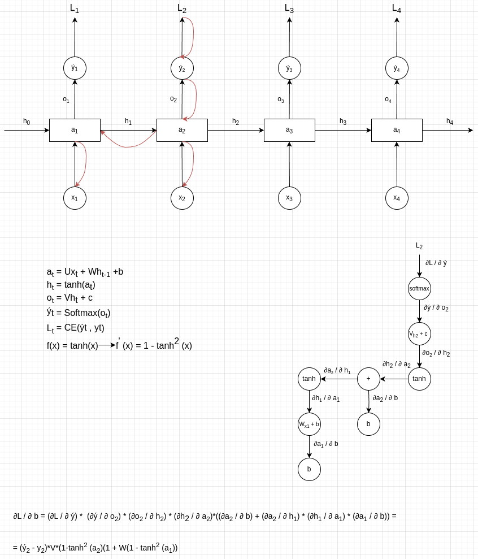
Theory question
Add additional slides as necessary for your answer
This file is attached with other files, called diagram_L2_backprop_drawio_Rafayel_Veziryan.pdf

