Slide 1

Hashing Functions in Cryptography

Slide 2


What is Cryptography?
It is an art of Hiding and Solving codes.
Method to send secret messages to other location without the acknowledgment of third person.

Slide 3

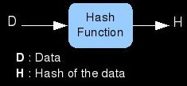
What is Hashing?
Hashing carried out in a Hash function.
Transformation of string into a shorter fixed length value.

Slide 4
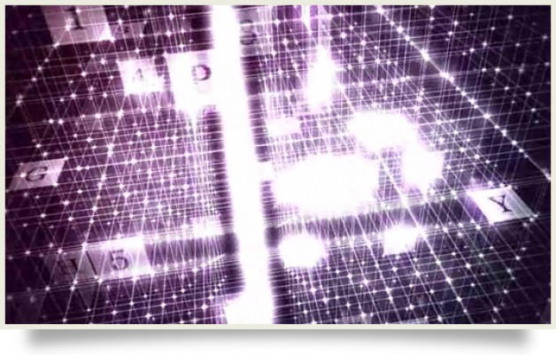
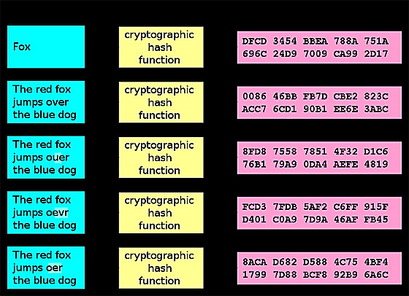
Why Hashing?
Single Change alters and changes the entire hash.
Hash bit always remains constant.

Slide 5
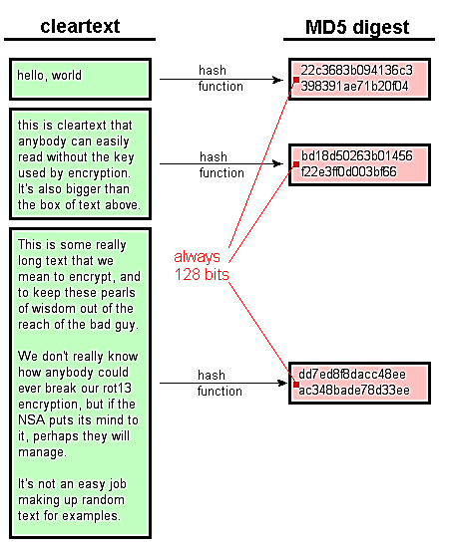

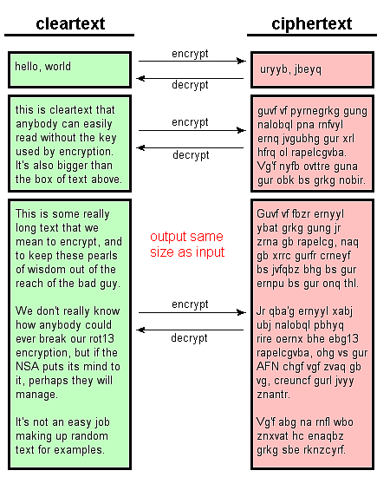
Some Common Misconceptions:-
Encryption VS Hashing:-
1. Encryption is a two way operation.
2. Hashing is a one way operation.

Slide 6

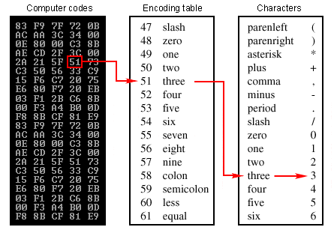
Encryption versus Encoding
Encryption turned the information into more disguised and unintelligible form
Encoding is a way to format data so that it’s manipulation, transmission and storage made efficient to electronic devices, storage devices and application software's.

Slide 7

Digital Signature
Digital Signature is the method to verify the text and its sender.
It is the equivalent of handwritten signature but has secure integration and efficient transfer properties.
It is widely used in application software’s and in mailing system.

Slide 8

Why do we need Digital Signature?
Integration
Authentication
Non-Repudiation
Low cost
Efficient
Digitalized
Completely Secure??

Slide 9
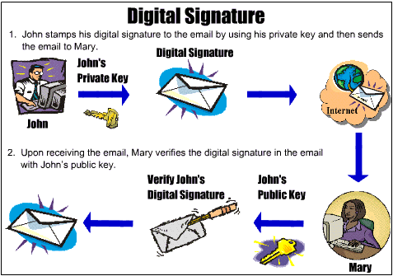
Digital Signature Algorithm

Slide 10
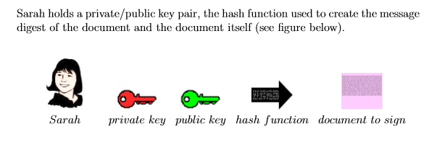
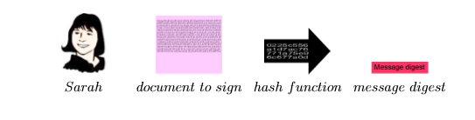

Slide 11
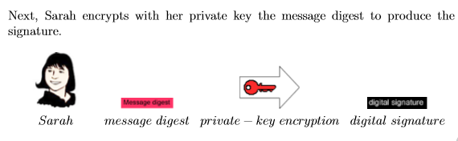
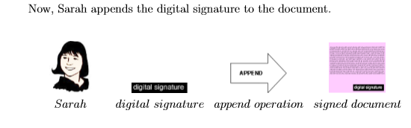

Slide 12
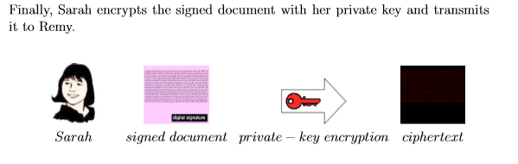
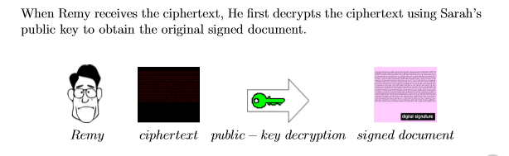

Slide 13
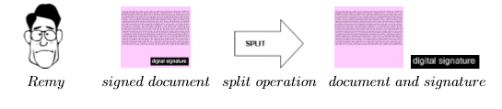
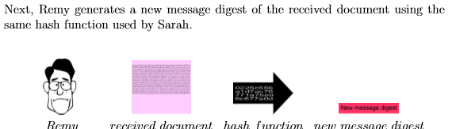
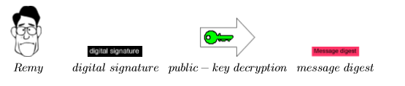

Slide 14

Flaw in Digital Signature
Date and Time has not been considered as the valuable aspect.
Digital Signature doesn’t authorize and tells the receiver as to when the document had been Signed by the Sender.
This could lead to great misconceptions on receiver's end.

Slide 15
C++ Implementation

