Slide 1

FINAL YEAR PROJECT
AICC
An AI Campus Companion for Academic Assistance
and Campus Navigation
Department of Computer Science
Lahore Garrison University
Session 2023–2026
Submitted by Abdul
Supervised by ________________
Chapters 1–9 of the final documentation

Slide 2
CONTENTS
Chapters of the documentation
01
Chapter 1
06
Chapter 6
Introduction
Detailed Design and Architecture
02
Chapter 2
07
Chapter 7
Literature Review
Implementation and Testing
03
Chapter 3
08
Chapter 8
Problem Definition
Results and Discussion
04
Chapter 4
09
Chapter 9
Software Requirement Specification
Conclusion and Future Work
05
Chapter 5
Methodology
AICC · Lahore Garrison University · 2 / 20

Slide 3
CHAPTER 1 · INTRODUCTION
What the companion is for
Orientation
AIM
A public map reaches the gate. It does not know the walk to the library or Classroom B-104.
Answer from maintained data, show the place when one exists, and walk the university’s own paths.
Trustworthy answers
A general chatbot can sound sure about a room, a fee, or a mark that was never stored.
Place lookup and personal records keep working when the language model is down.
One place to start
Challans, rules, teachers, and routes should begin from the same signed-in companion.
AICC · Lahore Garrison University · 3 / 20

Slide 4
CHAPTER 1 · INTRODUCTION
Objectives and scope
• Show CGPA, courses, attendance, fee challans, and roll slips from the student record.
• Resolve a place from the maintained list, including aliases, before any model is called.
• Answer handbook questions only after passages are retrieved.
• Refuse what the handbook does not contain. Never invent a mark or a coordinate.
• Route outdoors with Dijkstra, and hand city roads to Google Maps.
• Route indoors with A*, including stairs and the lift, from a QR code or a chosen start.
• Let an administrator edit people, places, and indoor areas without an application update.
Outside this delivery
• Live bus tracking
• Hostel booking
• Course registration itself
• A surveyed GPS-error log
• Official architectural sheets
AICC · Lahore Garrison University · 4 / 20

Slide 5
CHAPTER 2 · LITERATURE REVIEW
What was adopted, and what was not
Retrieval-augmented generation
BM25 and embeddings
Lewis et al. Phrase a rule only after the passage is retrieved.
Robertson and Zaragoza. Rank the handbook. Do not search the open web.
Dijkstra
A*
Non-negative walkway costs. The right search for the outdoor graph.
Hart, Nilsson, and Raphael. Straight-line distance is a safe indoor heuristic.
Indoor positioning surveys
QR at a door or stair
Radio maps work, and they need a survey. GPS indoors was rejected.
A start the student can see. Not a fingerprint of the corridor.
AICC · Lahore Garrison University · 5 / 20

Slide 6
CHAPTER 3 · PROBLEM DEFINITION
The gap this system closes
A student who needs a place, a rule, or a document must assemble the answer from sources that do not know about each other.
01
02
03
04
No shared place
No guard on the model
No campus graph
No edit path
A sentence and a map pin are not the same record.
Nothing stops a fluent sentence from containing a CGPA.
Internal walkways, stairs, and lifts are unpublished.
A changed hour should not require a new application build.
Success means a stored card, a stored rule, a path on authored edges, and a refusal when nothing is stored.
A blank GPS-error cell is not treated as a pass.
AICC · Lahore Garrison University · 6 / 20

Slide 7
CHAPTER 4 · SOFTWARE REQUIREMENT SPECIFICATION
Users and the requirements that matter
Student
Administrator
Reads their own record, asks questions, follows routes, and opens notices. Cannot publish a place or see the model key.
Maintains students, teachers, places, indoor areas, and broadcasts. Signs into a separate shell.
Functional highlights
Qualities
• FR-06 Place match prefers the longer name.
• FR-08 Open questions go to the handbook first.
• FR-15 On-campus route uses the published graph.
• FR-19 Indoor route can change floor by stairs or lift.
• NFR-01 Facts come from a store, not from model text.
• NFR-02 The Groq key stays on the server.
• NFR-10 A missing length is marked estimated.
AICC · Lahore Garrison University · 7 / 20

Slide 8
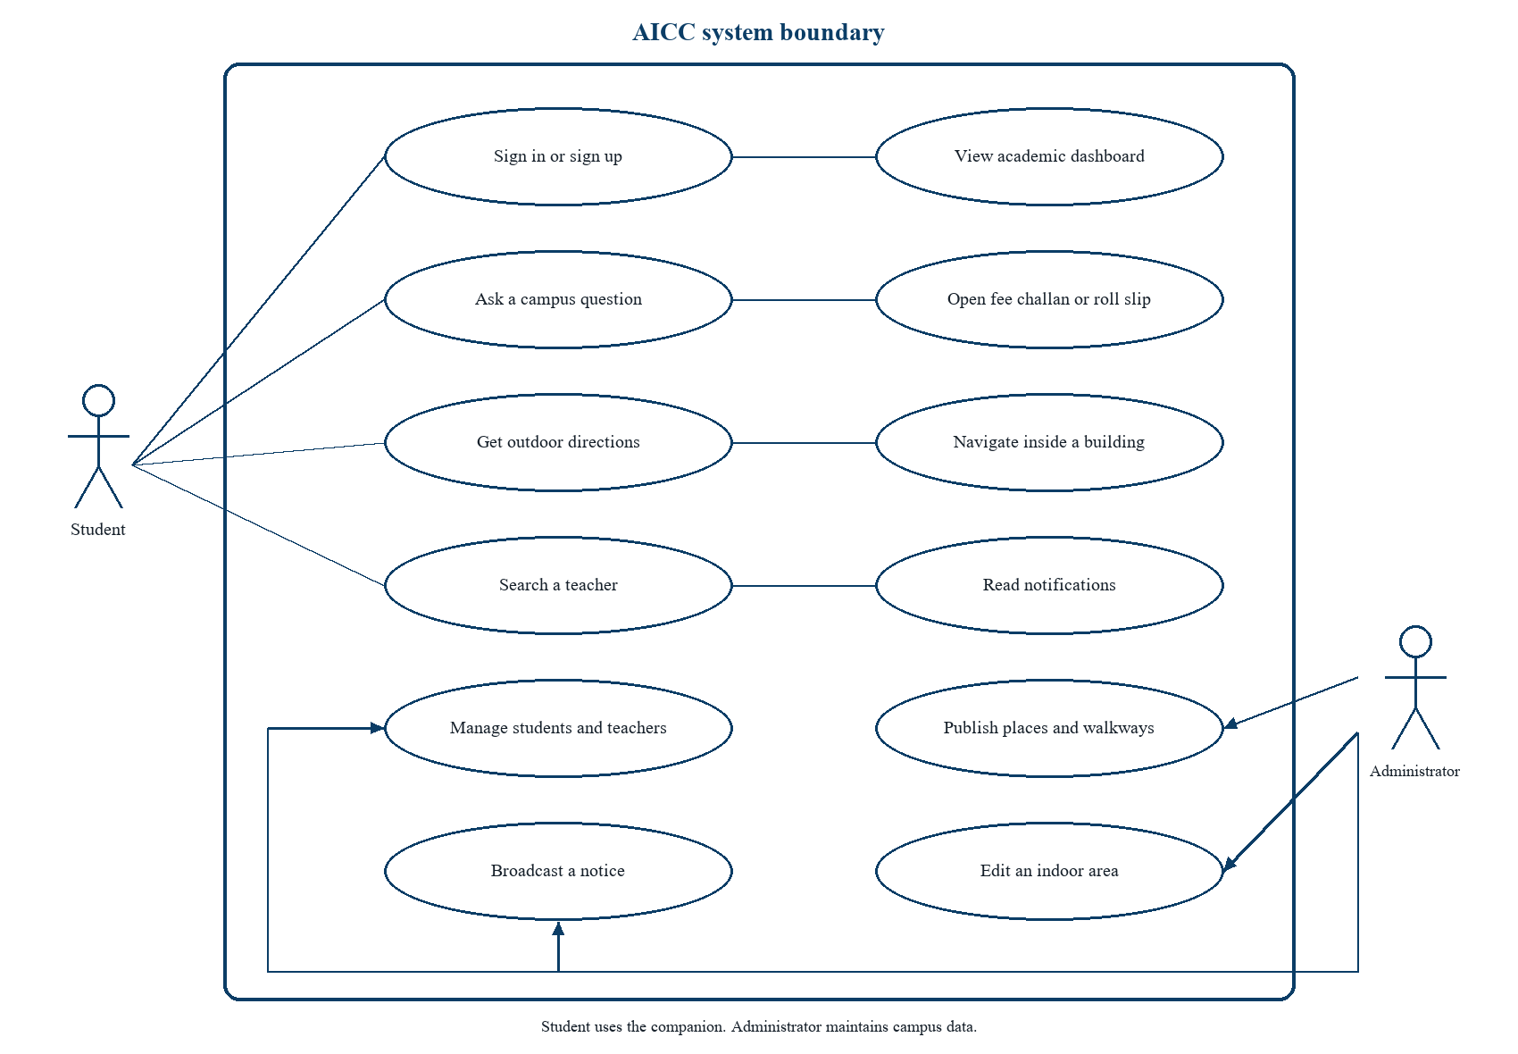
CHAPTER 4 · SOFTWARE REQUIREMENT SPECIFICATION
Use cases
• UC-04 Ask where a place is.
• UC-05 Ask a handbook rule.
• UC-08 Walk on campus, or hand off outside it.
• UC-09 Walk inside Block B.
• UC-13 An administrator publishes a place.
AICC · Lahore Garrison University · 8 / 20

Slide 9
CHAPTER 5 · METHODOLOGY
Lookup before generation
1
2
3
Normalise
Classify
Match a place
Trim, lowercase, and collapse spaces.
Greeting, document, academics, faculty, or place.
Aliases and the longer name win on the phone.
4
5
6
Retrieve
Phrase
Attach a card
BM25 plus embeddings over the handbook.
Groq may speak only the retrieved passages.
Only if that passage already has a place id.
AICC · Lahore Garrison University · 9 / 20

Slide 10
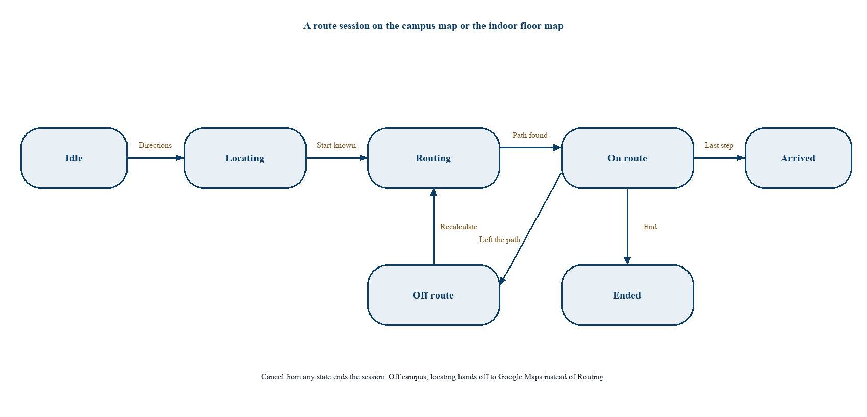
CHAPTER 5 · METHODOLOGY
Two graphs, two searches
Outdoors · Dijkstra
• Published nodes and walkways only.
• Missing length uses 25 metres and marks the route estimated.
• No straight line across buildings.
• Outside the campus outline, open Google Maps toward a gate.
Indoors · A*
A route session moves from Idle to Locating, Routing, On route, and Arrived. Leaving the path recalculates.
Stairs 12 per floor. Lift 8. Preferring stairs adds 40 to each lift. A zero heuristic is Dijkstra, kept for tests.
AICC · Lahore Garrison University · 10 / 20

Slide 11
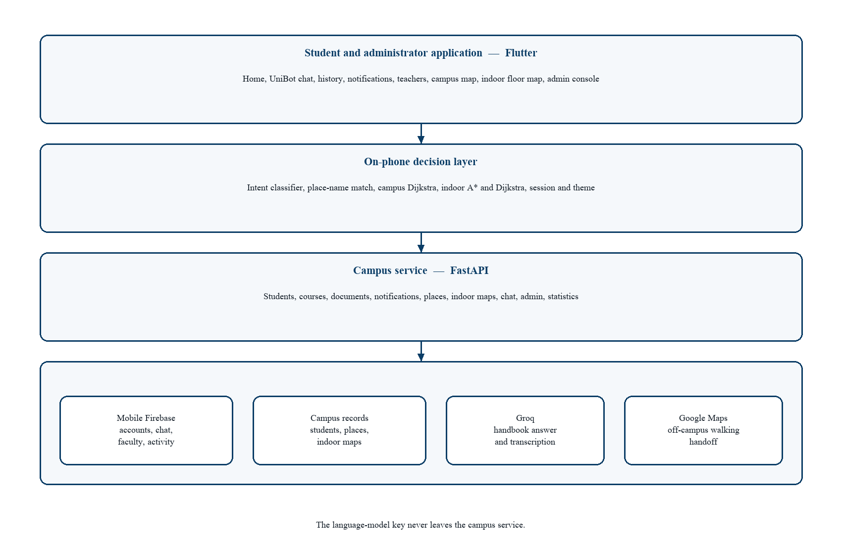
CHAPTER 6 · DETAILED DESIGN AND ARCHITECTURE
System architecture
• The phone decides the tap, the place, and the path.
• The service decides which passage may be spoken.
• The stores decide what is true.
• The model is not a store.
• The key never ships inside the application.
AICC · Lahore Garrison University · 11 / 20

Slide 12
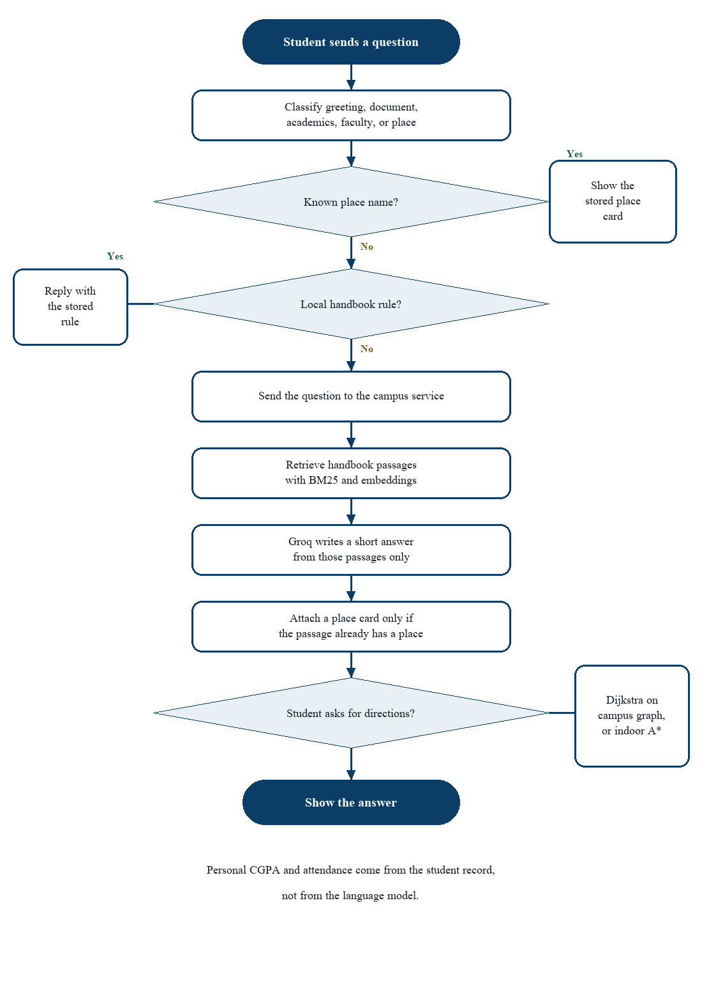
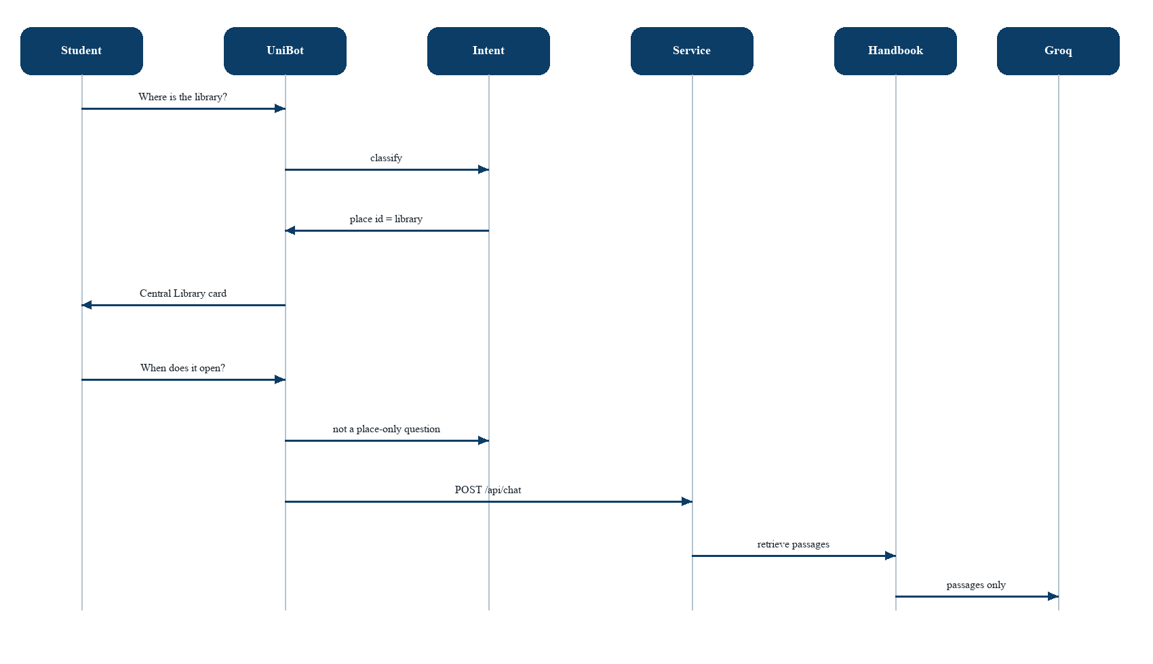
CHAPTER 6 · DETAILED DESIGN AND ARCHITECTURE
One question, then a route
Activity of a question, and the sequence when “library” is a place and the next turn asks for hours.
AICC · Lahore Garrison University · 12 / 20

Slide 13
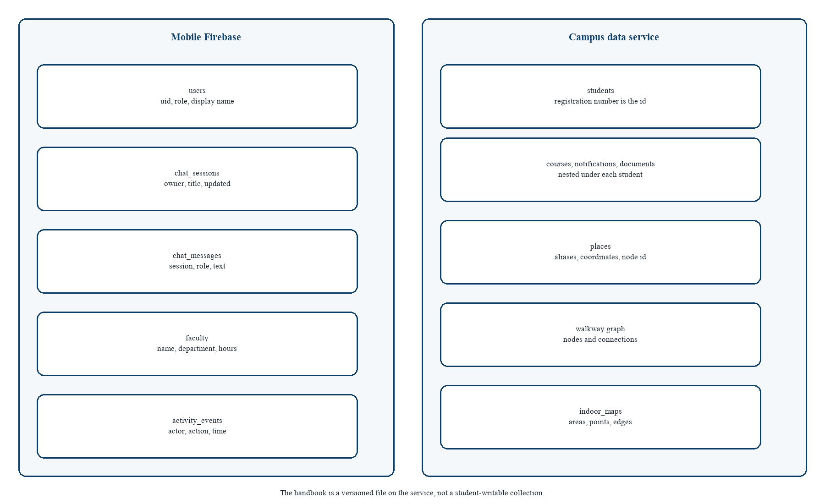
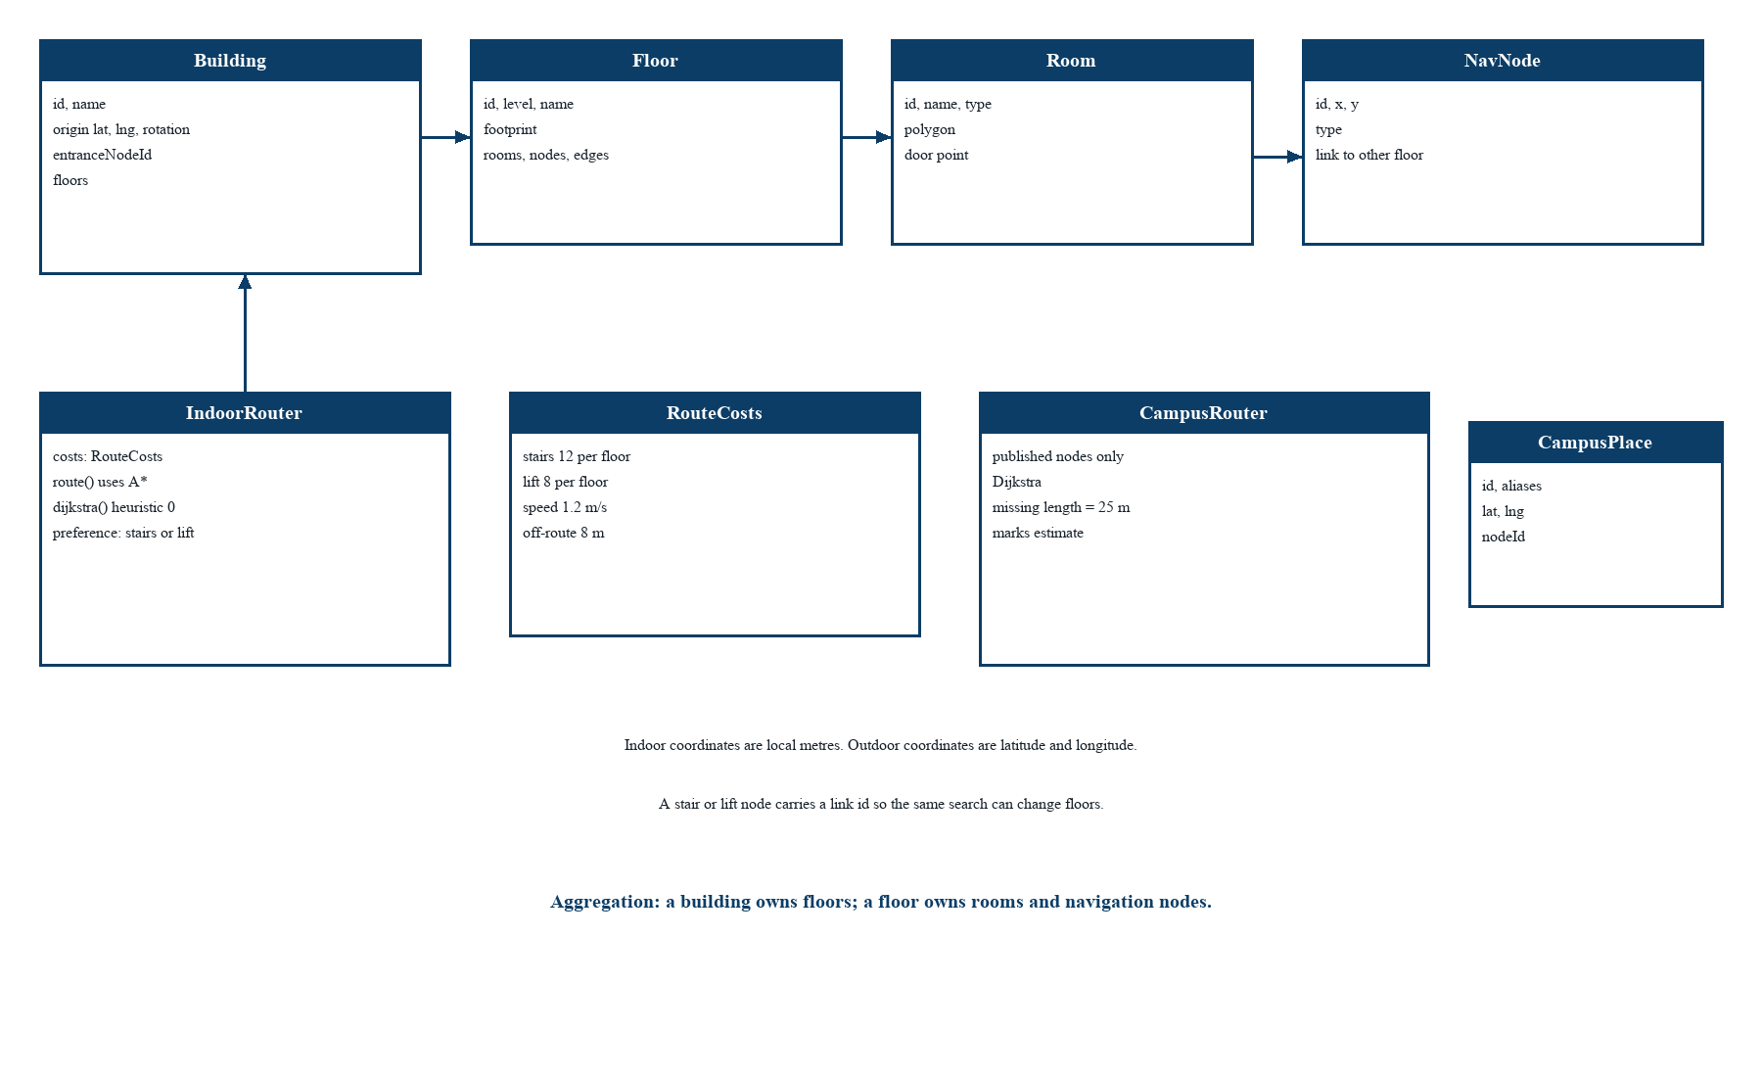
CHAPTER 6 · DETAILED DESIGN AND ARCHITECTURE
Records and the navigation model
Mobile Firebase holds accounts, chat, faculty, and activity. The campus service holds students, places, the walkway graph, and indoor maps. The handbook is a file, not a student-writable collection.
AICC · Lahore Garrison University · 13 / 20

Slide 14
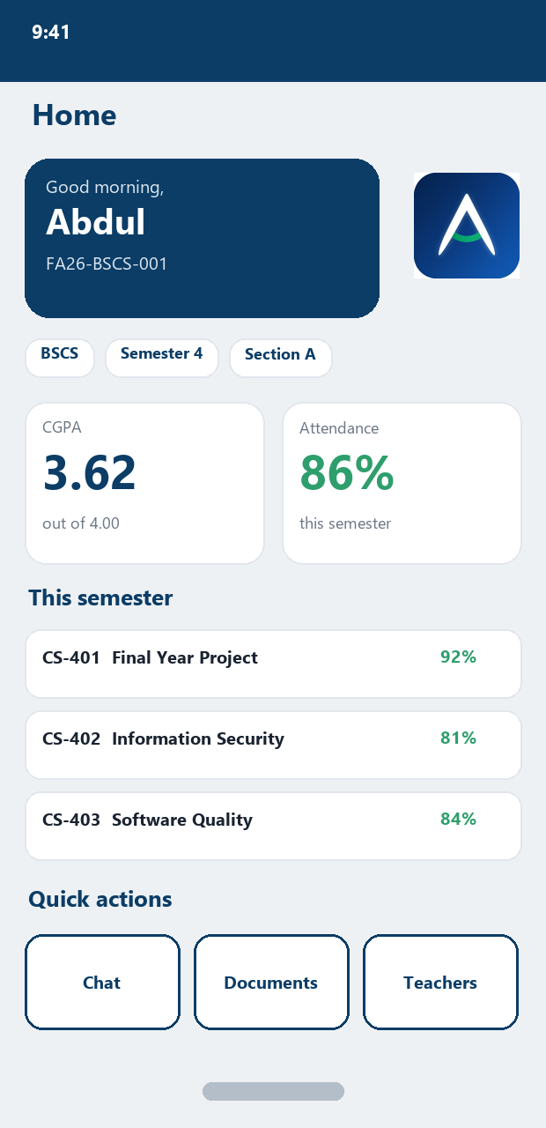
CHAPTER 7 · IMPLEMENTATION AND TESTING
Student home
The signed-in home
• Welcome card uses the stored name and registration number.
• CGPA is the value on the student row. It is not recalculated.
• Attendance is the average of this semester’s courses.
• Quick actions open chat, documents, and teachers.
• The drawer also reaches history, notices, and indoor navigation.
• Loading, empty, and error states replace a blank screen.
AICC · Lahore Garrison University · 14 / 20

Slide 15
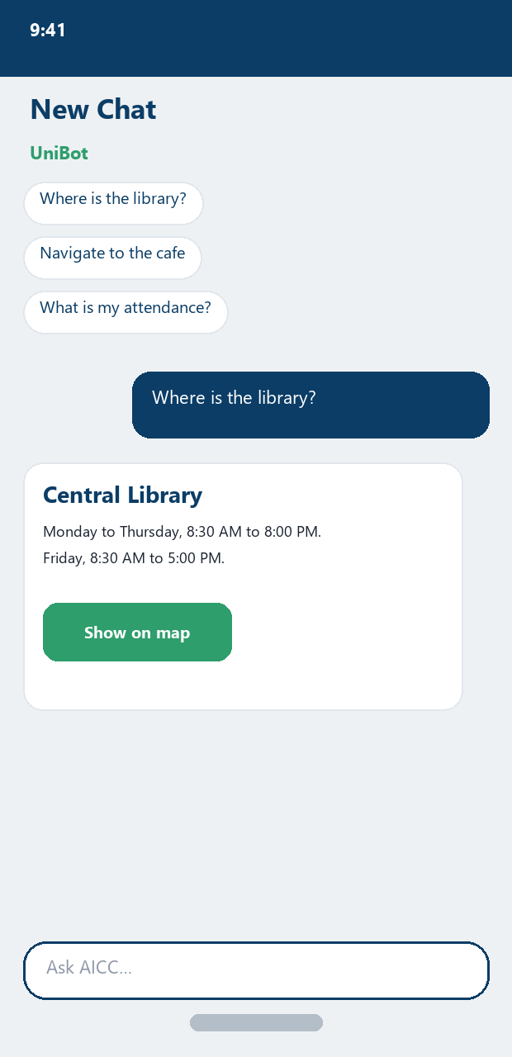
CHAPTER 7 · IMPLEMENTATION AND TESTING
UniBot
A place is a card, not a guess
• “Where is the library?” matches Central Library on the phone.
• Hours are a handbook answer. The card is attached because the passage is tagged.
• “Who won the cricket world cup?” is refused. No place card.
• Voice is transcribed on the server, then run through the same classifier.
• The reply can be spoken. The model key stays on the server.
• History can replay or delete a session.
AICC · Lahore Garrison University · 15 / 20

Slide 16
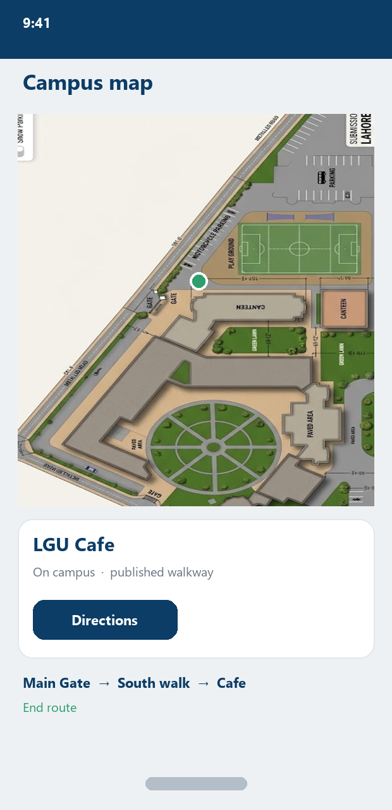
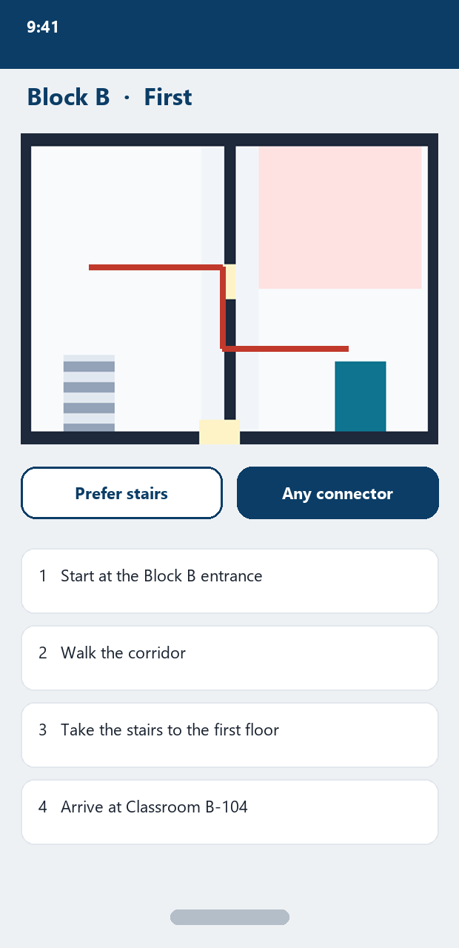
CHAPTER 7 · IMPLEMENTATION AND TESTING
Campus map and indoor floor
• The outdoor line is the Dijkstra node list.
• The site drawing under the pin is the packaged campus plan.
• Block B shows the first-floor drawing and the step list.
• Prefer stairs changes a cost. It does not delete the lift.
• A QR code can set the start when GPS is on the wrong side of a wall.
AICC · Lahore Garrison University · 16 / 20

Slide 17
CHAPTER 8 · RESULTS AND DISCUSSION
Chatbot checks
LGU
Where is LGU cafe
Main campus card
Longer name wins
Navigate to canteen
Library kahan hai
Cafe alias
Central Library
Where can I eat lunch?
When does the library open?
Text plus the cafe card
Hours, not a route
Who won the cricket world cup?
Admin drops a pin
Refusal, no card
Visible after save
AICC · Lahore Garrison University · 17 / 20

Slide 18
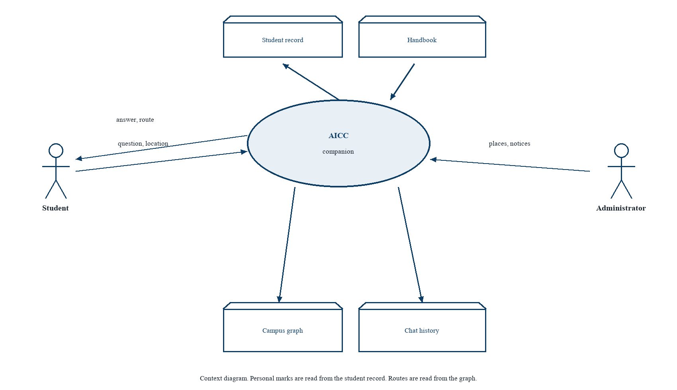
CHAPTER 8 · RESULTS AND DISCUSSION
Navigation checks, stated honestly
• Main Gate to the cafe, the library, and the fountain follow the published graph.
• Classroom B-104 continues indoors by stairs or lift.
• Off campus, a public walking link opens toward a gate.
• GPS error was not surveyed. The field log stays blank.
• Floor art is a Block B sketch. The graph is what the router trusts.
Say “this is the published path.” Do not say “this is a surveyed distance.”
AICC · Lahore Garrison University · 18 / 20

Slide 19
CHAPTER 9 · CONCLUSION AND FUTURE WORK
What was delivered
Records
Places
Rules
Personal numbers are read, not generated.
Aliases resolve to one stored pin.
Retrieved, then phrased, or refused.
Outdoors
Indoors
Administration
Dijkstra inside the gate. Public map outside it.
A* with an explicit stair and lift cost.
People, notices, and places change without a rebuild.
AICC · Lahore Garrison University · 19 / 20

Slide 20
CHAPTER 9 · CONCLUSION AND FUTURE WORK
What should happen next
• Survey the walkways and fill the GPS-error log.
• Replace the Block B sketch with cleared floor drawings.
• Add buildings on the same graph contract.
• Review handbook passages with the offices they describe.
• Keep places as lookups and routes as authored edges.
Thank you
Questions
AICC · 20 / 20

