Slide 1


MediaApp
I am Rafeh Saayfan, Welcome to the presentation of our innovative social media app!

Slide 2

Why MediaApp?
Introducing our new social media website app for easy communication, photo sharing, and profile customization. Connect, share photos, and customize your profile effortlessly. Stay connected, receive likes, and interact with others in a fun and straightforward way. Visit the website now to join us and to start connecting and sharing

Slide 3

MediaApp features:
Login and register
Users profiles
Settings
Posts
Comments and Likes
Home
search

Slide 4
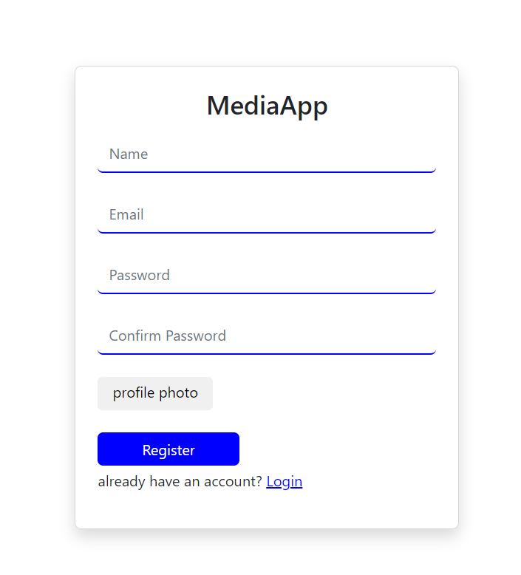
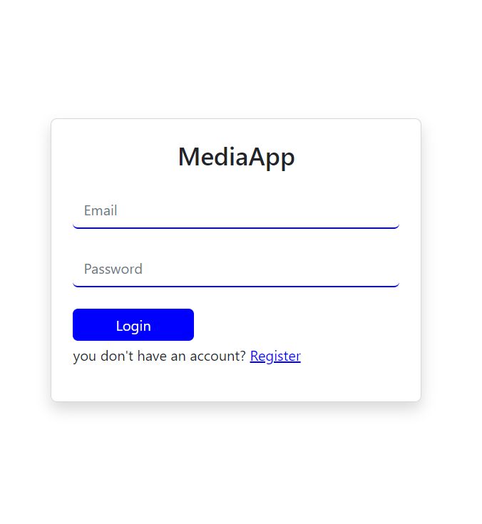
Login and register
Register:
You need to enter a name with more than 6 characters, a valid email address that is not already in the database, a password with more than 6 characters, and a profile photo in either .png, .jpeg, or .jpg format
Login:
If you have a registered email and haven't forgotten your password, you can log in.

Slide 5
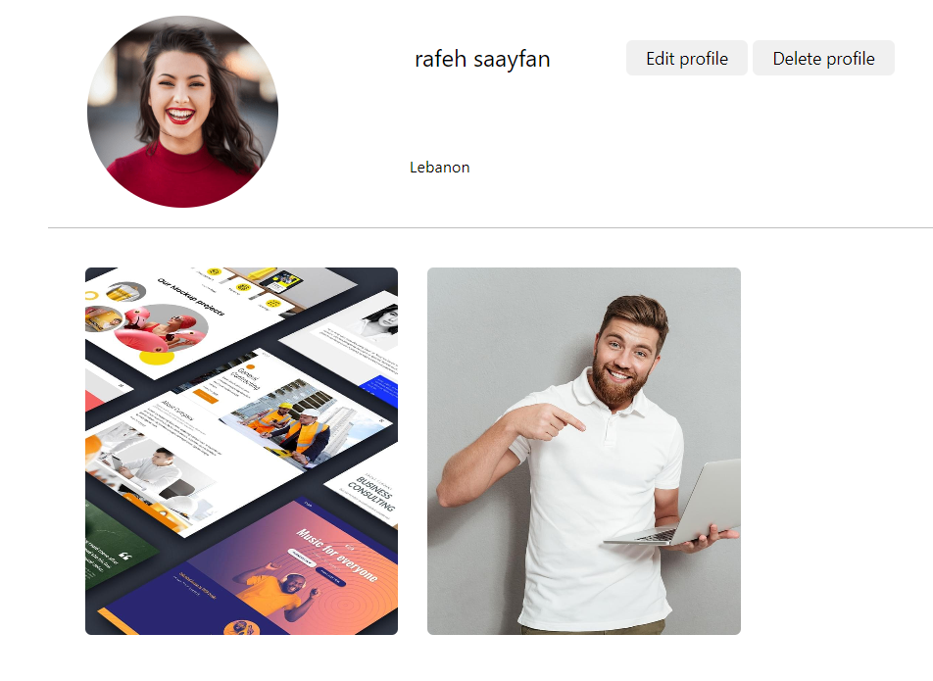
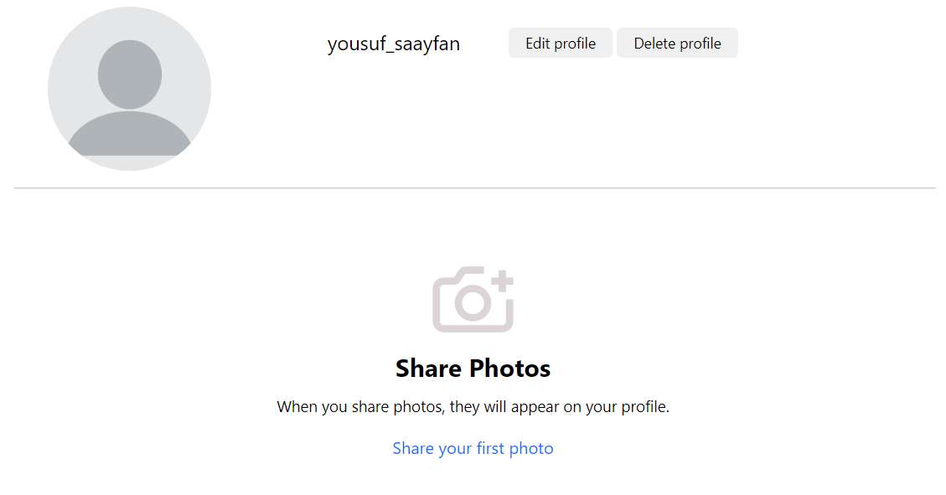
Users profiles
The 'Edit Profile' button allows you to access all settings
By clicking on the profile photo, you can easily change or remove it without navigating to the settings.
Clicking on any post will display all post information.
The 'Delete Profile' button permanently deletes your account from the database

Slide 6
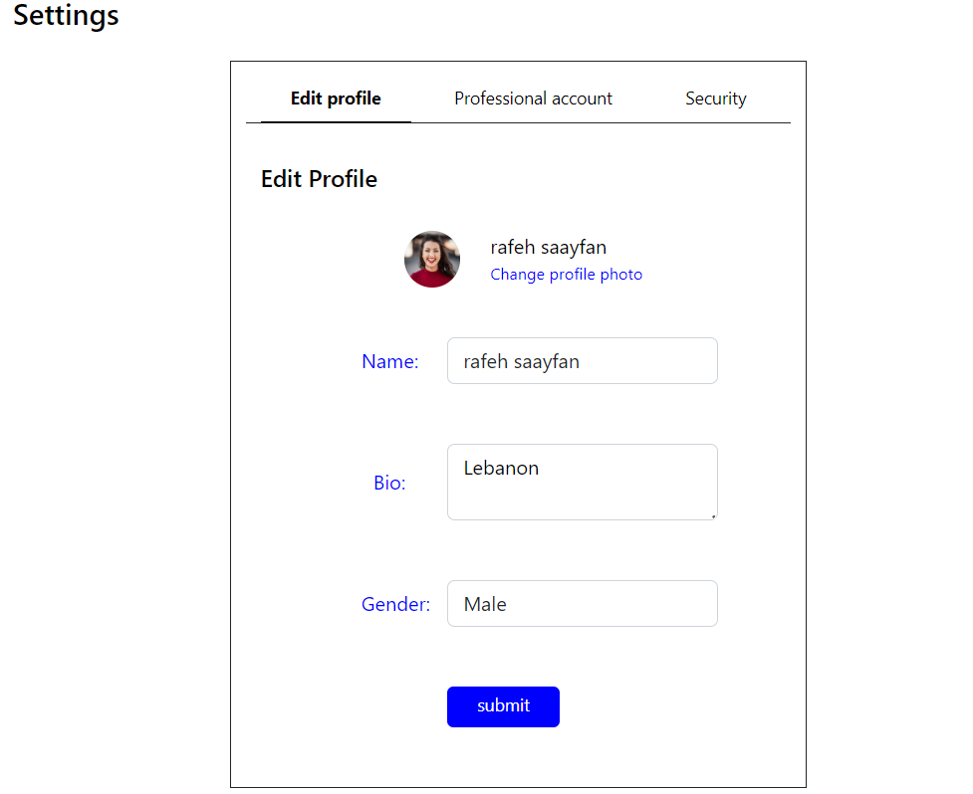
Settings
Edit profile:
On this page, you can change or remove your profile photo (in either .png, .jpeg, or .jpg format), change your name to have more than 6 characters, modify your bio or remove it, and select your gender

Slide 7
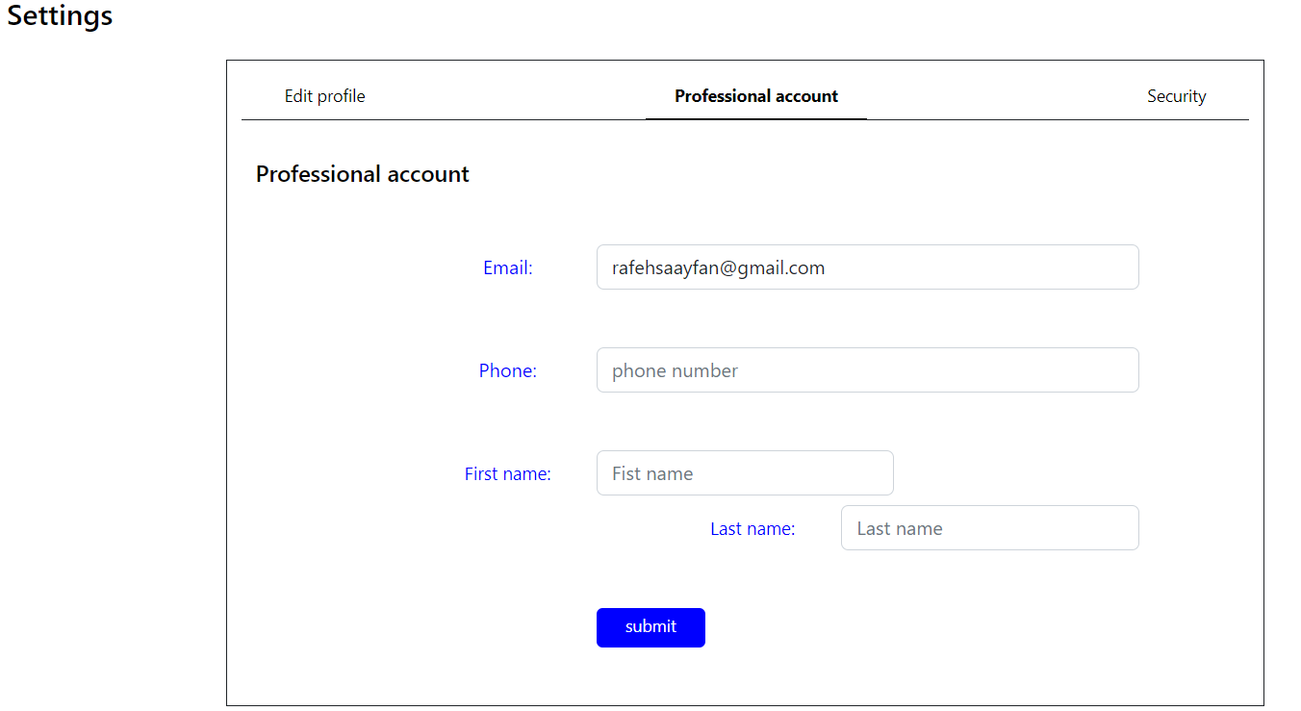
Settings
Professional account:
On this page, you can change your email to another valid email address that does not already exist in the database. You can also provide your phone number (numbers only), first name, and last name, where the first and last name must be at least 2 characters long.
It is permissible to leave your phone, first name, or last name empty if desired

Slide 8
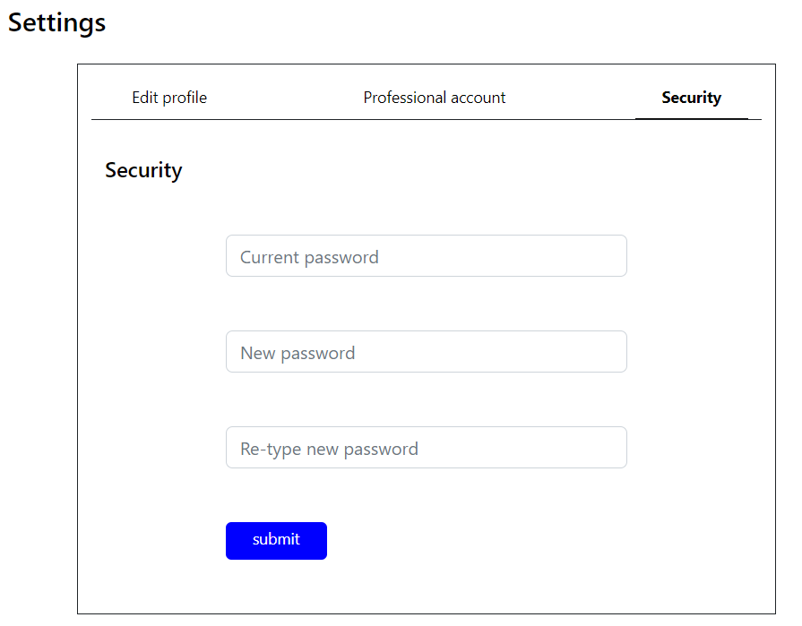
Settings
Security:
If you want to change your password, you need to enter your current password. If it is correct, you can then type your new password, which must be at least 7 characters long.

Slide 9
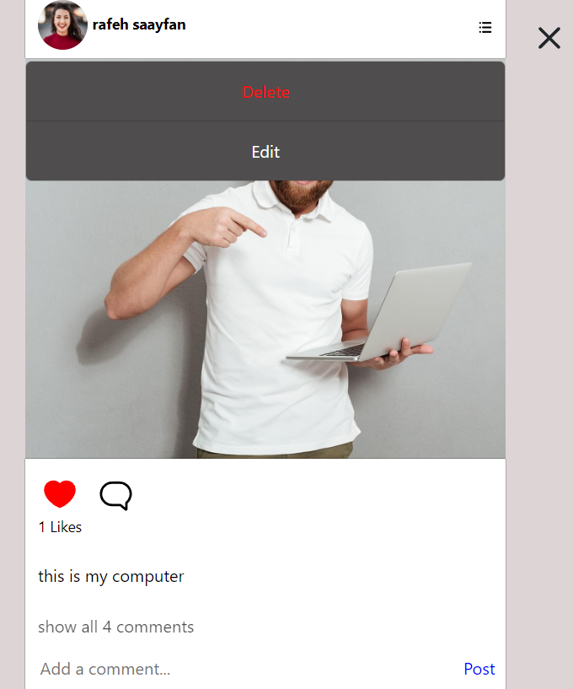
Posts
On this page, you can:
Delete a post.
Use the Edit button to change your post description.
You can like or unlike a post and view the count of likes as well as the list of users who have liked the post, all without refreshing the page
Add a comment and view the count of comments as well as the list of users who have comment the post, all without refreshing the page.

Slide 10


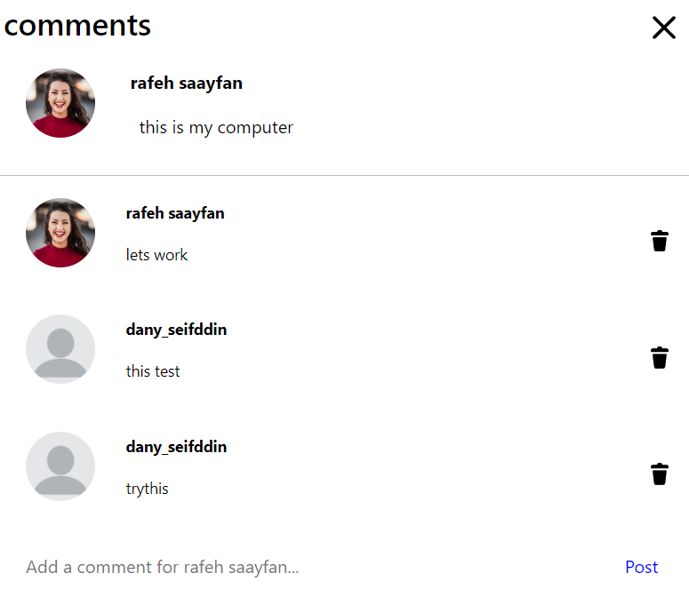
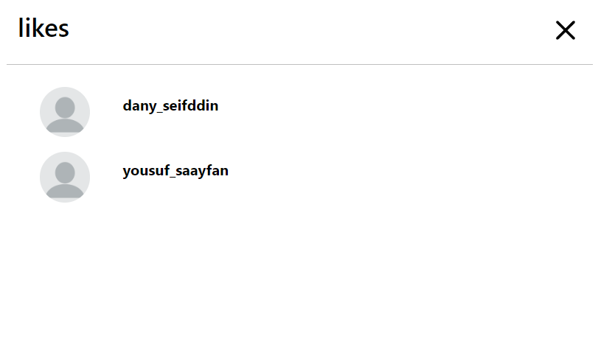
Comments and Likes
Comments:
On this page, we display all comments for every post. By clicking on any user name or photo, you can access the profile of that user. You can only delete your own comments; you have control to delete them. However, if you are the owner of the post, you have the ability to delete any comment on that post.
Likes:
On this page, we display all likes for every post. By clicking on any user name or photo, you can access the profile of that user

Slide 11
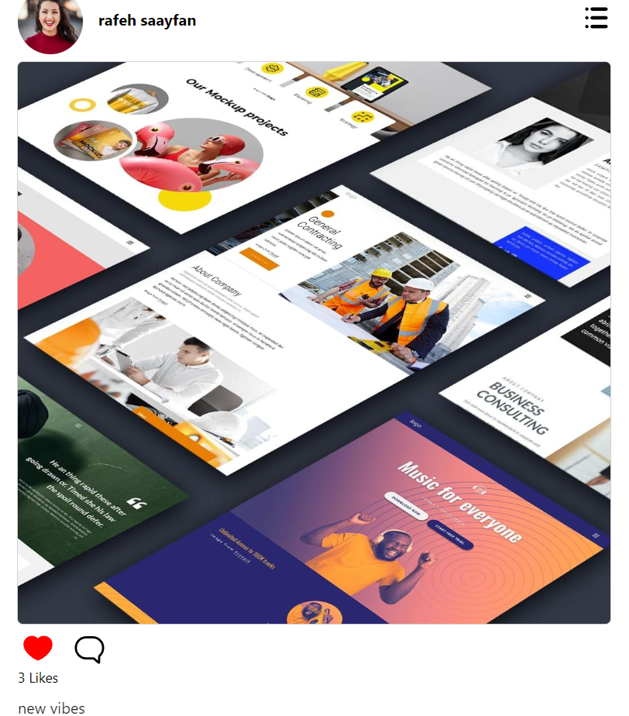
Home
On the Home page, you can show all users posts and perform all the aforementioned features(like, comment, see other profile) regularly and based on the permissions granted to each user.

Slide 12
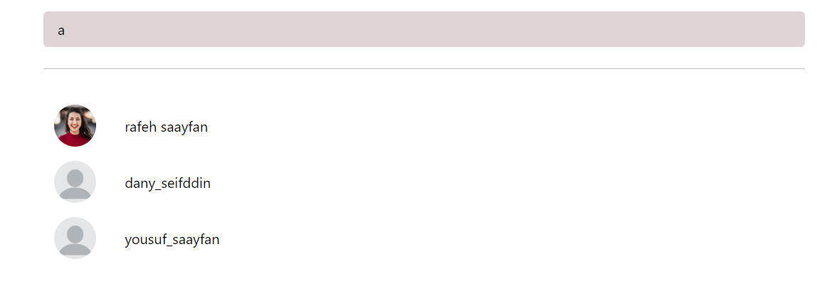
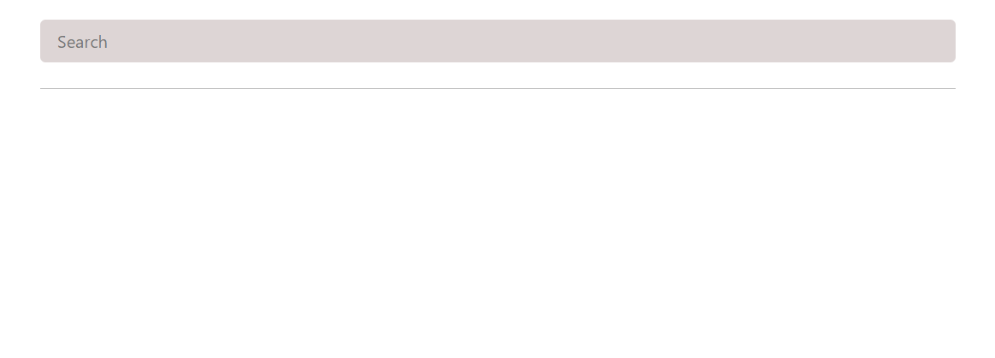
Search
On this page, you can search for any user by simply typing their name. The user accounts that match your search will be displayed on the page instantly, without the need for refreshing or submitting.

Slide 13


MediaApp is here to serve you
This Photo by Unknown author is licensed under CC BY-SA-NC.

