Slide 1

GodExpo: An Automated God Structure Detection Tool for Golang
Rafed Muhammad Yasir, Moumita Asad, Asadullah Hill Galib,
Kishan Kumar Ganguly, Md. Saeed Siddik
Institute of Information Technology
University of Dhaka

Slide 2
Contents
About Golang
Problem Definition
Related Work
Example of Golang Code
Features of GodExpo
Flowchart of GodExpo
Findings
Future Work
Notes:
sdsdgdg

Slide 3

About Golang
An open source programming language developed and maintained by Google [1]

Slide 4



Renowned Golang Projects

Slide 5






Companies Using Golang

Slide 6
Problem Definition
As Golang’s popularity increases, code smell detection tool in Golang is crucially required for maintaining code quality [2].
This research focuses on God Class detection of Golang
God class
exhibits high complexity, low cohesion and heavy access to foreign classes’ data [3]
leads to defect and frequent change [4]
violates the single responsibility principle - “a class should have only one reason to change” [3]

Slide 7
Related Work
Jdeodorant [5]
open source Eclipse plugin
infusion [6]
Commercial standalone tool
JSpIRIT [7]
identifies and prioritizes ten code smells including God Class
PMD [6]
detects four code smells: God Class, God Method, Feature Envy, and Type Checking
detects God Class along with 21 other smells
open source tool for Java
detect various smells including God Class and God Method

Slide 8
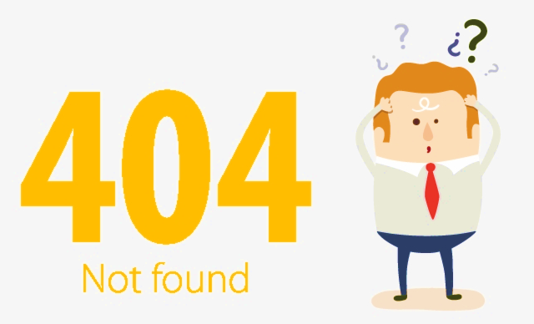
No God Struct Detection Tool for Golang!

Slide 9
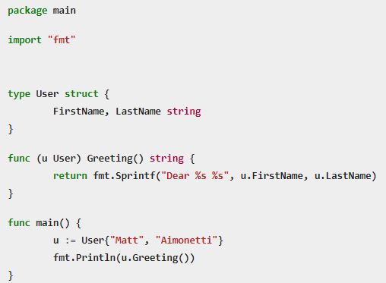
Example of Golang Code
Struct
Method
Method
receiver

Slide 10

Technique
C: Class being inspected.
WMC(C): Weighted Method Count
ATFD(C): Access to Foreign Data
TCC(C): Tight Class Cohesion

Slide 11

Tight Class Cohesion (TCC)
NP(C): maximum possible number of direct or indirect connections in a class [8].
NDC(C): number of direct connections.

Slide 12
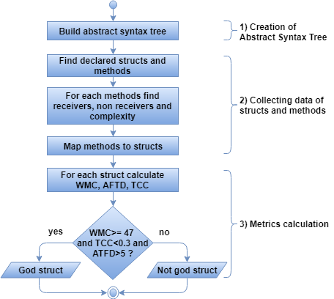
Flowchart of GodExpo

Slide 13
Features of GodExpo
GodExpo is a CLI tool that can-
Show struct summary
Find God Structs
Show evolution of God Structs across versions of a project

Slide 14
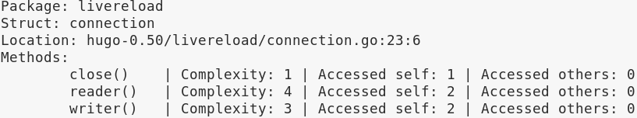
Show Struct Summary
$ godExpo -f f i l e . go

Slide 15
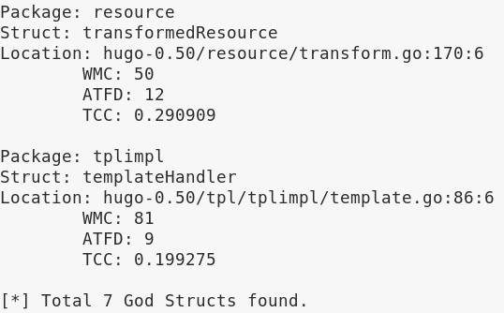
Find God Structs
$ godExpo -d d i r e c t o r y/

Slide 16
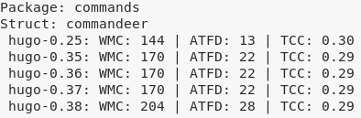
Show Evolution of God Structs across Versions of a Project
$ godExpo -e d i r e c t o r y/

Slide 17
Other Flags
“-wmc number”: Set customized WMC threshold
“-atfd number”: Set customized ATFD threshold
“-tcc number”: Set customized TCC threshold

Slide 18
Dataset Description
To evaluate the tool, it has been executed on seven different versions of two popular Go projects.
Hugo [9]
a static HTML and CSS website generator written in Golang
Average LOC 45K+
Mattermost [10]
an open source, private cloud, Slack-alternative.
Average LOC 777K+

Slide 19
Hugo statistics
Project name | Number of stars | Version | Total Number of Structures | Number of God Structures Detected
Hugo | 31704 (as of 10 Jan 2019) | v0.20 | 162 | 4
 |  | v0.25 | 206 | 5
 |  | v0.30 | 224 | 4
 |  | v0.35 | 233 | 7
 |  | v0.40 | 280 | 7
 |  | v0.45 | 343 | 8
 |  | v0.50 | 369 | 7

Slide 20
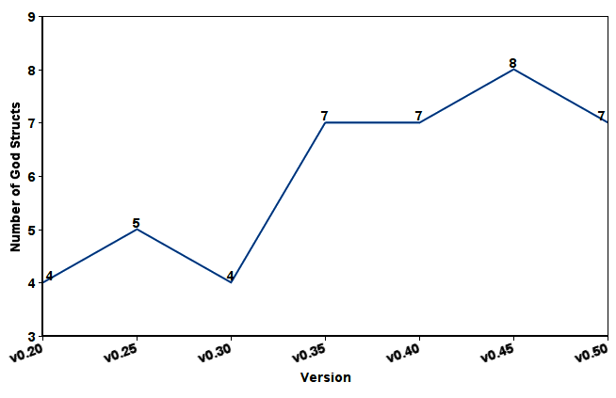
Hugo God Structs

Slide 21
Mattermost statistics
Project name | Number of stars | Version | Total Number of Structures | Number of God Structures Detected
Mattermost | 13886 (as of 10 Jan 2019) | v5.0.0 | 4626 | 51
 |  | v5.1.0 | 4693 | 52
 |  | v5.2.0 | 5151 | 59
 |  | v5.3.0 | 5219 | 59
 |  | v5.4.0 | 5238 | 59
 |  | v5.5.0 | 5238 | 59
 |  | v5.6.0 | 5611 | 60

Slide 22
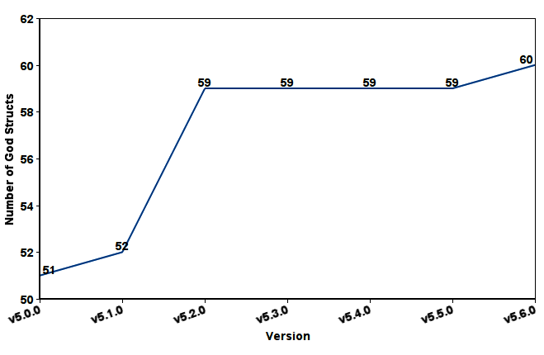
Mattermost God Structs

Slide 23
Future Work
Handling anonymous structs
Providing refactoring suggestions

Slide 24
References
[1] The Go Project. Retrieved October 20, 2018, from
https://golang.org/project/
[2] Paiva, T., Damasceno, A., Figueiredo, E., & SantAnna, C. (2017). On
the evaluation of code smells and detection tools. Journal of Software
Engineering Research and Development, 5(1), 7.
[3] Martin, R. C. (2002). Agile software development: principles, patterns, and practices. Prentice Hall.
[4] Olbrich, S. M., Cruzes, D. S., & Sjoberg, D. I. (2010, September). Are
all code smells harmful? A study of God Classes and Brain Classes
in the evolution of three open source systems. 2010 IEEE International
Conference on Software Maintenance (ICSM) (pp. 1-10). IEEE.

Slide 25
References
[5] Tsantalis, N., Chaikalis, T., & Chatzigeorgiou, A. (2008, April). JDeodorant: Identification and removal of type-checking bad smells. In 12th European Conference on Software Maintenance and Reengineering (CSMR) 2008. (pp. 329-331). IEEE.
[6] Paiva, T., Damasceno, A., Figueiredo, E., & SantAnna, C. (2017). On
the evaluation of code smells and detection tools. Journal of Software
Engineering Research and Development, 5(1), 7.
[7] Vidal, S., Vazquez, H., Diaz-Pace, J. A., Marcos, C., Garcia, A.,
& Oizumi, W. (2015, November). JSpIRIT: a flexible tool for the
analysis of code smells. In 34th International Conference of the Chilean
Computer Science Society (SCCC)(pp. 1-6). IEEE.

Slide 26
References
[8] Bieman, J. M., & Kang, B.-K. (1995). Cohesion and Reuse in an Object-Oriented System. Proc. Int’l Symp. Software Reusability, (259-262).
[9] Hugo. Retrieved January 19, 2019, from https://github.com/gohugoio/hugo
[10] Mattermost. Retrieved January 19, 2019, from
https://github.com/mattermost/mattermost-server

Slide 27

Demonstration

Slide 28
Thank You

