Slide 1
Dynamic Programming:
from the Basics
to
Completely Dyamic Applications

Slide 2
John Campbell
White Star Software
Creating a Shared Vision of Excellence
in the Progress Community
Since 1985
Training
Tools
Consulting
Publications

Slide 3
Programming
Models

Slide 4
What are Today's Demands?
Web Client -- App Server
MainFrame -- Batch Program
“Any Client” (Java, VB, Perl …)
WebSpeed
Etc.

Slide 5
Goals of Good Web Client Programming
Separate Interface and Business Rules
Isolate DB Access
Reduce client-side code
Reduce AppServer Calls
Reduce network traffic

Slide 6
Interface vs. Database
These interfaces --the "Client" (except WebSpeed) cannot talk to the DB
The "Server Application" can't talk to the Interface
How do you bridge the gap?

Slide 7
Web Client / App Server
Web Client
Interface
App Server
Database

Slide 8
Web Client / App Server
Web Client
Interface
App Server
Database

Slide 9
Bridging the Gap with V9
Create the interface
  Simple validation (e.g. non-blank)
Create the Business Rules
  More complex calculations
Create the Database Access Code
  No rules involved; simply queries

Slide 10
Static Interface (V6)
Static Frame
  Define it with a form
  Can't change much at runtime
    Titles, row, column, down, etc.
  Can't add fields, etc.
Static Fields
  Can change virtually nothing

Slide 11
Dynamic Interface (V7+)
Can create most widgets (V7/V8)
Full Interface (V9)
Start with handle
Characteristics of static objects are
ATTRIBUTES
Functions which operate on a widget are called METHODS

Slide 12
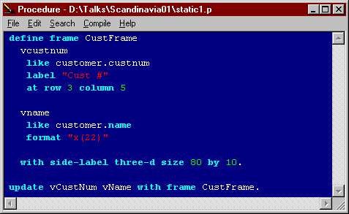
Let's Take a Look

Slide 13
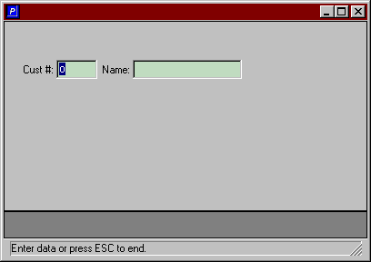
The Result

Slide 14
What we Know About this Code
Format, location, label etc. are fixed
Or so we think

Slide 15
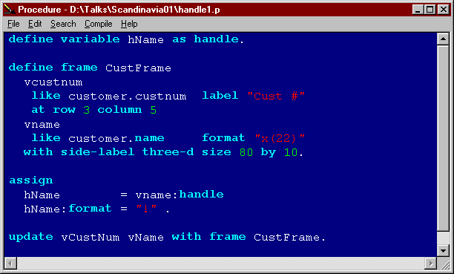
Let's do Something Cool

Slide 16
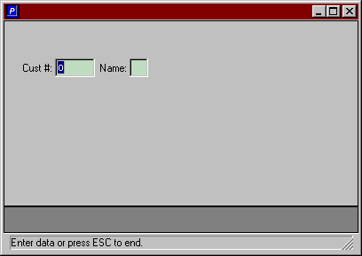
The Result

Slide 17
The Principle
A handle points to a widget
A widget is a piece of code which communicates with a Windows API
This widget is somewhat dynamic:
  We can now change its attributes
  You can do this with *any* V6 code: character or GUI!

Slide 18
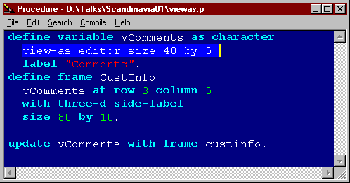
Understanding View-as
This is just a new "dimension" of format

Slide 19
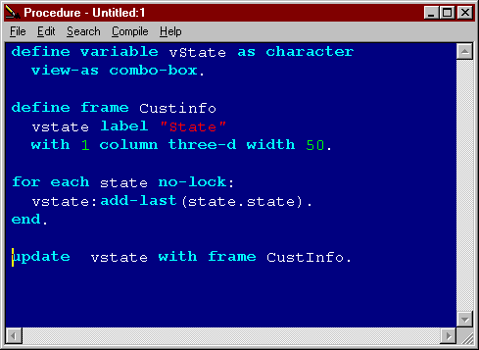
View-as; Methods

Slide 20
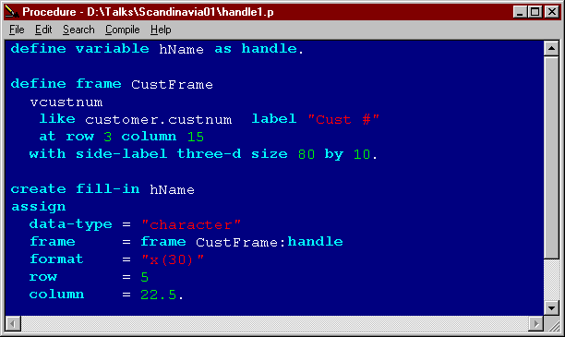
We Can Build Our
Interface Dynamically

Slide 21
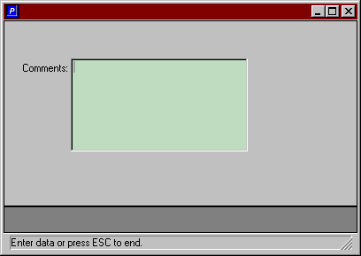
The Result

Slide 22
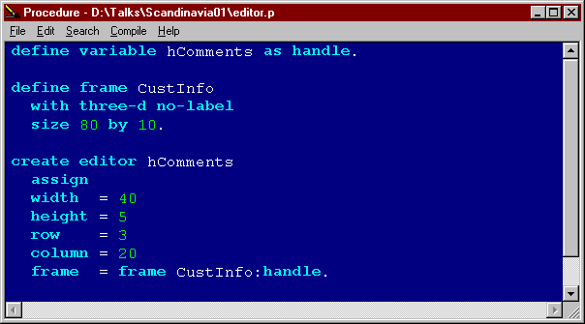
The Full Monty (part 1)

Slide 23
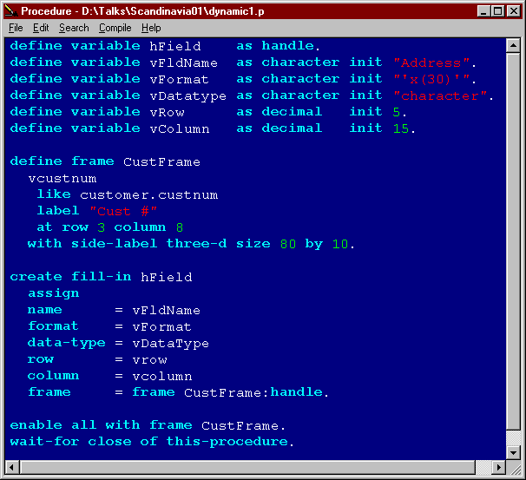
The Full Monty (part 2)

Slide 24
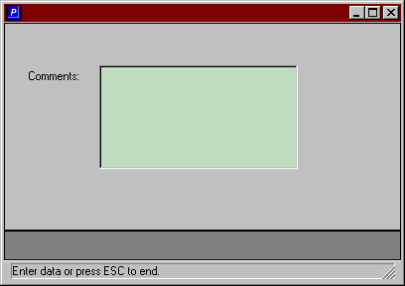
The Result (sort of)

Slide 25
Where Does This Take Us?
We can create a dynamic interface
The values for the attributes can be variables or fields
Therefore, the source of the attributes can be stored in a repository

Slide 26
What About Business Rules?
They must be separated from the interface
You can't use
  For Each, etc.
  Editing blocks
  Event Triggers (if you're going to have a dynamic interface)

Slide 27
Why The Different Code Model?
If there is one program to render the interface, you can't put business rules in that program
The rules must be in super-procedures
The communication can also be publish-subscribe
Don't panic; just know it's like all of Progress: simple and clear...

Slide 28
Conclusion
You can build your interface dynamically
You can store this information in a database
You can isolate your business rules from your interface
but…you still need to perform database access

Slide 29
Dynamic Buffers

Slide 30
What Are They
A 'pseudo' widget
They use same principles as interface widgets
They support attributes and methods
Distinct entity from a record buffer
Permit creation, deletion and updating of data

Slide 31
Some Important Information
They are created at run time
Created by the CREATE BUFFER statement
Scoped to the SESSION!
Not released automatically
Not cleaned up automatically (memory leaks)

Slide 32
Uses
Support of Dynamic Queries
Separation of Interface & DB Layers
Abstract Data Maintenance
Web-client Programming

Slide 33
Methods
Buffer-create
Buffer-delete
Buffer-release
Find-by-rowid
Buffer-field

Slide 34
Attributes
      Adm-data
      Available
      Can-create
      Can-delete
      Can-read
      Can-write
      Current-changed
      Dbname
      Handle
      Locked
      Name
      New
      Num-fields
      Private-data
      Recid
      Record-length
      Rowid
      Table
      Table-number
      Type
      Unique-id

Slide 35
Standard vs. Dynamic Buffers
Find, For each, Get
Standard Buffer
Dynamic Buffer
Create

Slide 36
Static to Dynamic Association
Standard Buffer
htable = buffer employee:handle
Dynamic Buffer

Slide 37
Dynamic to Static Association
When a dynamic buffer is created, it is automatically associated with a static buffer
Dynamic Buffer
create buffer htable for table employee
Static Buffer
If the buffer does not exist, it is created

Slide 38
The Buffer Field Object
Always associated with a dynamic buffer (i.e. never independently--not creatable)
One buffer-field is created for each field in the buffer

Slide 39
Attributes
      adm-data
      buffer-handle
      buffer-name
      buffer-value
      can-read
      can-write
      case-sensitive
      column-label
      data-type
      dbname
      extent
      format
      handle
      help
      initial
      key
      label
      mandatory
      name
      position
      private-data
      read-only
      validate-message
      width-chars
      string-value
      table
      type
      unique-id
      validate-expression

Slide 40
Methods
At present, there are no methods for a buffer-field object

Slide 41
Principles
When you are done with a dynamic object delete it using DELETE OBJECT
Failure to do so causes memory leaks
Progress cannot manage this memory
If you don't manage it, your system will ultimately crash

Slide 42
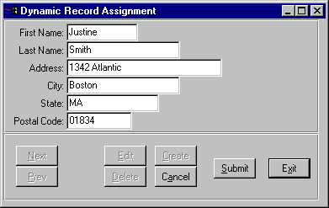
Sample Screen

Slide 43
How to Build a Program
You need:
  Table Name
  Table Rowid
  List of Fields to update
  List of Values to put in the fields
  Actions to be performed (delete, create…)

Slide 44
Application Model
Dynamic Interface Program
Data Maintenance Program (using dynamic buffers)
Validation Program (super procedure)
Validation
Routines
Maintenance
Program

Slide 45
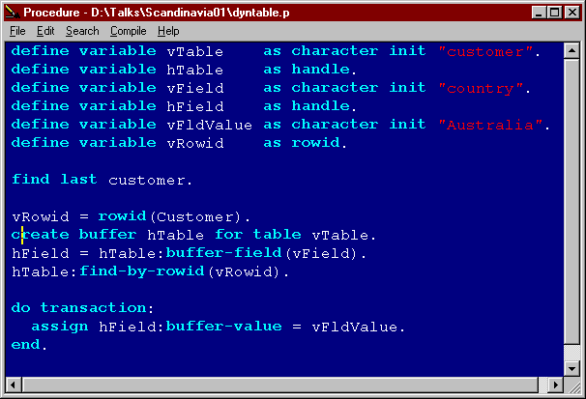
Building Abstract Data Maintenance

Slide 46
Dynamic Queries

Slide 47
Review of Static Queries
define query qCust for customer scrolling.
open query qCust for each customer.
repeat:
get next qcust.
if not query-off-end("qcust") then
display name city with use-text 10 down.
else leave.
end.

Slide 48
Dynamic Query Principles
Same as buffers:
  It is a pseudo widget with methods and attributes
  You create it, you clean it up
  Nothing new to learn except the specific syntax

Slide 49
Drawbacks
Break by not supported (must be simulated; see KB 20295)
Can-find not supported
Run time errors possible/probable
European formats: be aware!
  Use session:date-format attribute
Decimal support
  session:numeric-format
  'for each customer where credit-Limit > "99,50" '

Slide 50
Dynamic Query Methods
ADD-BUFFER
CREATE-RESULT-LIST-ENTRY
DELETE-RESULT-LIST-ENTRY
GET-BUFFER-HANDLE
GET-CURRENT
GET-FIRST
GET-LAST
GET-NEXT
GET-PREV
SET-BUFFERS
QUERY-CLOSE
QUERY-OPEN
QUERY-PREPARE
REPOSITION-BACKWARD
REPOSITION-FORWARD
REPOSITION-TO-ROW

Slide 51
Attributes
ADM-DATA
CACHE
CURRENT-RESULT-ROW
HANDLE
INDEX-INFORMATION
IS-OPEN
NAME
NUM-BUFFERS
NUM-RESULTS
PREPARE-STRING
PRIVATE-DATA
QUERY-OFF-END
SKIP-DELETED-RECORD
TYPE
UNIQUE-ID

Slide 52
A Semi-Dynamic Query
define variable hQuery as handle.
create query hQuery.
hQuery:set-buffers(buffer customer:handle).
hQuery:query-prepare("for each customer").
hQuery:query-open().
repeat:
hQuery:get-next().
if not hQuery:query-off-end then
display name city with use-text 10 down.
else leave.
end.
Delete object hQuery.

Slide 53
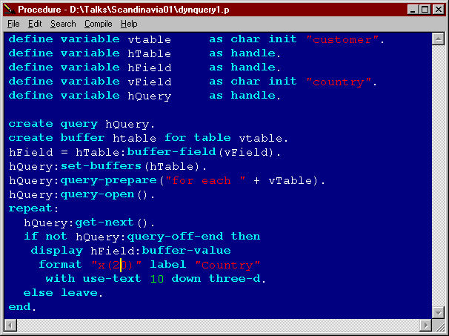
Abstracting this Query

Slide 54
What's Missing?
We can now:
  Build a dynamic interface
  Retrieve data dynamically
  Update the DB dynamically
We cannot (easily)
  Communicate data to the Web Client
  Pass changes back to the DB

Slide 55
Dynamic
Temp-tables

Slide 56
What About DB Access?
If the client doesn't know about the DB, what do we do?
All code on the client must compile without DB access.
You must therefore use temp tables.
You have 2 choices: dynamic or static

Slide 57
Server-side DB Access
Traditionally, you had only one model
  Static temp-tables
As pointed out, you have a more flexible (and more complex) model:
  Dynamic buffers
  Dynamic queries
  Dynamic temp-tables
Let's take a look

Slide 58
Static Temp Tables
Pros
  May already have code supporting them
  Can use earlier versions of Progress
  Concepts are familiar to most Progress programmers
Cons
  Definitions must exist on both sides if both are Progress; can't change only one side
  Non-Progress client must 'understand' the temp-table

Slide 59
Another Consideration
At least one static definition per table
Perhaps one definition per set of table relationships
This can be unwieldy when there are database changes
  Code definitions may have to be changed
  Field definitions and rules may need to change

Slide 60
Ways to Use
Dynamic Temp-tables
To enable a generic .p to move data between the interface and a database table without knowing about the DB table at compile time.
To allow applications such as web client and appserver to communicate without knowing about DB structures at compile time

Slide 61
Retrieving Data
DB Unaware Interface
Interface
Program
Empty Dyn TT
Structure
Dynamic T-T
Buffer
Empty DynTT Structure
DB Aware
Program
Dynamic T-T Buffer
Dynamic Buffer

Slide 62
Concepts
It is possible to define dynamic temp tables at runtime
It is possible to derive their structure dynamically
Dynamic objects require only run-time Progress
  Interface, queries, buffers, temp-tables

Slide 63
Creating Dynamic Temp Tables
Just like creating any dynamic widget
define variable hTempTable as handle.
create temp-table hTempTable.
At this point, you have an empty temp-table structure

Slide 64
Attributes and Methods
Most methods for a temp-table object are definition methods.
These can be used only when the temp-table is in the "clear" or "unprepared" state.

Slide 65
Dynamic T-T Methods
create-like
add-fields-from
add-new-field
add-like-field
add-like-index
add-new-index
add-index-field

Slide 66
Temp-table Attributes
default-buffer-handle
name
undo
prepared
primary

Slide 67
Adding Fields
Standard 'method' syntax:
  Two components:
    New Field Name
    Field structure being added

Slide 68
Example of add-like-field
Progress Syntax:
t-t-handle:add-like-field(field-name-expression , source-buffer-field-name-expression)
Example:
hTempTable:add-like-field( "t-t-zip", "customer.zip")
or
define variable ttFieldName as char init "t-t-zip".
define variable BaseField as char init "postalcode".
define variable BaseTable as char init "Customer".
hTempTable:add-like-field(ttFieldName,
BaseTable + "." + BaseField).

Slide 69
Creating Like DB Fields
define variable hTempTable as handle.
define variable cntr as int.
define variable FieldList as char init
"name,address,city,state,postalcode".
define variable TableName as char init "customer".
create temp-table hTempTable.
do cntr = 1 to num-entries(FieldList):
/* The first expression will be tname,
the second, customer.name */
hTempTable:add-like-field(
"t" + entry(cntr,FieldList),
TableName + "." + entry(cntr,FieldList)).
end.
/* Now freeze the structure of the temp table */
hTempTable:temp-table-prepare("t" + TableName).

Slide 70
The add-new-field Method
Components:
    Field Name
    Data Type
    Extents
    Format
    Initial Value
    Label

Slide 71
Example of Add New Field
hTempTable:add-new-field
("customer.name",
"character",
0,
"x(10)",
"",
"Name").
As with the previous example, this can also be an expression

Slide 72
States of a Dynamic Temp-Table
Clear
  The object has no definition yet but has just been created or cleared
Prepared
  The object has been completely defined and may be used
Unprepared
  The object is in the middle of definition and may not be used

Slide 73
Creating
a
Model

Slide 74
Objective
To take any abstract interface and create a single "server" routine to handle database IO
Use dynamic temp tables in this program

Slide 75
Populating a DB Record
DB Unaware Interface
Empty TT Structure
Populated Dynamic T-T Buffer
Empty Dynamic DB Record Buffer
Database Record

Slide 76
Requirement
There must be some means of mapping the "fields" in the interface to actual fields in the database
The interface component type doesn't matter (i.e. fields, editors, selection lists, etc.)

Slide 77
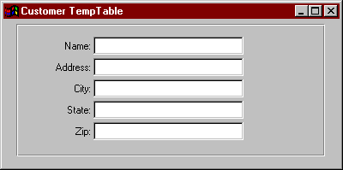
Need for Mapping
vname
customer.name
customer.address
etc.
vaddress
Software Mapping
Mechanism
Database Unaware
Interface Component
DataBase Fields

Slide 78
Mapping Mechanism
Store the fieldname in a database record
Pass the data in a temp table to the Web Client
Create the variable with the field name + one letter (vname, vaddress, etc)

Slide 79
Repository Example
object.name
object.datatype
object.format
object.initial
object.row
object.column
The values for these fields would be maintained through a software interface

Slide 80
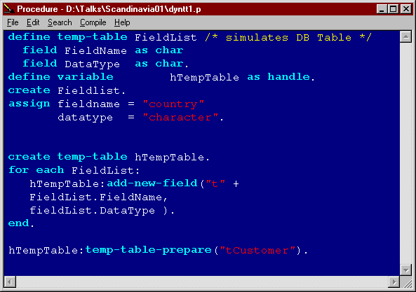
Creating Fields Dynamically

Slide 81
What We Now Have
An empty temp table structure
This has no "buffer" structure to hold data

Slide 82
Populating a Temp Table
Requires a BUFFER for the temp table
This buffer
  Is a handle
  Is not the STRUCTURE, but is a temp-table BUFFER
define variable hTTBuffer as handle.
hTTBuffer = hTempTable:default-buffer-handle.

Slide 83
Dynamic T-T vs. T-T Buffer
create temp-table hTempTable.
Dynamic T-T Structure
hTTBuffer = hTempTable:default-buffer-handle.
Empty T-T (record) Buffer

Slide 84
The Temp-Table Buffer
Attributes and methods are just like dynamic record buffers

Slide 85
Populating the Buffer
vaddr vcity vzip
fieldvalues
Variable
taddr tcity tzip
Temp Table
buffer-field()
cust.addr cust.city cust.zip
buffer-field()
Database

Slide 86
Populating a DB Record
do transaction:
/* create the DB record */
hTable:buffer-create().
/* loop through temp table fields */
do Cntr = 1 to hTTBuffer:num-fields:
assign
/* get the handle to the current TT field */
hTTField = hTTBuffer:buffer-field(cntr)
/* slice off the 1st character; e.g. tName */
FieldName = substring(hTTField:name,2)
/* get the DB field handle */
hDBField = hTable:buffer-field(FieldName)
/* populate the DB field from the T-T field */
hDBField:buffer-value = hTTField:buffer-value.
end. /* field loop */
end. /* transaction */
end procedure.

Slide 87
Transferring T-T Records
Prior to V9.1, for programs on different machines (i.e. in different sessions) you can only send data parameters (i.e. variables, or table parameters)
This process is efficient, but requires both sessions to have precisely the same static definitions

Slide 88
Transferring T-T Records
Transferring a table requires the table to be identically defined in both sessions.
define temp-table tC
like customer.
run getTT.p on Ashandle
(output table tC).
for each tC:
display name city.
end.
define temp-table tC like cust.
define output parameter table
for TC.
for each Customer where ...:
create tC.
assign tc.name = cust.name...
end.

Slide 89
The Table-handle Parameter
The table-handle parameter is new in V9.1
It passes both the table structure as well as the data
It is the most abstract way to pass a temp table between programs in different sessions (i.e. on an appserver)

Slide 90
T-T Handles as Parameters
define {input | output | input-output}
parameter table-handle hTempTable.
run progname.p ( {input | output | input-output} table-handle hTempTable [append])

Slide 91
Passing Data
Between
Client and Server

Slide 92
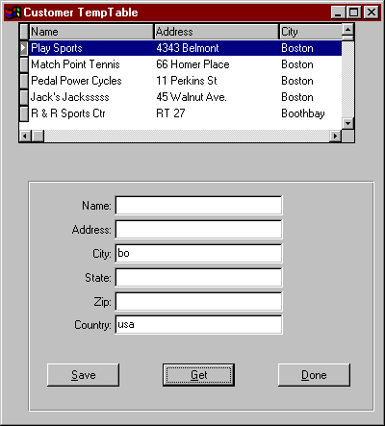
Getting Data to This Client

Slide 93
Passing a Table-handle
1.Create a dynamic temp table on the app server
2.Then, from the interface, pass it data criteria to retrieve from the DB
3.Create and populate records in the dynamic TT on the App Server
4.Pass back the table-handle to Web Client
5.Create a query & browser on the client for the Temp Table

Slide 94
T-T Conclusion
Dynamic temp-tables are an efficient, flexible way to pass data back from the App Server.
They are not for the faint of heart
Once mastered, they are the key to highly flexible, productive code

Slide 95
What Does this look Like in the Real World?
Dynamic Web Client
  One basic interface program
Dynamic Screen handling
  Repository based
Dynamic Query resolution
  One basic server program

Slide 96
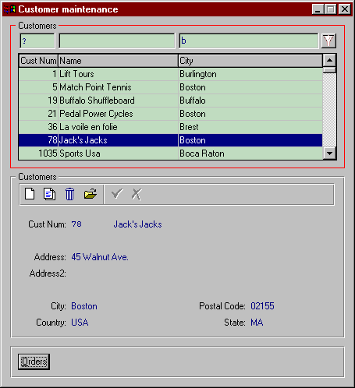
Dynamic Web Screen

Slide 97
What is the Future?
ICF Will Evolve
Other models such as DWP, also
Web Client is SUPERB technology
You have to be a dynamic programmer to use it well

Slide 98
Time to Think Different
For each customer: display customer. is gone
Are html or javascript-based pages the best way to go?
A full GUI web interface is the best of both worlds for e-based applications
Web client is a golden opportunity

Slide 99
White Star Software
Creating a Shared Vision of Excellence
in the Progress Community
Since 1985
Training
Tools
Consulting
Publications

Slide 100
Dreams
When building your Dream
Hold fast to your Vision.
With it, all is possible.

