Slide 1
Capstone Project
Credit Card Usage Segmentation

Slide 2

Credit card Usage Segmentation
This project focuses on developing unsupervised learning models for customer segmentation based on credit card usage data.
The models aim to provide insights into distinct customer segments, improve credit risk assessment, and optimize marketing strategies.
Deliverables include segmentation models, comprehensive data visualizations, and a comparative analysis of various algorithms.

Slide 3
Agenda
Introduction
Steps Involved
Data Overview
Data Preprocessing
Exploratory Data Analysis (EDA)
Dimensionality Reduction (PCA & t-SNE)
Model Selection And Evaluation
Model Deployment
Applications and Benefits
Conclusion

Slide 4
Introduction
Credit card companies handle large volumes of customer data related to spending, payments, and credit behavior.
Understanding how different customers use their credit cards is critical for:
Targeted marketing
Risk assessment
Customer retention
This project applies unsupervised machine learning (KMeans Clustering) to group customers based on their usage patterns.
These segments help businesses offer personalized services and make strategic decisions.

Slide 5
Steps Involved in Developing “Credit Card Usage Segmentation”
Step 1: Collecting of Data from Various source
Step 2:Data cleaning and Feature Engineering
Step 3: Model building for selecting correct ML Algorithm
Step 4: Evaluate Model
Step 5: Model Deployment

Slide 6
Data Overview
The dataset contains Total Rows: 8950, Columns: 18.
It related to credit card usage and customer behaviour.
Drop missing values in Dataset

Slide 7
Here's a brief description of the columns you've listed:
CUST_ID : A unique identifier for each customer.
BALANCE : The current balance on the credit card account.
BALANCE_FREQUENCY : Could indicate how often the balance changes.
PURCHASES : Total amount of purchases made.
ONEOFF_PURCHASES : Amount spent on one-time purchases.
INSTALLMENTS_PURCHASES : Amount spent on purchases paid in installments.
CASH_ADVANCE : Total amount of cash advances taken.
PURCHASES_FREQUENCY : How often purchases are made.
ONEOFF_PURCHASES_FREQUENCY : Frequency of one-time purchases.
PURCHASES_INSTALLMENTS_FREQUENCY : How often installment purchases are made.
CASH_ADVANCE_FREQUENCY : Frequency of cash advances.
CASH_ADVANCE_TRX : Number of cash advance transactions.
PURCHASES_TRX : Total number of purchase transactions.
CREDIT_LIMIT : The credit limit on the account.
PAYMENTS : Total amount of payments made.
MINIMUM_PAYMENTS : Total amount of minimum payments made.
PRC_FULL_PAYMENT : Percentage of times the full payment was made.
TENURE : Length of time the customer has had the credit card account.

Slide 8
Data Preprocessing
Impute missing values
Drop ID column if present
Drop non-numeric and irrelevant column
Scale the data using Standard Scaler

Slide 9

Exploratory Data Analysis (EDA)
Explore customer behavior patterns in spending, payments, and credit usage.
Plotted distributions of balances, purchases, credit limits.
Correlation heatmap showed strong relationships.
Identified key behavior-driving variables.

Slide 10
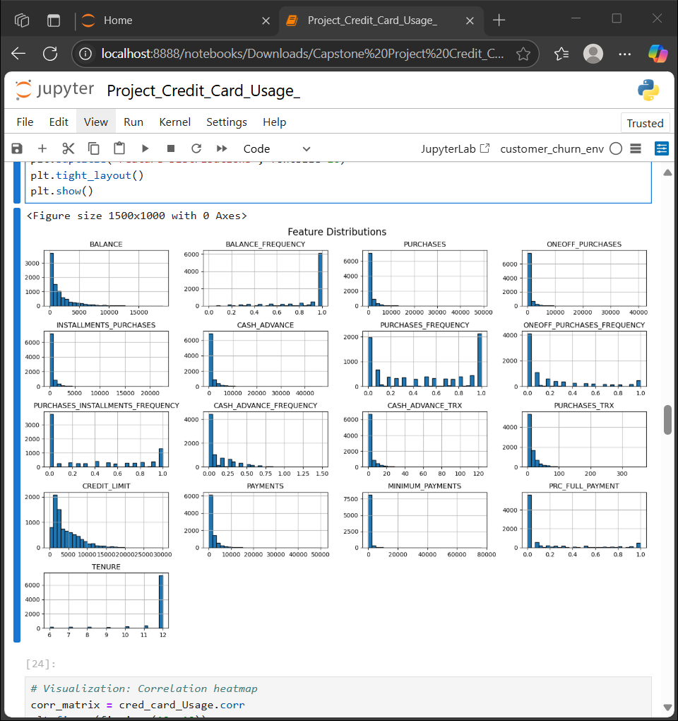
Histogram
1. BALANCE & BALANCE_FREQUENCY Balance is highly right-skewed – most customers keep low balances, while a few maintain very high amounts.Balance Frequency is clustered near 1.0 – indicates many users check their balance frequently or regularly.
2. PURCHASES-RELATED FEATURESPURCHASES & ONEOFF_PURCHASES:Most customers make small or occasional purchases.A few make very large one-time purchases – these may represent high-spending or business customers.INSTALLMENTS_PURCHASES:Spikes at low values – EMI-based purchases are less common than direct purchases.PURCHASES_FREQUENCY:Many customers shop frequently (values near 1), suggesting active usage.ONEOFF_PURCHASES_FREQUENCY:Lower than general purchase frequency – most customers prefer regular over one-time usage.PURCHASES_INSTALLMENTS_FREQUENCY:Again, lower compared to other frequency features – installment shopping is less common.
3. CASH ADVANCE-RELATED FEATURESCASH_ADVANCE & CASH_ADVANCE_TRX:Most customers avoid cash advances, with very few having high usage.CASH_ADVANCE_FREQUENCY:Majority of values are close to 0 – confirms infrequent or no use of cash withdrawals.
Notes:
PURCHASES_FREQUENCY:Lower than general purchase frequency – most customers prefer regular over one-time usage.PURCHASES_INSTALLMENTS_FREQUENCY:Again, lower compared to other frequency features – installment shopping is less common.✅ 3. CASH ADVANCE-RELATED FEATURESCASH_ADVANCE & CASH_ADVANCE_TRX:Most customers avoid cash advances, with very few having high usage.CASH_ADVANCE_FREQUENCY

Slide 11
4. CREDIT & PAYMENT BEHAVIORCREDIT_LIMIT: Right-skewed – most customers have modest credit limits, a few have very high limits.PAYMENTS & MINIMUM_PAYMENTS:Majority of customers pay small amounts – may indicate either responsible usage or lower usage overall.Spikes near 0 in minimum payments suggest some customers may miss due payments.
5. FULL PAYMENT RATIO (PRC_FULL_PAYMENT)Values concentrated near 0 – majority of users don’t pay their balance in full.Can be used to identify potentially risky or interest-paying customers.
6. TENURE Majority of customers have a tenure of 12 months – indicating that data might be collected on an annual basis, or most users are relatively new but stable.
Conclusion :The feature distributions reveal that most customers have low balances, infrequent purchases, avoid cash advances, and often do not pay their full balances. These patterns help us understand and cluster user behavior effectively for segmentation

Slide 12
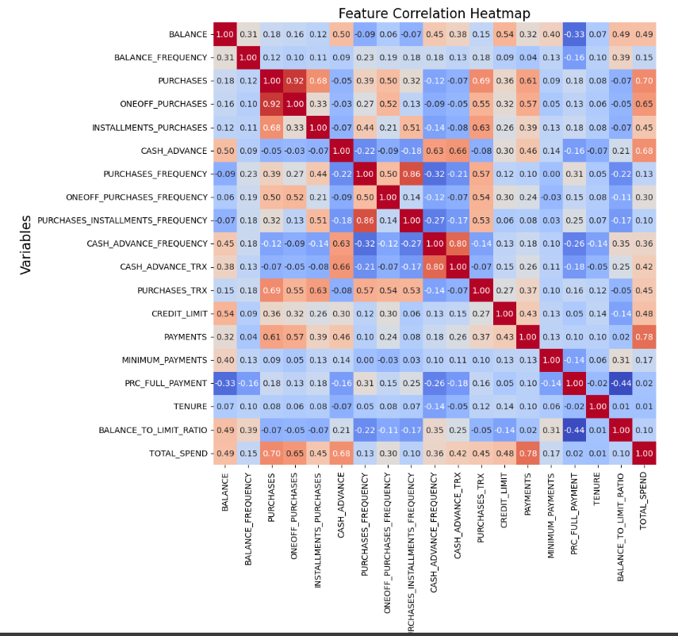
Correlation heatmap
Purpose
The heatmap displays Pearson correlation coefficients between all pairs of features.
Color scale:
🔴 Red indicates strong positive correlation
🔵 Blue indicates strong negative correlation
Values close to 0 indicate weak or no correlation

Slide 13
1. Strong Positive Correlations
PURCHASES and ONEOFF_PURCHASES: 0.92
Indicates that customers who make purchases also tend to make one-off purchases.
INSTALLMENTS_PURCHASES and PURCHASES: 0.68
EMI purchases are a major contributor to total purchases.
PURCHASES and TOTAL_SPEND: 0.70
Logical, as purchases significantly impact total spend.
CREDIT_LIMIT and BALANCE: 0.54
Higher credit limits are associated with higher balances.
PURCHASES and PURCHASES_TRX: 0.63
More transaction count → more spending.
2. Negative Correlations
BALANCE and PRC_FULL_PAYMENT: -0.33
Customers with higher balances are less likely to pay their full amount.
BALANCE and CASH_ADVANCE: -0.50
May suggest people with high balances are not frequent users of cash advances.
BALANCE_TO_LIMIT_RATIO has:
Positive correlation with BALANCE: 0.49
Negative correlation with PRC_FULL_PAYMENT: -0.44
Indicates that high utilization ratio customers usually don’t pay in full.

Slide 14
3. Moderate Relationships
MINIMUM_PAYMENTS and PAYMENTS: 0.78
People who pay more also tend to meet or exceed minimum payments.
ONEOFF_PURCHASES_FREQUENCY and PURCHASES_FREQUENCY: 0.52
Frequency of general purchases and one-off purchases tend to rise together.
4. Weak or No Correlation
TENURE is mostly uncorrelated with other variables.
Suggests duration of association does not directly impact usage/spending patterns.
Conclusion:
The heatmap helps identify between behavioral and financial attributes. Highly correlated features can be considered for dimensionality reduction or deeper behavioral profiling in customer segmentation.

Slide 15
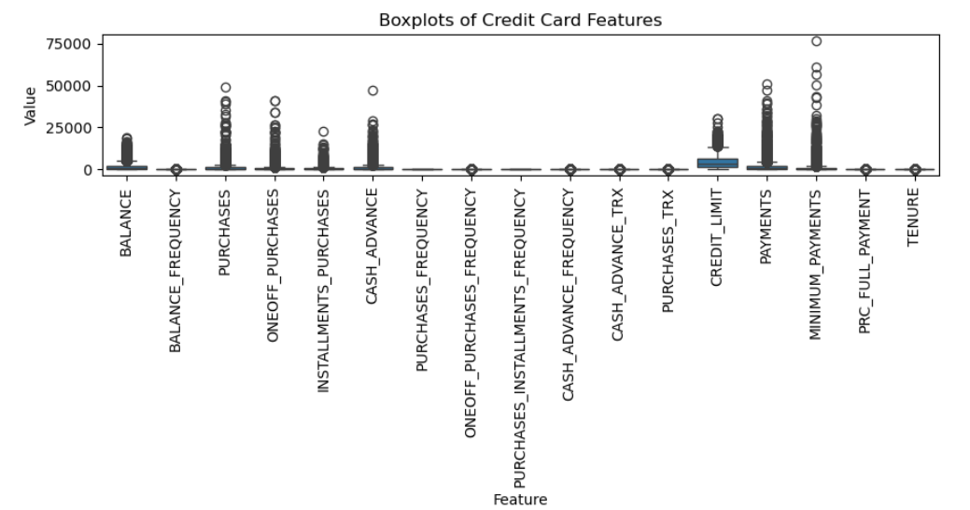
Boxplot
Purpose:
Boxplots visually represent the spread, median, and outliers in each feature.
Useful to detect skewness, variability, and extreme values in customer data.

Slide 16
1. High Skewness and Outliers
Features such as PURCHASES, ONEOFF_PURCHASES, INSTALLMENTS_PURCHASES, CASH_ADVANCE, PAYMENTS, and MINIMUM_PAYMENTS:
Have a long upper whisker and numerous outliers.
Indicates a small number of customers spend/pay significantly more than others.
2. Frequency-Based Features
BALANCE_FREQUENCY, PURCHASES_FREQUENCY, ONEOFF_PURCHASES_FREQUENCY, PURCHASES_INSTALLMENTS_FREQUENCY, CASH_ADVANCE_FREQUENCY, and PRC_FULL_PAYMENT:
Mostly bounded between 0 and 1.
Show less variability but some outliers suggest irregular behavior patterns in a few customers.
3. CREDIT_LIMIT
Moderate spread with a few large outliers.
Shows variation in credit exposure given to customers, but most limits are skewed towards the lower end.

Slide 17
4. Low Variance Features
TENURE:
Shows almost no variability, concentrated around a few values (e.g., 12 months).
Could imply most customers have been with the bank for about the same duration.
5. Important Insight for Preprocessing
Many features are highly skewed and contain extreme outliers.
These may need log transformation or scaling before clustering.
Consider robust scaling or outlier treatment to avoid model distortion
Conclusion:
Boxplots reveal significant variability and outliers across key credit card usage metrics. Proper data preprocessing such as scaling and outlier handling is essential for reliable customer segmentation.

Slide 18
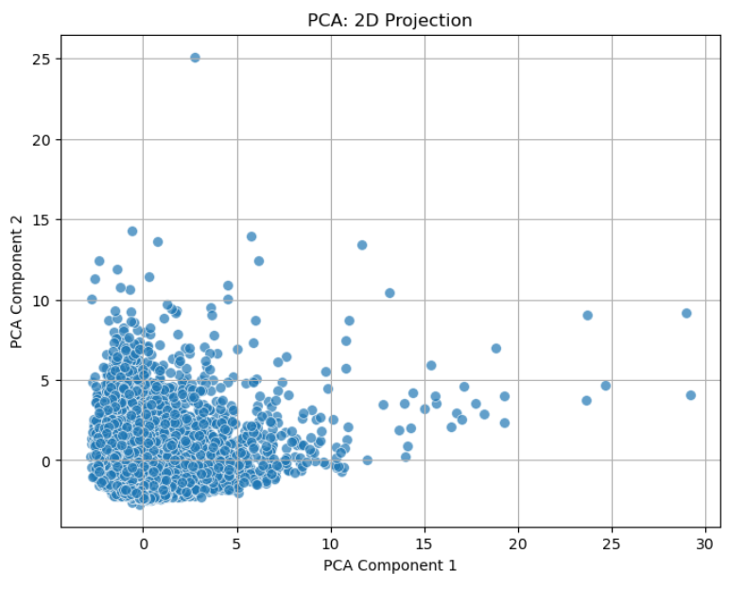
DIMENSIONALITY REDUCTION (PCA & t-SNE)
PCA:
PCA is a dimensionality reduction technique used to simplify complex datasets.
It reduces the number of features while retaining the most of the information.
In this case, PCA is used to project high-dimensional credit card data onto a 2D plane.
Observations:
Data points are densely clustered in the lower left quadrant.
Outliers are present in the upper right quadrant.
Non-uniform distribution with higher concentration near the origin

Slide 19
Analysis :
The 2D projection reveals underlying structure in the data
First two principal components capture significant variance
Further analysis is needed to understand underlying factors
Conclusion:
PCA is a useful tool for visualizing high-dimensional data
The 2D projection provides a simplified representation of the data
Further analysis is needed to uncover deeper insights

Slide 20
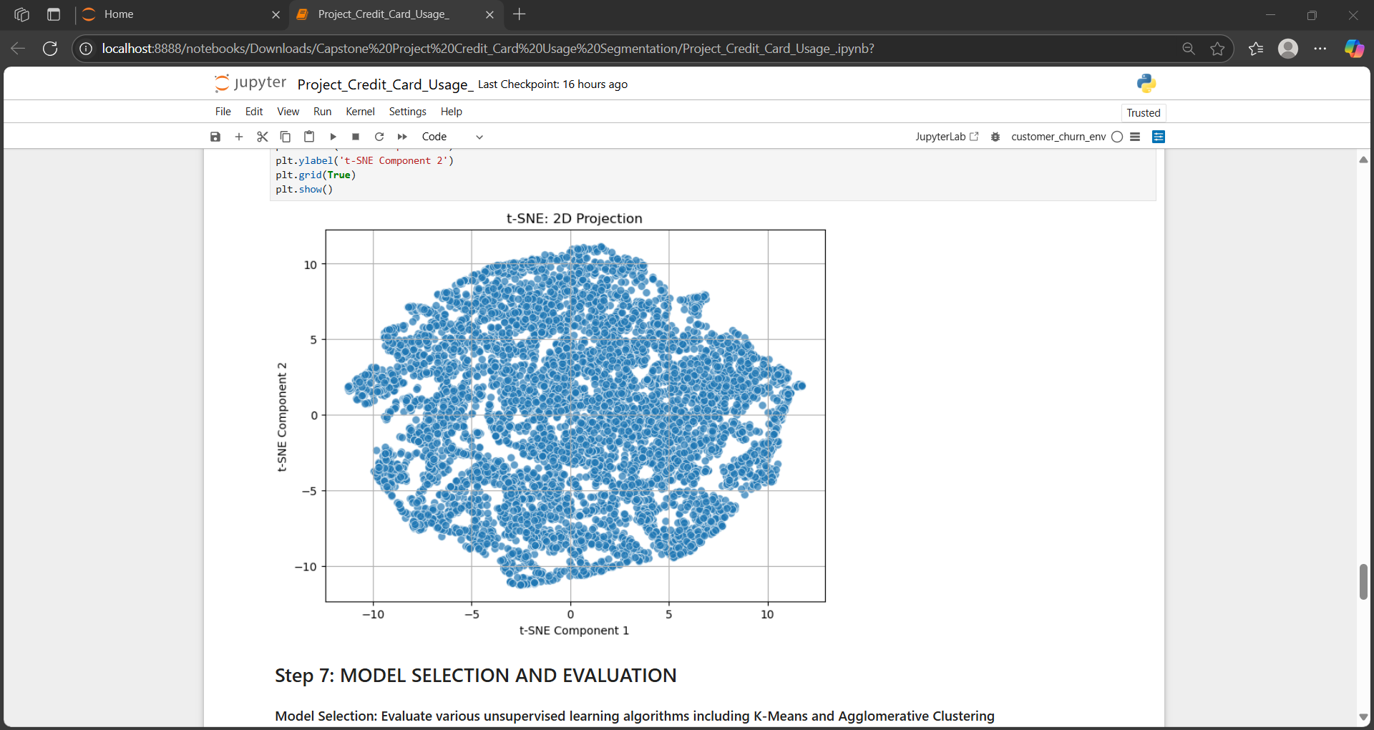
t-SNE:
t-SNE is a non-linear dimensionality reduction technique.
It preserves local structures and relationships in the data.
Used to visualize high-dimensional data in a lower-dimensional space.
Observations:
The data points form a large, dense cluster with some sparse regions
The cluster is not uniformly distributed, with varying densities
No clear outliers or distinct sub-clusters are visible

Slide 21
Analysis:
The 2D projection reveals the underlying structure of the data.
t-SNE has preserved the local relationships between data points.
Further analysis is needed to understand the underlying factors driving the observed patterns.
Conclusion :
t-SNE is a useful tool for visualizing high-dimensional data.
The 2D projection provides a simplified representation of the data.
Further analysis is needed to uncover deeper insights into the credit card usage.

Slide 22
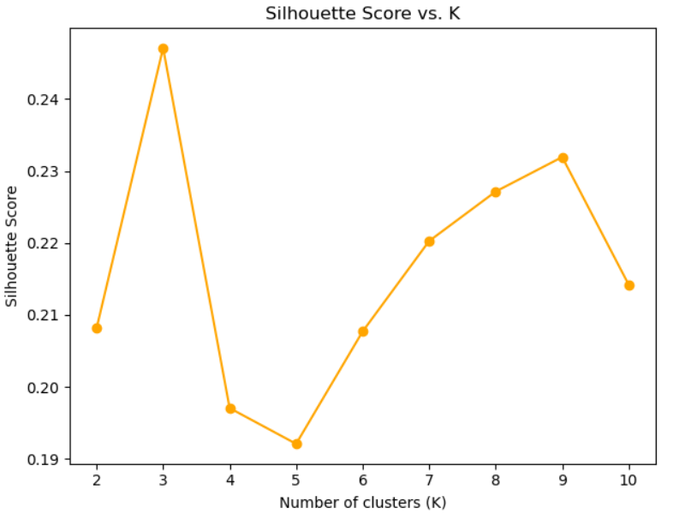
MODEL SELECTION AND EVALUATION
Identifying the Optimal Unsupervised Learning Algorithm for Credit Card Usage Data.
Brief overview of K-Means and Agglomerative Clustering.
Explanation of Silhouette Score and Inertia.
Observations:
The optimal number of clusters (K) is 3, as indicated by the highest Silhouette Score.
The Silhouette Score initially increases from K=2 to K=3, then decreases until K=5, followed by a gradual increase until K=9, and finally decreases again at K=10.
The highest Silhouette Score is achieved at K=3.
The lowest Silhouette Scores are observed at K=4 and K=5.

Slide 23
Additional Points for Consideration:
Context:
The analysis is part of a project on credit card usage, suggesting that the clustering is related to customer segmentation or behavior analysis.
Methodology:
The use of K-Means clustering and Silhouette Score for evaluation indicates a quantitative approach to understanding the data structure.

Slide 24
Applications and Benefits
Targeted Marketing: Enables personalized marketing strategies for different customer segments, leading to higher engagement and coversion rates.
Risk Management: identifiers high-risk customer segments for proactive credit monitoring and risk mitigation, reducing potential defaults.
Customer Retention: Offers insights to develop loyalty programs and personalized rewards, increasing customer satisfaction and retention.
Product Development: Supports data-driven decisions for designing credit card products and services tailored to specific customer needs
Operational Efficiency: Streamlines resources by focusing on high-value or high-risk segments, optimizing resource allocation

Slide 25
Conclusion
Successful Customer Segmentation: Identified distinct customer groups based on usage patterns, providing deeper insights
Targeted Marketing Opportunities: Enabled personalized marketing strategies to improve engagement and response rates.
Enhanced Risk Management: Identified high-risk segments for proactive credit risk management.
Improved Customer Retentio Potential for tailored rewards and services to increase customer loyalty.
Algorithm Performance Analysis: Evaluated multiple algorithms to select the most effective segmentation approach.
Future Scope: Possibilities for further insights byincorporating transaction-level data and exploring supervised models.

Slide 26
Questions ?

Slide 27
Thank You!

