Slide 1
ENGI 301 PocketKerbal Controller Proposal
2/13/23
Rafe Neathery

Slide 2
Background Information
Kerbal Space Program is a popular video game that allows players to build and launch their own space missions
Recognized for educational value: https://www.space.com/kerbal-space-program-10th-anniversary
Over 10 years a vibrant modding community has formed
Some players, inspired by the original Apollo mission control consoles, have built their own consoles to control rockets in the game (More on this in the next slide)
Kerbal Space Program 2 releases in Early Access on February 24th
Improvements/Differences:
Custom selection of controls/displays and how they are realized
My controller will use PocketBeagle (as opposed to Arduino like most projects)
The controller will be designed for use with KSP 2, which will include new unknown features
The design should emphasize modularity, with the ability to swap out controls, or add expansions to the console
This is due to the budget and time constraints of this project, as well as the unknown features of the new sequel.

Slide 3
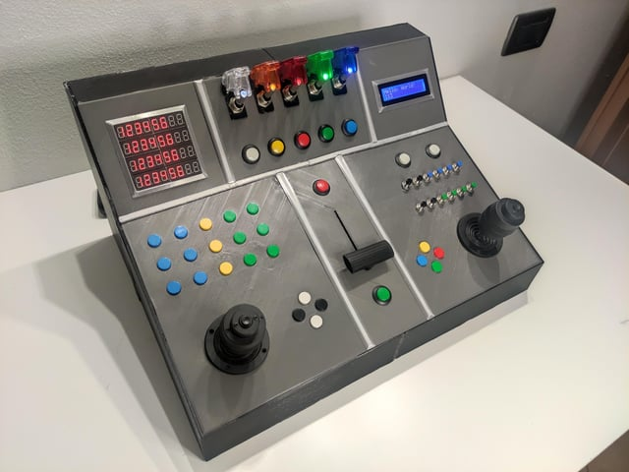
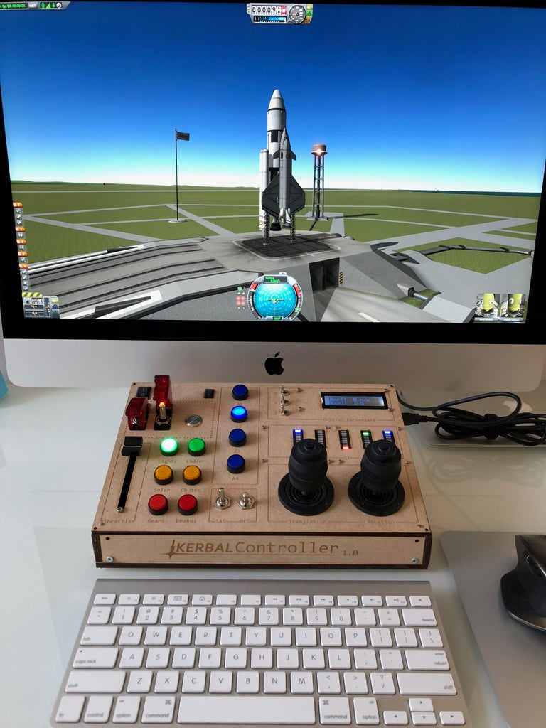
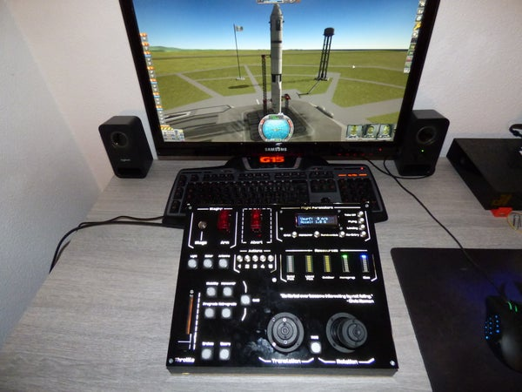
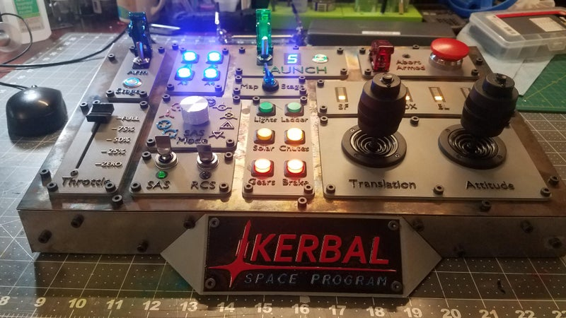
Examples
Instructables: https://www.instructables.com/KerbalController-a-Custom-Control-Panel-for-Rocket/
SubReddit: https://www.reddit.com/r/KerbalControllers/
KSP Forums: https://forum.kerbalspaceprogram.com/index.php?/topic/193227-how-to-build-your-own-kerbal-control-panel/

Slide 4
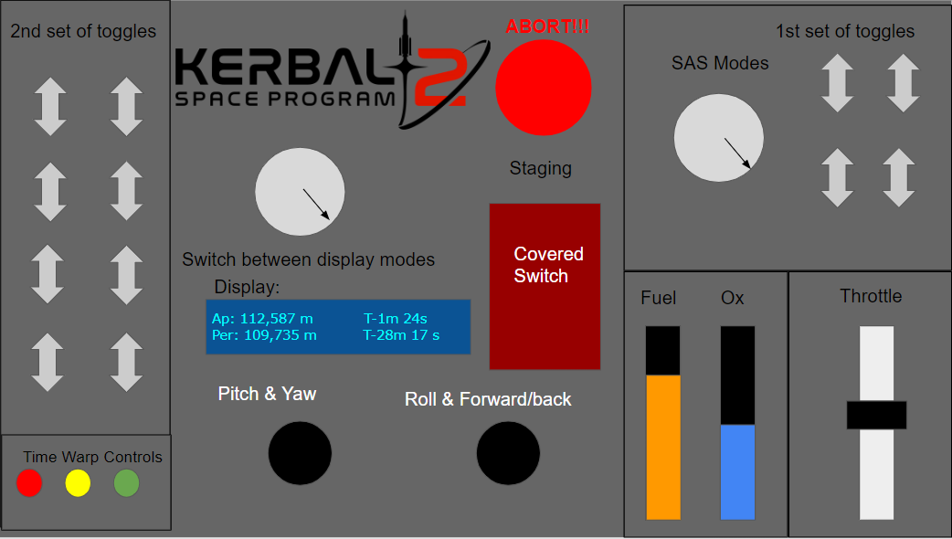
Preliminary Layout

Slide 5
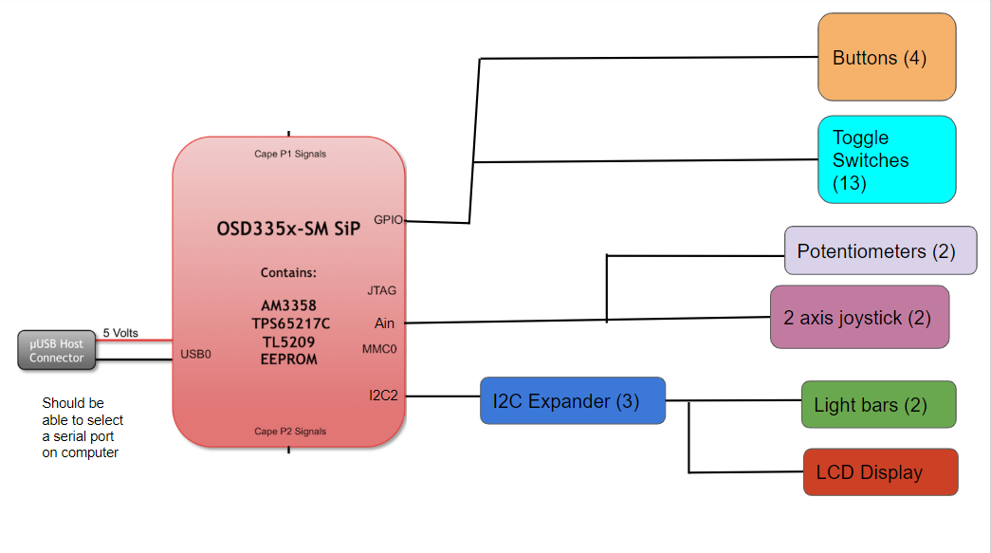
System Block Diagram

Slide 6
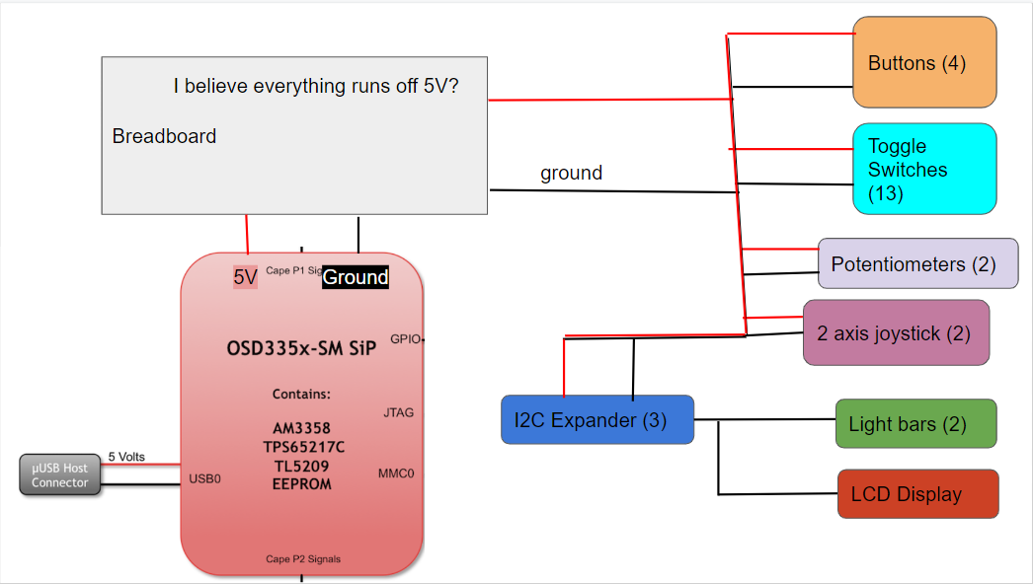
Power Block Diagram

Slide 7
Components / Budget
Component (All from Adafruit) | Need to Buy | Cost
Sliding Potentiometer | 1 | $2.95
Toggle Switch with Cover | 1 | $3.95
Toggle Switch | 12 | $0.86 each
Rotary Potentiometer | 2 | $0.95 each
Aluminum Potentiometer knob | 2 | $2.95 each
Buttons | 3 | ~$1 each?
Big Red Button | 1 | $2.50
Character Displays | 1 | $9.95
LED Bars | 2 | $2 each
2 Axis Joystick | 2 | $6 each
Total: ~$60
Not including PocketBeagle, OEDK resources, things included in parts kit
Haven’t had time to check, but assuming that I can find things for even cheaper on other websites

