Slide 1
The Floras Traiter Project
Extract information from unstructured or semi-structured text of plant descriptions.
The goal is to take information about
  Sources: Web-based treatments of taxonomies.

Slide 2
Current Information Extraction (IE) Projects
These are in various states of completion and all are far from perfect.
eFloras: Extract traits from plant treatments scraped from eFloras.org.
  This is currently the most advanced IE project.
  We may use parts of this as an exemplar for ButterflyNet automated IE.
Lice: Extract traits from PDFs of louse species descriptions and distribution.
  We may use some of the same PDF to Text techniques for ButterflyNet.
Label Babel: Extract information from images of herbarium specimens.
  This is the most ambitious IE project.
  It forced my hand at moving from home grown parsers to using software expertly designed for this purpose.
VertNet: Extract data from vertebrate field notes.
  This was our first IE project and uses the most primitive techniques.
  The notation is probably the most difficult to parse due to idiosyncratic shorthand.
  Mistakes were made but we learned a huge amount about what does and does not work in IE.

Slide 3
What May Be Useful to ButterflyNet
Find “traits” in documents, for our purposes traits are:
  Weights, measurements, colors, shapes, etc.
  They are atomic non-overlapping fragments of text that we attach meaning to.
  They have values, either numeric (with units) or from a controlled vocabulary.
Link traits to the appropriate taxonomic unit and/or the correct higher order trait.
  i.e. both a wing and a body may have their own width or color traits.
  Linking to taxonomic unit is often but not always implied by context.
  Also move parent values to the child trait. Example: “female flowers: petals are red”, we want to make sure that we associate the petal color with female flowers.
From the Lice project: Correctly parse PDFs into text.
  Strip page headers and footers.
  Align text so that text flows from page to page correctly.

Slide 4
Design Goals
The ultimate goal is for end-to-end parsing of information from text/PDFs to formatted output (JSONL, CSV, HTML, etc.).
  There are actually two pipelines per IE project (more on that later).
Use commodity off-the-shelf software.
  I am not an expert in Natural Language Processing (NLP)! I shouldn’t write packages for NLP.
  We do, however, have experience (over 5 years so far) with the NLP subfield of Information Extraction (IE).
Make sure that other people can set up the same automation steps.
  There is nothing magical about what we’re doing and given the time and background knowledge most programmers should be able to do it too.

Slide 5
Strategy
Experts bootstrap and monitor the progress of the project.
  They develop the initial vocabulary which we will enhance.
  They identify the target traits.
  Feedback on the correctness of model output is boring but critical.
Using rule-based models to start.
  We are currently also examining ML models and transfer learning for faster model development.
Having a good test suite is absolutely critical to the success of these projects.
  We’re using standard red/green testing. When a parser fails, we put the failing data into a test to make sure it never happens again.

Slide 6
Method
Using spaCy for both the rule-based and ML models.
  It’s fast and it handles large vocabularies easily. For instance, I load all of the mammal species names into rules from ITIS in a second or two.
Using (abusing?) the spaCy Named Entity Recognition (NER) and Named Entity Linking (NEL).
  NER: identifies atomic traits.
  NEL: links the traits to other traits, species, etc.
  We are not really using spaCy’s models as most people do but ML models often work well when you present a different problem that is similar (isomorphic) to its original design.
We are using spaCy’s rules for the rule-based NER and handwritten finite state machines (FSM) for the NEL.
  We are also using spaCy’s NER ML model.
  We are exploring alternatives for the replacing or augmenting the handwritten FSM for the NEL model. Knowledge database, dependency tree walking, etc.

Slide 7
Rule-Based NER in spaCy (Vocabulary)
There is a CSV file of controlled vocabulary terms that form the basis of the rule-based parsers.
We also query data from other sources like instance ITIS for taxonomic data.
label | pattern | attr | replace
color | black | lower
color | blue | lower
color | brown | lower
dimension | diameter at breast height | lower | dbh

Slide 8
Rule-Based NER in spaCy (Rules)
Rules look like regular expressions applied to token (records):
  This example is for parsing plant colors phrases:
'patterns': [
[
{'ENT_TYPE': 'color_leader', 'OP': '?'},
{'TEXT': {'IN': DASH}, 'OP': '?'},
{'ENT_TYPE': 'color', 'OP': '+'},
{'TEXT': {'IN': DASH}, 'OP': '?'},
{'ENT_TYPE': {'IN': ['color', 'color_follower']},
'OP': '*'},
],
[
{'ENT_TYPE': 'color_leader'},
{'ENT_TYPE': 'color_follower', 'OP': '*'},
],

Slide 9
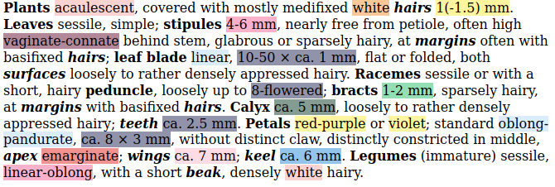
Identified Traits (NER)
Targeted traits are in color.
Plant parts are in bold
Plant subparts are in bold italic.

Slide 10
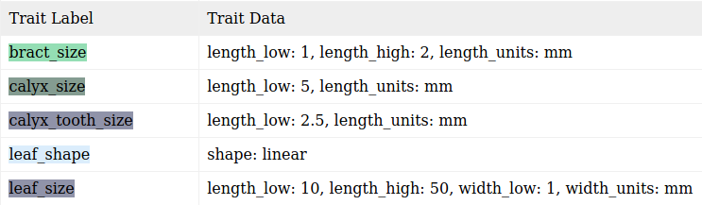
Trait Links (NEL)
The targeted traits are linked to the plant part and subparts. A few examples from the prior treatment.

Slide 11
Finally
Maybe this is useful for ButterflyNet? But, then again, maybe you’re already past these steps.
I would love it if other programmers started doing IE on these kinds of data and improved upon the techniques presented here.
There is a lot of unmined data out there.

