Slide 1
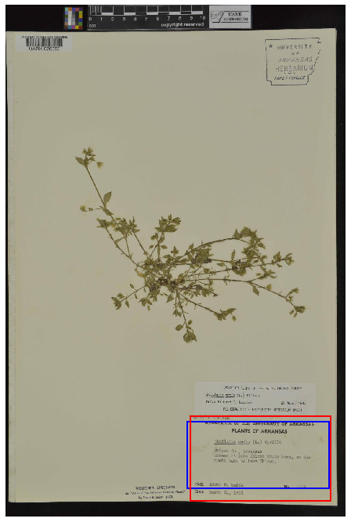
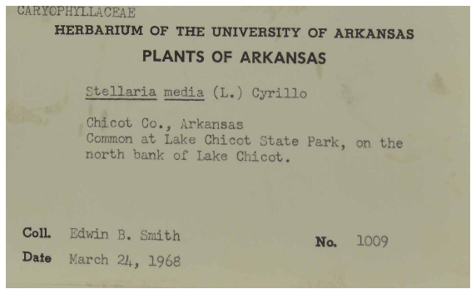
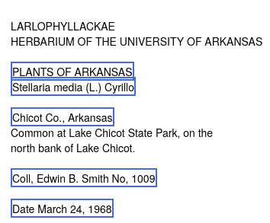
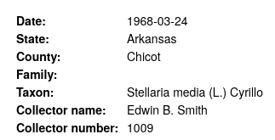
a
b
c
d
a: original herbarium sheet, predicted label (red), target label (blue) b: extracted label based upon the predicted label (red). c: OCR text, identified text (blue). d: extracted information.

