Slide 1
Using the orthology inference scripts from Yang, Y. and S.A. Smith. 2014. Orthology inference in non-model organisms using transcriptomes and low-coverage genomes: improving accuracy and matrix occupancy for phylogenomics to go from atram contigs to aligned orthologs (avoid combining paralogs)
Link to pipeline scripts: https://bitbucket.org/yanglab/phylogenomic_dataset_construction/src/master/
Link to paper: https://academic.oup.com/mbe/article/31/11/3081/2925722

Slide 2
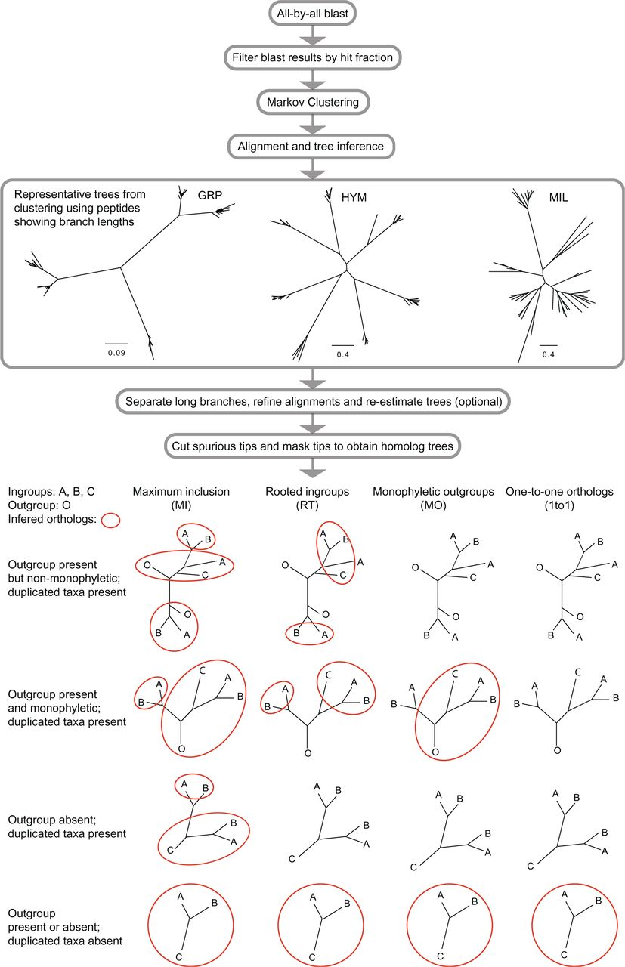
We start here with atram contigs per target locus
Step 5: Build homolog trees
Dependences: raxml, fasttree, phyx(pxclsq,pxcat,pxs2phy,pxs2nex), TreeShrink, mafft and pasta
fasta_to_tree_pxclsq.py
tree_shrink_wrapper.py
mask_tips_by_taxonID_transcripts.py
write_fasta_files_from_trees.py
Step 6: Paralogy pruning to infer orthologs. Use one of the following:
filter_1to1_orthologs.py OR
prune_paralogs_MI.py OR
prune_paralogs_MO.py OR
prune_paralogs_RT.py
Notes:
Questions: W

Slide 3
Step 7: Visualize matrix occupancy stats and constructing the supermatrix

