Slide 1
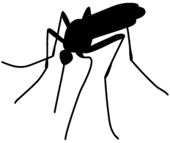
Predicting West Nile virus in mosquitoes across the city of Chicago
Name: Rafel Taye
First Project Presentation
Data:13July2015

Slide 2
Problem and Question
Problem: First human case of West Nile virus was discovered in 2002.
Every week from late spring to fall, mosquito is trapped and tested for virus presence
Result of this tests influence how the city of Chicago allocate its resources in fighting malaria outbreak
Question: Predict when and where different species of mosquitos will test positive for West Nile virus.
It is a classification problem (Wnv present or not)

Slide 3
Data
Data provided by city of Chicago
Train data: consists data from 2007, 2009,2011 and 2013 with test result
Weather data: weather conditions of 2007 to 2014 during the months of tests
Spray data: GIS data where
Test data: requested to predict the test results for 2008, 2010, 2012 and 2014

Slide 4
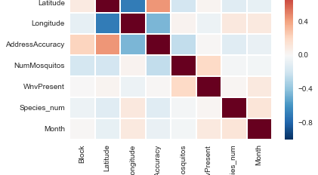
Data Exploration

Slide 5
Next Steps
Merge the three sets of data’s
Train, Weather, Spray
Find any correlation between features and response
Create additional feature columns
The final result should be a dataframe of predicted probability of WnvPresent for test data
Use area under the curve of ROC curve

