Slide 1
Examining COVID-19 Forecasting using Spatio-Temporal Graph Neural Networks Amol Kapoor*, Xue Ben*, Luyang Liu, Bryan Perozzi, Matt Barnes, Martin Blais, Shawn O’Banion published in Google Research
Presenters:
Raffaele Francesco Barbagallo

Slide 2
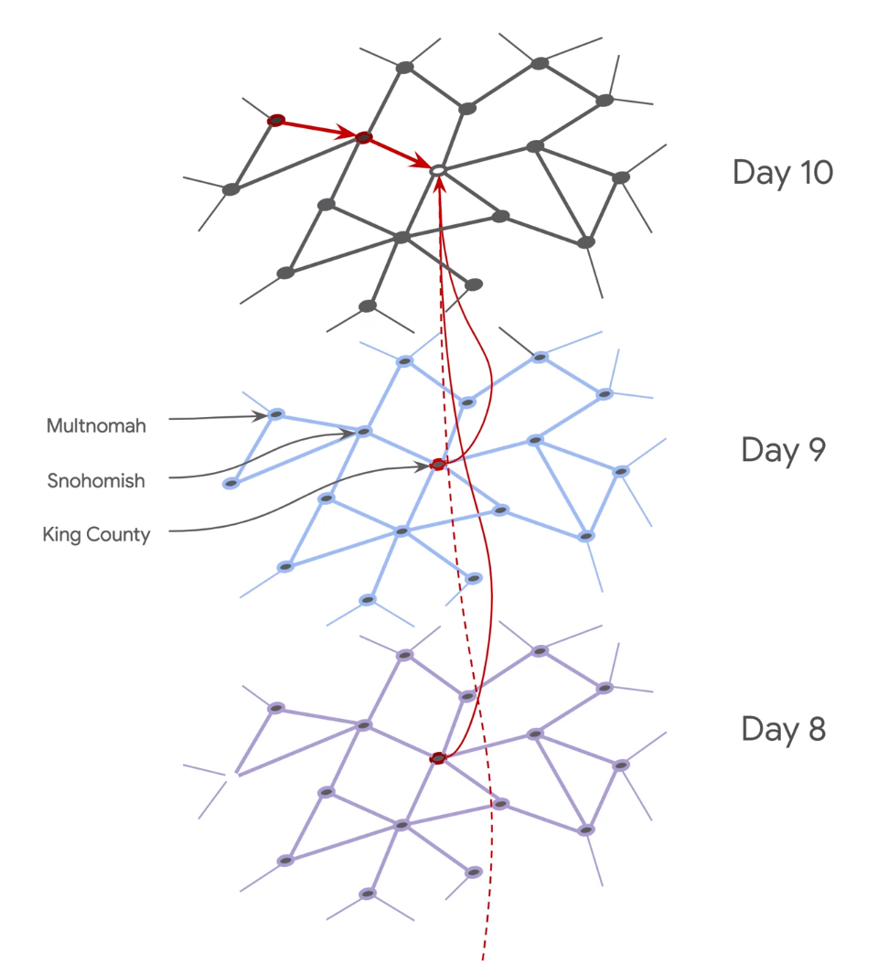
Motivation
Epidemiological modelling mainly uses two approaches:
Agent-based modeling
Time-series learning (curve-fitting, AR, deep learning)
These approaches assume closed-systems where forecasts for a given location does not depend on other locations.
But inter-regional information is important to forecast infections.

Slide 3
Contribution
The proposed approach takes account of:
Inter-region interactions and region-level mobility (GPS data)
Temporal and spatial interactions
Goal:
Makes forecasts on COVID-19 new cases

Slide 4
State of the art
[1] 2019 - Spatio-temporal influenza forecasting
[2] 2019 - Spatio-temporal traffic graphs
[3] 2020 - Understanding the role of international flights in the early spread of COVID-19 to different countries.
[4] 2018 - Spatio-temporal neural networks
[5] 2016 - Semi-supervised classification with graph convolutional networks

Slide 5
Proposed approach
Nodes: represent a single location (in a single time).
Features: state, county, day, past cases (vector for d days), past deaths (vector for d days).
Edges:
Spatial edges: directed location-to-location mobility weighted on mobility flows normalized against intra-flows.
Temporal edges: binary connections to past days.
Layers: county connectivity graph for 100 days (100 layers) from Feb 22nd, 2020 to May 31st, 2020. Direct edges to the 7 nodes before it in time.
Skip connections model:
Spectral graph convolution
Output of each layer is concatenated with a learned embedding from the temporal node features

Slide 6
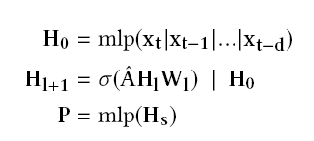
Proposed approach
x is node’s temporal features
H0 is the output of an MLP over the node’s temporal features.
H represents the state at layer l.
Â is the spectral normalized adjacency matrix
Wl is the learned weight matrix (layer l)
σ is a ReLU.
x at time t reaching back d days, while the final prediction is the output of an MLP over s spatial hops.

Slide 7
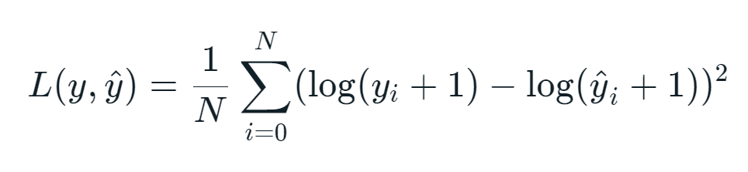
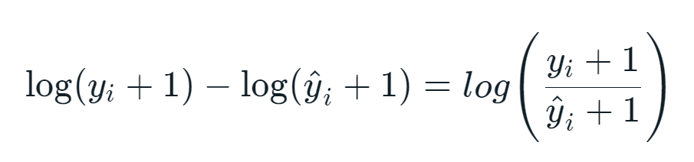
Proposed approach
The employed loss is the MSLE (Mean Squared Logarithmic Error):
Relative (%) difference between true and predicted value
Penalizes underestimates more than overestimates

Slide 8
Experimental Results
Datasets
NYT COVID-19 - https://github.com/nytimes/covid-19-data
State, county, day, past cases and past deaths.
Google COVID-19 Aggregated Mobility Research
GPS mobility data
Anonymized through a Laplace noise mechanism
Google Community Mobility Reports - https://www.google.com/covid19/mobility
Trends at various categories of places
0 as “normal” mobility based on the median value for the corresponding day of the week aggregated per county and categories
Limitations
Not representative of the population as whole
Does not take account of awareness, masks etc.

Slide 9
Experimental Results
Metrics
RMSLE (Root Mean Squared Logarithmic Error)
Relative (%) difference between true and predicted value
Penalizes underestimates more than overestimates
Assumption: target is normally distributed
Pearson Correlation
Prediction: sum of predicted delta and previous day’s cases.
Metrics also calculated for case deltas.
RMSLE | Corr | Δ RSMLE | Δ Corr

Slide 10
Data pre-processing
Common node features: each node contains data about state, county, day, past cases and past deaths.
Aggregated mobility research dataset: edges that contain information about the flow between counties and between states.
Community mobility reports: trends at various categories of places aggregated at the county (node) level.

Slide 11
Training procedure
7 days time horizon
1M steps with MSLE regression loss.
Models were trained to predict the change in the number of cases on day t+1, given previous information.
2 hops of spatial data: used 32 neighbors with the highest edge weight for each hop

Slide 12
Training procedure
Optimizer: ADAM optimizer set to 1e-5
Architecture: 4 hidden layers (64, 32, 32, 32):
MLP - Initial embedding layer (64)
Two hops of time and spatial aggregation (32, 32) with ReLU
MLP - Final prediction layer (32)
Dropout: 0.5 for each layer.
L2 regularization: 5e-4 for each layer.
1 Million steps

Slide 13
Baselines
Previous day: used to understand what the models are able to extract from other features.
ARIMA: treats the time dependent daily new cases as univariate time series. Model chosen by using AIC and BIC.
LSTM: two stacked (32, 16) LSTM layers and a final dense layer. Outputs vector with size 4 (number of steps ahead predictions).
Seq2Seq: encoder-decoder architecture. Dense layer (16) and a GRU layer (32) with Bahdanau attention.

Slide 14
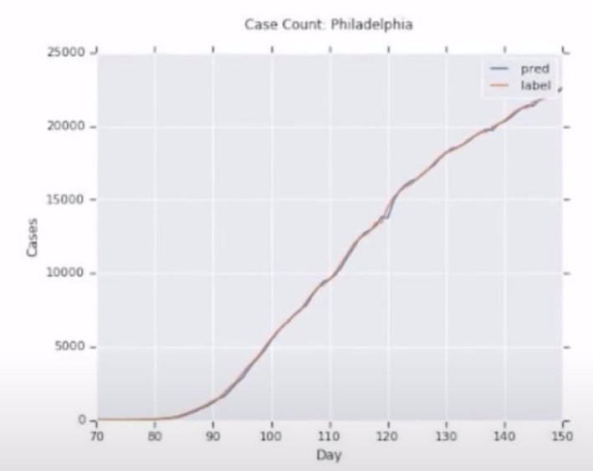
Experimental Results
Model | RMSLE | Corr | Δ RMSLE | Δ Corr
Previous Cases | 0.0226 | 0.9981 | 4.7879 | NaN
Previous Delta | 0.0127 | 0.9965 | 0.9697 | 0.1854
No Mob ARIMA | 0.0124 | 0.9968 | 0.9217 | 0.1449
ARIMA | 0.0144 | 0.9952 | 0.9624 | 0.0966
No Mob LSTM | 0.0125 | 0.9978 | 0.9172 | 0.1540
LSTM | 0.0121 | 0.9978 | 0.9163 | 0.1863
No Mob Seq2Seq | 0.0118 | 0.9976 | 0.8467 | 0.1020
Seq2Seq | 0.0116 | 0.9977 | 0.8634 | 0.2802
GNN | 0.0109 | 0.9980 | 0.7983 | 0.2230

Slide 15
Conclusion
The work proposes a new way to learn from spatio-temporal data and inter-region interactions with Graph Neural Networks
Future works could:
Incorporate new features
Expand the time horizon for long term predictions
Use data from different countries

Slide 16
Questions
Should everyone have public access to mobility data considering that it is actually possible to anonymize it?
Do you think about different fields where it could be possible to apply this approach?
Would you add other features to the model? Which ones?

Slide 17
(Possible) Answers
This approach could be also used in different fields (e.g. migration flows), but also to the same field but with different diseases (influenza).
It could be interesting to add information about nonpharmaceutical interventions like social distancing and quarantine.

Slide 18
Bibliography
[1] Songgaojun Deng, Shusen Wang, Huzefa Rangwala, Lijing Wang, and Yue Ning. 2019. « Graph Message Passing with Cross-location Attentions for Long-term ILI Prediction.» arXiv preprint arXiv:1912.10202 (2019).
[2] Zulong Diao, Xin Wang, Dafang Zhang, Yingru Liu, Kun Xie, and Shaoyao He. 2019. « Dynamic spatial-temporal graph convolutional neural networks for traffic forecasting.» In Proceedings of the AAAI Conference on Artificial Intelligence, Vol. 33. 890–897.
[3] Aniruddha Adiga, Srinivasan Venkatramanan, James Schlitt, Akhil Peddireddy, Allan Dickerman, Andrei Bura, Andrew Warren, Brian D Klahn, Chunhong Mao, Dawen Xie, Dustin Machi, Erin Raymond, Fanchao Meng, Golda Barrow, Henning Mortveit, Jiangzhuo Chen, Jim Walke, Joshua Goldstein, Mandy L Wilson, Mark Orr, Przemyslaw Porebski, Pyrros A Telionis, Richard Beckman, Stefan Hoops, Stephen Eubank, Young Yun Baek, Bryan Lewis, Madhav Marathe, and Chris Barrett. 2020. «Evaluating the impact of international airline suspensions on the early global spread of COVID-19.» medRxiv (2020).
[4] Uri Shaham, Kelly Stanton, Henry Li, Boaz Nadler, Ronen Basri, and Yuval Kluger. 2018. « SpectralNet: Spectral Clustering using Deep Neural Networks.» arXiv preprint arXiv:1801.01587 (2018).
[5] Thomas N Kipf and MaxWelling. 2016. Semi-supervised classification with graph convolutional networks. arXiv preprint arXiv:1609.02907 (2016).

Slide 19
THE END
Examining COVID-19 Forecasting using Spatio-Temporal Graph Neural Networks Amol Kapoor*, Xue Ben*, Luyang Liu, Bryan Perozzi, Matt Barnes, Martin Blais, Shawn O’Banion
Thank you for your attention!
Raffaele Francesco Barbagallo

