Slide 1
noWorkflow

Slide 2
Anyone can cook (Auguste Gusteau – Ratatouille)
“computing is now an integral part of every aspect of science, but most scientists are never taught how to build, use, validate, and share software well”
http://software-carpentry.org
Besides Software Engineers, there are laymen developing software
Biologists
Astronomers
Physicists
Etc.

Slide 3
Exploratory development
Multiple cycles of changes and executions with different parameters and input data
Analysis of the outputs to guide further hypothesis
Necessity of identifying changes that lead to better outputs
Hypothesis
Change
Execution
Analysis
Results

Slide 4
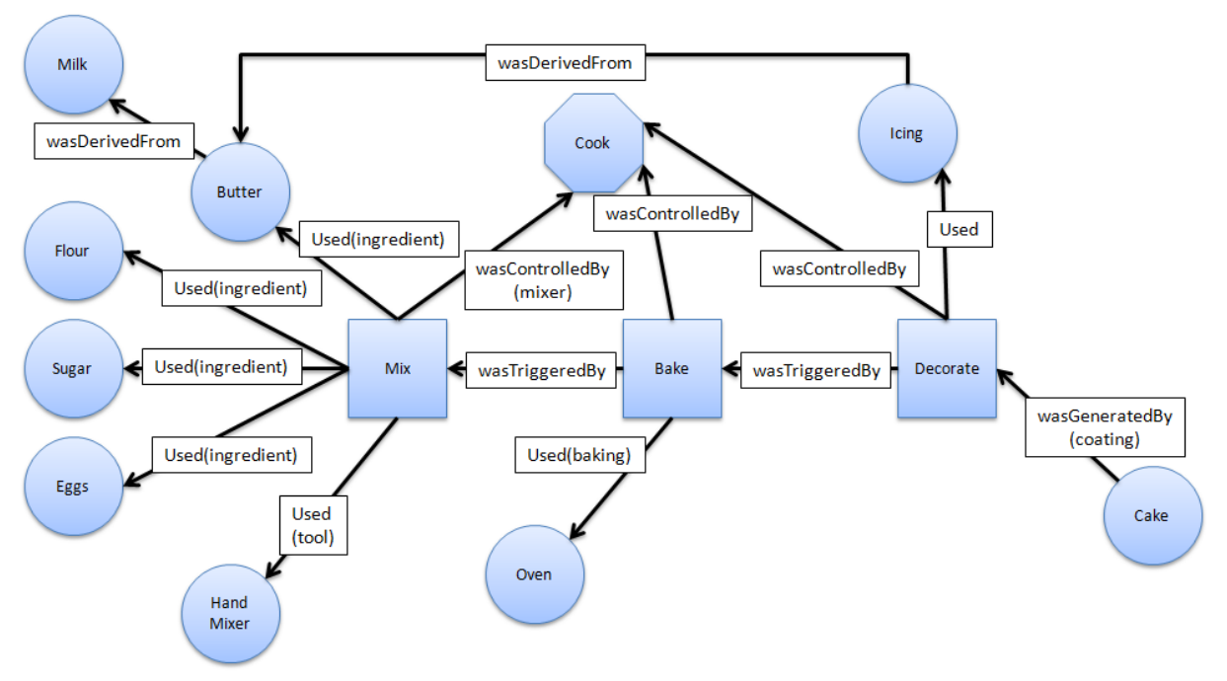
Data Provenance
(Kohwalter 2013)

Slide 5
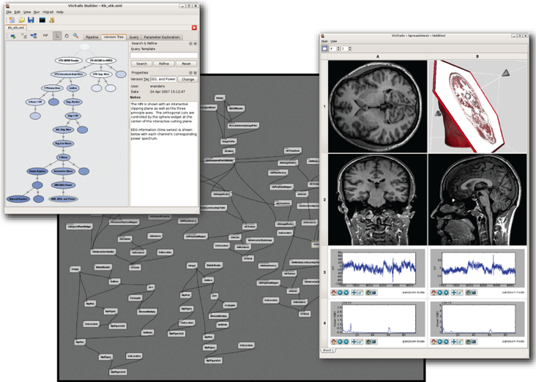
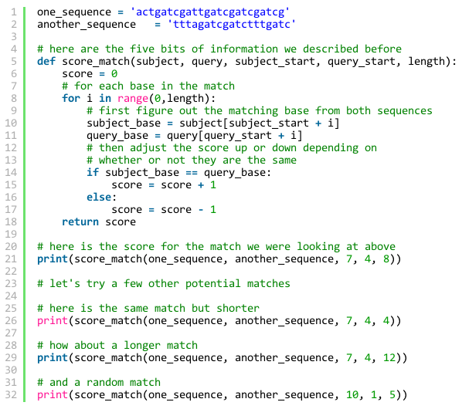
Options for Leyman
vs.
Complete SWfMS
Scripts with CM support
Scripts and nothing more

Slide 6
On-the-fly versioning: noWorkflow
Non-intrusive versioning of Python scripts and their execution data
Static analysis to capture script version at fine grain via AST
Dynamic analysis to capture data transformations via Profiling API and Reflection
Relational database for logical data
Sha1-indexed database for physical data (content)

Slide 7
Collected data
Function definitions
Arguments
Dependencies
Python script
Module dependencies
Global variables
Execution
Context attributes
Function calls
File accesses
Argument values
Global values

Slide 8
Collecting module dependencies
sha1: 359aad
sha1: 97f2ab
import csv
import json
threshold = 15
def run_simulation(data_a, data_b):
global threshold
...
def csv_read(f):
fc = open(f, 'rU')
...
def extract_column(data, column):
x = float(data[column])
...
def plot(x, y):
...
plt.savefig("output.png")
...
csv
re
…
sha1: c6596a
json
sha1: d76350
…
json.decoder
sha1: 397207
Json.encoder

Slide 9
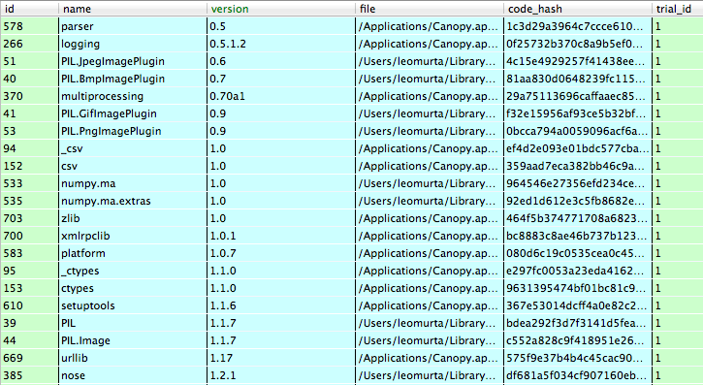
Collecting module dependencies
Module dependencies

Slide 10
Collecting function definitions
sha1: baa730
def run_simulation(data_a, data_b):
global threshold
...
import csv
import json
threshold = 15
def run_simulation(data_a, data_b):
global threshold
...
def csv_read(f):
fc = open(f, 'rU')
...
def extract_column(data, column):
x = float(data[column])
...
def plot(x, y):
...
plt.savefig("output.png")
...
Arguments: data_a, data_b
Global: threshold
…
sha1: a1149d
def csv_read(f):
fc = open(f, 'rU')
...
Arguments: f
Calls: open
…

Slide 11

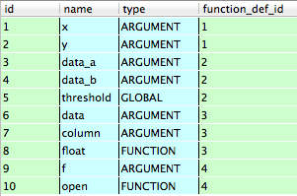
Collecting function definitions
Function definitions
Arguments, Global variables, and Function calls

Slide 12
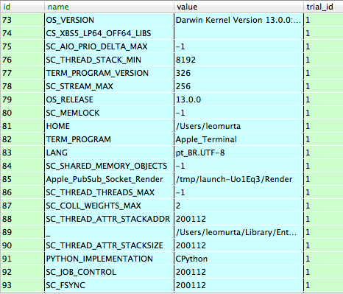
Collecting context attributes
Context attributes

Slide 13
Collecting function calls and file accesses
script
csv_read
run_simulation
scatter
…
…
plot
open
reader
…
xlabel
ylabel
savefig
open
import csv
import json
threshold = 15
def run_simulation(data_a, data_b):
global threshold
...
def csv_read(f):
fc = open(f, 'rU')
...
def extract_column(data, column):
x = float(data[column])
...
def plot(x, y):
...
plt.savefig("output.png")
...

Slide 14
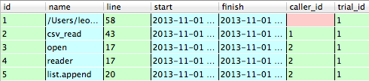

Collecting execution traces
Function calls
…
File accesses

Slide 15
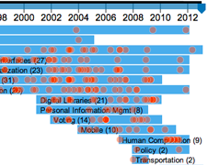
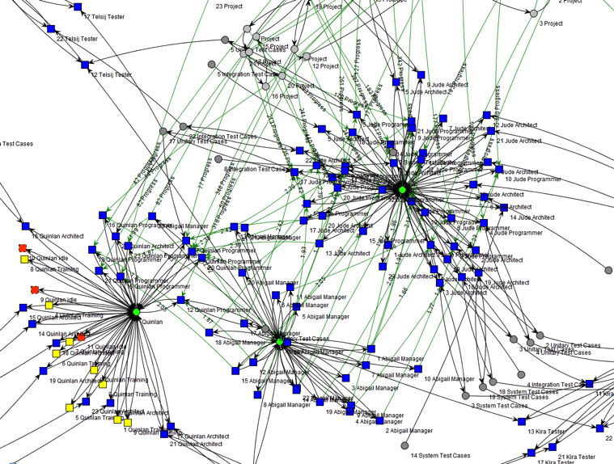
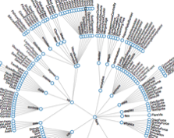
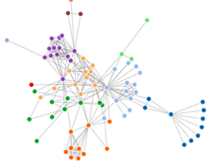
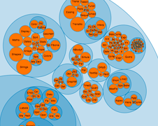
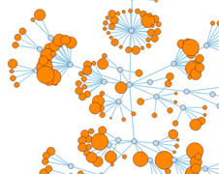
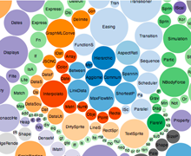
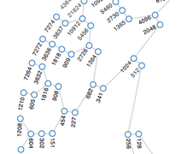
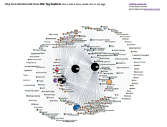
Under development…
Prolog
D3.js
Visualization and Query

