Slide 1
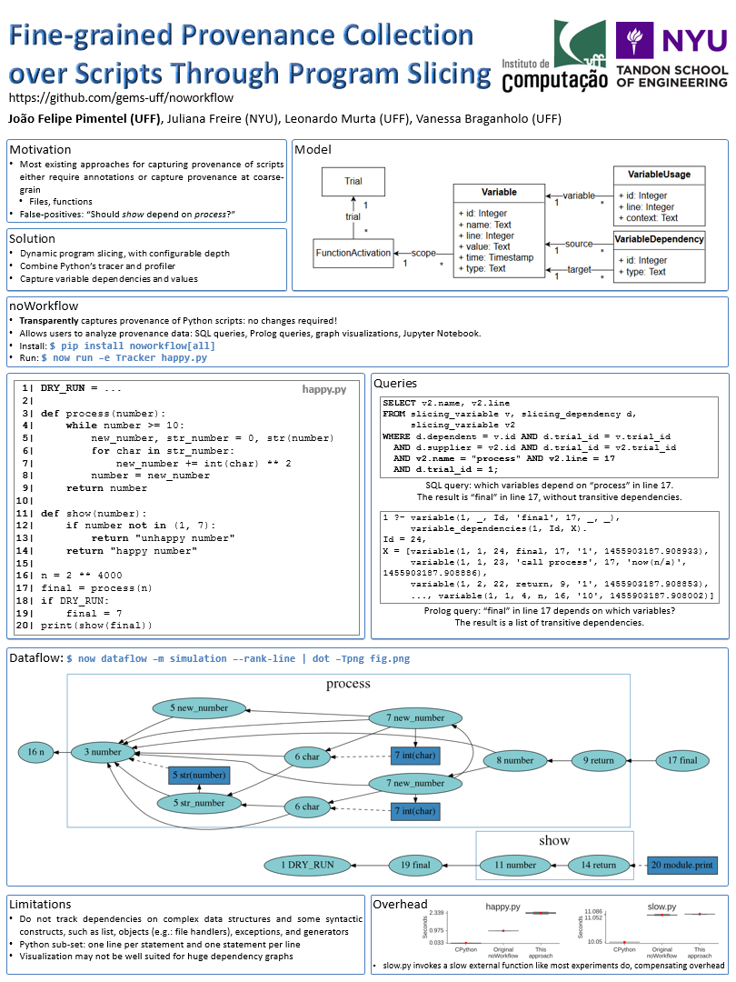

Fine-grained Provenance Collection over Scripts Through Program Slicing
jpimentel@ic.uff.br
github.com/gems-uff/noworkflow
João Felipe Nicolaci Pimentel (UFF), Juliana Freire (NYU), Leonardo Murta (UFF),
Vanessa Braganholo (UFF)
Notes:
Hello, my name is João Felipe and I have a poster about fine-grained provenance collection over scripts through program slicing

Slide 2
Provenance of Scripts
YesWorkflow
McPhillips et al., 2015
API
Bochner; Gude; Schreiber, 2008
StarFlow
Angelino; Yamins; Seltzer, 2010
RDataTracker
Lerner and Boose, 2014
noWorkflow
Murta et al., 2014
Sumatra
Davison, 2012
LLVM compiler
Tariq et al., 2012
DataTracker
Stamatogiannakis et al., 2014
…
Notes:
In the last decade, many approaches have been proposed to capture provenance from scripts

Slide 3
Provenance of Scripts
YesWorkflow
McPhillips et al., 2015
API
Bochner; Gude; Schreiber, 2008
StarFlow
Angelino; Yamins; Seltzer, 2010
RDataTracker
Lerner and Boose, 2014
noWorkflow
Murta et al., 2014
Sumatra
Davison, 2012
LLVM compiler
Tariq et al., 2012
DataTracker
Stamatogiannakis et al., 2014
…
Coarse-grained Provenance
Files
Functions
…
Notes:
However, most of them work at coarse grain, capturing files and functions

Slide 4
1| DRY_RUN = ...
2|
3| def process(number):
4| ...
10|
11| def show(number):
12| ...
15|
16| n = 10
17| final = process(n)
18| if DRY_RUN:
19| final = 7
20| print(show(final))
Notes:
In this script, we attribute the result of process to “final” variable.
Then, if DRY_RUN is True, we replace the final variable.
Finally, we pass “final” as parameter to show

Slide 5
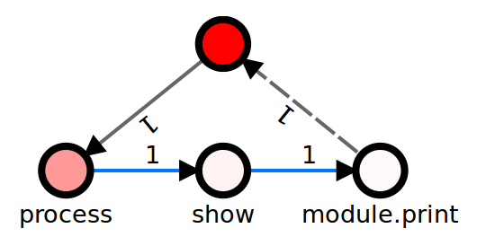
1| DRY_RUN = ...
2|
3| def process(number):
4| ...
10|
11| def show(number):
12| ...
15|
16| n = 10
17| final = process(n)
18| if DRY_RUN:
19| final = 7
20| print(show(final))
happy.py
Notes:
A coarse-grained provenance would indicate that show depends on process, because it were called after it

Slide 6
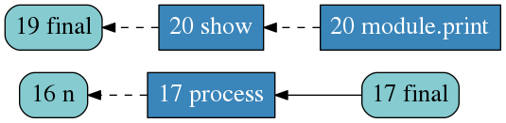
1| DRY_RUN = True
2|
3| def process(number):
4| ...
10|
11| def show(number):
12| ...
15|
16| n = 10
17| final = process(n)
18| if DRY_RUN:
19| final = 7
20| print(show(final))
happy.py
Notes:
However, with fine-grained provenance, we would be able to say that these call are independent should DRY_RUN be True

Slide 7
Fine-grained Provenance Collection over Scripts Through Program Slicing
jpimentel@ic.uff.br
github.com/gems-uff/noworkflow
João Felipe Nicolaci Pimentel (UFF), Juliana Freire (NYU), Leonardo Murta (UFF),
Vanessa Braganholo (UFF)
Notes:
I invite you to see our poster and understand how we perform fine-grained provenance collection on python scripts

