Slide 1


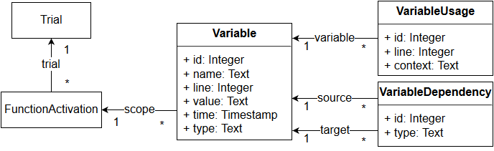
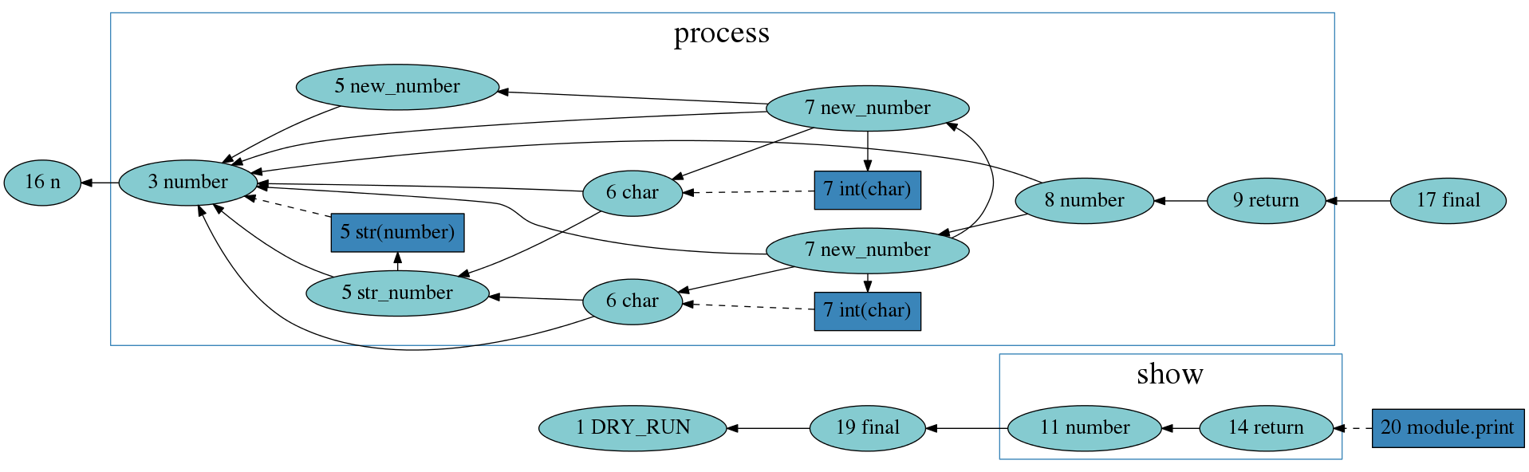
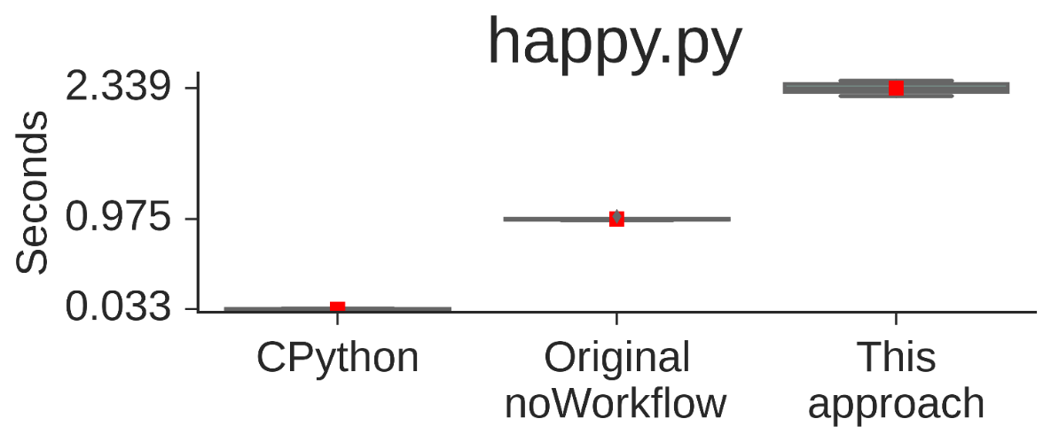
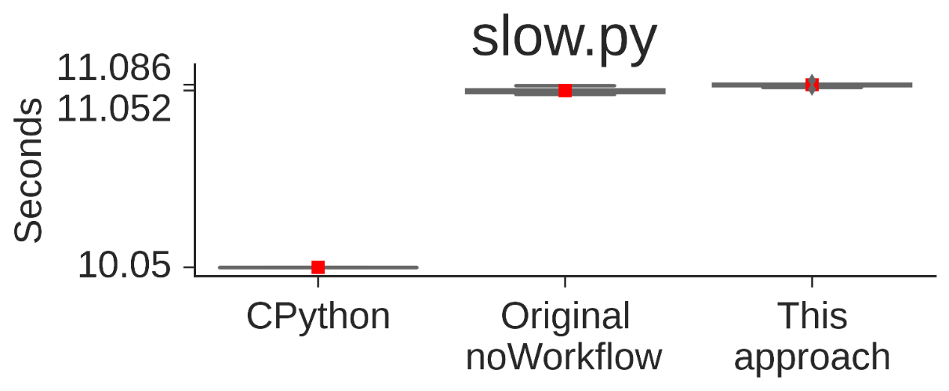
Fine-grained Provenance Collection over Scripts Through Program Slicing
https://github.com/gems-uff/noworkflow
João Felipe Pimentel (UFF), Juliana Freire (NYU), Leonardo Murta (UFF), Vanessa Braganholo (UFF)
Motivation
Most existing approaches for capturing provenance of scripts either require annotations or capture provenance at coarse-grain
Files, functions
False-positives: “Should show depend on process?”
Model
Solution
Dynamic program slicing, with configurable depth
Combine Python’s tracer and profiler
Capture variable dependencies and values
noWorkflow
Transparently captures provenance of Python scripts: no changes required!
Allows users to analyze provenance data: SQL queries, Prolog queries, graph visualizations, Jupyter Notebook.
Install: $ pip install noworkflow[all]
Run: $ now run –e Tracker happy.py
1| DRY_RUN = ...
2|
3| def process(number):
4| while number >= 10:
5| new_number, str_number = 0, str(number)
6| for char in str_number:
7| new_number += int(char) ** 2
8| number = new_number
9| return number
10|
11| def show(number):
12| if number not in (1, 7):
13| return "unhappy number"
14| return "happy number"
15|
16| n = 2 ** 4000
17| final = process(n) 18| if DRY_RUN:
19| final = 7 20| print(show(final))
Queries
happy.py
SELECT v2.name, v2.line
FROM slicing_variable v, slicing_dependency d,
slicing_variable v2
WHERE d.dependent = v.id AND d.trial_id = v.trial_id
AND d.supplier = v2.id AND d.trial_id = v2.trial_id
AND v2.name = "process" AND v2.line = 17
AND d.trial_id = 1;
SQL query: which variables depend on “process” in line 17. The result is “final” in line 17, without transitive dependencies.
1 ?- variable(1, _, Id, 'final', 17, _, _),
variable_dependencies(1, Id, X).
Id = 24,
X = [variable(1, 1, 24, final, 17, '1', 1455903187.908933),
variable(1, 1, 23, 'call process', 17, 'now(n/a)', 1455903187.908886),
variable(1, 2, 22, return, 9, '1', 1455903187.908853),
..., variable(1, 1, 4, n, 16, '10', 1455903187.908002)]
Prolog query: “final” in line 17 depends on which variables? The result is a list of transitive dependencies.
Dataflow: $ now dataflow –m simulation –-rank-line | dot –Tpng fig.png
Limitations
Do not track dependencies on complex data structures and some syntactic constructs, such as list, objects (e.g.: file handlers), exceptions, and generators
Python sub-set: one line per statement and one statement per line
Visualization may not be well suited for huge dependency graphs
Overhead
slow.py invokes a slow external function like most experiments do, compensating overhead

