Slide 1


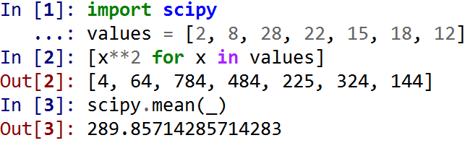
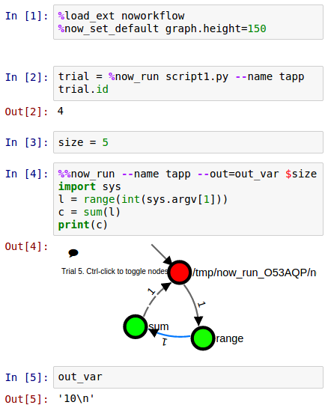
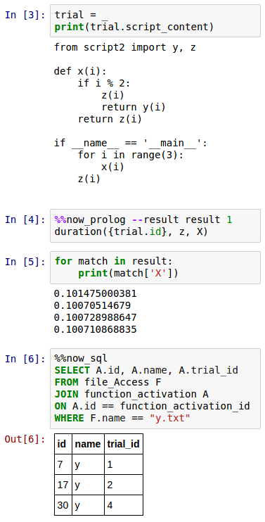
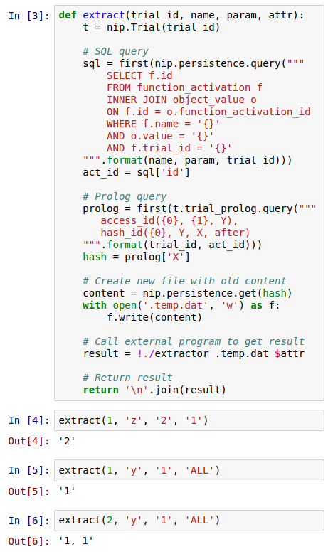


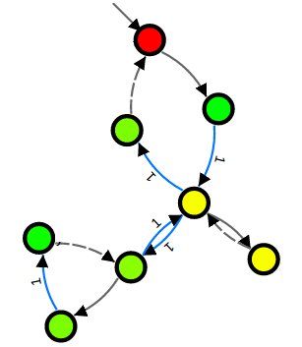
Collecting and Analyzing Provenance on Interactive Notebooks
When IPython meets noWorkflow
https://github.com/gems-uff/noworkflow
João Felipe Nicolaci Pimentel (UFF), Juliana Freire (NYU), Leonardo Murta (UFF), Vanessa Braganholo (UFF)
Motivation
Interactive Notebooks
Documents with code, text, plots and rich media
Exploratory research
Lack of provenance support. Interactive notebook documents do not capture history, environment, intermediate results, and inputs
Reproducibility of results is compromised
noWorkflow
Transparently captures provenance of Python scripts
no changes required!
Allows users to analyze provenance data
Install: $ pip install noworkflow[all]
Installs noWorkflow, PyPosAST, Flask,
IPython Notebook, PySWIP
Run: $ now run script.py 0 1
1| from script2 import y, z
2|
3| def x(i):
4| if i % 2:
5| z(i)
6| return y(i)
7| return z(i)
8|
9| for i in range(3):
10| x(i)
11| z(i)
script1.py
Provenance
IPython
Shell that interactively executes cells of code
Superset of Python: line magic, cell magic, bang
IPython Notebook: interactive notebook with more than 500,000 active users
Deployment
Environment Variables
PATH, PWD, …
Imported Modules & dependencies
script2: 1.0.2; random: 2.7.6; …
1| from random import random
2| from time import sleep
3| def y(i):
4| sleep(.01)
5| with open('y.txt', 'a') as f:
6| f.write('- {}\n').format(i))
7| def z(i):
8| sleep(.1)
9| with open('z.txt', 'w') as f:
10| f.write('- {}\n').format(i))
11|
12| __version__ = '1.0.2'
script2.py
Definition
Global Variables
Function definitions with arguments
x(i)
Execution
Function Calls (activations) with parameter values and return values
range(3) => [0, 1, 2]; x(0) => None; z(0) => None; x(1) => None; z(1) => None
y(1) => None; x(2) => None; z(2) => None; z(2) => None
File content before and after each open
‘in.dat’, ‘out.dat’
Program arguments and globals
Args = “0 1”
Provenance collection
Provenance Analysis
Advanced Analysis
Use Python to combine SQL queries, Prolog queries, intermediate file content, and program invocations
Trial object attribute
Line Magic now_run
Cell Magic now_run
Cell Magic now_prolog
Cell Magic now_sql
Provenance visualization
Trial 1. Double-click to toggle nodes
/home/joao/projects/tapp15/script1.py
z
range
x
Conclusion
Mechanism to collect and analyze provenance for IPython Notebooks
Collection method: invoke noWorkflow through IPython magics
Analytic tools: SQL queries, Prolog queries, object properties, graphs
y
x
z
noWorkflow tracks history, environment and intermediate results
-> Reproducible notebooks
z

