Slide 1
JSR-352 Batch Applications for the Java Platform
Simon Martinelli / sm@simas.ch / @simas_ch

Slide 2
Java Community Process / www.jcp.org
JSR-352 Expert Group
Chris Vignola, IBM (Lead)
Joe Pullen, Credit Suisse
Mahesh Kannan, Oracle
Michael Minella
Simon Martinelli
Tim Fanelly, IBM
Wayne Lund, VMWare
Java EE 7
Spring Batch 3.0

Slide 3
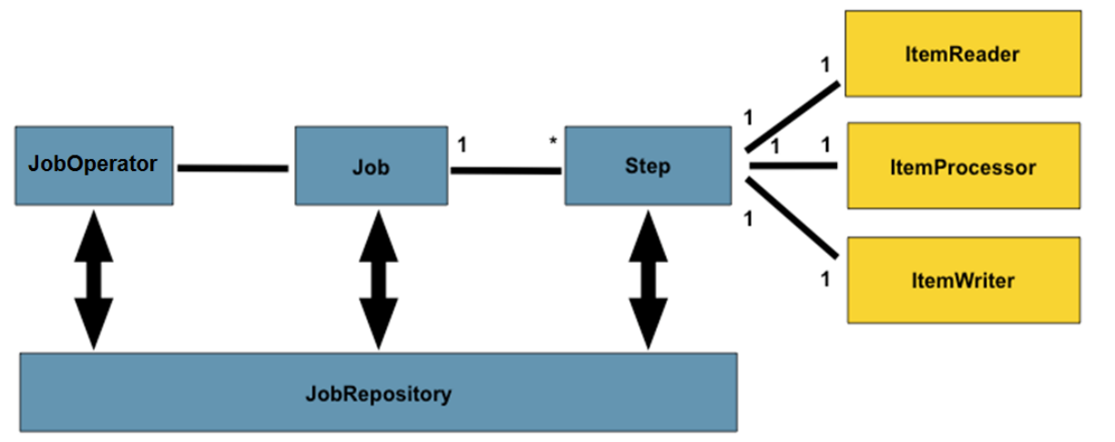
https://www.jcp.org/en/jsr/detail?id=352
<job id="myJob" xmlns="http://xmlns.jcp.org/xml/ns/javaee" version="1.0">
<flow id="flow1" next="step3">
<step id="step1" next="step2">
<batchlet ref="myBatchlet1"/>
</step>
<step id="step2" >
<chunk item-count="3">
<reader ref="myItemReader"/>
<writer ref="myItemWriter"/>
</chunk>
</step>
</flow>
<step id="step3" >
<batchlet ref="myBatchlet2"/>
</step>
</job>
JobOperator jobOperator = BatchRuntime.getJobOperator();
Long executionId = jobOperator.start("myJob", new Properties());
JobExecution jobExecution = jobOperator.getJobExecution(executionId);
https://github.com/javaee-samples/javaee7-samples

