Slide 1
WELCOME
Spring Batch - Field Report
Michael Beer, Raffael Schmid
September 27th, 2013
Notes:
Michael Beer a.k.a Mugi und ich hatten im ersten Halbjahr dieses Jahres Möglichkeit ein Loader basierend auf Spring Batch zu implementieren.
Projekt war bei einer Schweizer Grossbank – nicht CS
Das ganze hat uns doch so viel Spass gemacht, dass wir gedacht haben, wir könnten die Erfahrungen auch mit euch teilen.
Business Domäne spielt im Sales Umfeld
Kundenberater kann seine Opportunitäten über Web GUI erfassen, via Sekretärin, Excel und Fileupload über den Loader;)
btw: Andere Applikationen können via diese Schnittstelle auch Daten liefern.

Slide 2
AGENDA
Spring Batch framework and lessons learned
Execution environment – Field Report
Batch Applications for the Java Platform (JSR-352)
Notes:
Im ersten Teil zeigen wir einige Grundlagen über Spring Batch – das unseren erachtens beste Java Batch Framework (weil wir die anderen nicht kennen).
Im zweiten Teil zeigen wir worüber man sich bei der Integration Gedanken machen kann respektive was Spring Batch nicht liefert.
Im dritten Teil gehen wir noch kurz auf den neuen Standard JSR-352 Batch Applications for the Java Platform vor.

Slide 3
AGENDA
Spring Batch framework and lessons learned
Execution environment – Field Report
Batch Applications for the Java Platform (JSR-352)
Notes:
Im ersten Teil zeigen wir einige Grundlagen über Spring Batch – das unseren erachtens beste Java Batch Framework (weil wir die anderen nicht kennen).
Im zweiten Teil zeigen wir worüber man sich bei der Integration Gedanken machen kann respektive was Spring Batch nicht liefert.
Im dritten Teil gehen wir noch kurz auf den neuen Standard JSR-352 Batch Applications for the Java Platform vor.

Slide 4
Roadmap
Version | Description
1.x | Single-process, possibility multi-threaded execution
2.x | New features enabling an application to scale to multiple processes
Java 7 | JSR-352 - Batch Applications for the Java Platform
3.0 M1 | Alignement with JSR-352 (70/155 TCK)
Notes:
http://spring.io/blog/2013/08/23/spring-batch-3-0-milestone-1-released
Out of the 155 SE tests in the JSR-352 TCK, this release passes 70.
Technology Compatibility Kit
1.1.4 2009

Slide 5
Job/Step Stereotypes
Job
*
Step
*
Job Instance
*
*
Job Execution
*
Step Execution
Job Execution
Context
Step Execution
Context

Slide 6

Meta-Data Schema
STEP EXECUTION
CONTEXT
JOB INSTANCE
JOB
PARAMETER
n
1
1
1
serialized context
1
n
cleanup
STEP EXECUTION
1
JOB EXECUTION
n
1
1
JOB EXECUTION
CONTEXT
Notes:
Prefix kann gewählt werden.
Ansonten müssen die Namen übernommen werden (Namenskonvention der Firma=
Achtung: Serialisierte Objekte in Context Tabellen
Ob Jobs am laufen sind finde ich nur über das Repository raus. Es gibt keine Möglichkeit das über das Memory zu tun.
Skripts für:
DB2
Derby
HSQL
Oracle
SqlServer
Sybase
http://docs.spring.io/spring-batch/reference/html/metaDataSchema.html
Serializing
Basiert auf Jackson, wird in JSON serialisiert
renaming der Klassen, Packete ist ein Problem
Zyklische Abhängigkeiten sind ein Problem von Jackson
Cleanup muss selber implementiert werden

Slide 7
Job/Step/Tasklet configuration
<job id="job" restartable="false“>
<validator ref="validator" />
<step id="step">
<partition step="partitionerStep" partitioner="partitioner" />
</step>
<decision id="decision" decider="decider">
<next on="*" to="nextStep" />
<end on="FAILED" />
</decision>
</job>
<step id="partitionerStep">
<tasklet transaction-manager="transactionManager">
<chunk reader=“pagingItemreader" processor="processor" writer="writer“ commit-interval="10“
skip-policy=“skipPolicy“/>
<listeners>
<listener ref="listener" />
</listeners>
</tasklet>
</step>
Notes:
Vieles kann direkt über die Konfiguration gelöst werden. Es braucht keine Implementierung für JDBC Reader
Validator für JobParameter
- Liste von required und optional JobParameters
Zusätzlich sind noch
Abstract / Parent
SQL
Composite pattern
Splitt to execute steps in parallel

Slide 8
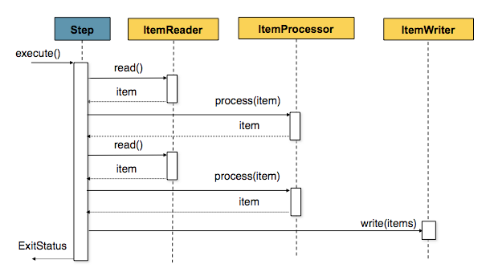
Chunk / Read / Process / Write
commit-interval=2
items.size() == commit-interval
(Source: http://docs.spring.io/spring-batch/reference/html/configureStep.html)

Slide 9
Scalability
Typ | Local/Remote | Description
Multi-threaded Step | Local | A step is multithreaded (TaskExecutor)
Parallel Steps | Local | Executes steps in parallel using multithreading
Partitioning Step | Local Remote | Partitions data and splits up processing
Remote Chunking | Remote | Distributed chung processing to remote nodes
Notes:
Bietet beides:
Vertical scaling (scale up) – Getting a bigger, better and faster machine
Hoeizontal scaling (scale out) – Adding more porcessing nodes
https://blog.codecentric.de/en/2013/07/spring-batch-2-2-javaconfig-part-6-partitioning-and-multi-threaded-step/
http://docs.spring.io/spring-batch/reference/html/scalability.html
Multithreades Step → Step mit TaskExecutor
Parallel Steps → flow
Partition → Beispiel kommt
Remote Chunking → JMS

Slide 10
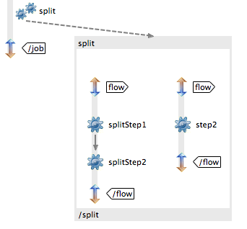
Parallel Steps
<split id="split“>
<flow>
<step id="splitStep1“ next="splitStep2"/>
<step id="splitStep2"/>
</flow>
<flow>
<step id=“step"/>
</flow>
</split>
Notes:
Seit 2.x

Slide 11
Partitioning overview
Job
Slave
Step
Slave
Master
Salve
Slave
Step
Slave

Slide 12

Partitioning detail
StepScopes
Execution Context [0]
Slave [0]
Execution
Context [1]
Slave [1]
Master
Execution
Context [2]
Salve [2]
rowId % 5
Execution
Context [3]
Slave [3]
Execution
Context [4]
Slave [4]
Notes:
Die konfigurierte grid-size muss nicht zum Zuge kommen ☺
Beispiel MultiResourcePartitioner:
public Map<String, ExecutionContext> partition(int gridSize) {
Map<String, ExecutionContext> map = new HashMap<String, ExecutionContext>(gridSize);
int i = 0;
for (Resource resource : resources) {
ExecutionContext context = new ExecutionContext();
Assert.state(resource.exists(), "Resource does not exist: "+resource);
try {
context.putString(keyName, resource.getURL().toExternalForm());
}
catch (IOException e) {
throw new IllegalArgumentException("File could not be located for: "+resource, e);
}
map.put(PARTITION_KEY + i, context);
i++;
}
return map;
}

Slide 13
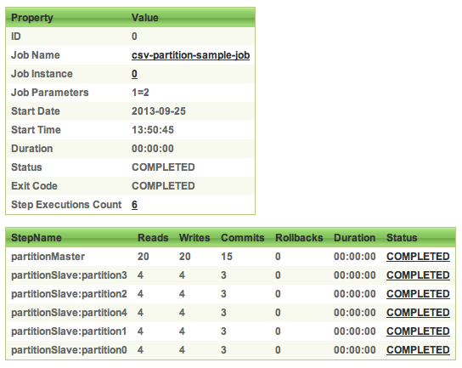
Partitioning detail – Spring Batch Admin

Slide 14
Transaction
Begin Step
10
For each item
Open Transaction
ItemReader
Item read()
ItemProcessor
Process(Item)
ItemWriter
Write(List<Item>)
Commit Transaction
RuntimeException
RuntimeException
RuntimeException
Rollback Transaction
Finish Step
Notes:
http://docs.spring.io/spring-batch/reference/html/configureStep.html
https://blog.codecentric.de/en/2012/03/transactions-in-spring-batch-part-1-the-basics/
→ Trivadis
→ Kunde selber ☺
Robust: An error affects only the current chung, not all items

Slide 15
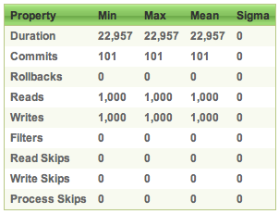
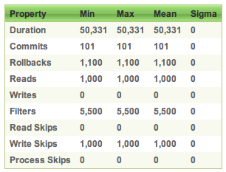
Performance skip all / chunk processing (2/2)
No error | Error on each item
~ 22 sec 0 Rollbacks | ~ 50 sec 1‘100 Rollbacks 5‘500 Filter 1‘000 Write Skips
Notes:
Die Verarbeitungszeit erhöht sich pro Fehler um die chunk-size * duration (20ms)

Slide 16

Listener
Step
@Transactional(propagation = Propagation.REQUIRES_NEW)
Read
Listener
Before
After
OnError
OnSkip
Process
LoggerService
Write
2 calls on error in writer
Notes:
REQUIRES_NEW natürlich nur für ERROR und nicht für Success

Slide 17
Skip/Retry/Restart – Bulletproof Job
Feature | When? | What? | Where?
Skip | For nonfatal exceptions | Keeps processing for an incorrect item | Chunk-oriented step
Retry | For transient exceptions | Makes new attemps on an operation | Chunk-oriented step, application code
Restart | After an excution failure | Restarts a job instance where the last execution failed | On job launch

Slide 18
Test
End-To-End Testing of Batch Jobs
Testing Individual Steps
Testing Step-Scoped Components
Validating Output Files
MetaDataInstanceFactory
JobExecution
JobInstance
StepExecution

Slide 19
General Principles and Guidelines for Batch Architectures
Simplify and avoid building complex logical structures
Think about the overhead when using ORM
Caching
Lazy loading
Carefully design application I/O
Read, write once
Use cursors
Always assume the worst with regard to data integrity
Plan and execute stress tests as early as possible
Notes:
ORM → ist cache notwendig? Es wird mehr geschrieben. Lazy Loading
https://github.com/spring-projects/spring-batch/blob/master/src/site/apt/batch-principles-guidelines.apt
Spring Batch Overview
------
Scott Wintermute
------
May 2007
A batch architecture typically affects on-line architecture and vice versa. Design with both architectures and environments in mind using common building blocks when possible.
Simplify as much as possible and avoid building complex logical structures in single batch applications.
Process data as close to where the data physically resides as possible or vice versa (i.e., keep your data where your processing occurs).
Minimize system resource use, especially I/O. Perform as many operations as possible in internal memory.
Review application I/O (analyze SQL statements) to ensure that unnecessary physical I/O is avoided. In particular, the following four common flaws need to be looked for:
Reading data for every transaction when the data could be read once and kept cached or in the working storage;
Rereading data for a transaction where the data was read earlier in the same transaction;
Causing unnecessary table or index scans;
Not specifying key values in the WHERE clause of an SQL statement.
Do not do things twice in a batch run. For instance, if you need data summarization for reporting purposes, increment stored totals if possible when data is being initially processed, so your reporting application does not have to reprocess the same data.
Allocate enough memory at the beginning of a batch application to avoid time-consuming reallocation during the process.
Always assume the worst with regard to data integrity. Insert adequate checks and record validation to maintain data integrity.
Implement checksums for internal validation where possible. For example, flat files should have a trailer record telling the total of records in the file and an aggregate of the key fields.
Plan and execute stress tests as early as possible in a production-like environment with realistic data volumes.
In large batch systems backups can be challenging, especially if the system is running concurrent with on-line on a 24-7 basis. Database backups are typically well taken care of in the on-line design, but file backups should be considered to be just as important. If the system depends on flat files, file backup procedures should not only be in place and documented, but regularly tested as well.

Slide 20
AGENDA
Spring Batch framework and lessons learned
Execution environment – Field Report
Batch Applications for the Java Platform (JSR-352)

Slide 21
Requirements to the execution environment
Administrative User Interface „Jobs can be started, stopped, monitored over a Web Interface.“
Trigger jobs periodically or out of database events „Jobs must be triggered either by cron expression, fixed rate, fixed delay or due to new data in the staging area.“
Control execution of jobs „Postpone executions due to inter-job dependencies or control the database-load.“
Detailed execution log „A detailed execution log needs to be available over a web interface.“
Gather diagnostic information „Only to know that an error happened might not be sufficient. Sometimes further diagnostic information is necessary.“
Notes:
Unser Loader soll ein Admin Interface haben
Jobs werden aufgrund unterschiedlicher Events getriggert (periodisch oder durch das Eintreffen neuer Daten)
Der Startzeitpunkt kann sich aufgrund von bestimmten Konstellationen verzögern.
Dem Benutzer muss ein mehr oder weniger detailliertes Execution Log angezeigt werden: Output der Rule Engine, Status Informationen.
Nicht immer, aber teilweise müssen wir Diagnoseinformationen darstellen können.

Slide 22
Administrative User Interface
Spring Batch Admin
Execution Environment
Start, restart, stop Jobs
Inspect Jobs and Executions
Configuration Upload
Data upload
JMX
Spring Integration
Spring Batch Integration
Notes:
Keine andere Platform als Spring Batch in Frage gekommen.
Execution Environment
lookup job configuration files
setup jobRepository, jobLocator, etc.
provide start channel
Inspect Jobs
See number of commits, rollbacks, reads, writes
See partitions

Slide 23
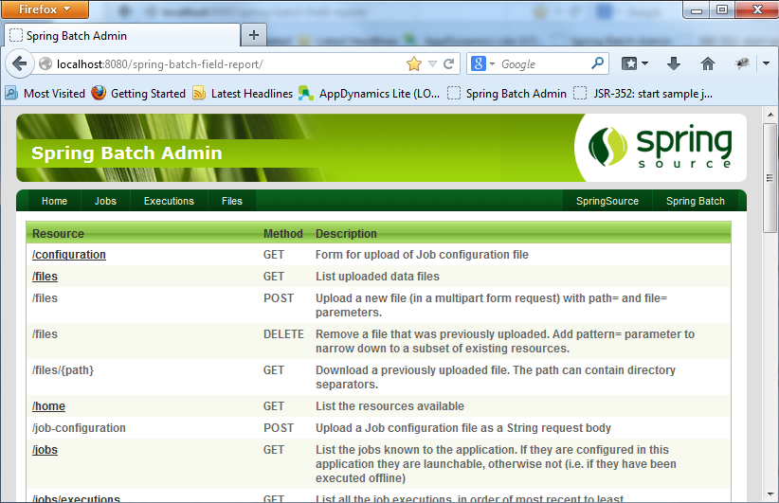
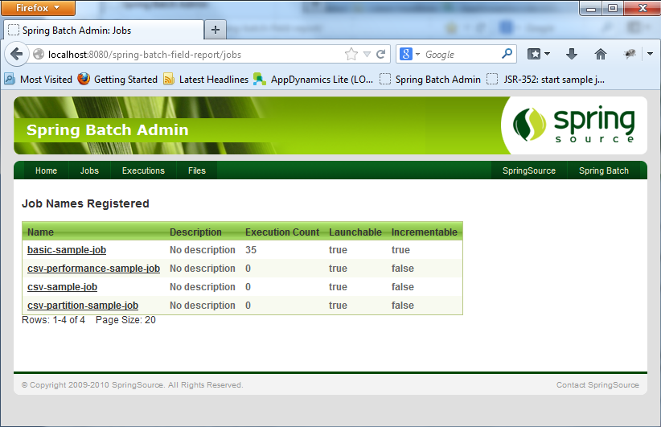
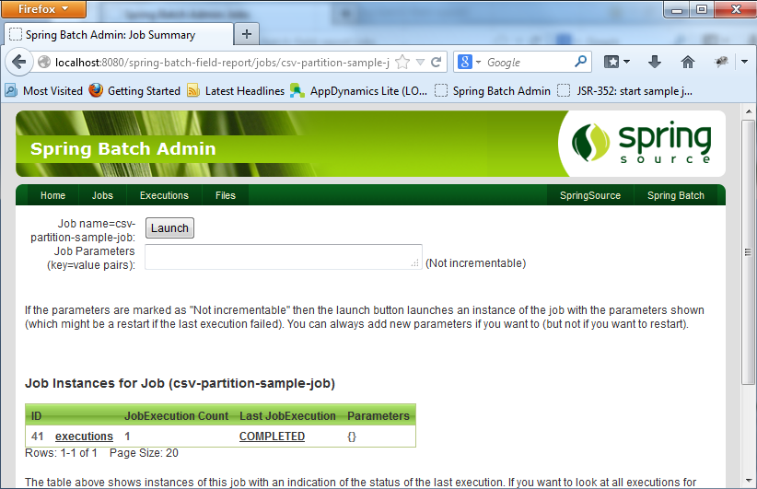
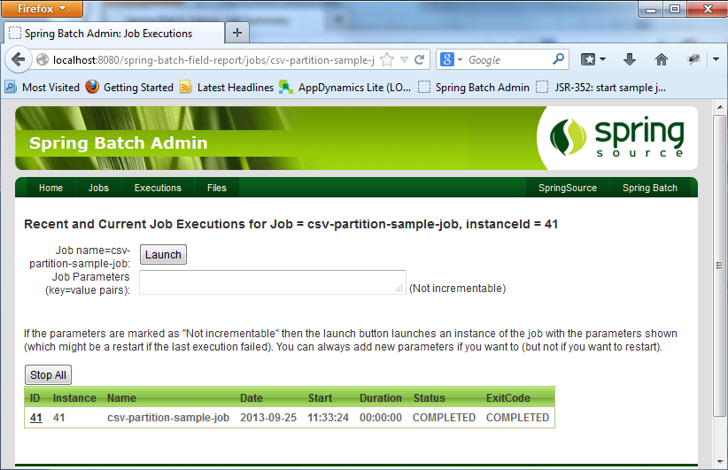
Administrative User Interface

Slide 24

Spring Batch Admin - Setup
Most probably the toughest job for a Spring application!
Configure the library dependencies
Setup or enrich root context
Configure servlet and mapping
<context-param>
<param-name>contextConfigLocation</param-name>
<param-value>classpath*:/.../webapp-config.xml</param-value>
</context-param>
<servlet>
<servlet-name>Batch Servlet</servlet-name>
<servlet-class>org.sfw.web.servlet.DispatcherServlet</servlet-class>
<init-param>
<param-name>contextConfigLocation</param-name>
<param-value>classpath*:/.../servlet-config.xml</param-value>
</init-param>
<load-on-startup>1</load-on-startup>
</servlet>
Notes:
Referenz auf Spring Batch Admin Sample Application.
Schützen der Applikation via Servlet Filter

Slide 25

Trigger jobs periodically or out of database events
job-requests
Data import job (database)
JobLaunchingMessageHandler
SimpleJobLauncher
Periodic jobs
0 0/5 * * * ?
job-operator
LoggerHandler
Notes:
Im Diagramm sind zwei verschiedene Trigger.

Slide 26
Trigger jobs periodically or out of database events
<bean id="factory" class="job.LoadJobLaunchRequestFactory">
<constructor-arg ref="jobRegistry" />
</bean>
<int:inbound-channel-adapter method="create" channel="job-requests" ref="factory">
<int:poller cron="0 0/5 * * * ?" />
</int:inbound-channel-adapter>
define polling channel adapter
public class LoadJobLaunchRequestFactory {
...
public JobLaunchRequest create() throws NoSuchJobException {
JobParameters jobParams = new JobParametersBuilder()
.addDate("random", new Date()).toJobParameters();
return new JobLaunchRequest(jobLocator.getJob(NAME), jobParams);
}
}
factory to create job launch request

Slide 27
Trigger jobs periodically or out of database events
job-requests
Data import job (database)
JobLaunchingMessageHandler
SimpleJobLauncher
Periodic jobs
0 0/5 * * * ?
No control of execution time!
job-operator
LoggerHandler
Notes:
Im Diagramm sind zwei verschiedene Trigger.

Slide 28
Control execution time of job (e.g. postpone)
Data import job (database)
job queue
*JobQueueMessageHandler
Periodic jobs
0 0/5 * * * ?
Disabling jobs not possible!
*JobLaunchingMessageHandler
job launch request
job-requests
Guard verification
*JobLauncher
update status
save job dependencies

Slide 29
Disable job execution or set on hold
*JobQueueMessageHandler
Data import job (database)
job queue
Job active or on hold
*JobQueueMessageHandler
yes
Periodic jobs
0 0/5 * * * ?
*JobLaunchingMessageHandler
job launch request
job-requests
Guard verification
*JobLauncher
update status
save job dependencies

Slide 30
Detailed execution log
All our jobs write an execution log, the collected information will be sent to a shared mailbox (evt. file submitter) at the end of a job
Data will be written to a database, therefore a nested transaction is used this times (critical for success messages)
A message consists of the following fields:
Time
Thread name
Message
Status
Reference (i.E. line number, object id, etc.)
Exception trace (opt)

Slide 31
Gather diagnostic information (Explain Plan)
Problem:
Loading data involes calling a rule engine. The rule engine is able to collect diagnostic information (no default behaviour).
Solution 1: Store diagnostic information all the time
Solution 2: On error reprocess item in diagnostic mode
Solution 3: Let the user rerun the job for a single item in diagnostic mode
Involves adjusting partitioner and reader, the query might look like this
Not applicable for file readers
select * from data_loader where partition_key = :partition_key and record_number = nvl(:record_number, record_number)

Slide 32
AGENDA
Spring Batch framework and lessons learned
Execution environment – Field Report
Batch Applications for the Java Platform (JSR-352)

Slide 33
JSR-352: Terminology
The terminology stays more or less the same: Job, Step, Chunk, Item, ItemProcessor, JobInstance, JobExecution.
The differences are summarized as follows:
Spring Batch | JSR 352 | Comments
Tasklet | Batchlet
ItemReader / ItemStream | ItemReader | JSR-352‘s ItemReader includes Spring Batchs ItemStream capabilities
ItemWriter / ItemStream | ItemWriter | JSR-352‘s ItemReader includes Spring Batchs ItemStream capabilities
JobExecutionListener | JobListener
StepExecutionListener | StepListener

Slide 34
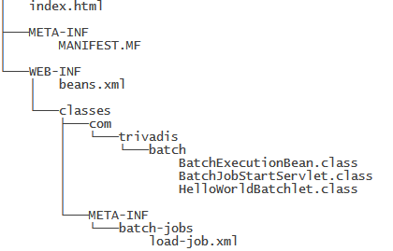
JSR-352: Create and deploy a Batch Job
public class HelloWorldBatchlet implements Batchlet {
@Inject
JobContext jobContext;
@Inject
StepContext stepContext;
@Override
public String process() throws Exception {
...
return "SUCCESS";
}
@Override
public void stop() throws Exception {
}
}
@Stateless
public class BatchExecutionBean {
public long submitJob() {
JobOperator operator = BatchRuntime.getJobOperator();
Properties properties = new Properties();
return operator.start("load-job-jsr352", properties);
}
...
}
<?xml version="1.0" encoding="UTF-8"?>
<job id="load-job" xmlns="http://xmlns.jcp.org/xml/ns/javaee" version="1.0">
<step id="batchlet-step">
<batchlet ref=”com.trivadis.batch.HelloWorldBatchlet" />
</step>
</job>
Deployment as a Web Archive
Deploy to JEE 7 compliant (e.g. Glassfish 4) application server

Slide 35
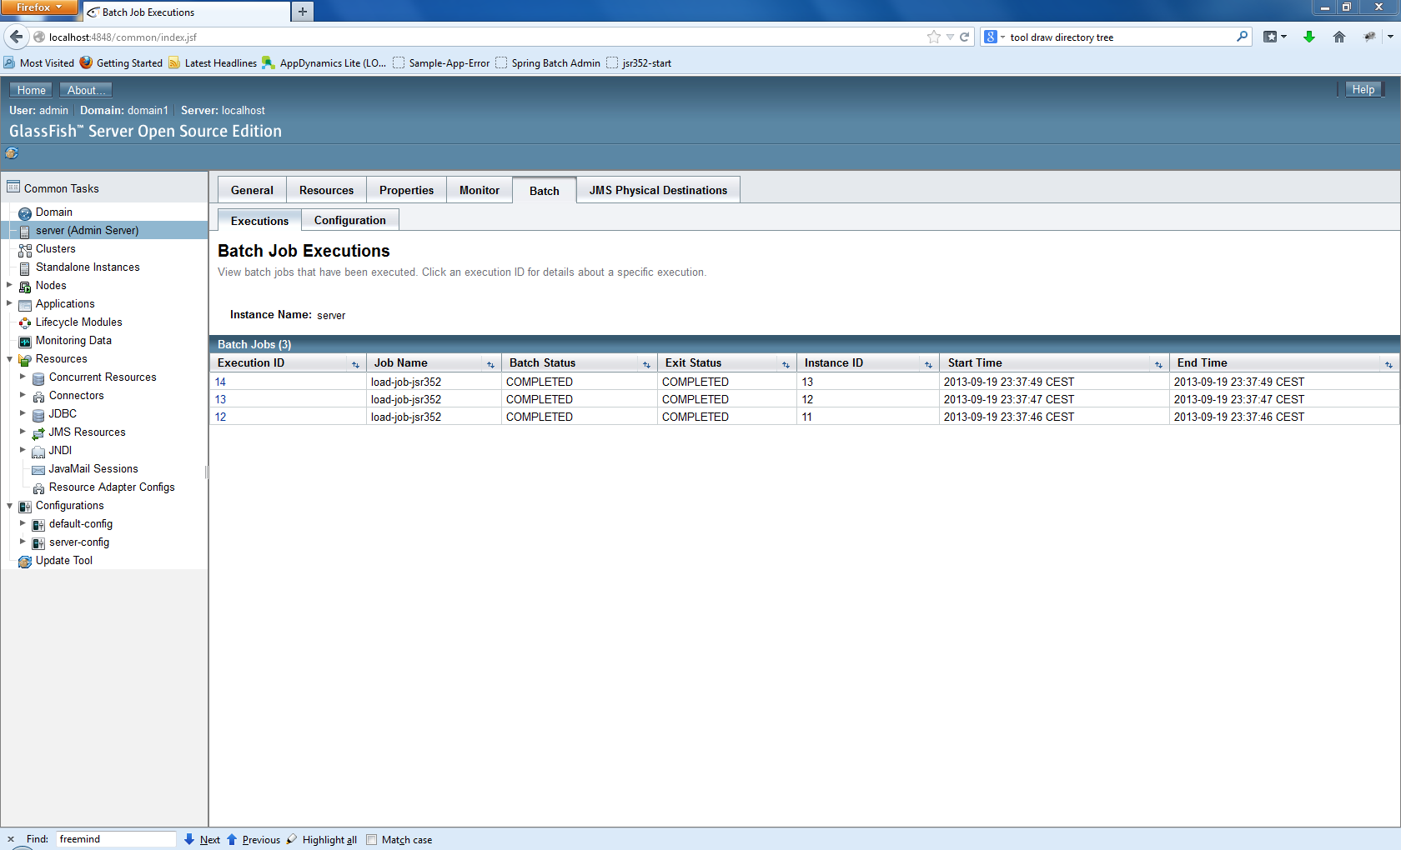

JSR-352: Overview of job executions in Glassfish 4
look at this!

Slide 36
Batch Applications for the Java Platform (JSR-352)
Java Specification Request | JSR-352 (Version 1.0)
Reference Implementation | JBatch (https://java.net/projects/jbatch)
API: number of interfaces | ~30
API: number of classes | ~25 (~11 Exceptions)
Specification Lead | Chris Vignola (IBM)
part of Glassfish 4.0
Support | Spring Batch | JSR-352
File reading | Yes | No
Database reading | Yes | No
Admin interface available | Yes (Spring Batch Admin) | No (overview of executions so far)
Job Scheduling | No | No

Slide 37
Benchmarks
Number of periodic jobs | > 800 (per day)
Number of file loads | ~ 8 (per day)
Number of data migrations | ~ 15 (since june)
Average number of items per migration | ~ 300 000
Items per second (single threaded) | ~30*
Items per second (5 threads) | ~150*
* in case of low error rate

Slide 38

Questions?

Slide 39
THANK YOU.
Trivadis AG
Europa-Strasse 5 8152 Glattbrugg
michael.beer@trivadis.com raffael.schmid@trivadis.com

Slide 40
List of references
Tutorial: Create Batch Application based on JSR-352 | http://www.planetjones.co.uk/blog/25-05-2013/introducing-jsr-352-java-batch-ee-7
Similarities and differences: Spring Batch vs. JSR-352 | http://blog.codecentric.de

