Slide 1
WELCOME
Spring Batch - Field Report
Michael Beer, Raffael Schmid
September 27th, 2013

Slide 2
AGENDA
Spring Batch framework and lessons learned
Execution environment – Field Report
Batch Applications for the Java Platform (JSR-352)

Slide 3
Roadmap
Version | Description
1.x | Single-process, possibility multi-threaded execution
2.x | New features enabling an application to scale to multiple processes
Java 7 | JSR-352 - Batch Applications for the Java Platform
3.0 M1 | Alignement with JSR-352 (70/155 TCK)

Slide 4
Job/Step Stereotypes
Job
*
Step
*
Job Instance
*
*
Job Execution
*
Step Execution
Job Execution
Context
Step Execution
Context

Slide 5

Meta-Data Schema
STEP EXECUTION
CONTEXT
JOB INSTANCE
JOB
PARAMETER
n
1
1
1
serialized context
1
n
cleanup
STEP EXECUTION
1
JOB EXECUTION
n
1
1
JOB EXECUTION
CONTEXT

Slide 6
Job/Step/Tasklet configuration
<job id="job" restartable="false“>
<validator ref="validator" />
<step id="step">
<partition step="partitionerStep" partitioner="partitioner" />
</step>
<decision id="decision" decider="decider">
<next on="*" to="nextStep" />
<end on="FAILED" />
</decision>
</job>
<step id="partitionerStep">
<tasklet transaction-manager="transactionManager">
<chunk reader=“pagingItemreader" processor="processor" writer="writer“ commit-interval="10“
skip-policy=“skipPolicy“/>
<listeners>
<listener ref="listener" />
</listeners>
</tasklet>
</step>

Slide 7
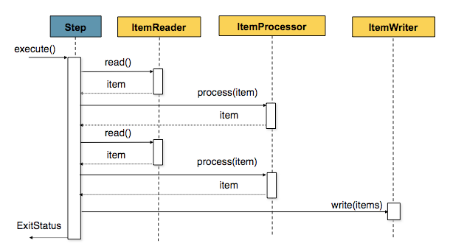
Chunk / Read / Process / Write
commit-interval=2
items.size() == commit-interval
(Source: http://docs.spring.io/spring-batch/reference/html/configureStep.html)

Slide 8
Scalability
Typ | Local/Remote | Description
Multi-threaded Step | Local | A step is multithreaded (TaskExecutor)
Parallel Steps | Local | Executes steps in parallel using multithreading
Partitioning Step | Local Remote | Partitions data and splits up processing
Remote Chunking | Remote | Distributed chung processing to remote nodes

Slide 9
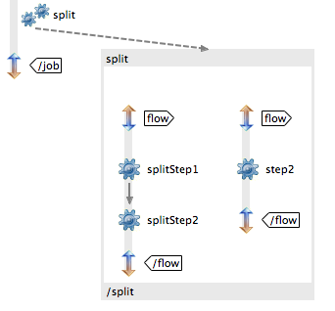
Parallel Steps
<split id="split“>
<flow>
<step id="splitStep1“ next="splitStep2"/>
<step id="splitStep2"/>
</flow>
<flow>
<step id=“step"/>
</flow>
</split>

Slide 10
Partitioning overview
Job
Slave
Step
Slave
Master
Salve
Slave
Step
Slave

Slide 11

Partitioning detail
StepScopes
Execution Context [0]
Slave [0]
Execution
Context [1]
Slave [1]
Master
Execution
Context [2]
Salve [2]
rowId % 5
Execution
Context [3]
Slave [3]
Execution
Context [4]
Slave [4]

Slide 12
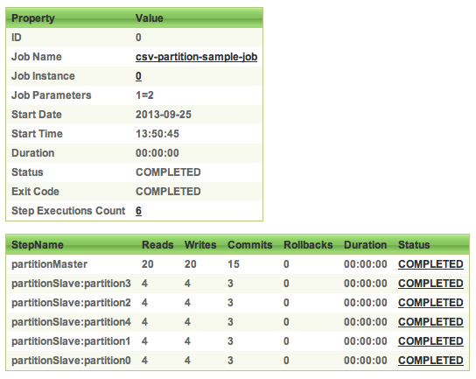
Partitioning detail – Spring Batch Admin

Slide 13
Transaction
Begin Step
10
For each item
Open Transaction
ItemReader
Item read()
ItemProcessor
Process(Item)
ItemWriter
Write(List<Item>)
Commit Transaction
RuntimeException
RuntimeException
RuntimeException
Rollback Transaction
Finish Step

Slide 14
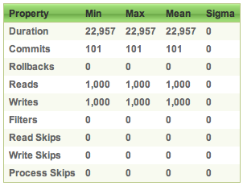
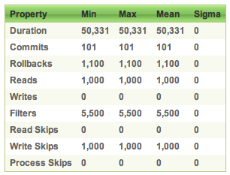
Performance skip all / chunk processing (2/2)
No error | Error on each item
~ 22 sec 0 Rollbacks | ~ 50 sec 1‘100 Rollbacks 5‘500 Filter 1‘000 Write Skips

Slide 15

Listener
Step
@Transactional(propagation = Propagation.REQUIRES_NEW)
Read
Listener
Before
After
OnError
OnSkip
Process
LoggerService
Write
2 calls on error in writer

Slide 16
Skip/Retry/Restart – Bulletproof Job
Feature | When? | What? | Where?
Skip | For nonfatal exceptions | Keeps processing for an incorrect item | Chunk-oriented step
Retry | For transient exceptions | Makes new attemps on an operation | Chunk-oriented step, application code
Restart | After an excution failure | Restarts a job instance where the last execution failed | On job launch

Slide 17
Test
End-To-End Testing of Batch Jobs
Testing Individual Steps
Testing Step-Scoped Components
Validating Output Files
MetaDataInstanceFactory
JobExecution
JobInstance
StepExecution

Slide 18
General Principles and Guidelines for Batch Architectures
Simplify and avoid building complex logical structures
Think about the overhead when using ORM
Caching
Lazy loading
Carefully design application I/O
Read, write once
Use cursors
Always assume the worst with regard to data integrity
Plan and execute stress tests as early as possible

Slide 19
AGENDA
Spring Batch framework and lessons learned
Execution environment – Field Report
Batch Applications for the Java Platform (JSR-352)

Slide 20
Requirements to the execution environment
Administrative User Interface „Jobs can be started, stopped, monitored over a Web Interface.“
Trigger jobs periodically or out of database events „Jobs must be triggered either by cron expression, fixed rate, fixed delay or due to new data in the staging area.“
Control execution of jobs „Postpone executions due to inter-job dependencies or control the database-load.“
Detailed execution log „A detailed execution log needs to be available over a web interface.“
Gather diagnostic information „Only to know that an error happened might not be sufficient. Sometimes further diagnostic information is necessary.“

Slide 21
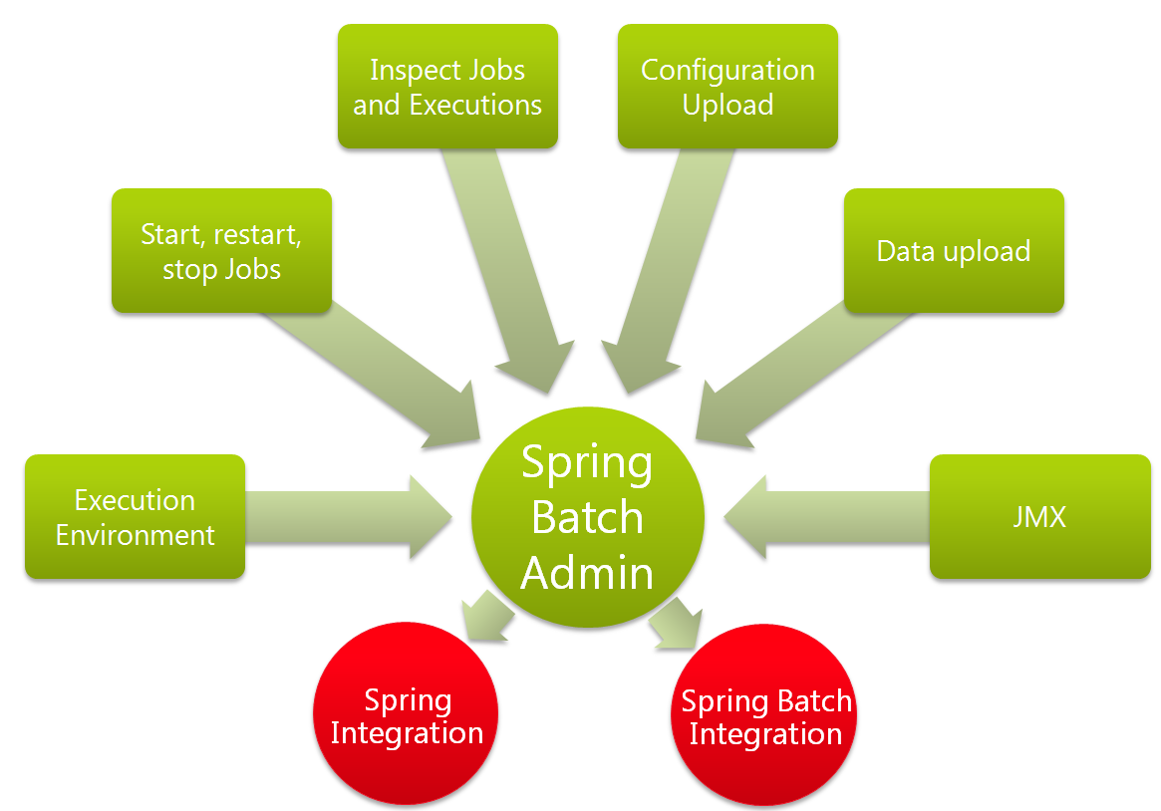
Administrative User Interface
Spring Btch Integration

Slide 22
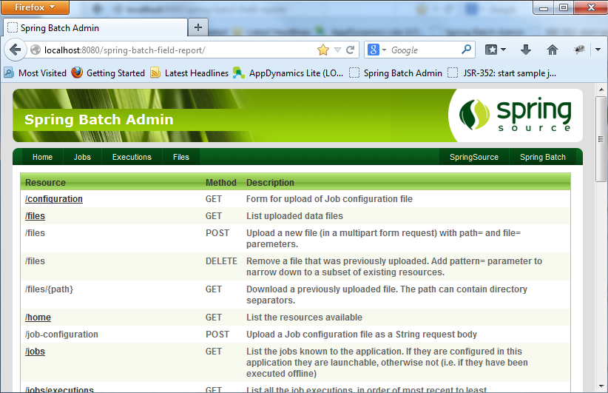
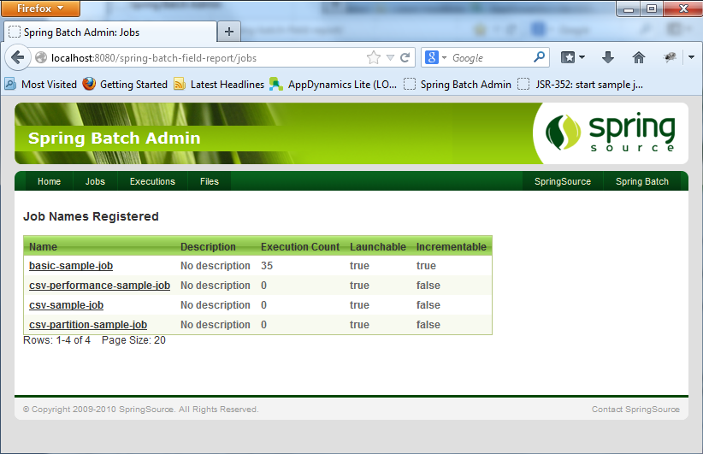
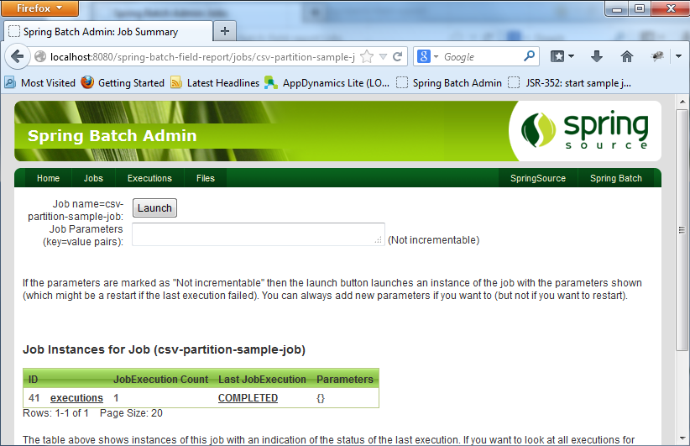
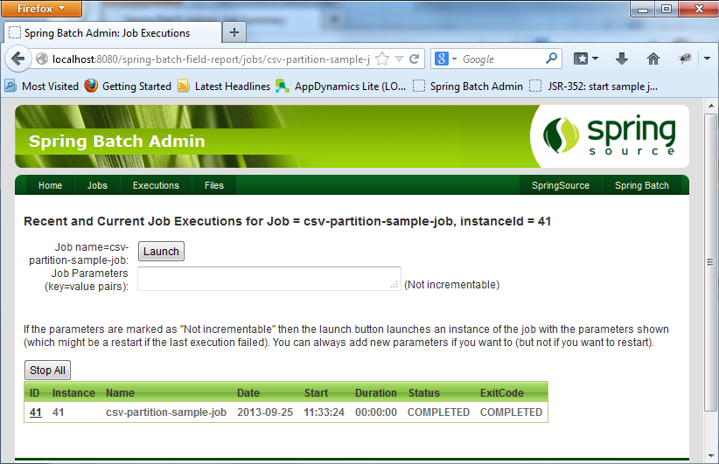
Administrative User Interface

Slide 23

Spring Batch Admin - Setup
Most probably the toughest job for a Spring application!
Configure the library dependencies
Setup or enrich root context
Configure servlet and mapping
<context-param>
<param-name>contextConfigLocation</param-name>
<param-value>classpath*:/.../webapp-config.xml</param-value>
</context-param>
<servlet>
<servlet-name>Batch Servlet</servlet-name>
<servlet-class>org.sfw.web.servlet.DispatcherServlet</servlet-class>
<init-param>
<param-name>contextConfigLocation</param-name>
<param-value>classpath*:/.../servlet-config.xml</param-value>
</init-param>
<load-on-startup>1</load-on-startup>
</servlet>

Slide 24

Trigger jobs periodically or out of database events
job-requests
Data import job (database)
JobLaunchingMessageHandler
SimpleJobLauncher
Periodic jobs
0 0/5 * * * ?
job-operator
LoggerHandler

Slide 25
Trigger jobs periodically or out of database events
<bean id="factory" class="job.LoadJobLaunchRequestFactory">
<constructor-arg ref="jobRegistry" />
</bean>
<int:inbound-channel-adapter method="create" channel="job-requests" ref="factory">
<int:poller cron="0 0/5 * * * ?" />
</int:inbound-channel-adapter>
define polling channel adapter
public class LoadJobLaunchRequestFactory {
...
public JobLaunchRequest create() throws NoSuchJobException {
JobParameters jobParams = new JobParametersBuilder()
.addDate("random", new Date()).toJobParameters();
return new JobLaunchRequest(jobLocator.getJob(NAME), jobParams);
}
}
factory to create job launch request

Slide 26
Control execution time of job (e.g. postpone)
Data import job (database)
job queue
*JobQueueMessageHandler
Periodic jobs
0 0/5 * * * ?
*JobLaunchingMessageHandler
job launch request
job-requests
Guard verification
*JobLauncher
update status
save job dependencies

Slide 27
Disable job execution or set on hold
*JobQueueMessageHandler
Data import job (database)
job queue
Job active or on hold
yes
Periodic jobs
0 0/5 * * * ?
*JobLaunchingMessageHandler
job launch request
job-requests
Guard verification
*JobLauncher
update status
save job dependencies

Slide 28
Detailed execution log
All our jobs write an execution log, the collected information will be sent to a shared mailbox (evt. file submitter) at the end of a job
Data will be written to a database, therefore a nested transaction is used this times (critical for success messages)
A message consists of the following fields:
Time
Thread name
Message
Status
Reference (i.E. line number, object id, etc.)
Exception trace (opt)

Slide 29
Gather diagnostic information (Explain Plan)
Problem:
Loading data involes calling a rule engine. The rule engine is able to collect diagnostic information (no default behaviour).
Solution 1: Store diagnostic information all the time
Solution 2: On error reprocess item in diagnostic mode
Solution 3: Let the user rerun the job for a single item in diagnostic mode
Involves adjusting partitioner and reader, the query might look like this
Not applicable for file readers
select * from data_loader where partition_key = :partition_key and record_number = nvl(:record_number, record_number)

Slide 30
AGENDA
Spring Batch framework and lessons learned
Execution environment – Field Report
Batch Applications for the Java Platform (JSR-352)

Slide 31
JSR-352: Terminology
The terminology stays more or less the same: Job, Step, Chunk, Item, ItemProcessor, JobInstance, JobExecution.
The differences are summarized as follows:
Spring Batch | JSR 352 | Comments
Tasklet | Batchlet
ItemReader / ItemStream | ItemReader | JSR-352‘s ItemReader includes Spring Batchs ItemStream capabilities
ItemWriter / ItemStream | ItemWriter | JSR-352‘s ItemReader includes Spring Batchs ItemStream capabilities
JobExecutionListener | JobListener
StepExecutionListener | StepListener

Slide 32
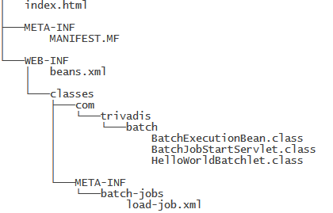
JSR-352: Create and deploy a Batch Job
Deployment as a Web Archive
Deploy to JEE 7 compliant (e.g. Glassfish 4) application server

Slide 33
JSR-352: Create and deploy a Batch Job
public class HelloWorldBatchlet implements Batchlet {
@Inject
JobContext jobContext;
@Inject
StepContext stepContext;
@Override
public String process() throws Exception {
...
return "SUCCESS";
}
@Override
public void stop() throws Exception {
}
}

Slide 34
JSR-352: Create and deploy a Batch Job
@Stateless
public class BatchExecutionBean {
public long submitJob() {
JobOperator operator = BatchRuntime.getJobOperator();
Properties properties = new Properties();
return operator.start("load-job-jsr352", properties);
}
...
}

Slide 35
JSR-352: Create and deploy a Batch Job
<?xml version="1.0" encoding="UTF-8"?>
<job id="load-job" xmlns="http://xmlns.jcp.org/xml/ns/javaee" version="1.0">
<step id="batchlet-step">
<batchlet ref=”com.trivadis.batch.HelloWorldBatchlet" />
</step>
</job>

Slide 36
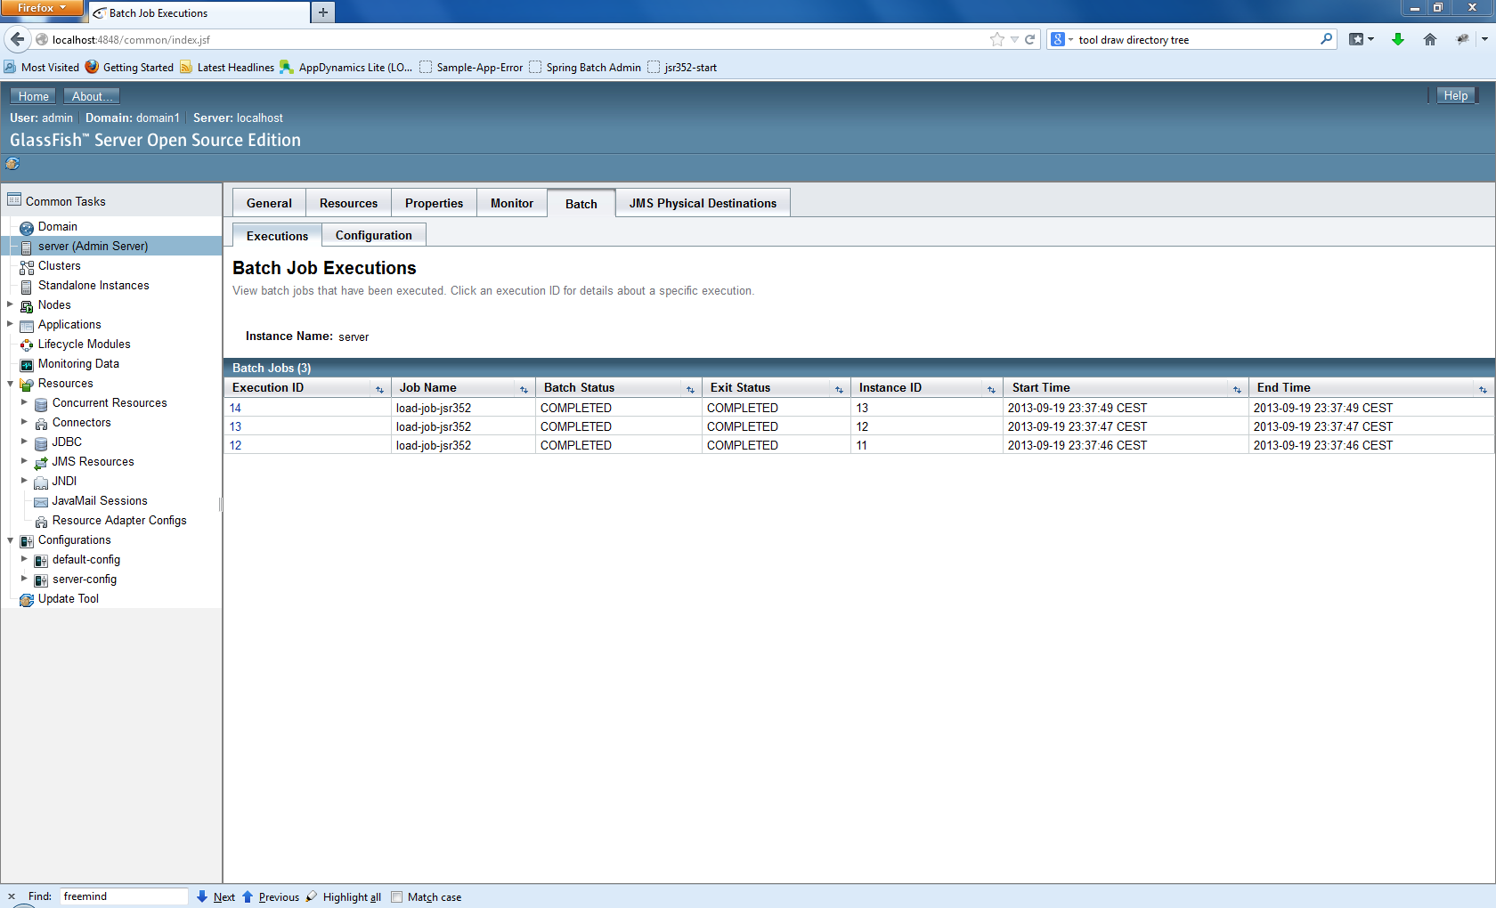

JSR-352: Overview of job executions in Glassfish 4
look at this!

Slide 37
Batch Applications for the Java Platform (JSR-352)
Java Specification Request | JSR-352 (Version 1.0)
Reference Implementation | JBatch (https://java.net/projects/jbatch)
API: number of interfaces | ~30
API: number of classes | ~25 (~11 Exceptions)
Specification Lead | Chris Vignola (IBM)
part of Glassfish 4.0
Support | Spring Batch | JSR-352
File reading | Yes | No
Database reading | Yes | No
Admin interface available | Yes (Spring Batch Admin) | No (overview of executions so far)
Job Scheduling | No | No

Slide 38
Benchmarks
Number of periodic jobs | > 800 (per day)
Number of file loads | ~ 8 (per day)
Number of data migrations | ~ 15 (since june)
Average number of items per migration | ~ 300 000
Items per second (single threaded) | ~30*
Items per second (5 threads) | ~150*
* in case of low error rate

Slide 39

Questions?

Slide 40
THANK YOU.
Trivadis AG
Europa-Strasse 5 8152 Glattbrugg
michael.beer@trivadis.com raffael.schmid@trivadis.com

Slide 41
List of references
Tutorial: Create Batch Application based on JSR-352 | http://www.planetjones.co.uk/blog/25-05-2013/introducing-jsr-352-java-batch-ee-7
Similarities and differences: Spring Batch vs. JSR-352 | http://blog.codecentric.de

