Slide 1
Understanding CI/CD in Networking Context
Josh VanDeraa
Network to Code, LLC

Slide 2
Agenda
Introduction
What is CI/CD?
Introduce the tooling and concepts
Demos

Slide 3




Introduction
16+ years working on networks
Large Enterprise, SMB, MSP
Have been automating networks for 5+ years with Python, Ansible, & CI/CD

Slide 4
What is CI/CD?
Continuous Integration / Continuous Deployment/Delivery
Continuous Automated Testing
Does the data/code match organizational standards and guidelines
Will this generate the configuration that is expected
Catch the simple stuff
Catch the difficult to spot
Validate IP addressing (when setup right)
Some have automated test suites, or create your own testing application
Img src: https://dzone.com/articles/what-is-cicd

Slide 5
Workflow
Develop Code / Change Data
Check into Git -> CI/CD Tool
Run Tests
Provide Feedback
Optional: Deploy
Monitor Environment

Slide 6


Testing Concepts
Linting
Line length standards
Variable names
Verify modules are used
Doc Strings are of appropriate format
Style Formating
Should you use single quotes or double quotes?
How many new lines between functions and methods?
Data Validation
Is that an IP Address?
Is that a proper DNS server for the environment?
Test Code
Functional programming
Send in controlled data, test that you get the expected result
Helps prevent future bugs introduced from changes to code/configuration changes

Slide 7


Tooling
Python
Pylint
Bandit
Pytest
Ansible
Ansible Lint
Data
YAMLLint
JSON Schema
Makefile
Docker containers

Slide 8
Tooling
Brief Search > 50 platforms
Examples
Jenkins
Travis-CI
GitHub Actions
Gitlab CI
Drone.io
Circle CI
Microsoft TFS
Cloud platforms

Slide 9
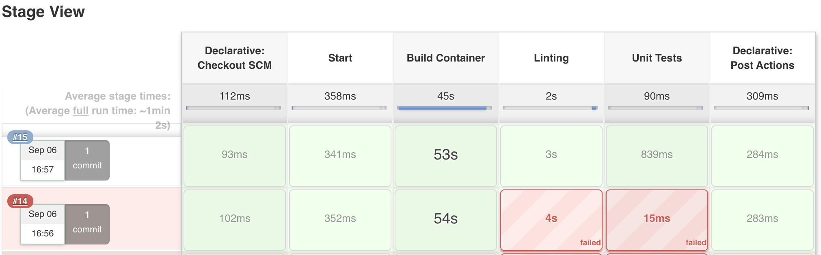
Jenkins Example

Slide 10
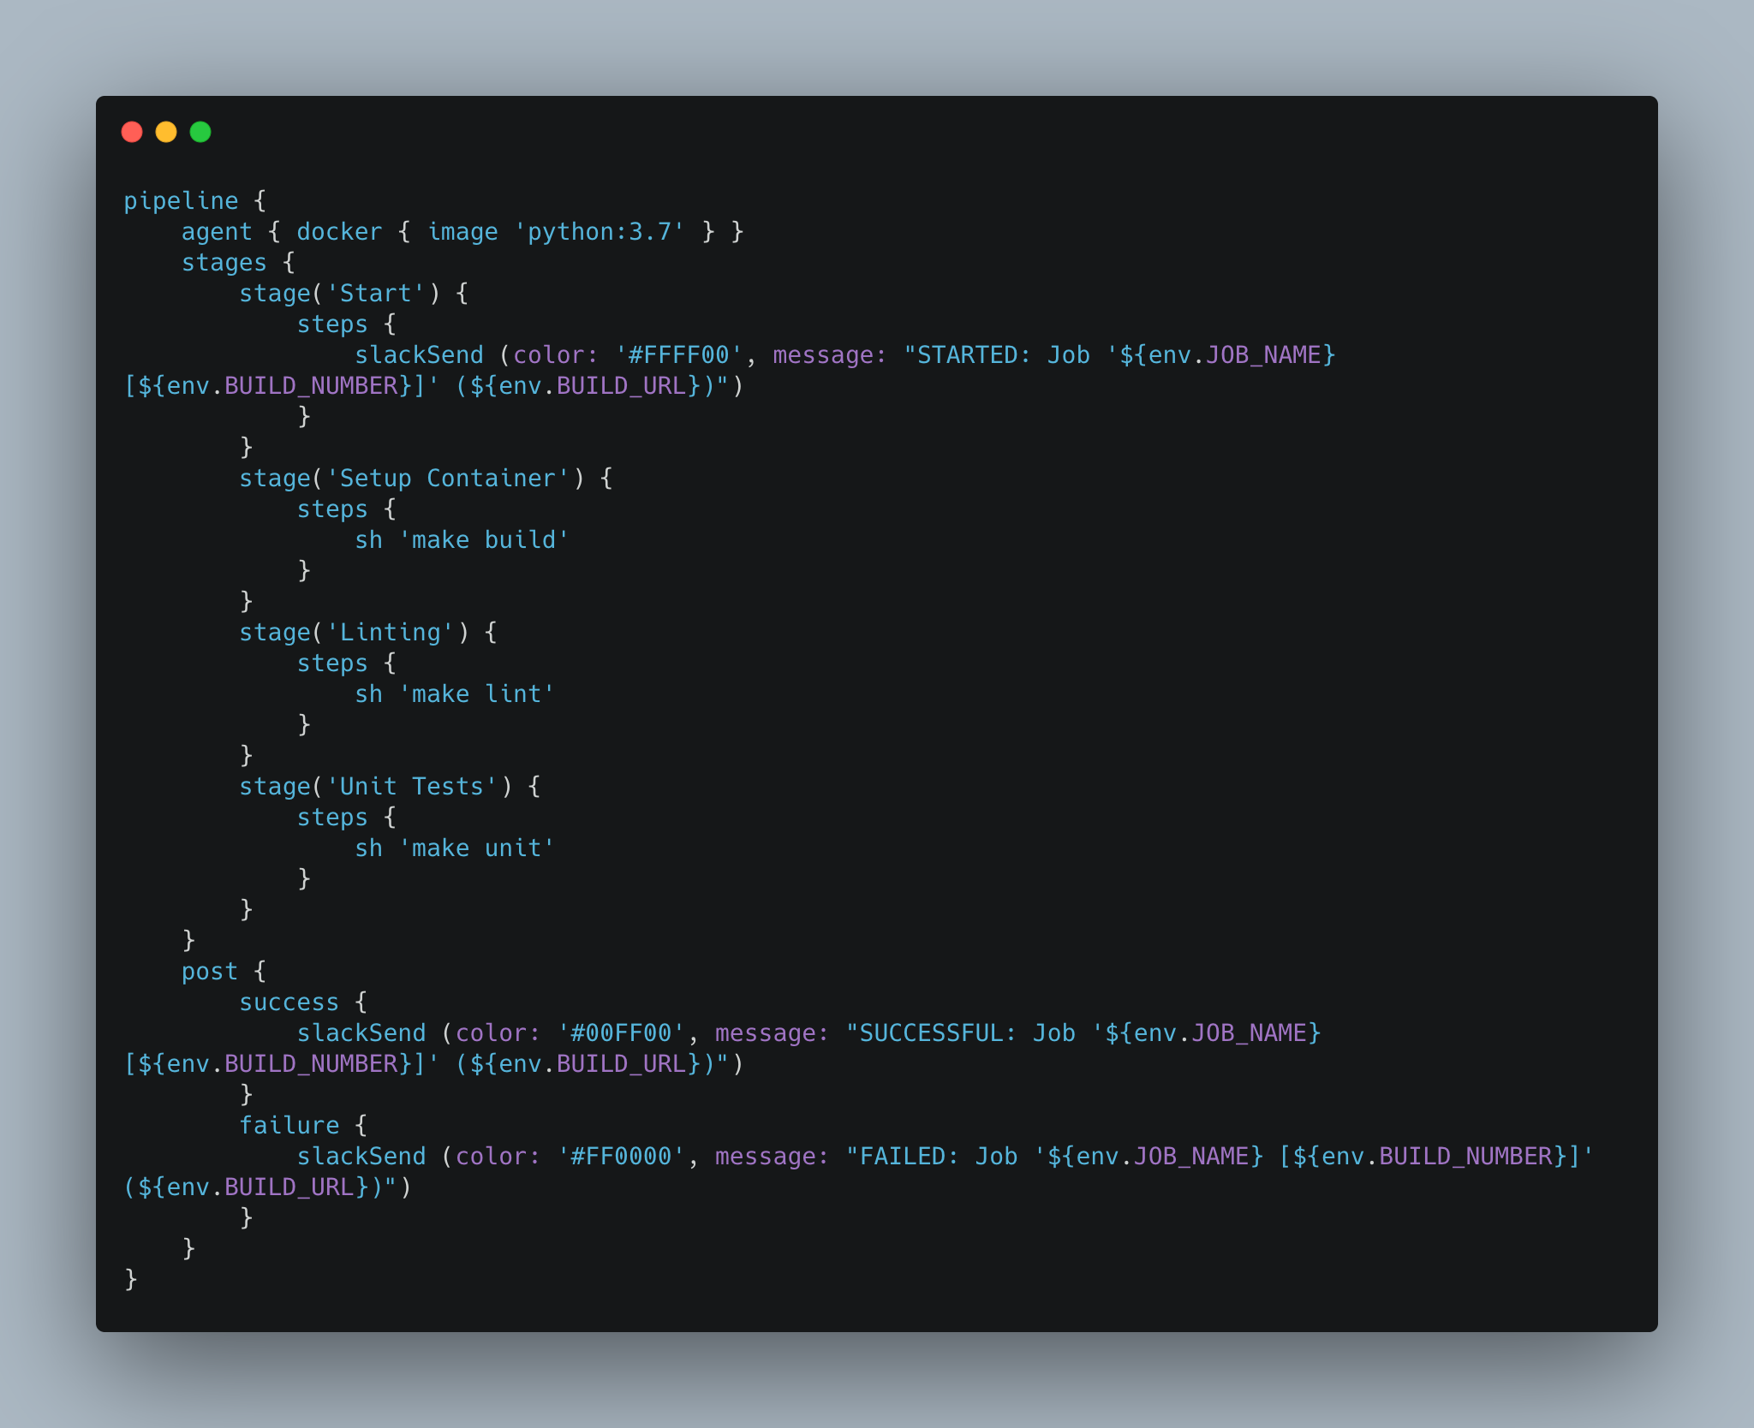
Jenkinsfile

Slide 11
Demos Overview
Walk thru Linting
Introduce pytest and testing via Python
All done in containers
Consistent development experience
Portable to the CI/CD system
Simplified with Make in this example, Python Invoke is an option

Slide 12
Demos
Subtitle

Slide 13




Contact Me
networktocode.slack.com: jvanderaa
@vanderaaj
jvanderaa
https://www.linkedin.com/in/josh-vanderaa/

