Slide 1
ist 263
Layout Day 2

Slide 2
Agenda
Centering Horizontally
More Flexbox

Slide 3
Centering

Slide 4
Centering Inline Elements
text-align: center;

Slide 5
Centering Block Elements
Block elements take up 100% of the page width by default so you must first set a width or it won’t look like anything happened.
width: 30%;
margin: 0 auto;

Slide 6
Centering With Flexboxes
display: flex;
justify-content: center;

Slide 7
More Flexbox

Slide 8
Flex-End
justify-content: flex-end;

Slide 9
Space-Around
justify-content: space-around;

Slide 10
Space-Between
justify-content: space-between;

Slide 11
Elements on the Left and Right
2 Flexboxes inside a Flexbox with:
justify-content: space-between;

Slide 12
Breaking Down Complex Layouts

Slide 13
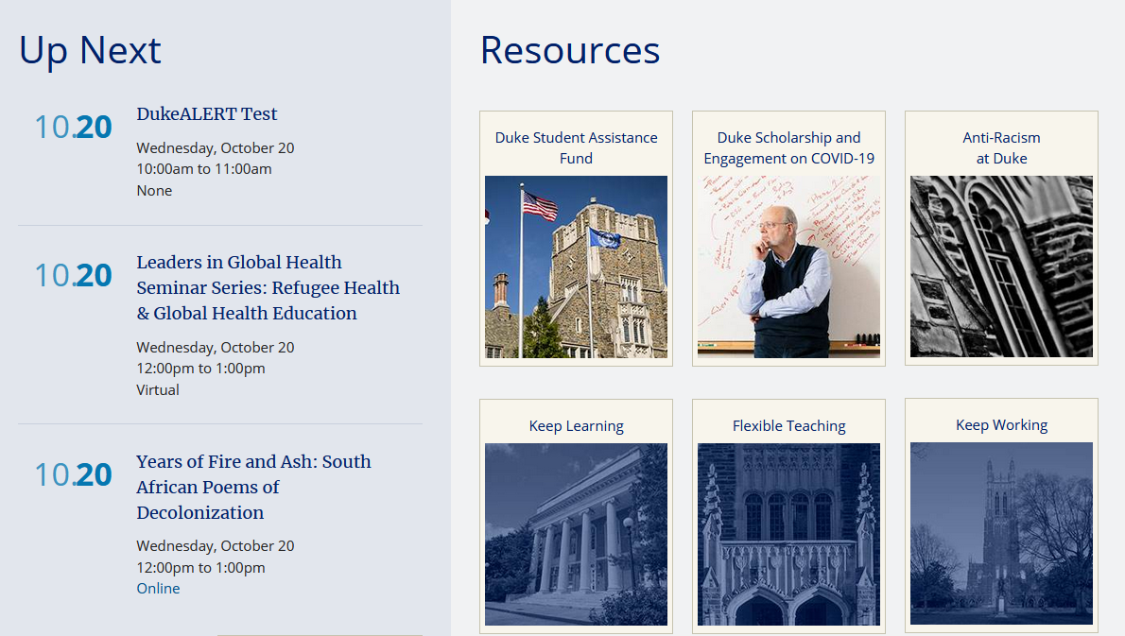
Examine This Design
https://duke.edu/

