Slide 1
ist 263
Exam 1 and Photoshop

Slide 2
Agenda
Exam 1 Review
Image Types
Image Sizes
Photoshop Walk Through

Slide 3
Exam Review

Slide 4
Review
Exam Guide
Question Sheet
Syntax Sheet

Slide 5
Review – Sample Short Answer Code
Write HTML code that produces the following in your web browser:
Oranges
Apples
Bananas

Slide 6
Review – Kahoot Quiz

Slide 7
Image Types

Slide 8
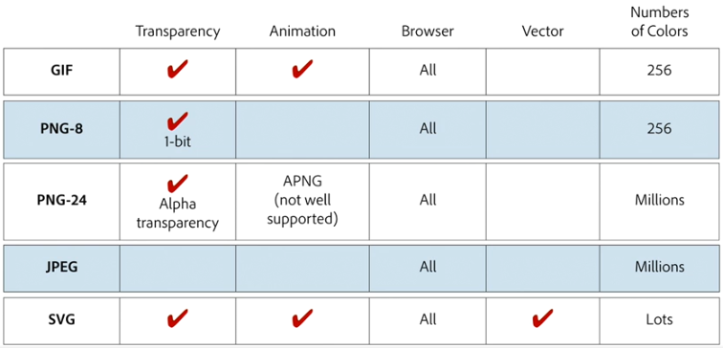
The Formats

Slide 9
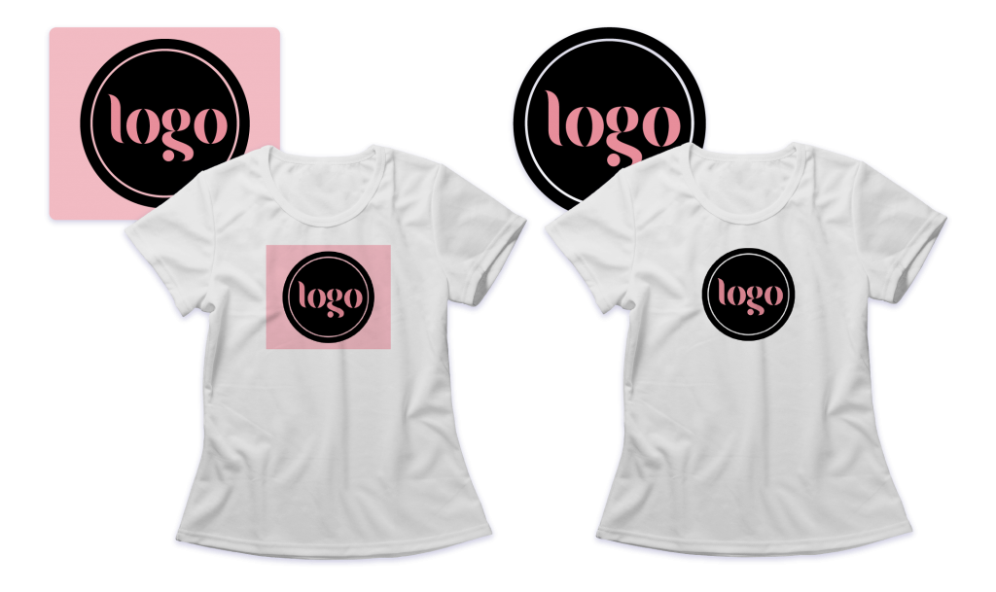
Transparency

Slide 10

Transparency

Slide 11
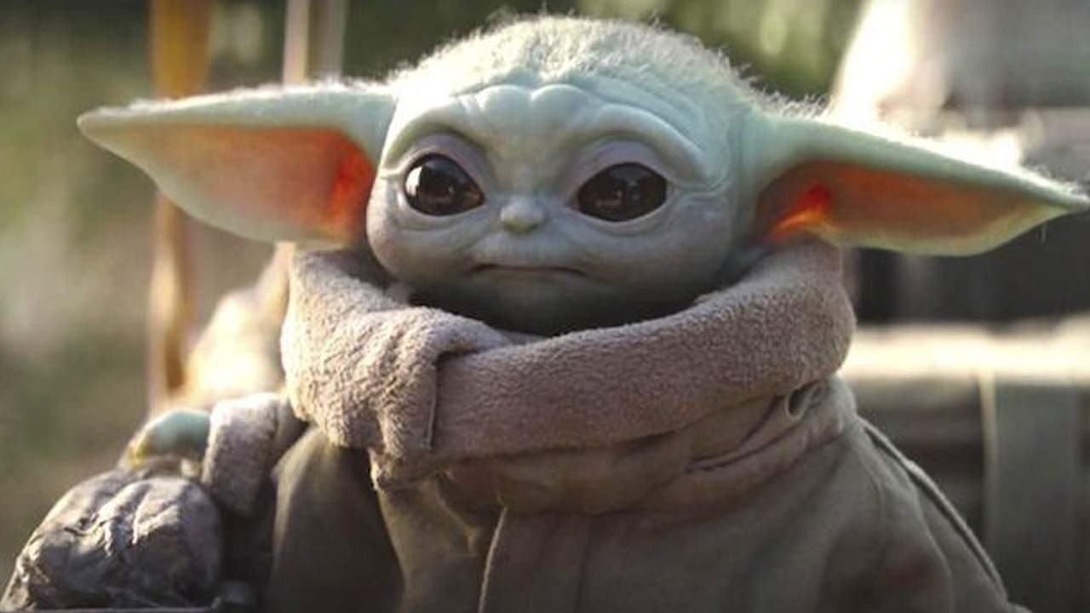
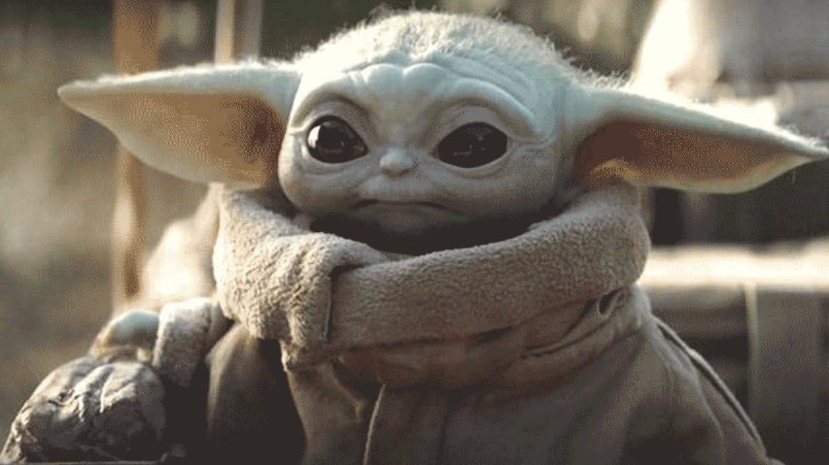
Number of Colors

Slide 12
Number of Colors

Slide 13
Image Sizes

Slide 14

Pixels
This emoji is made up of dots of color
A pixel is one dot in an image
There are 72 pixels per inch on a screen
The number of pixels per inch is abbreviated PPI

Slide 15
Dimensions
|------------------------- width -------------------------|
|------------ height ------------|

Slide 16


Pixelated Image

Slide 17
Image Look and Feel

Slide 18
How Fonts Make You Feel
Hello World
Hello World
Hello World

Slide 19
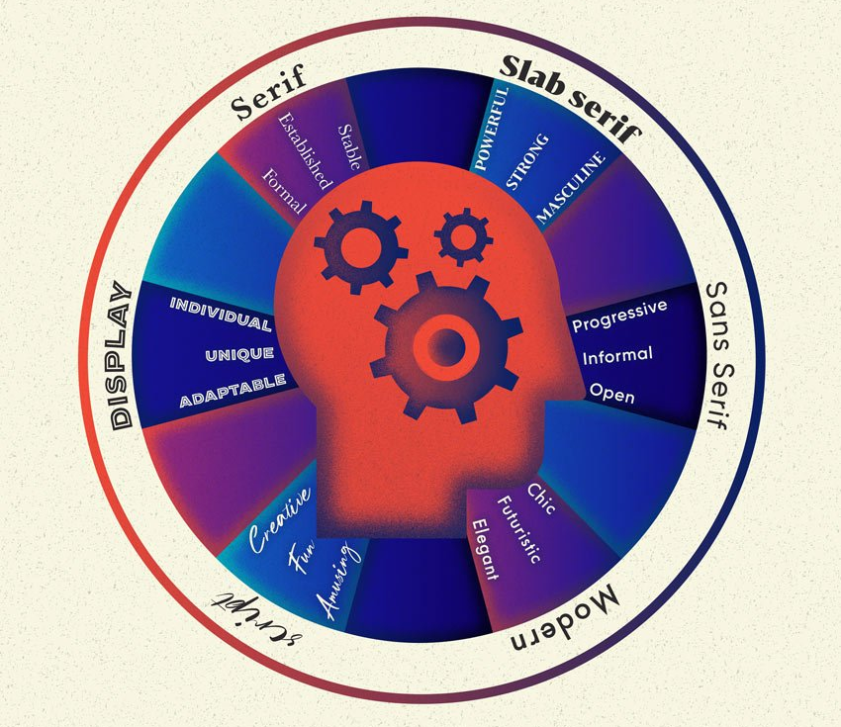
https://design.tutsplus.com/articles/the-psychology-of-fonts--cms-34943

Slide 20

Communicating with a Photo

Slide 21
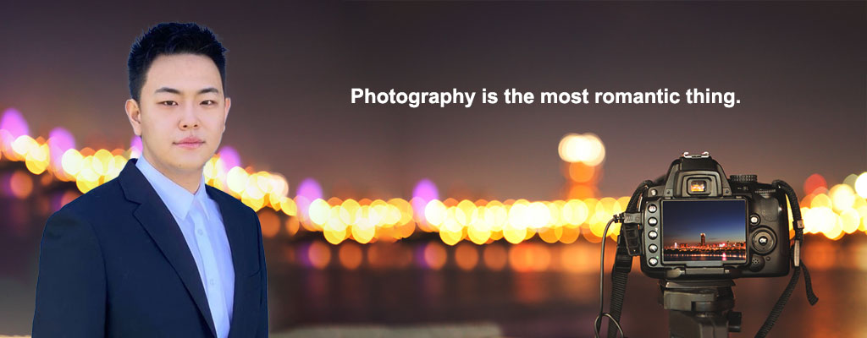
Communicating with a Photo

Slide 22

Communicating with a Photo

Slide 23
Photoshop Walk Through
(time permitting)

Slide 24
Photoshop Walk Through
Crop Image
Resize Image
Save for the Web

