Slide 1
ist 263

Slide 2
Agenda
CSS Colors
CSS Backgrounds
CSS Box Model

Slide 3
CSS Colors

Slide 4
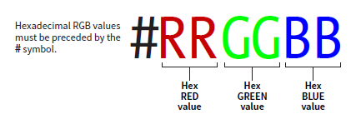
Hex Color

Slide 5
Color Pickers
Google Color Picker

Slide 6
New Selector

Slide 7
New Selector - Pseudo Selectors
Applies a style to a state of an element
What does an element look like when your mouse is over it
What does an element look like after it’s been clicked
What does a form filed look like when it is the one you are using
Etc.

Slide 8
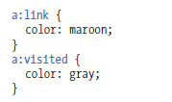
Pseudo Selectors

Slide 9
Pseudo Selectors

Slide 10
Css Backgrounds

Slide 11
Background Colors
body {background-color: coral;}

Slide 12
Background Images
body { background-image: url("paper.gif"); }

Slide 13
CSS Box Model

Slide 14
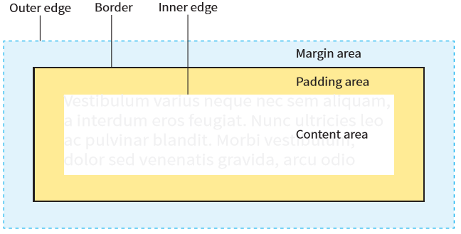
Element Box

Slide 15
Box Dimensions

Slide 16
Borders, Margins and Padding

Slide 17
participation

Slide 18
Time permitting:
Make page with a background image of Otto (our mascot) that repeats across the screen vertically and horizontally?
Add a paragraph that says: “I bleed orange.”
Change the background color of the paragraph to anything you want using the hex numbering system.
Put a non-black border around your paragraph.

