Slide 1
1. General Architecture

Slide 2
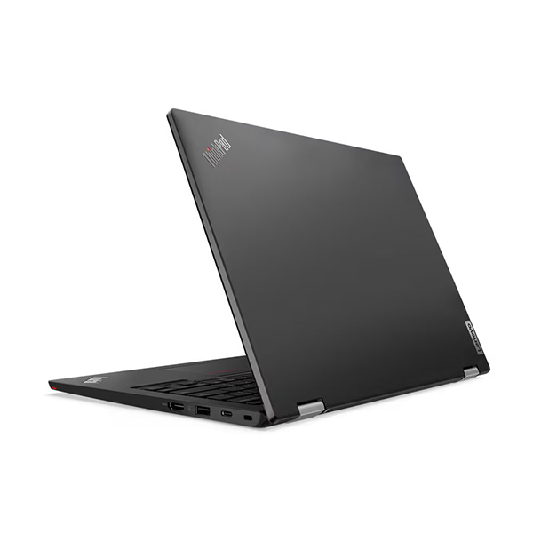
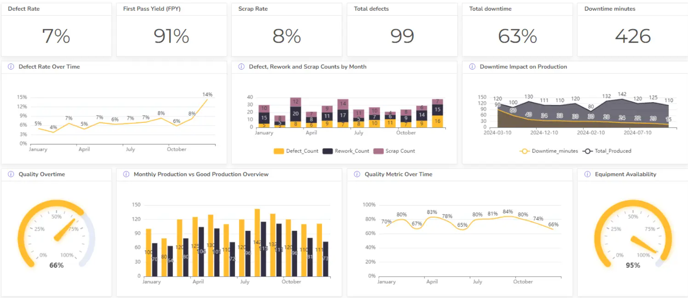
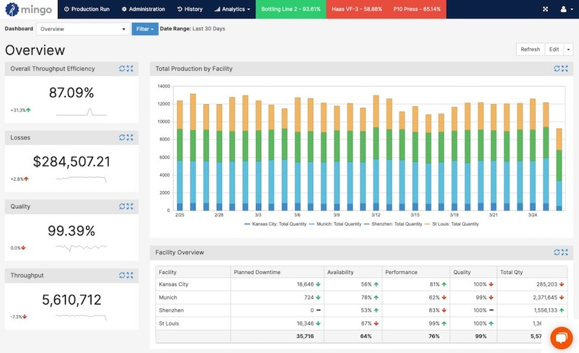


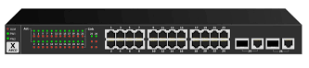
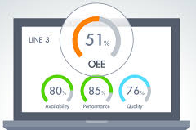
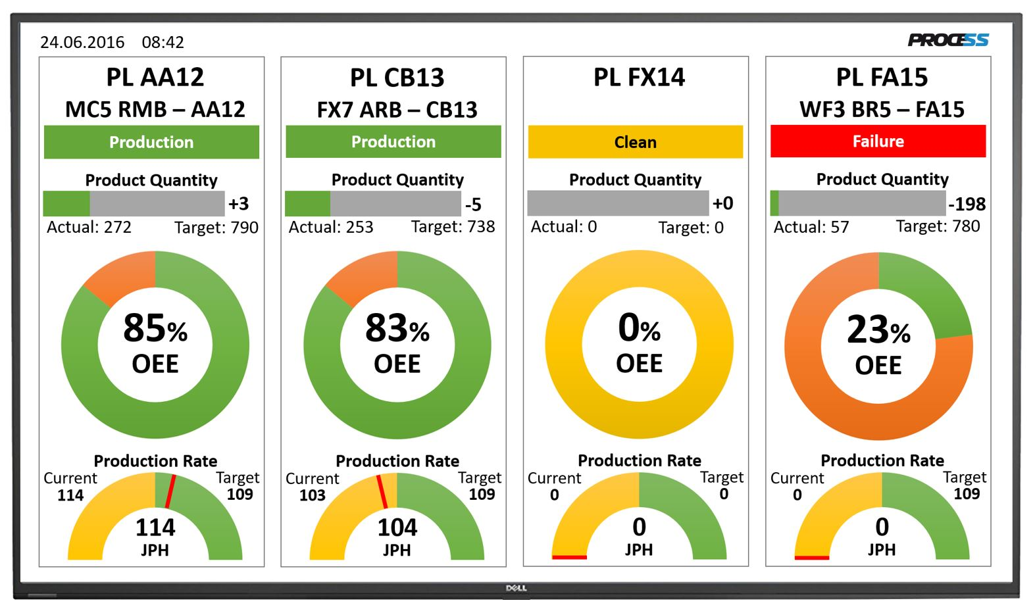
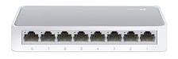
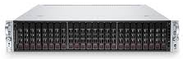
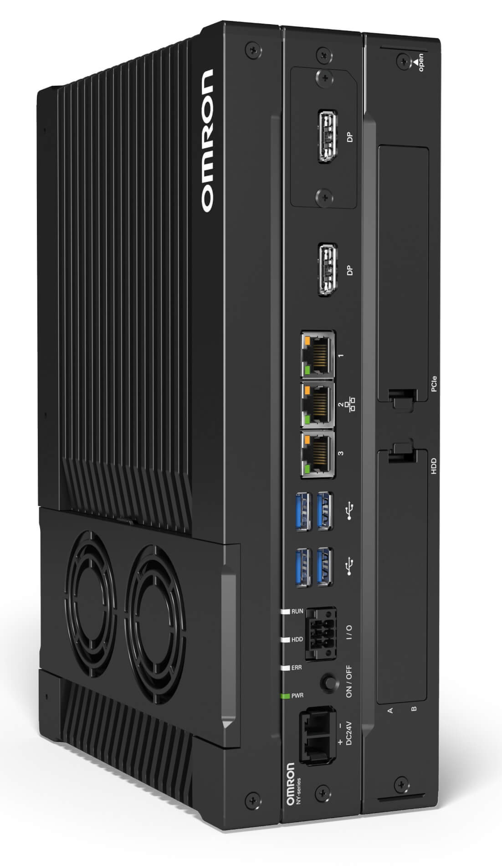
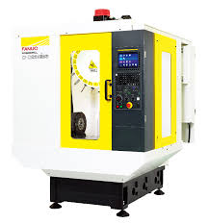
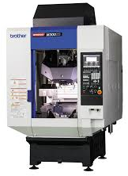
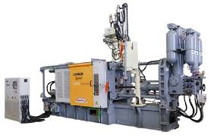
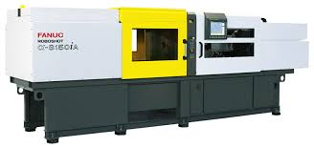
General Architecture IT - OT
Ruang Anyer1 – Monirot Room
IT
Network
OT
Network
Dashboard Monitoring (Control Room Office / BOD Room)
Core Switch
Distribution Switch
Distribution Switch
Distribution Switch
Area
Switch
Area
Switch
Area
Switch
Control Room Area
Control Room Area
Control Room Area
Server IoT
Vlan 10
Vlan 20
Vlan 30
Vlan 40
Vlan 50
Vlan 60
Server File
Server Scada
Server Nodered
Area
Machine
Area
Machine
Area
Machine
IPC OT
R. Server
Gedung A
Gedung B
Gedung C

Slide 3
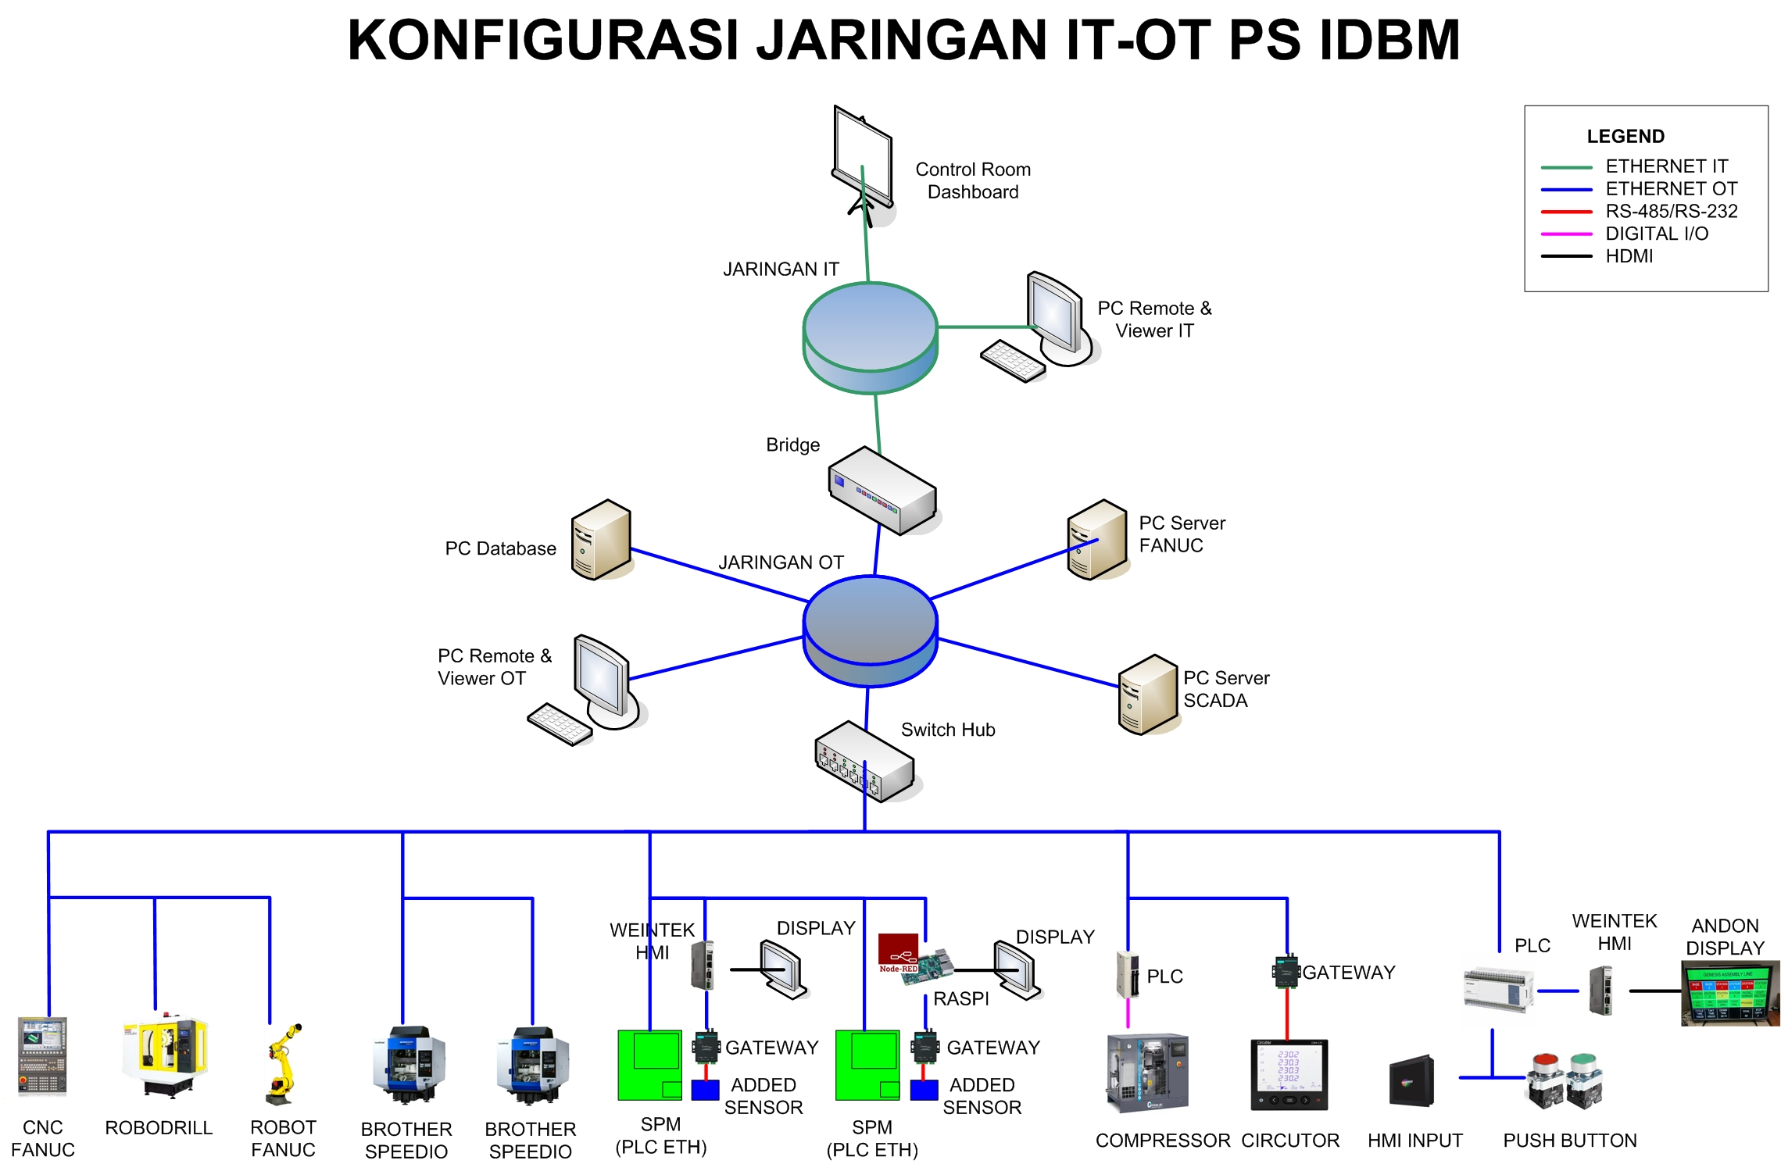
General Architecture IT - OT

Slide 4
Rules IT - OT
By default : Computers in the IT area cannot access machines/PCs/servers in the OT area, and vice versa.
Data from the OT area is centralised on the OT IPC. This data is synchronised to the IT IPC for further processing for analysis purposes (big data, analytical, machine learning, dashboard, etc).
If there is a need to access computers/servers across network segments, access is granted based on the approval of the relevant department/division, while still taking data security aspects into consideration.

