Slide 1
Chapter 20
Comparing Groups

Slide 2
20.1
The Standard Deviation of a Difference

Slide 3
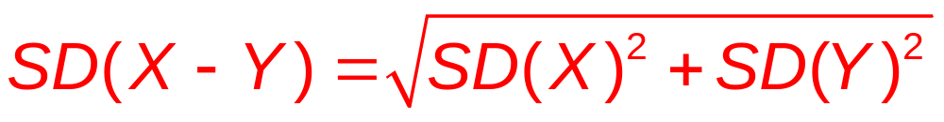
Variance of the Differences Revisited
For independent variables X and Y
Var(X – Y) = Var(X) + Var(Y)
  The variance of the difference is larger than either.
    The height of men and women vary, but there's even more uncertainty if I pick a man and woman at random and find the difference.
  Take a square root to get

Slide 4
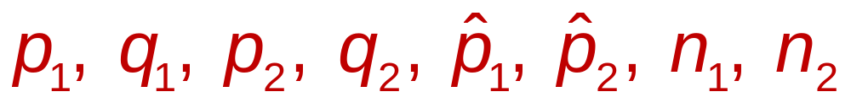
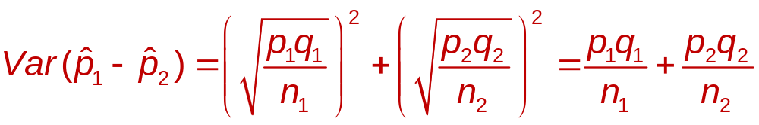
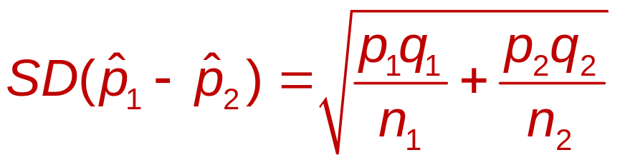
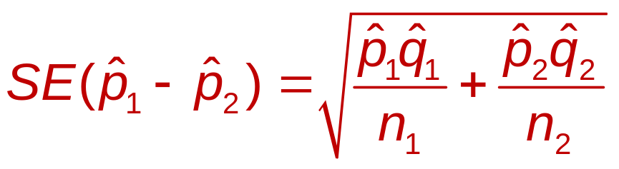
The Standard Deviation of the Difference Between Two Proportions
  Use subscripts to show two proportions:
  Standard Error:

Slide 5
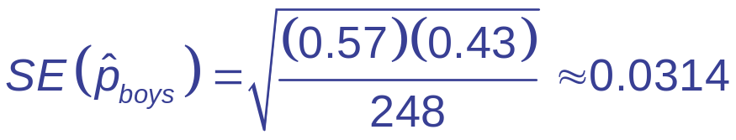
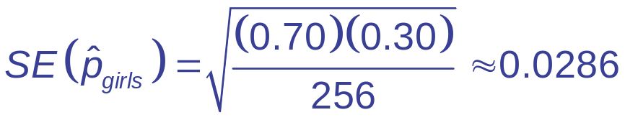
Standard Deviation of a Difference
57% of 248 boys aged 15-17 have online profiles. 70% of 256 girls aged 15-17 have online profiles.
  What is the standard error of the difference?
    The boys and girls were selected at random, so independent

Slide 6
20.2
Assumptions and Conditions for Comparing Proportions

Slide 7
Independence
Independence Assumption: Check
  Randomization Condition: The data are drawn independently and randomly.
  10% Condition: If without replacement, the data represent less than 10% of the population.
Independent Groups Assumption
  The two groups are independent of each other.
    Comparing wives and husbands or before and after can give a smaller difference between SDs.
Sample size
    Successes and Failures for both ≥ 10

Slide 8
Teens Satisfy Assumptions?
Recap: Randomly selected teens (girls vs. boys) checked for online posting.
  Can we use the results to make inferences?
    Randomization Condition: Samples of
    boys and girls taken randomly.
    10% Condition: 248 boys and 256 girls;
    less than 10% of all boys and girls
    Independent Groups Assumption: Boys’ online behaviors independent of girls’

Slide 9
Teens Satisfy Assumptions?
Recap: Randomly selected teens (girls vs. boys) checked for online posting.
  Can we use the results to make inferences? (Continued)
    Success/Failure Condition:
      248 X 0.57 = 141 ≥ 10 (boy successes)
      248 X 0.43 = 107 ≥ 10 (boy failures)
      256 X 0.70 = 179 ≥ 10 (girl successes)
      256 X 0.30 = 77 ≥ 10 (girl failures)
  All assumptions are met. Proceed.

Slide 10
20.3
A Confidence Interval for the Difference Between Two Proportions

Slide 11
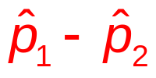
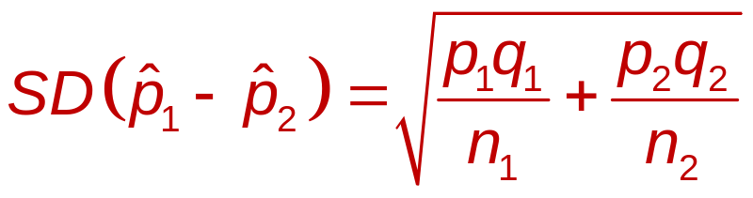
Sampling Distribution for the Difference Between Two Independent Proportions
If samples are independent (individually and by groups) and the sample sizes are large, then the sampling distribution of
  Follows a Normal model
  Has mean μ = p₁ – p₂
  Has standard deviation

Slide 12
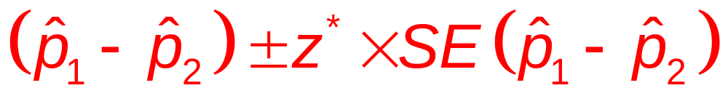
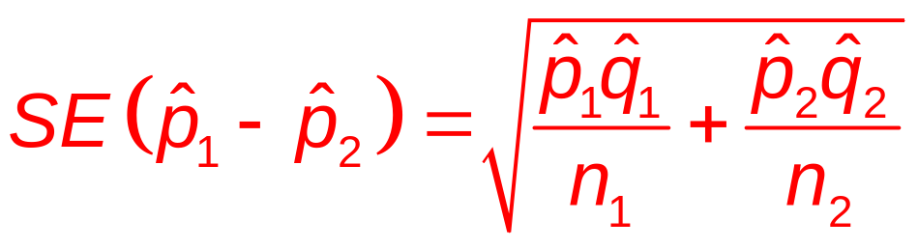
Two-Proportion z-Interval
If the conditions are met, the confidence interval
for p₁ – p₂ is
  z* is the critical value that corresponds to the confidence level C.

Slide 13

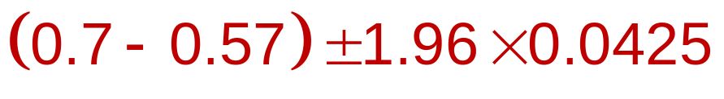

Online Presence: Boys vs. Girls
  57% of the 248 boys had an online profiles.
  70% of the 256 girls had an online profiles.
  What does the confidence interval say about the difference?
  We are 95% confident that the proportion of teen girls who post online is between 4.7% and 21.3% higher than for boys.

Slide 14
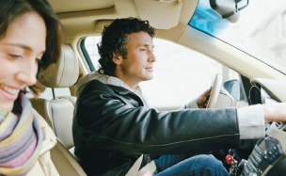
Wearing Seat Belts
Question: How much difference is there
in the proportion of male drivers who wear seat belts when sitting next to a man and the proportion when sitting next to a woman?
Think →
  Plan: Want a 95% confidence interval for p_{F} – p_{M}.
  Data are from a random sample of MA drivers.

Slide 15
Wearing Seat Belts
Model:
  Randomization Condition: Participants selected randomly and independently from car to car.
  10% Condition: Sample size is less than 10% of all drivers.
  Independent Groups Assumption: The seat-belt use with male and female passengers are independent.

Slide 16
Wearing Seat Belts
Model:
  Success Failure Condition:
    With female passengers: 2777 wore seat belts, 1431 did not.
    With male passengers: 1363 wore seat belts, 1400 did not.
    All successes and failures ≥ 10.
  All conditions are met. Use the Normal model and find a 2-proportion z-interval.

Slide 17
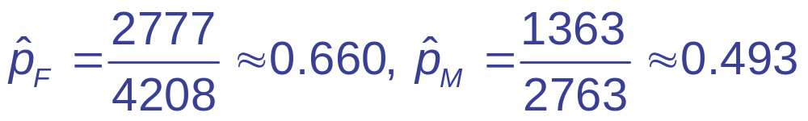
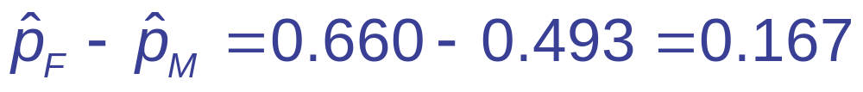
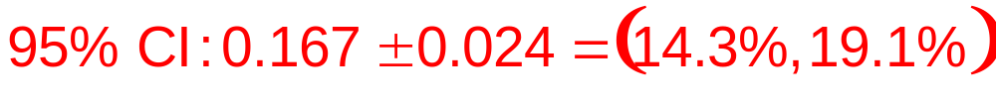
Wearing Seat Belts
Show →
  Mechanics: n_{F} = 4208, n_{M} = 2763

Slide 18
Wearing Seat Belts
Tell →
  Conclusion: I am 95% confident that the proportion of male drivers who wear seat belts when driving next to a female passenger is between 14.3 and 19.1 percentage points higher than the proportion who wear seat belts when driving next to a male passenger.
Caution
  Can’t generalize to other states
  Can’t say men buckle up because of the women; Lurking variables such as age may be present.

Slide 19
20.4
The Two Sample
z-Test: Testing for the Difference Between Proportions

Slide 20
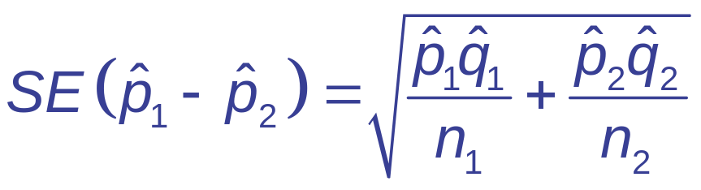
Internet Before Sleep
The Sleep in America Poll found that 205 of 293, or 70%, of Gen-Y use the Internet before sleep. 235 of 469, or 50%, of Gen-X use the Internet before sleep.
  Is this difference of 20% real or is it likely to be due only to natural fluctuations in the sample?
    H₀: p₁ – p₂ = 0
  For CI:
  For hypothesis testing, we can do better.

Slide 21
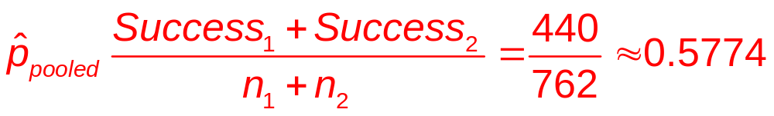
Pooling the Proportion
  H₀ says the proportions are equal.
  p₁ and p₂ should both be about equal the total proportion of successes.
  Total successes: 205 + 235 = 440
  Total trials: 293 + 469 = 762
  Pooled Proportion:

Slide 22
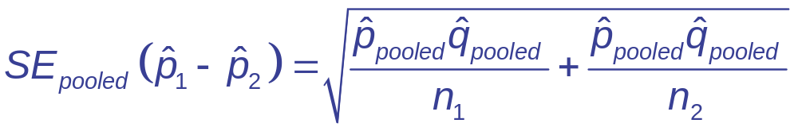
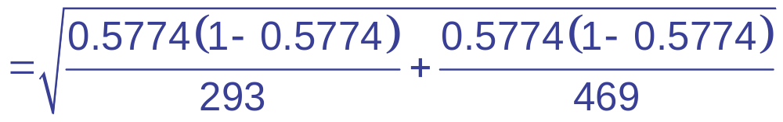
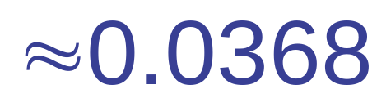
Standard Error for Internet Before Sleep
The Sleep in America Poll found that 205 of 293 or 70% of Gen-Y use the Internet before sleep. 235 of 469 or 50% of Gen-X use the Internet before sleep.

Slide 23
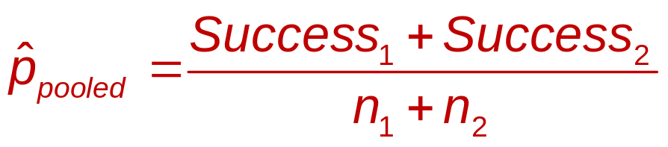
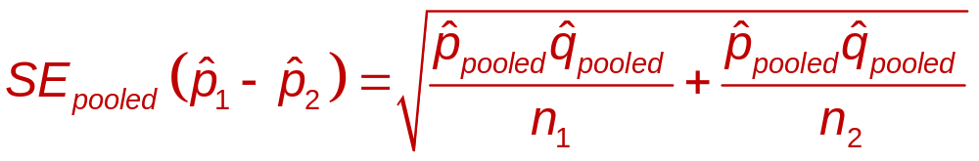
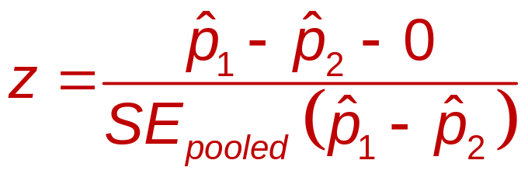
Two-Proportion z-Test
  Conditions same as 2-proportion CI.
  H₀: p₁ – p₂ = 0
  The statistic follows the Normal model.

Slide 24

Pre-Sleep Internet Rates Differ?
Think →
  Plan: Random sample of
  adults: 293 Gen Y, 469 Gen X
  Hypotheses:
    H₀: p_{GenY} – p_{GenX} = 0
    H_{A}: p_{GenY} – p_{GenX} ≠ 0
  Model
    Randomization Condition: Randomly selected and stratified by sex.

Slide 25
Pre-Sleep Internet Rates Differ?
Think →
  Model (Continued)
    10% Condition: Samples less than 10% of all
    Gen X and Gen Y.
    Independent Groups Assumption: The samples were selected at random so independent.
    Success/Failure Condition: Observed numbers of successes and failures for both groups ≥ 10.
  The conditions are all met. Use the Normal model and perform a two-proportion z-test.

Slide 26
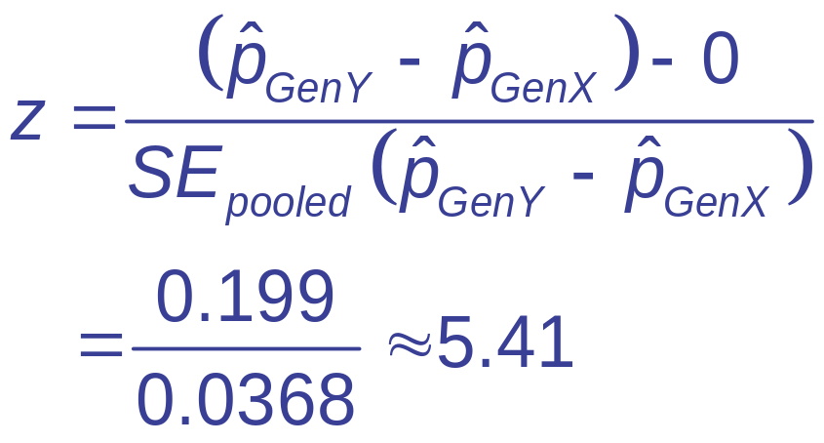
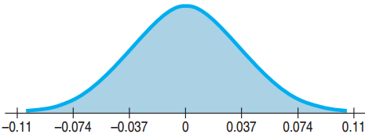
Pre-Sleep Internet Rates Differ?
Show →
  Mechanics: (Continued)
  P-value = 2 × P(z > 5.41) ≤ 0.0001

Slide 27
Pre-Sleep Internet Rates Differ?
Tell →
  Conclusion:
    P-value ≤ 0.0001: If there really was no difference in surfing rates between the two groups, then the difference observed in this study would be very rare indeed.
    We can conclude that there is, in fact, a difference in the rate of surfing between GenY and GenX adults.

Slide 28
Easy to Find Teens Online: Girls vs. Boys
19% (62 girls) of 325 girls and 28% (75 boys) of 268 boys have easy to find online profiles.
  Is there a real difference between all boys and girls?
    H₀: p_{boys} – p_{girls} = 0
    H_{A}: p_{boys} – p_{girls} ≠ 0
  Randomization Condition: Both samples randomly and independently chosen
  10% Condition: Sample sizes certainly less
  than 10% of all boys and girls

Slide 29
Easy to Find Teens Online: Girls vs. Boys
  Independent Groups Assumption: The boys are independent of the girls.
  Success/Failure Condition:
    Girls: 62 successes and 263 failures.
    Boys: 75 successes and 193 failures.
  Use the two-proportion z-test.

Slide 30
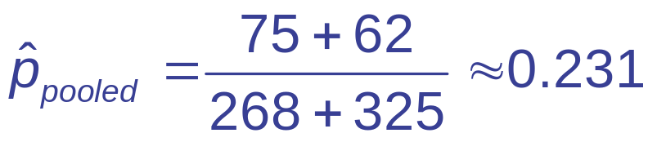
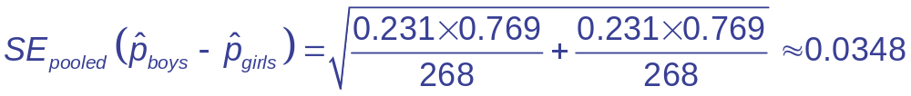
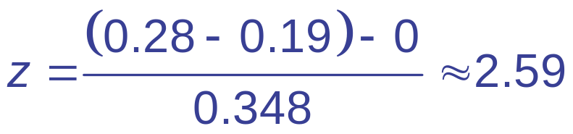
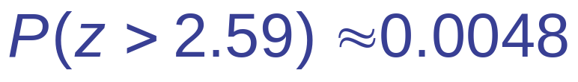
Easy to Find Teens Online: Girls vs. Boys
  Two-Tailed Test: P-value = 2(0.0048) = 0.0096
  P-value very small → Reject H₀
  There is strong evidence to say that there is a difference between the proportions of boys and girls who say they are easy to find online.

Slide 31
20.5
A Confidence Interval for the Difference Between Two Means

Slide 32
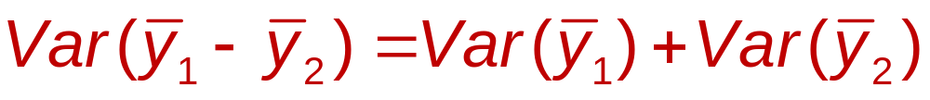
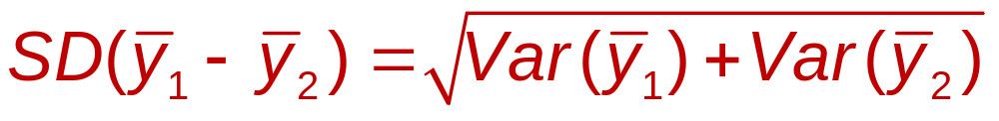
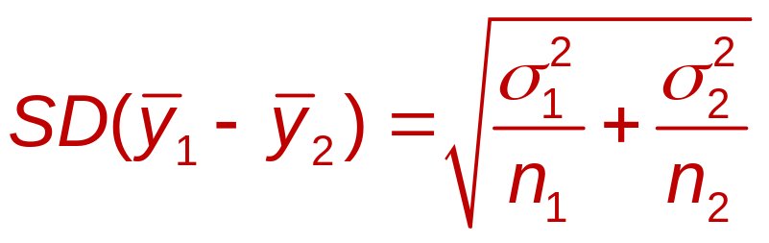
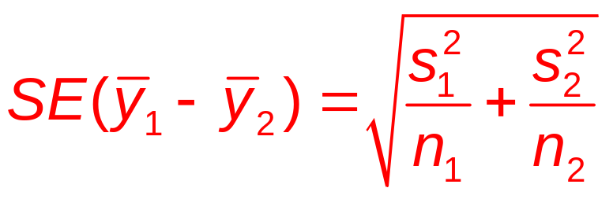
Difference Between Means:
Standard Error
  Don’t know the population SDs, so use the sample SDs:

Slide 33
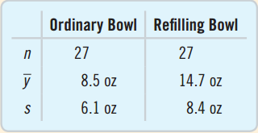
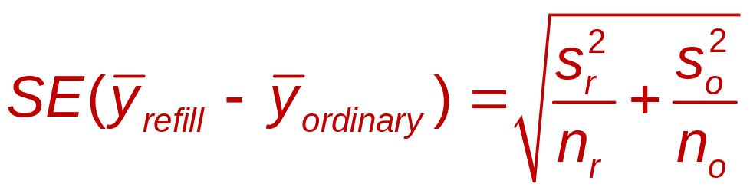
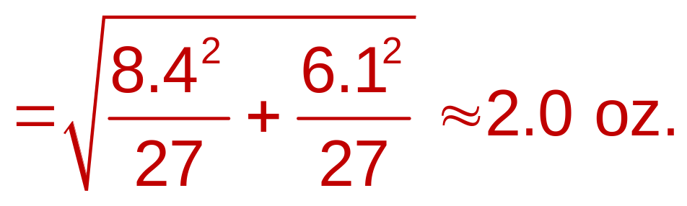
Effect of Knowing How Much We Eat
  27 people observed eating soup from ordinary bowl.
  27 people observed eating soup from a bowl that slowly refills without the person knowing.
  Find the standard error.

Slide 34
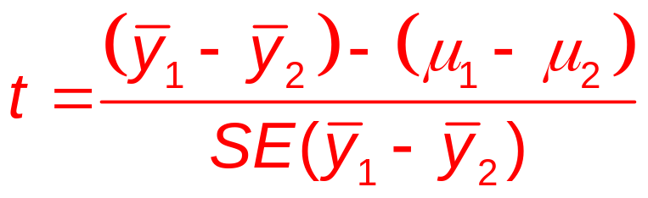
Sampling Distribution for the Difference Between Two Means
  When the assumptions are met, the sampling distribution for the difference between two independent means:
  Uses the Student’s t-model
  The degrees of freedom are complicated, so just use a computer.

Slide 35
Assumptions and Conditions
Independence
  Same assumptions as proportions
  Between and within groups
  Randomization is evidence of independence.
  If not independent, can you use pairing?
Nearly Normal Condition
  Same as with a single mean, but must check both.
  n < 15: must be very close to normal.
  15 ≤ n ≤ 40: Check for outliers and skewness.
  n > 40: Fine as long as no extreme outliers or extreme skewness

Slide 36
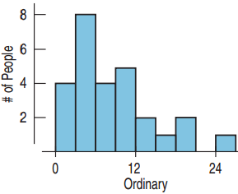
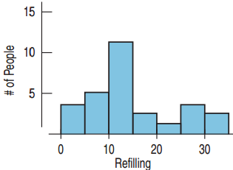
Checking Conditions for Soup Experiment
  Randomization Condition: The
  subjects were randomly assigned.
  Nearly Normal Condition: n = 27
  for both. Histograms only a little
  skewed. No outliers.
  Independent Groups Assumption:
  Randomization to treatment groups guarantees this
  Okay to construct a two-sample t-interval for the difference between two means.

Slide 37
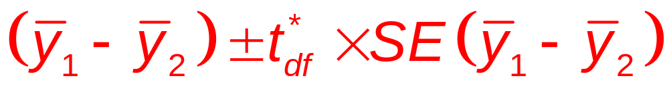
Two-Sample t-Interval for the Difference Between Two Means
  When the conditions are met, the confidence interval for the difference between means from two independent groups is

Slide 38
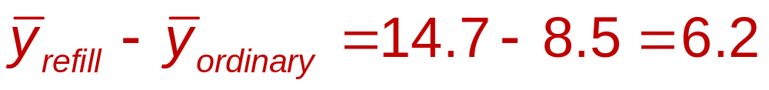
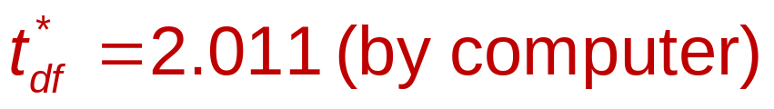
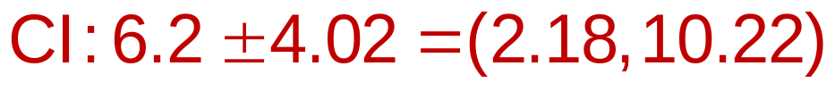
Confidence Interval for Soup Experiment
What does a 95% confidence interval say about the difference in mean amounts eaten?
  I am 95% confident that people eating from a refilling bowl will eat between 2.18 and 10.22 more ounces than those eating from an ordinary bowl.

Slide 39
20.6
The Two-Sample
t-Test: Testing for the Difference Between Two Means

Slide 40
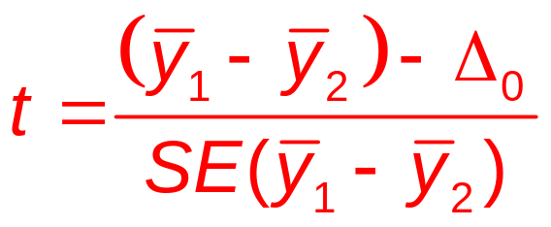
Two-Sample t-Test for the Difference Between Means
  Conditions same as two-sample t-interval
  H₀: μ₁ – μ₂ = Δ₀ (Δ₀ usually 0)
  When the conditions are met and the null hypothesis is true, use the Student’s t-model to find the
  P-value.

Slide 41
Do People Offer a Lower Price to Friends than to Strangers?
Is there a difference in the average price for a used camera people would offer a friend and a stranger?
Think →
  Plan: I have bid prices from 8 subjects buying from a friend and 7 buying from a stranger, found in a randomized experiment.
  Hypotheses
    H₀: μ_{F} – μ_{s} = 0
    H_{A}: μ_{F} – μ_{s} ≠ 0

Slide 42
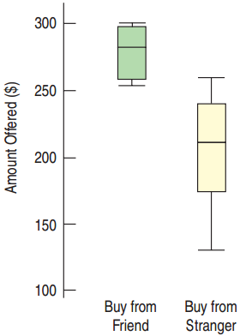
Friends vs. Strangers
Think →
  Model: Has practical significance,
  but is there statistical significance?
    Randomization Condition:
    Subjects assigned to treatment
    groups randomly.
    Independent Groups Assumption: Randomizing gives independent groups.

Slide 43
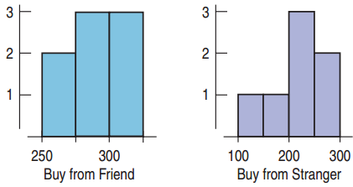
Friends vs. Strangers
Think →
  Model (Continued):
    Nearly Normal Condition:
    Histograms are reasonably unimodal and symmetric, but with the very small sample sizes, we should be concerned.
  The assumptions and conditions are somewhat reasonable.
  Use the Student’s t-model to perform a
  two-sample t-test.

Slide 44
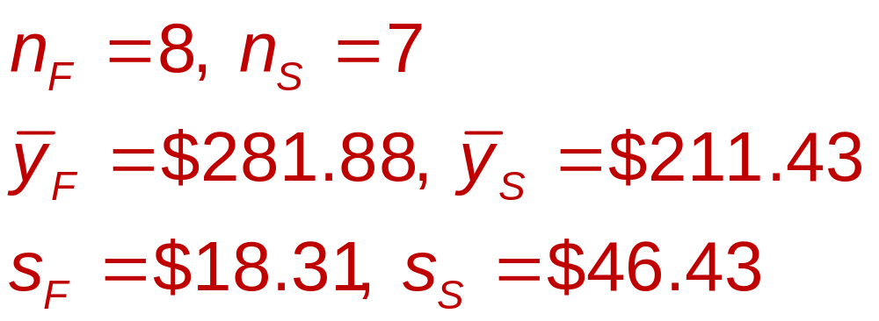
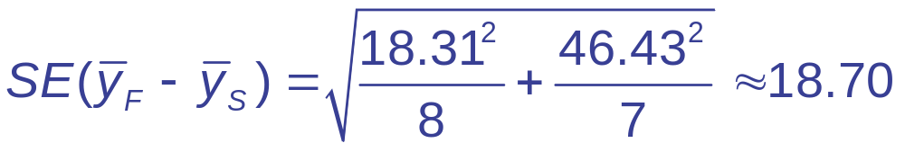
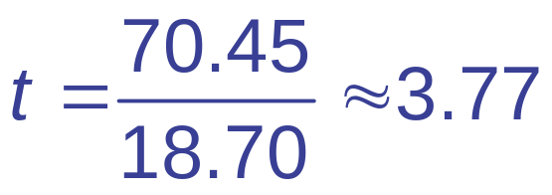

Friends vs. Strangers
Show
  Mechanics:

Slide 45
Friends vs. Strangers
Tell →
  Conclusion: The P-value = 0.006 is very small.
  If there were no difference in the mean prices, then a difference this large would occur 6 times in 1000.
  Too rare to believe
  Reject H₀.
  Conclude that people are likely, on average, to offer a friend more than they’d offer a stranger for a used camera.

Slide 46
What Can Go Wrong?
Don’t use two-sample methods when the samples aren’t independent.
  Random sampling is best.
  Consider matched-pairs design for dependent data.
Look at the plots.
  Boxplots, histograms, and normal plots will help you determine if the Near Normal Condition is met.
  A strong outlier can completely change the conclusions.

Slide 47
What Can Go Wrong?
Be cautious if you apply inference methods where there was no randomization.
  Without randomization, the inferences about the differences may be wrong.
Don’t interpret a significant difference in proportions or means causally.
  People with higher incomes are more likely to snore.
  Will surgery to prevent snoring make you rich?
  Maybe the lurking variable, age, causes both.

