Slide 1
Chapter 21
Paired Samples and Blocks

Slide 2
21.1
Paired Data

Slide 3
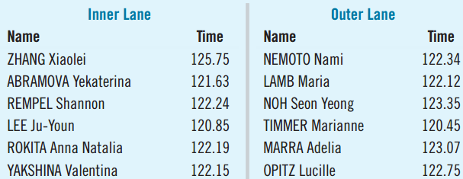
Pairing
  Speed-skating
  races run in
  pairs. One starts in the inner lane, the other in the outer lane.
  Above are some of the randomly assigned pairs.
  The data are paired rather than independent.
  Blocking involves pairing arising from an experiment.
  Matching involves pairing arising from an observational study.
  With pairing, we look at the differences.

Slide 4
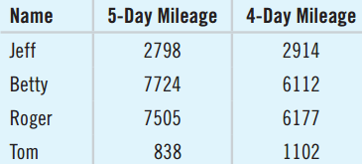
Comparing Mileage
Do flexible schedules reduce total
mileage? The table shows some workers’ mileage before and after the company switched to a 4-day work week.
  Why are these data paired?
    Each driver’s mileage recorded before and after.
    Not independent since we expect a high “before” mileage to predict a high “after” mileage.
    Paired because the differences such as
    Jeff: 2798 – 2914 = –116 have meaning.

Slide 5
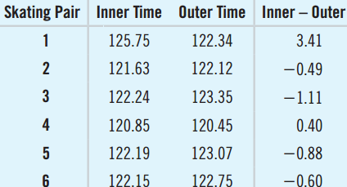
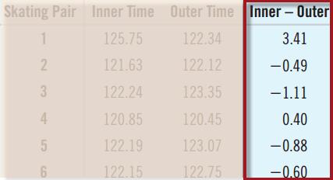
Differences for Speed-Skater Pairs
  For paired data, create a new data set of the differences.
  We can now look only
  at the differences.
  Ignoring the original
  data, we now have a
  single data set.
  Proceed with a one-sample t-test. This process is called a paired t-test.

Slide 6
21.2
Assumptions and Conditions

Slide 7
Assumptions and Conditions
Paired Data Condition
  The data must be paired.
  Only use pairing if there is a natural matching.
  The two-sample t-test and the paired t-test are not interchangeable.
Independence Assumption
  For paired data, the groups are never independent.
  Need differences independent, not individuals
  Randomization ensures independence.

Slide 8
Assumptions and Conditions (Continued)
Normal Population Assumption
  Need to assume the differences follow a Normal model.
  Nearly Normal Condition:
    Sketch a histogram and normal probability plot of the differences.
    Normality less important for larger sample sizes.
    Even if the individual measurements are skewed, bimodal or have outliers, the differences may still be Normal.

Slide 9
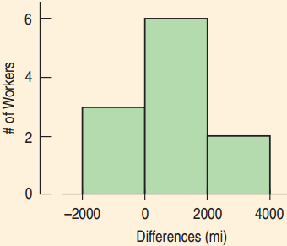
4-Day vs. 5-Day Mileage
Is it okay to use these data to test whether the new schedule changed the amount of driving?
  Paired Data Condition: Before and after study
  Independence Assumption: The driving behavior of one worker is independent of another.
  Randomization Condition: The work trips randomly occurred.
  Nearly Normal Condition: The
  sample size is small, but the
  histogram is unimodal and
  symmetric.
  The paired t-test can be used.

Slide 10
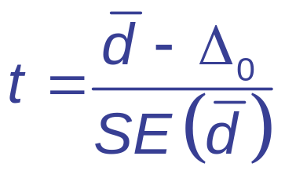
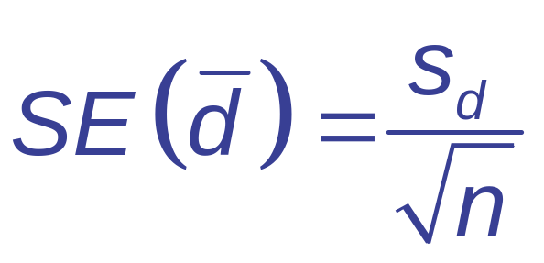

The Paired t-Test
When the conditions are met, we can test whether the mean differences significantly differ from 0.
  H₀: μ_{d} = Δ₀ (Δ₀ is usually 0)
  and s_{d} are the mean and standard deviation of the pairwise differences and n is the number of pairs.
  Use the Student’s t-model with n-1 degrees of freedom and find the P-value.

Slide 11

Speed-Skating Comparisons
Was there a difference between speeds
between inner and outer speed-skating lanes?
Think →
  Plan: I have data for 17 pairs of racers.
  Hypotheses:
    H₀: μ_{d} = 0
    H_{A}: μ_{d} ≠ 0

Slide 12
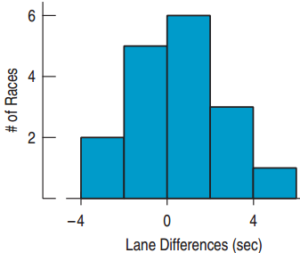
Speed-Skating Comparisons
Think →
  Model:
    Paired Data Condition: The racers compete in pairs.
    Independence Assumption: Each race was independent of the others. Racers were assigned to lanes randomly.
    Nearly Normal Condition: The
    histogram of the differences is
    unimodal and symmetric. No outliers.
  Use Student’s t-model with 16 df.
  Perform a paired t-test.

Slide 13
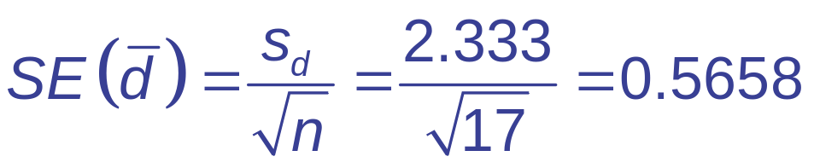
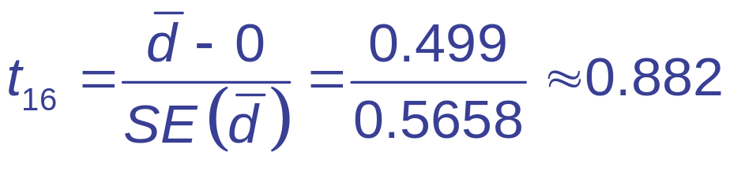
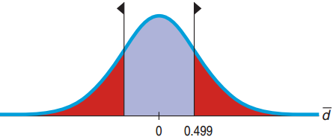

Speed-Skating Comparisons
Show →
  Mechanics:
  n = 17 pairs, = 0.499 sec., s_{d} = 2.333 sec.

Slide 14
Speed-Skating Comparisons
Tell →
  Conclusion:
    Events that occur more than a third of the time
    (P-value = 0.39) are not remarkable.
    I can’t conclude that the observed difference isn’t due simply to random chance. It appears the fans may have interpreted a random fluctuation in the data as favoring one lane. There’s insufficient evidence to declare any lack of fairness.

Slide 15
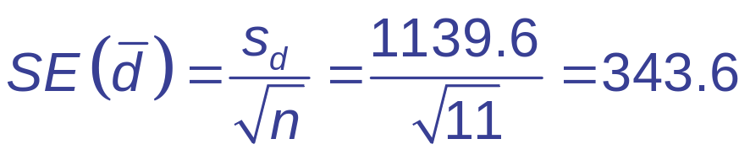
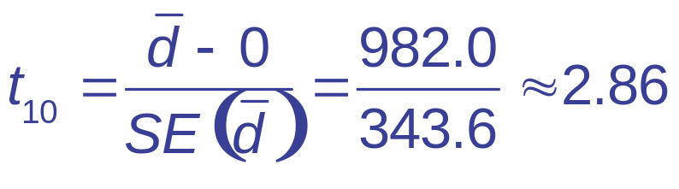
4-Day vs. 5-Day Mileage
Is there evidence that a 4-day work week vs. a 5-day work week would change how many miles workers drive?
  H₀: μ_{d} = 0
  H_{A}: μ_{d} ≠ 0
  n = 11 pairs, = 982 miles, s_{d} = 1139.6 miles
  The assumptions and conditions are met. Use Student’s t-model with 10 df.

Slide 16
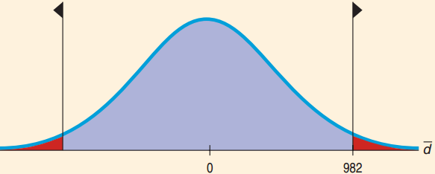
4-Day vs. 5-Day Mileage
  P-value = 2P(t₁₀ > 2.86) = 0.017
  Since the P-value is
  small, reject H₀.
  Conclude that the
  change in workweek
  did lead to a change in average driving mileage. It appears that changing the work schedule may reduce the mileage driven by workers.
  The confidence interval will help determine if there is practical significance.

Slide 17
21.3
Confidence Intervals for Matched Pairs

Slide 18
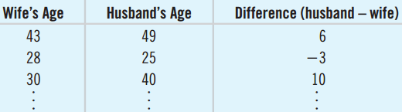
How Much Older is the Husband?
170 couples selected at random provided their ages.
  Goal: Find a confidence interval for the mean difference.

Slide 19
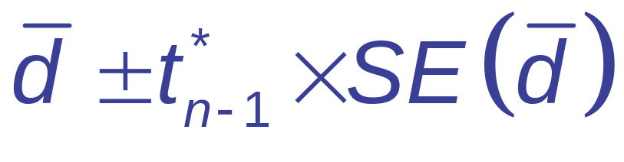
Paired t-interval
When the conditions are met, the confidence interval for the mean paired difference is
  The critical value t* from the Student’s t-model depends on the confidence level C and df = n – 1.
  (n is the number of pairs.)

Slide 20

How Much Older is the Husband?
How big a difference is there, on average,
between husbands and wives?
Think →
  Plan: I want the mean difference in age. Have a random sample of 200 couples with 170 providing ages their ages. n = 170
  Model:
    Paired Data Condition: Married couples make a natural pairing.
    Independence Assumption: The survey was randomized.

Slide 21
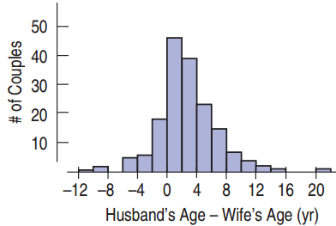
How Much Older is the Husband?
Think →
  Model:
    Nearly Normal Condition:
    The histogram is unimodal
    and symmetric.
  The conditions are met, so I
  can use the Student’s t-model
  with n – 1 = 169 degrees of freedom and
  find a paired t-interval.

Slide 22


How Much Older is the Husband?
Show →
  Mechanics: n = 170, = 2.2 years, s_{d} = 4.1 years
    t₁₆₉ = 1.97 (from StatCrunch)
  The 95% CI for the difference between the means is
  2.2 ± 0.61 = 1.6 to 2.8 years.

Slide 23
How Much Older is the Husband?
Tell →
  Conclusion:
  I am 95% confident that husbands are, on average, 1.6 to 2.8 years older than their wives.

Slide 24
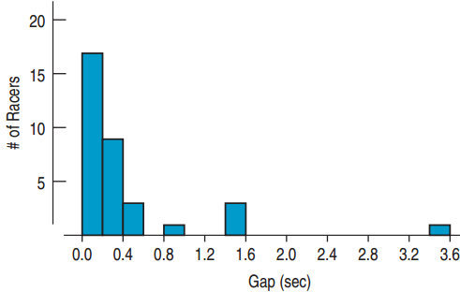
Effect Size
For the speed-skating times, P-value = 0.39.
  Would a confidence interval tell us more?
  95% CI = (–0.70, 1.70)
  At the high end, 1.70, would this difference matter?
  All differences except for Gold – Silver are less than
  1.70 seconds.
  The difference could be
  large enough, but we don’t
  know for sure.

Slide 25

Effect Size and the Work Week
We found a statistically significant difference between the driving mileage for the 4-day and 5-day work week. Is there a practical difference?
  95% CI for μ_{d} is 982 ± 765.54 = (216.46, 1747.54)
  With 95% confidence, average mileage is between 216 and 1748 miles less on the 4-day work week. This could save money with high gas prices.

Slide 26
21.4
Blocking

Slide 27
Disadvantages and Advantages of Pairing
Disadvantage
  Fewer degrees of freedom. Each pair considered as a single data value instead of two values.
Advantage
  Can significantly reduce variability by focusing just on what is being compared.
  Pairing is an example of effective blocking.
The advantage outweighs the disadvantage, so consider pairing if possible.

Slide 28
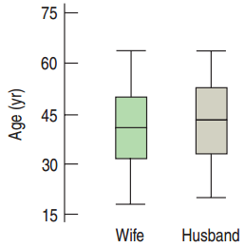
Comparing Pairs and No Pairs
Pairing
  With pairing husbands and wives, there was a clear difference in ages. 95% CI: (1.6, 2.8).
Without Pairing
  Without pairing, this would not
  have been as conclusive.
  From the box plots the
  difference is hard to detect.

Slide 29
Dependence and Independence
  Previous methods required independence both between and within groups.
  With pairing, the samples are always dependent.
  With pairing, we need the pairs to be independent of each other.
  Paired methods are sometimes called methods for “dependent” samples.

Slide 30
What Can Go Wrong?
Don’t use a two-sample t-test when you have paired data.
  Two-sample t-test and paired t-tests are not the same.
Don’t use a paired t method when the samples aren’t paired.
  Always check for a natural pairing such as
  husband/wife, before/after, younger sister/older sister.

Slide 31
What Can Go Wrong?
Don’t forget outliers.
  Outliers of the differences not individuals. Make a plot of the differences to check for outliers.
Don’t look for the difference between the means of paired groups with side-by-side box plots.
  The box plots of each group still contain the variation that pairing can remove. Comparing box plots is likely to be misleading.

