Slide 1
Chapter 19
More About Tests and Intervals

Slide 2
19.1
Choosing Hypotheses

Slide 3
Choosing the Null
The null hypothesis typically means no change or no difference.
  Identify the status quo or value that indicates that things are the same.
  This does not mean 0. H₀: p = 0 is rarely correct.
  The null hypothesis is never shown to be true.
The alternative hypothesis is that things did decrease, increase or change.
  It’s what you are interested in showing is true.

Slide 4
Examples of Choosing Hypotheses
The helmet law was dropped for those over 21. You are interested in whether people under 21 are now less likely to wear a helmet. Before dropping the law 60% of youths wore helmets.
  H₀: p = 0.6
  H_{A}: p < 0.6
Have athletes’ strength increased with the new exercise equipment?
  H₀: μ = past mean strength
  H_{A}: μ > past mean strength

Slide 5
Hypotheses for Avandia
There is concern about the Type 2 diabetes drug Avandia raising the risk of heart attack. People with Type 2 diabetes have a 20.2% chance of heart attack within 7 years. 28.9% of the 4485 people with Type 2 diabetes had heart attacks within 7 years.
  What are the null and alternative hypotheses?
    H₀: p = 0.202
    H_{A}: p > 0.202
  We use a one-sided upper-tailed test since we are concerned about a higher risk of heart attack.

Slide 6
19.2
How to Think about P-Values

Slide 7
P-Value is a Conditional Probability
The P-value is the probability of getting results as unusual as observed given that H₀ is true.
  P-value = P(observed stat value | H₀ is true)
  P-value ≠ P(H₀ is true | observed stat value)
The P-value never gives a probability that H₀ is true.
  P-value = 0.03 does not mean a 3% chance of H₀ being correct.
  It just says that if H₀ is correct, then there would be a 3% chance of observing a statistic value more unlike what was observed.

Slide 8
Small P-Values
A smaller P-value provides stronger evidence against H₀.
  This does not mean that H₀ is less true.
  The person is not more guilty, you just are more convinced of the guilt.
There is no hard and fast rule on how small is small enough.
  How believable is H₀?
  Do you trust your data?

Slide 9
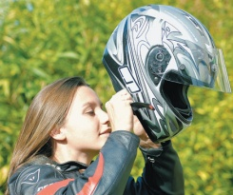
Has Helmet Use Declined among
Youth Since the Law Changed?
Think →
  Plan: The proportion before was 60%. Is it less now?
  Hypotheses: The status quo is that the proportion of youth wearing helmets is still 60%. We are interested in whether this proportion has declined.
    H₀: p = 0.60
    H_{A}: p < 0.60

Slide 10
Has Helmet Use Declined among
Youth Since the Law Changed?
Show →
  Model:
    Independence Assumption: The accident victims were independent of each other.
    Randomization Condition: Great effort was taken to make the sample representative.
    Success/Failure Condition:
      np = (781)(0.6) = 468.6 ≥10
      nq = (781)(0.4) = 312.4 ≥ 10
    Use the Normal model and a one-proportion z-test.

Slide 11
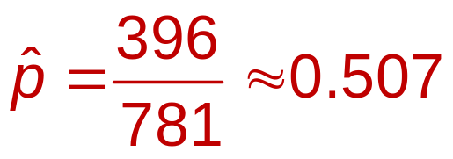
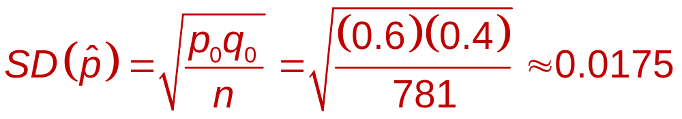
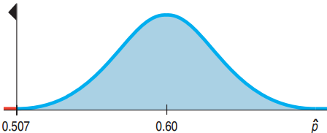
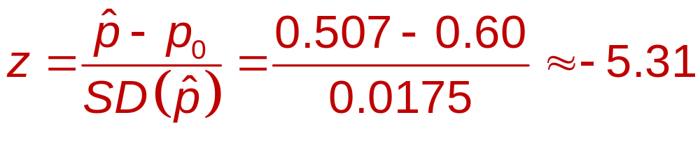
Has Helmet Use Declined among
Youth Since the Law Changed?
Show →
  Mechanics:
    P-value < 0.001

Slide 12
Has Helmet Use Declined among
Youth Since the Law Changed?
Tell →
  Conclusion: The very small p-value tells us that if helmet rate among youth were still 60%, then there would be less than 1 in 1000 a chance of observing a rate no higher than 50.7%.
  Reject H₀.
  There is strong evidence that there has been a decline in helmet use among riders under 21.

Slide 13
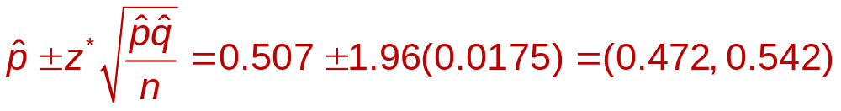
How Much Has Helmet Use Declined?
  The strong evidence for a decline does not mean a large decline.
  Instead use a confidence interval.
  With 95% confidence, helmet use declined between 6% and 13%.

Slide 14
Not Guiltier, Just More Evidence Against
A Bank Robbery Trial:
  The getaway car’s color matches the defendant’s.
    P-value pretty large
  Both robber and defendant have same color hair and same height and weight.
    P-value getting smaller
  Robber’s jacket found in trash near defendant’s house.
    P-value still smaller

Slide 15
Diabetes Drug Revisited
The sample of patients who took the drug had 28.9% heart attack risk while the general population has a 20.2% risk.
  Interpret the P-value.
    The P-value represents the probability of seeing such a high heart attack rate among those studied if, in fact, taking the drug doesn’t increase risk at all.

Slide 16
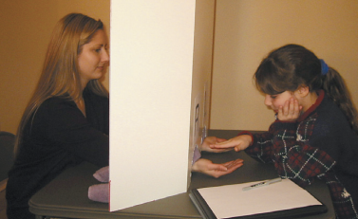
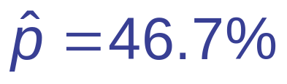
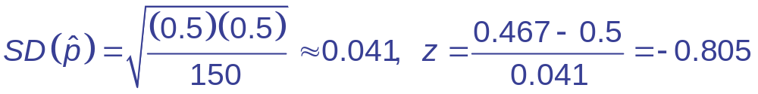
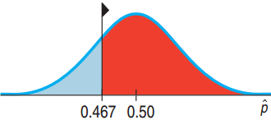
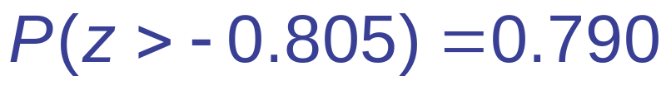
Detecting the Human
Energy Field
The Therapeutic Touch (TT)
practitioners tried to decide whether
the girls hand hovered over the left or right hand.
  H₀: p = 0.5 H_{A}: p > 0.5
  TT practitioners successful 70 of 150 tries:

Slide 17
How to Interpret P-Value = 0.790
  The P-value of 0.790 is so large we certainly do not reject H₀.
  P-value > 0.5 indicates that the sample was on the wrong side of the inequality.
  The TT practitioners were worse not better than random chance alone.
  This does not mean the null hypothesis is true, only that we cannot say it is false.

Slide 18
More on P-Values
An earlier study on the risk of the diabetes drug reported an increased risk of heart attack from 20.2% to 26.9% and a P-value of 0.27.
  Why did the researchers not express alarm?
  P-value = 0.27 means that there would be a 27% chance of at least such an increase for a sample even if there were not increased risk for the drug.
  The earlier study wasn’t convincing enough.

Slide 19
19.3
Alpha Levels

Slide 20
How to Define “Rare Enough”
  Need to make a decision whether P-value is low enough to reject H₀.
  Set a threshold value, called the alpha level (α).
  P-value < α:
    Reject H₀.
    The results are statistically significant.
  P-value > α:
    Fail to reject H₀.
    The results are not statistically significant.

Slide 21
Choosing an α
  α = 0.05 is most common .
    (1 in 20 chances is pretty rare)
  Other levels of significance commonly used:
    0.001, 0.01, 0.1
  Are the air bags safe?
    Low α such as 0.001.
  Do students like pepperoni or sausage?
    High α such as 0.1.

Slide 22
Just Make a Decision
The level of significance forces us to make a decision.
  P-Value below α:
    “The test is significant at that level.”
  P-Value above α:
    “The data have failed to provide sufficient evidence to reject the null hypothesis.”
    Never accept H₀.
  Always include the actual P-value.
    Showing the P-value is far below α tells a different story than when the P-value is just below α.

Slide 23
Practical vs. Statistical Significance
Practical Significance
  The results noticeably differ from the status quo.
    Proportion of wins = 85% vs. the expected 50%.
    Mean exam score 48 without studying vs. the course mean of 82.
Statistical Significance
  P-value < α
  If the status quo is true, it would be unlikely for a sample to have such extreme mean or proportion.

Slide 24
Are They Speeding?
  College Terrace speed limit: 25 mph
  Even after traffic-calming measures, a resident complains that cars still speed.
  250 of 2000 randomly selected cars were clocked with mean speed 25.55 mph, s = 3.618.
  Is the mean speed of all cars greater than 25 mph?
    H₀: μ = 25
    H_{A}: μ > 25

Slide 25
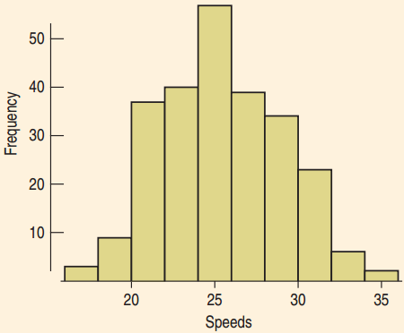
Are They Speeding?
  Independence Assumption:
    The random sample makes the independence assumption reasonable.
    The 10% condition is close enough to being met.
  Nearly Normal Condition
    The histogram is unimodal
    and symmetric. There are
    no outliers. The sample
    size is large.

Slide 26

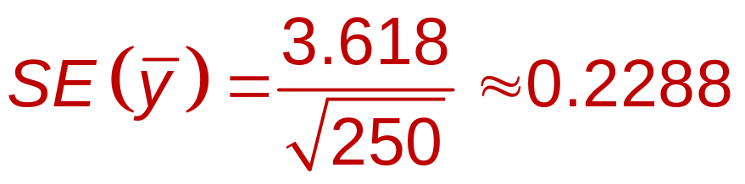
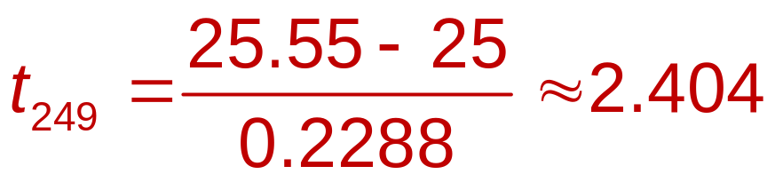
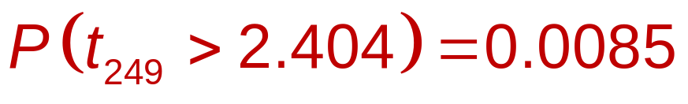
Are They Speeding?
  n = 250, df = 249, = 25.55, s = 3.618
  A 95% confidence interval is (25.099, 26.001) .

Slide 27
Are They Speeding?
  P-value = 0.0088 is very small.
  Reject the null hypothesis and conclude that the mean speed is greater than 25 mph.
  This is statistically significant but is it practically significant?
  Is 25.55 mph noticeably faster than 25 mph?
  Even at the high end of the CI, 26 mph, should the City Council make an effort based on this finding?

Slide 28
Decisions from a Confidence Interval
The diabetes drug study had a baseline of 20.2%. The 95% CI for the proportion of those who took the drug that had heart attacks was 20.8% to 40.0%
  What can you say about the drug’s safety?
    20.2 < 20.8
    There is evidence of risk.

Slide 29
19.5
Errors

Slide 30
Type I and II Errors
Type I Error
  Reject H₀ when H₀ is true.
Type II Error
  Fail to reject H₀ when H₀ is false.
Medicine: Such as an AIDS test
  Type I Error → False positive: Patient thinks he has AIDS when he doesn’t.
  Type II Error → False negative: Patient is told he is AIDS-free when in fact he has AIDS.

Slide 31
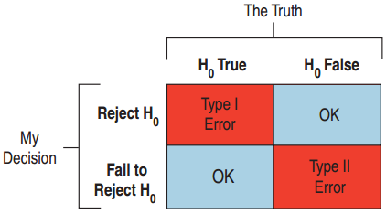
Type I and II Errors
Jury Decisions
  Type I: Found guilty when the defendant is innocent. Put an innocent person in jail.
  Type II: Not enough evidence to convict, but was guilty. A murderer goes free.

Slide 32
Probabilities of Type I and II Errors
  P(Type I Error) = α
    This represents the probability that if H₀ is true then we will reject H₀.
  P(Type II Error) = β
    We cannot calculate β. Saying H₀ is false does not tell us what the parameter is.
  Decreasing α results in an increase of β.
  The only way to decrease both is to increase the sample size.

Slide 33
Diabetes Drug Revisited
The study found patients who took the drug has an increased risk of heart attack.
  What kind of error if their findings were due to chance?
    H₀ is true but they rejected H₀.
    Type I error.
    Patients would be deprived of the diabetes drug’s benefits, when there is no increased risk of heart attack.

Slide 34
Power
The power of a test is the probability it will correctly
reject H₀ when H₀ is false.
  Power = 1 – β
  If a study fails to reject H₀, either
    H₀ was true. No error was made.
    H₀ is false. Type II error was made.

Slide 35
Diabetes Drug Study
The meta study resulted in a larger study
of 47 different trials.
  How could this larger sample size help?
    If the drug really did increase the chance of heart attack, doctors needed to know.
    Missing this side effect would be a Type II error.
    Increasing the sample size increases the power of the analysis, increasing the chance of detecting the danger if there is one.

Slide 36
Effect Size
The distance between the null hypothesis (p₀ for example) and the truth, p, is the effect size.
  A small effect size is difficult to detect (high probability of Type II error)
  Power depends on effect size and standard deviation.
  The effect size depends on how big a difference would matter.
    In detecting the “human energy field” would a 53% or a 75% success rate be remarkable?

Slide 37
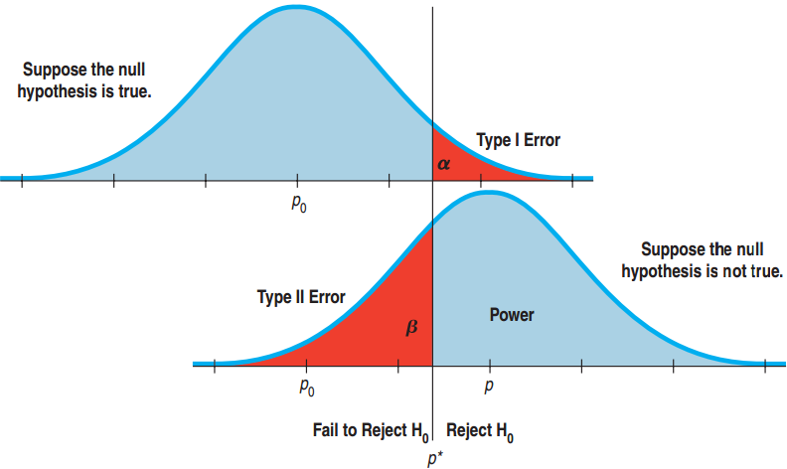

The Picture Explains It All
  In the top figure, p₀ is the true proportion. A high
  results in a Type I error.
  The bottom figure, p is the true proportion. A low (near p₀) results in a Type II error.

Slide 38
What We Get from
the Picture
  Power = 1 – β
  Reducing α to lower P(Type I)
  moves the critical value p* to the right. This increases β, P(Type II), and decreases the power.
  The larger difference between p and p₀, the smaller chance the chance of Type II error and greater the power.

Slide 39
Benefits of a Large Sample Size
The diabetes drug manufacturer looked at the study and rebutted that the sample size was too small.
  Why would this smaller study have been less likely to detect a difference in risks?
    Small studies have more sampling variability.
    Small studies have less power.
    Hard to discern whether the difference is due to chance: Higher P(Type II), since P(Type I) is fixed by the FDA.
    Large studies are better but very expensive.

Slide 40
What Can Go Wrong?
Don’t interpret the P-value as the probability
that H₀ is true.
  P-Value is about data, not the hypothesis.
  It is the probability of observing data this unusual given that H₀ is true.
Don’t believe too strongly in arbitrary α levels.
  P-value = 0.0499 and P-value = 0.0501 are basically the same.
  Often it is better to report just the P-value.

Slide 41
What Can Go Wrong?
Don’t confuse practical and statistical significance.
  A large sample size makes it easy to discern a trivial change from H₀.
  A small sample size can make practically significant data statistically insignificant.
Don’t forget that in spite of all your care, you might make a wrong decision.
  We can’t reduce P(Type I) and P(Type II) to 0.

