Slide 1
Chapter 22
Comparing Counts

Slide 2
22.1
Goodness-of-Fit Test

Slide 3

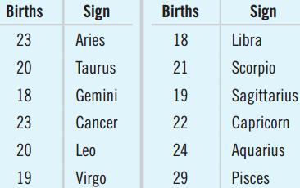
Are CEO Zodiac Signs Uniform?
  A survey of 256 randomly
  selected CEOs
  If uniform, each sign expected
  to have 256/12 ≈ 21.3 births
  Pisces has more.
  Others have fewer.
  Is the distribution far enough from uniform to conclude the data do not come from a uniform distribution?

Slide 4
Goodness-of-Fit vs. Two-Proportion t-Test
  To just test for Pisces, the two-proportion t-test works.
  Performing 12 separate t-tests each with α = 0.05, P(Type I Error) compounded
  Instead, the Goodness-of-Fit Test properly combines differences from expected into a single hypothesis test.

Slide 5
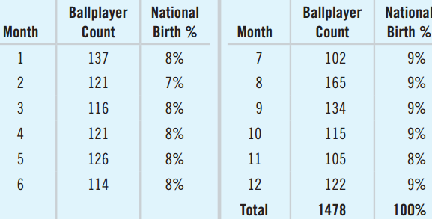
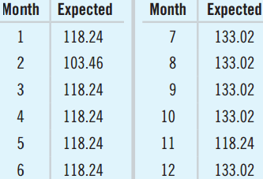
Finding Expected Counts
1478 baseball players’
birth months.
  Find the expected
  count for each
  month.
  January: 1478 × 0.08 = 118.24
  February: 1478 × 0.07 = 103.46

Slide 6
Assumptions and Conditions
Counted Data Condition
  The values in each cell are counts.
  Doesn’t work with percents, proportions, or measurements
Independence Assumption
  The counts in each cell must be independent of each other.
  For random samples, we can generalize to the entire population.

Slide 7
Assumptions and Conditions (Continued)
Sample Size Assumption
  Expected counts for each cell ≥ 5.
  This is called the Expected Cell Frequency Condition.
If the assumptions and conditions are met, we can perform a Chi-Square Test for Goodness-of-Fit.

Slide 8
Checking Assumptions and Conditions
  Are the assumptions and conditions met for the baseball player births study?
    Counted Data Condition: Each cell is a count.
    Independence Assumption: The births are independent. They do not come from a random sample, but they are representative of all players past and present.
    Expected Cell Frequency Condition: Expected counts range from 103.46 to 133.02. All ≥ 5.
  Goodness-of-fit does apply.

Slide 9
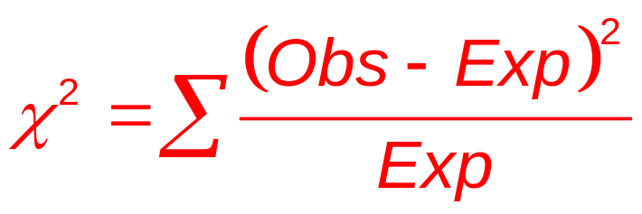
Chi-Square Calculations
  Interested in difference between observed and expected: residuals.
  Make positive by squaring them all.
  Get relative sizes of the residuals by dividing them by the expected counts.
  This is a Chi-Square Model with df = n – 1.
  n is the number of categories, not the sample size.

Slide 10
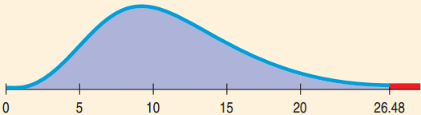
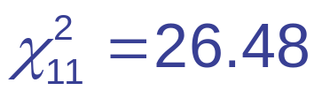
Baseball Birth Months
  H₀: The distribution of baseball player birth months
  is the same as for the general population.
  H_{A}: The distribution of baseball player birth months
  is not the same as for the general population.
  P-value = 0.0055
  There’s evidence that major league ballplayers’ birth months have a different distribution from the rest of us.

Slide 11

Zodiac Signs of CEOs
Think →
  Plan: I have the zodiac signs of 256 CEOs.
  Is there a uniform distribution?
  Hypotheses:
    H₀: Births are uniformly distributed over zodiac
    signs.
    H_{A}: Births are not uniformly distributed over zodiac
    signs.

Slide 12
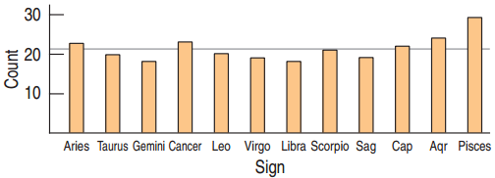
Zodiac Signs for CEOs
Model
  Counted Data Condition: I have counts of each sign.
  Independence Assumption: This is a convenience sample, but no reason to expect bias with respect to birthdays.
  Expected Cell Frequency Condition: 21.3 ≥ 5.
  The conditions are satisfied. I will use the
  Chi-Square Goodness-of-Fit Model with 12 – 1 = 11 degrees of freedom.

Slide 13

Zodiac Signs for CEOs
Show →
  Mechanics:
  χ² = 5.094, P-value = 0.926 (from StatCrunch)
Tell →
  Conclusion: If the zodiac signs of CEOs were distributed uniformly, an observed chi-square value of 5.09 or higher would occur about 93% of the time.
  Fail to reject the H₀. Conclude that there is no evidence of nonuniform distribution of zodiac signs among CEOs.

Slide 14
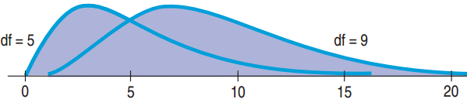
The Shape of χ²
  With df large, the weighted residuals add up quickly.
  Unlike z or t, a larger χ² is more common.
  The mode of χ² is df – 2.
  The expected value of χ² is df, to the right of the mode due to the right skewed distribution.

Slide 15
Can’t Prove the Null
  We often want to see if the distribution fits a model.
  Unfortunately, fitting the model is H₀.
  We can never accept the null hypothesis.
  A smaller sample size will likely result in failing to reject H₀.
  This does not mean that a small sample size will help prove the null.

Slide 16
22.2
Chi-Square Test
for Homogeneity

Slide 17
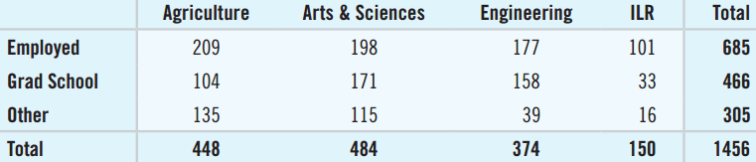
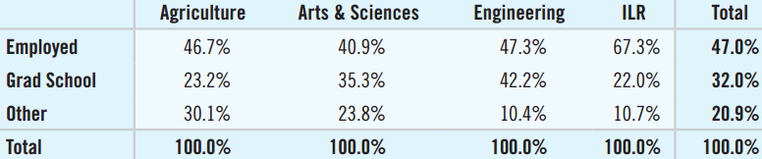
Plans of Graduates at Different Colleges
  Are students’ plans the same at different colleges within the same university?
  Class-size differences cloud the table. Proportions may be helpful.

Slide 18
Test for Homogeneity
  More than two proportions to compare, so we cannot use the two-proportion z-test.
  Generalize to the chi-square test for homogeneity.
  Same mechanics as goodness-of-fit, different hypotheses and conclusions.
  Chi-square test for homogeneity asks if the distribution is the same for different groups.
  The test looks for differences large enough to step beyond what we might expect from random
  sample-to-sample variation

Slide 19
Assumptions and Conditions
Same as Goodness-of-Fit
  Counted Data Condition: Always use counts, not proportions, percents, or measurements.
  Independence Assumption: Need randomization to generalize to the population.
  Expected Cell Frequency Condition: All expected counts should be at least 5.

Slide 20
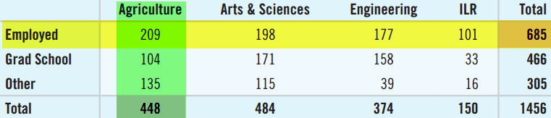
Calculations
Expected Counts
  685, or about 47.0%, of the 1456 students who responded to the survey were employed.
  Of the 448 agriculture students, expect 47% of 448 or 210.76 to be employed.
χ² Calculation
  Use the same formula with these observed and expected. df = (R – 1)(C – 1) = (3 – 1)(4 – 1) = 6.

Slide 21
Students’ Choices Same Across Colleges?
Think →
  Plan: I have a table of counts from the college’s class of 2011.
  Hypotheses:
    H₀: Students’ post-graduation activities are
    distributed in the same way for all four colleges.
    H_{A}: Students’ plans do not have the same
    distribution.

Slide 22
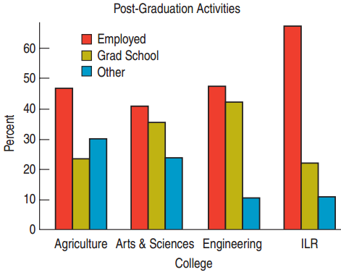
Students’ Choices Same Across Colleges?
  Model: The bar chart shows
  how the percents differ.
    Counted Data Condition:
    I will use the table of counts.
    Independence Assumption:
    It is not a random sample, but
    with this large study, most students act independently of the others.
    Expected Cell Frequency Condition: All ≥ 5
  Use the χ²-model with df = 6 and do a chi-square test for homogeneity.

Slide 23
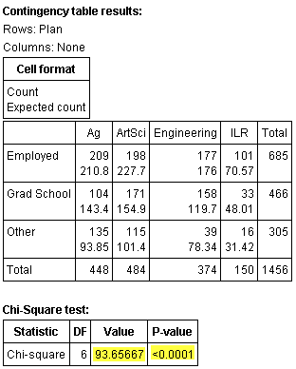
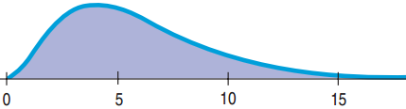
Students’ Choices Same Across Colleges?
Show →
  Mechanics: I used StatCrunch to produce the expected counts, χ², and P-value.
  χ² ≈ 93.66
  P-value < 0.0001

Slide 24
Students’ Choices Same Across Colleges?
Tell →
  Conclusion: The P-value is very small, so I reject the null hypothesis.
  I conclude that there’s evidence that the post-graduation activities of students from these four colleges don’t have the same distribution.

Slide 25
22.4
Chi-Square Test
of Independence

Slide 26
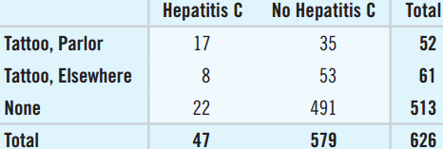
Hepatitis and Tattoos
The contingency table shows the results of a study that looked at where people had their tattoo and whether they have Hepatitis C.
  Two categorical
  variables
  Contingency
  tables are used to see if one categorical variable is contingent on another.
  Are Hepatitis C and Tattoo Status independent?

Slide 27
Independence
  Two events are independent if P(A|B) = P(A).
  If Tattoo Status and Hepatitis C are independent, we would expect the proportions of “positive” to be the same for the three levels of Tattoo Status.
  Same criterion as homogeneity
  The nuances of homogeneity and independence statements are different.
  Same distribution vs. independent

Slide 28
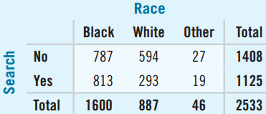
Race and Traffic Stops
  Data were collected on drivers’ race and whether they were searched when an officer stopped them.
  What test to decide if
  race is a factor in
  vehicle searches?
  Two categorical variables: Race and Search.
  Chi-Square test for independence.
    H₀: Race and Search are independent.
    H_{A}: Race and Search are not independent.

Slide 29
Assumptions and Conditions
  Counted Data Condition: Always use counts, not proportions, percents, or measurements.
  Independence Assumption: The data were collected independently.
  Expected Cell Frequency Condition: All expected counts at least 5.
  10% Condition: Data come from a random sample of less than 10% of the population.

Slide 30

Tattoos and Hepatitis
Are Tattoo Status and Hepatitis Status
independent?
Think →
  Plan: Test for independence. I have a contingency table of 626 patients.
  Hypotheses:
    H₀: Tattoo Status and Hepatitis Status are
    independent.
    H_{A}: Tattoo Status and Hepatitis Status are not
    independent.

Slide 31
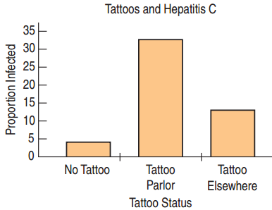
Tattoos and Hepatitis
  Model: The bar chart suggests
  a difference in Hepatitis C based
  on tattoo status.
    Counted Data Condition: I have counts of individuals categorized on two variables.
    Independence Assumption: Not SRS, but likely independent.

Slide 32
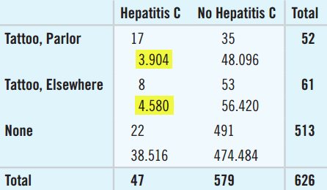
Tattoos and Hepatitis
  Model: (Continued)
      Expected Cell Frequency Condition:
      Two expected counts < 5.
    Not all the assumptions are met, but I will carefully go ahead with the chi-square test for independence with df = (3 – 1) × (2 – 1) = 2. I will check the residuals carefully.

Slide 33
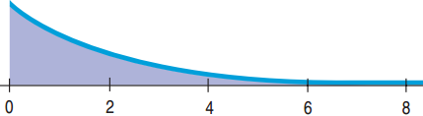

Tattoos and Hepatitis C
Show →
  Mechanics: With df = 2
  the χ² graph looks very different.
  Use StatCrunch just like with Homogeneity.
  χ² = 57.91, P-value < 0.0001

Slide 34

Chi-Square and Causation
  Just like correlation, rejecting H₀ for a chi-square test does not imply causation.
    Does having Hepatitis C cause a craving to get a tattoo?
    Maybe there is a lurking variable.
    Is there a subculture that tends to have both?
    Just state independence, not causation.

Slide 35
What Can Go Wrong?
Don’t use chi-square methods unless you have counts.
  Convert percents and proportions back to counts.
Beware large samples.
  There are no confidence intervals to see “how not independent” the categories are. Rarely are categories perfectly independent.
Don’t say that one variable “depends” on the other just because they’re not independent
  “Depends” suggest causation. Just state that the categories are “not independent” or are “associated.”

