Slide 1
Chapter 13
Probability Rules

Slide 2
13.1
The General Addition Rule

Slide 3

Or But Not Disjoint
Your Wallet
  S = {$1, $2, $5, $10, $20, $50, $100}
  A = {odd numbered value} = {$1, $5}
  B = {bill with a building} = {$5, $10, $20, $50, $100}
  Why is P(A or B) ≠ P(A) + P(B)?
  Answer: A and B are not disjoint.
  The intersection A and B = {$5} is double counted.
  To find P(A or B), subtract P(A and B).

Slide 4
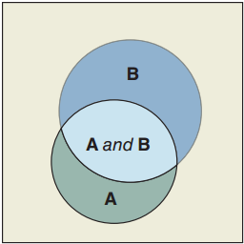
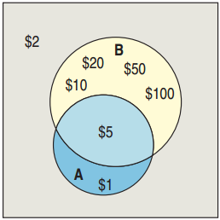
The General Addition Rule
P(A or B) = P(A) + P(B) – P(A and B)
  The General Addition Rule
  in words: Add the probabilities
  of the two events and then
  subtract the probability of
  their intersection.
P(odd amount or bill with a building)
= P(A) + P(B) – P(A and B}
= P({$1, $5}) + P({$5, $10, $20, $50, $100}) – P({$5})

Slide 5
General Addition Rule Example
Survey
  Are you currently in a relationship?
  Are you involved in sports?
Results
  33% are in a relationship.
  25% are involved in sports.
  11% answered “yes” to both.
Problem
  Find the probability that a randomly selected student is in a relationship or is involved in sports.

Slide 6
33% Relationship, 25% Sport, 11% Both
Events
  R = {in a relationship}
  S = {involved in sports}
Calculations
  P(R or S) = P(R) + P(S) – P(R and S)
  = 0.33 + 0.25 – 0.11
  = 0.47
Conclusion
  There is a 47% chance that a randomly selected student is in a relationship or is involved sports.

Slide 7
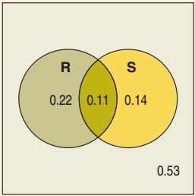
Using Venn Diagrams
P(not in relationship and no sports)
  P(R^{C} and S^{C})
  This is the part outside of both
  circles: 0.53.
P(in a relationship but no sports)
  P(R and S^{C})
  This is the part in the circle R that is outside S: 0.22.
P(in a relationship or involved in sports but not both)
  P((R and S^{C}) or (R^{C} and S))
  This is the combination of the circles minus the intersection: 0.22 + 0.14 = 0.36

Slide 8

E-mail or Text?
73% use e-mail, 62% text, 49% do both
  Find the probability that a randomly
  selected person:
  Either texts or e-mails?
  Either texts or e-mails, but not both?
  Doesn’t use e-mail and doesn’t text?
Think →
  Plan:
    A = {uses e-mail}
    B = {texts}

Slide 9
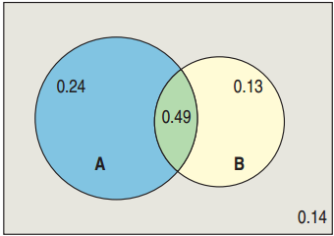
73% Use E-mail, 62% Text, 49% Both
Think →
  Plot:
    P(A) = 0.73
    P(B) = 0.62
    P(A and B) = 0.49
    P(A and B^{C}) = 0.73 – 0.49 = 0.24
    P(A^{C} and B) = 0.62 – 0.49 = 0.13
    P(A^{C} and B^{C}) = 1 – (0.24 + 0.49 + 0.13) = 0.14

Slide 10
73% Use E-mail, 62% Text, 49% Both
1. P(text or e-mail)
Show →
  Mechanics
    P(A or B) = P(A) + P(B) – P(A and B)
    = 0.73 + 0.62 – 0.49
    = 0.86
Tell →
    Conclusion: 86% send text messages or e-mail.

Slide 11
73% Use E-mail, 62% Text, 49% Both
2. P(text or e-mail but not both)
Show →
  Mechanics
    P(A or B) – P(A and B) = 0.86 – 0.49 = 0.37
    P((A and B^{C}) or (A^{C} and B)) = 0.24 + 0.13 = 0.37
Tell →
    Conclusion: 37% send text messages or e-mail, but not both.

Slide 12
73% Use E-mail, 62% Text, 49% Both
3. P(neither text nor e-mail)
Show →
  Mechanics
    1 – P(A or B) = 1 – 0.86 = 0.14
    P(A^{C} and B^{C}) = 0.14
Tell →
    Conclusion: 14% neither text nor e-mail.

Slide 13
13.2
Conditional Probability
and the General Multiplication Rule

Slide 14
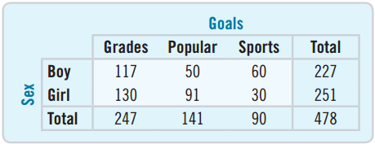
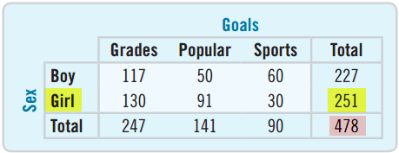
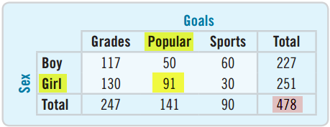
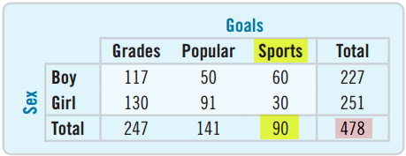
Contingency Table
A table that displays the
results of two categorical
questions is called a contingency table.
  P(girl) = 251/478 = 0.525
  P(girl and popular) = 91/478 = 0.190
  P(sports) = 90/478 = 0.188

Slide 15
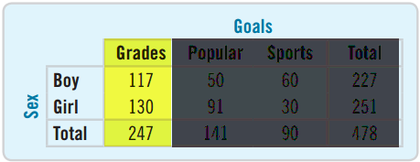
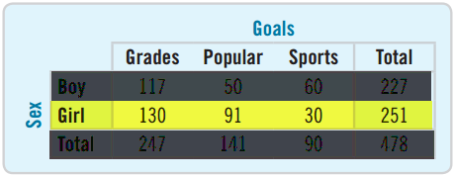
Conditional Probability
  What if we knew
  the chosen person
  was a girl? Would
  that change the
  probability that the girl’s goal was sports?
  Yes! We write P(sports | girl)
  Only look at Girl row: P(sports | girl) = 30/251 = 0.120
  Find the probability of selecting a boy given the goal is grades.
  P(boy | grades) = 117/247 = 0.474

Slide 16
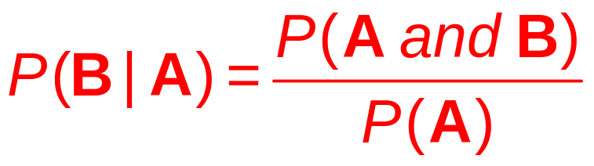
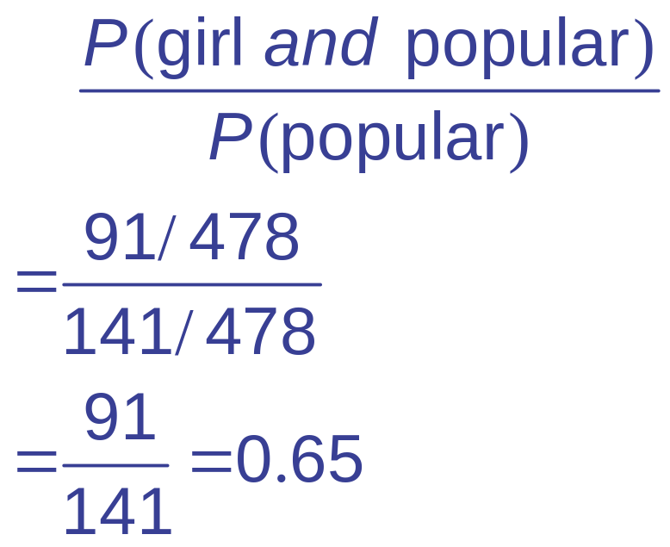
Conditional Probability Formula
Probability of B Given A:
  Example:
  P(girl | popular) =

Slide 17
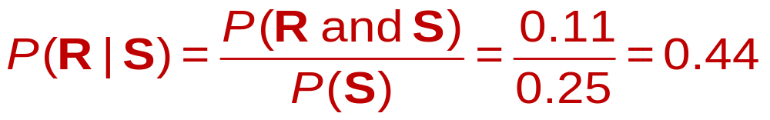
College Students: Relationships and Sports
33% in relationships, 25% in sports, 11% in both
  If you see a student athlete, what is the probability that this athlete is in a relationship?
  P(R) = 0.33, P(S) = 0.25, P(R and S) = 0.11
  There is a 0.44 probability the student involved in sports is in a relationship. Notice this is higher than the probability for the general student (0.33).

Slide 18
The General Multiplication Rule
  For A and B independent, we had:
  P(A and B) = P(A) × P(B)
  Rearranging the conditional probability equation, we get the General Multiplication Rule:
  P(A and B) = P(A) × P(B | A)
  Equivalently,
  P(A and B) = P(B) × P(A | B)

Slide 19
13.3
Independence

Slide 20
Definition of Independence
  Events A and B are independent if knowing A happened does not change the probability of B. In symbols:
  A and B are independent ↔ P(B | A) = P(B)
  Equivalent formulas for independence:
    P(A | B) = P(A)
    P(A and B) = P(A) × P(B)

Slide 21
Grades and Girl
Independent?
  Determine if the
  goal of good grades and sex are independent.
    P(grades | girl) = 130/251 ≈ 0.52
    P(grades) = 247/478 ≈ 0.52
  To two decimal places, they are independent.
  Are the goal of sports and sex independent?
    P(sports | boy) = 60/227 ≈ 0.26
    P(sports) = 90/478 ≈ 0.19
  No, the goal of sports and sex are dependent.

Slide 22
Relationships, Sports, and Independence
33% in a relationship, 25% involved in sports, 11% both
  Are being in a relationship and being involved in sports independent?
    P(relationship) = 0.33
    P(sports) = 0.25
    P(relationship and sports) = 0.11
    0.33 × 0.25 = 0.0825 ≠ 0.11
    No, they are dependent.
  Are they disjoint?
    P(relationship and sports) = 0.11 ≠ 0
    No, they are not disjoint.

Slide 23
Independent ≠ Disjoint
Disjoint events cannot be independent.
  Consider the events:
    Course grade A
    Course grade B
    Disjoint: You can’t get both.
    Not independent: P(A | B) = 0 ≠ P(A)
    A and B are disjoint (also called mutually exclusive) but not independent.

Slide 24
Independence and Insurance
An insurance company insures 1000 houses
  If each house is in a different location, then the destruction of each can be treated as independent.
  P(many are destroyed this year) is very small.
  If they are all in the same location, then they can all be destroyed by the same disaster. The events are not independent.
  P(many are destroyed this year) is not as small.
  The insurance company has less risk with the former.

Slide 25
13.4
Picturing Probability

Slide 26
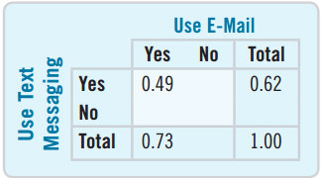
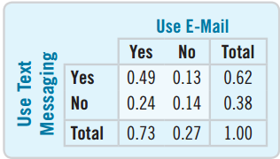
Marginal and Joint Probabilities
  73% use e-mail, 62% text, 49% both
  Draw a partial table.
  0.73 and 0.62 are called
  marginal probabilities.
  0.49 is a joint probability.
  How can we complete the
  table?
  The sum must add up
    0.49 + ? = 0.73
    0.62 + ? = 1.00

Slide 27

73% Use E-mail, 62% Text, 49% Both
1. E-mail and text mutually exclusive?
2. E-mail and text independent?
Think →
  Plan
    A = {uses e-mail}
    B = {texts}
    P(A) = 0.73, P(B) = 0.62, P(A and B) = 0.49

Slide 28
73% Use E-mail, 62% Text, 49% Both
1. E-mail and text mutually exclusive?
Show →
  Mechanics
    P(A and B) = 0.49 ≠ 0
Tell →
    Conclusion: E-mail and text are not mutually exclusive.

Slide 29
73% Use E-mail, 62% Text, 49% Both
1. E-mail and text independent?
Think →
  Plan: Make a table.
Show →
    Mechanics: P(B | A) = 0.49/0.73 ≈ 0.67
    P(B) = 0.62 ≠ 0.67
    Not independent
Tell →
    Conclusion: Since the respondents who use e-mail are more likely to text, they are not independent.

Slide 30
What Can Go Wrong?
Don’t use a simple probability rule where a general rule is appropriate.
  Don’t assume independence or disjoint until after you have done the verification.
Don’t reverse conditioning naïvely.
  P(A | B) may not be the same as P(B | A).
Don’t confuse “disjoint” with “independent.”
  Disjoint events cannot happen at the same time.
  Independent events must be able to happen at the same time.

