Slide 1
Chapter 15
Sampling Distribution Models

Slide 2
15.1
Sampling Distribution of a Proportion

Slide 3
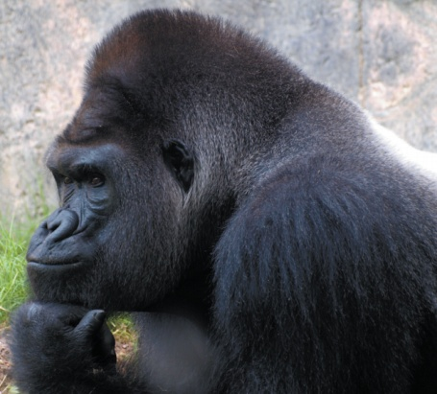
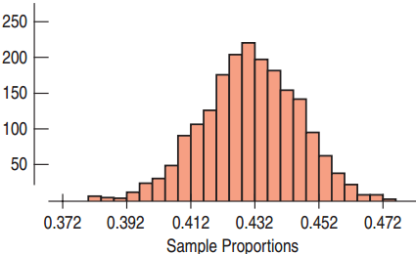
Sampling About Evolution
According to a Gallup poll, 43% believe in
evolution. Assume this is true of all Americans.
  If many surveys were done of 1007 Americans, we could calculate the sample proportion for each.
  The histogram shows the
  distribution of a simulation
  of 2000 sample proportions.
  The distribution of all possible
  sample proportions from samples with the same sample size is called the sampling distribution.

Slide 4
Sampling Distributions
Sampling Distribution for Proportions
  Symmetric
  Unimodal
  Centered at p
  The sampling distribution follows the Normal model.
What does the sampling distribution tell us?
  The sampling distribution allows us to make statements about where we think the corresponding population parameter is and how precise these statements are likely to be.

Slide 5
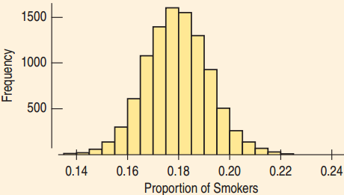
Sampling Distribution for Smoking
18% of US adults smoke. How much would we expect the proportion of smokers in a sample of size 1000 to vary from sample to sample?
  A histogram was drawn
  to display the results of a
  simulation.
  The mean is 0.18 = the
  population proportion.
  The standard deviation was calculated as 0.0122.
  Normal: 68-95-99.7 rule works.
  95% of all proportions are within 0.0244 of the mean.
  This is very close to the true value: 95.41%

Slide 6
Thinking about Many Samples
Distribution of the Sample
  Variable was the answer to the survey question or the result of an experiment.
  Proportion is a fixed value that comes from a single sample.
Sampling Distribution
  Variable is the proportion that comes from the entire sample.
  Many proportions that differ from one to another, each coming from a different sample.

Slide 7
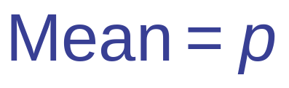
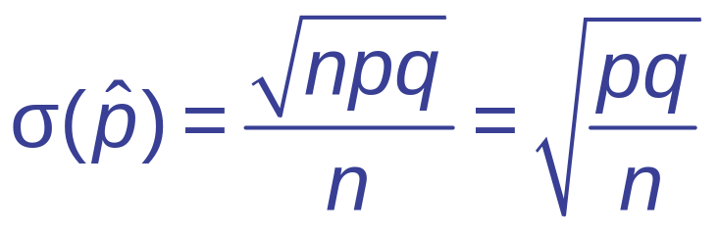
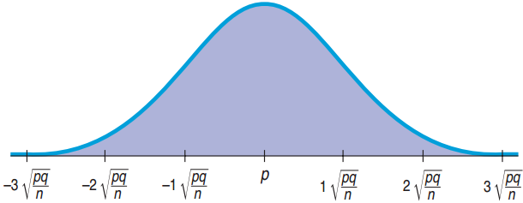
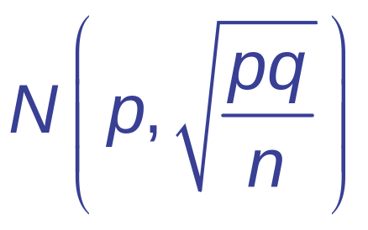
Mean and Standard Deviation
Sampling Distribution for Proportions

Slide 8
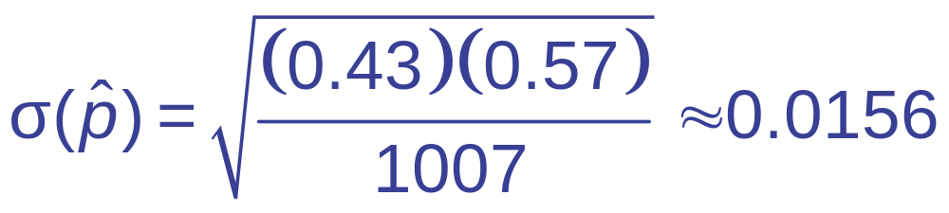
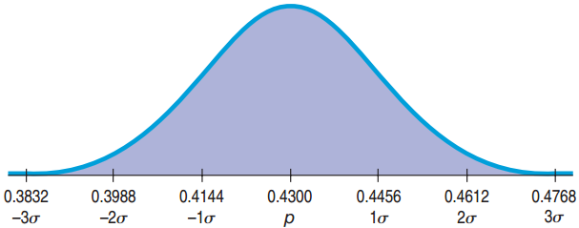
The Normal Model for Evolution
Population: p = 0.43, n = 1007. Sampling Distribution:
  Mean = 0.43
  Standard deviation =

Slide 9
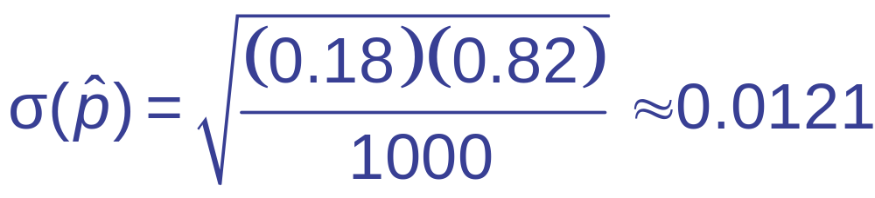
Smokers Revisited
p = 0.18, n = 1000
  Standard deviation =
  Standard deviation from simulation: 0.0122
The sample-to-sample standard deviation is called the standard error or sampling variability.
  The standard error is not an error, since no error has been made.

Slide 10
15.2
When Does the Normal Model Work? Assumptions and Conditions

Slide 11
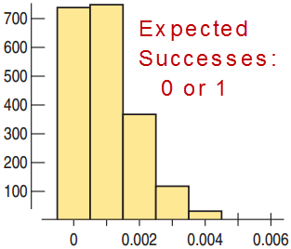
When Does the Normal Model Work?
  Success Failure Condition:
  np ≥ 10, nq ≥ 10 There must be at least 10 expected successes and failures.
  Independent trials: Check for
  the Randomization Condition.
  10% Condition: Sample size less
  than 10% of the population size

Slide 12
Understanding Health Risks
22% of US women have a BMI that is above the 25 healthy mark.
  Only 31 of the 200 randomly chosen women from a large college had a BMI above 25. Is this proportion unusually small?
    Randomization Condition: Yes, the women were randomly chosen.
    10% Condition: For a large college, this is ok.
    Success Failure Condition: 31 ≥ 10, 169 ≥ 10
  Yes, the Normal model can be used.

Slide 13
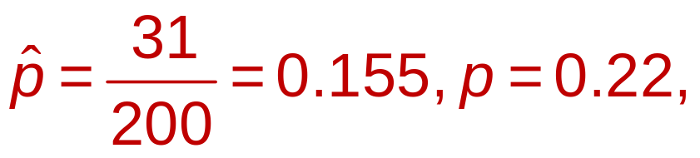
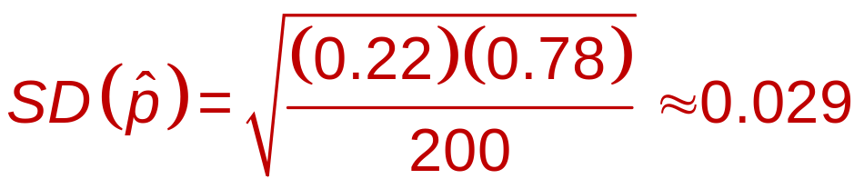
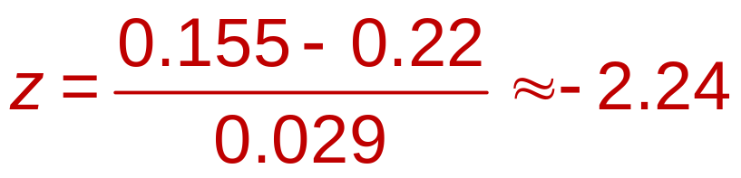
Understanding Health Risks:
n = 200, p = 0.22, x = 31
  68-95-99.7 Rule: Values 2 SD below the mean occur less than 2.5% of the time. Perhaps this college has a higher proportion of healthy women, or women who lie about their weight.

Slide 14
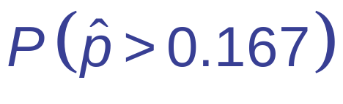
Enough Lefty Seats?
13% of all people are left handed.
  A 200-seat auditorium has 15 lefty seats.
  What is the probability that there will not be enough lefty seats for a class of 90 students?
Think→
  Plan: 15/90 ≈ 0.167, Want
  Model:
    Independence Assumption: With respect to lefties, the students are independent.
    10% Condition: This is out of all people.
    Success/Failure Condition: 15 ≥ 10, 75 ≥ 10

Slide 15
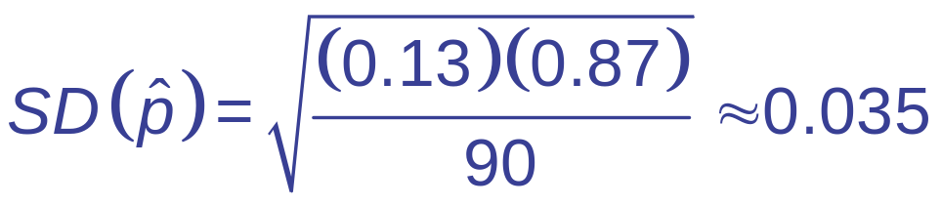
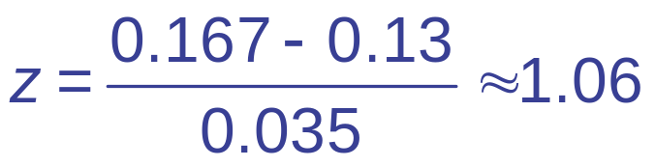
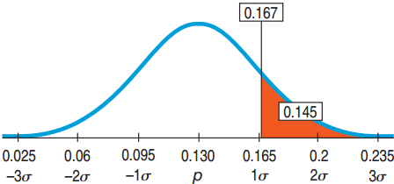
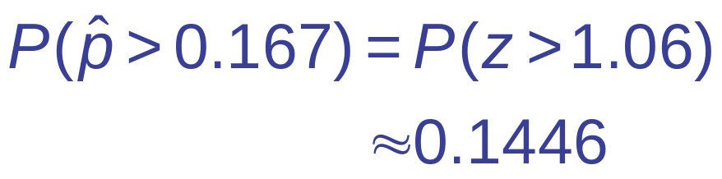
Enough Lefty Seats?
Think→
  Model: p = 0.13,
  The model is: N(0.13, 0.035)
  Show→
  Plot
  Mechanics:

Slide 16
Enough Lefty Seats?
Tell →
  Conclusion: There is about a 14.5% chance that there will not be enough seats for the left handed students in the class.

Slide 17
15.3
The Sampling Distribution of Other Statistics

Slide 18
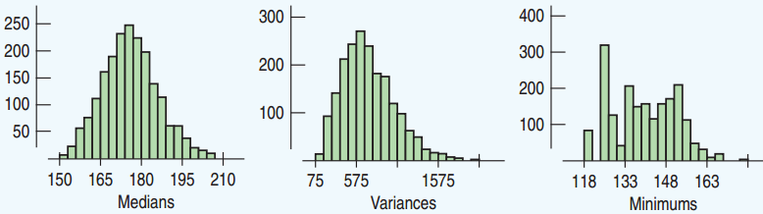
The Sampling Distribution for Others
  There is a sampling distribution for any statistic, but the Normal model may not fit.
  Below are histograms showing results of simulations of sampling distributions.

Slide 19
The Sampling Distribution For Others
  The medians seem to be approximately Normal.
  The variances seem somewhat skewed right.
  The minimums are all over the place.
  In this course, we will focus on the proportions and the means.

Slide 20
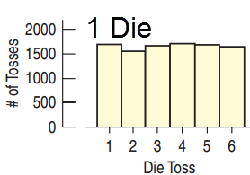
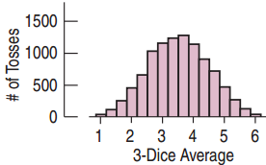
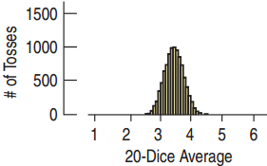
Sampling Distribution of the Means
  For 1 die, the distribution is Uniform.
  For 3 dice, the sampling distribution for the means is closer to Normal.
  For 20 dice, the sampling distribution for the means is very close to normal. The standard deviation is much smaller.

Slide 21
15.4
The Central Limit Theorem: The Fundamental Theorem of Statistics

Slide 22
The Central Limit Theorem
The Central Limit Theorem
  The sampling distribution of any mean becomes nearly Normal as the sample size grows.
Requirements
  Independent
  Randomly collected sample
The sampling distribution of the means is close to Normal if either:
  Large sample size
  Population close to Normal

Slide 23
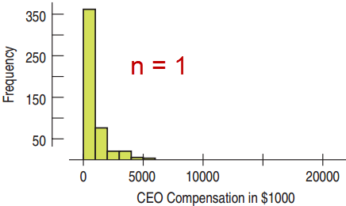
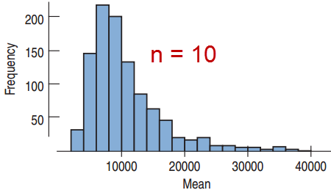
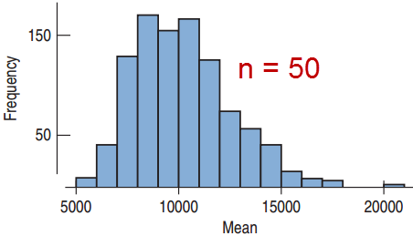
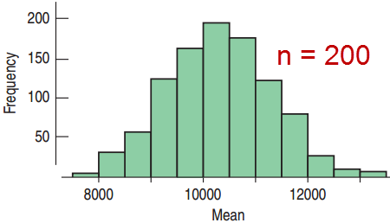
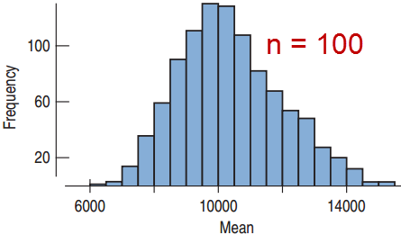
How Normal?

Slide 24
Population Distribution and Sampling Distribution of the Means
Population Distribution
  Normal
  Uniform
  Bimodal
  Skewed
Sampling Distribution for
the Means
  → Normal (any sample size)
  → Normal (large sample size)
  → Normal (larger sample size)
  → Normal (larger sample size)

Slide 25

Binomial Distributions and
the Central Limit Theorem
  Consider a Bernoulli trial as quantitative:
    Success = 1
    Failure = 0
    The mean of many trials is just .
  This distribution of a single trial is far from Normal.
  By the Central Limit Theorem, the Binomial distribution is approximately normal for large sample sizes.

Slide 26
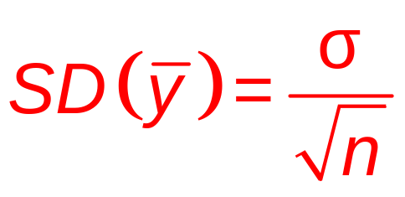
Standard Deviation of the Means
  Which would be more unusual: a student who is 6’9” tall in the class or a class that has mean height of 6’9”?
  The sample means have a smaller standard deviation than the individuals.
  The standard deviation of the sample means goes down by the square root of the sample size:

Slide 27
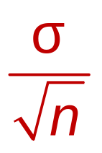
The Sampling Distribution Model for a Mean
When a random sample is drawn from a population with mean μ and standard deviation σ, the sampling distribution has:
  Mean: μ
  Standard Deviation:
  For large sample size, the distribution is approximately normal regardless of the population the random sample comes from.
  The larger the sample size, the closer to Normal.

Slide 28
Low BMI Revisited
The 200 college women with the low BMI reported a mean weight of only 140 pounds. For all 18-year-old women, μ = 143.74 and σ = 51.54. Does the mean weight seem exceptionally low?
  Randomization Condition: The women were a random sample with weights independent.
  Sample size Condition: Weights are approximately Normal. 200 is large enough.

Slide 29
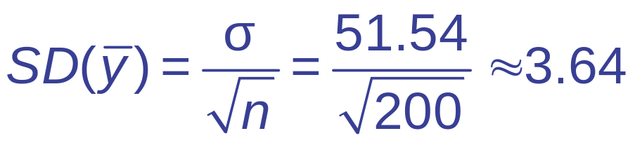
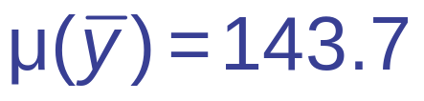
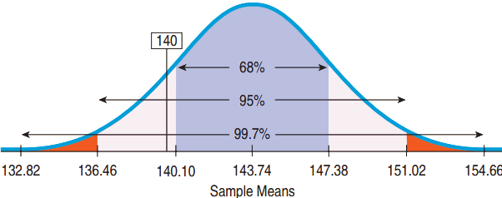
Low BMI Revisited
Mean and Standard Deviation of the sampling distribution
  The 68-95-99.7 rule suggests
  that the mean is low but
  not that unusual. Such
  variability is not
  extraordinary for
  samples of this size.

Slide 30

Too Heavy for the Elevator?
Mean weight of US men is 190 lb, the
standard deviation is 59 lb. An elevator has a weight limit of 10 persons or 2500 lb. Find the probability that 10 men in the elevator will overload the weight limit.
Think →
  Plan: 10 over 2500 lb same as their mean over 250.
  Model:
    Independence Assumption: Not random, but probably independent.
    Sample Size Condition: Weight approx. Normal.

Slide 31

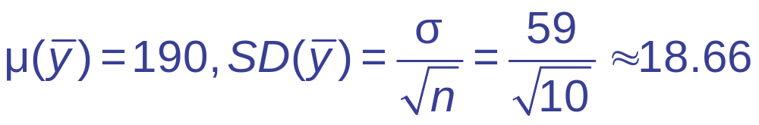
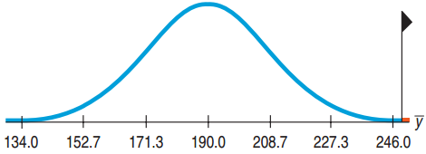
Too Heavy for the Elevator
Think →
  Model: μ = 190, σ = 59
  By the CLT, the sampling distribution of is
  approximately Normal:
Show→
  Plot:

Slide 32
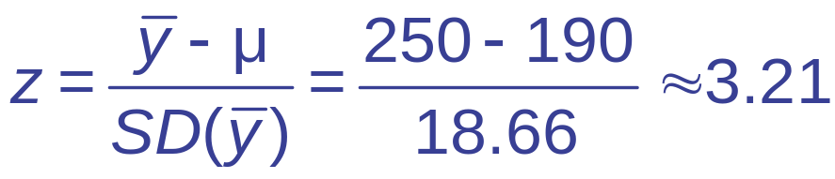
Too Heavy for the Elevator?
  Mechanics:
Tell →
  Conclusion: There is only a 0.0007 chance that the 10 men will exceed the elevator’s weight limit.

Slide 33
15.5
Sampling Distributions: A Summary

Slide 34
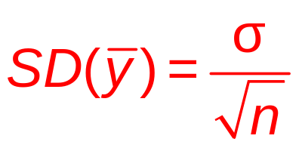
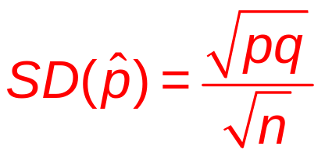
Sample Size and Standard Deviation
  Larger sample size → Smaller standard deviation
  Multiply n by 4 → Divide the standard deviation by 2.
  Need a sample size of 100 to reduce the
  standard deviation by a factor of 10.

Slide 35

Billion Dollar Misunderstanding
Bill and Melinda Gates Foundation found that the 12% of the top 50 performing schools were from the smallest 3%. They funded a transformation to small schools.
  Small schools have a smaller n, thus a higher standard deviation.
  Likely to see both higher and lower means.
  18% of the bottom 50 were also from the smallest 3%.

Slide 36
Distribution of the Sample
vs. the Sampling Distribution
Don’t confuse the distribution of the sample and the sampling distribution.
  If the population’s distribution is not Normal, then the sample’s distribution will not be normal even if the sample size is very large.
  For large sample sizes, the sampling distribution, which is the distribution of all possible sample means from samples of that size, will be approximately Normal.

Slide 37
Two Truths About Sampling Distributions
  Sampling distributions arise because samples vary. Each random sample will contain different cases and, so, a different value of the statistic.
  Although we can always simulate a sampling distribution, the Central Limit Theorem saves us the trouble for proportions and means. This is especially important when we do not know the population’s distribution.

Slide 38
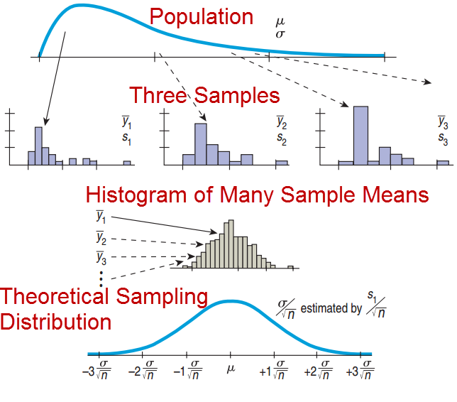

Slide 39
What Can Go Wrong?
  Don’t confuse the sampling distribution with the distribution of the sample.
    A histogram of the data shows the sample’s distribution. The sampling distribution is more theoretical.
  Beware of observations that are not independent.
    The CLT fails for dependent samples. A good survey design can ensure independence.
  Watch out for small samples from skewed or bimodal populations.
    The CLT requires large samples or a Normal population or both.

