Slide 1
Chapter 17
Testing Hypotheses About Proportions

Slide 2
17.1
Hypotheses

Slide 3
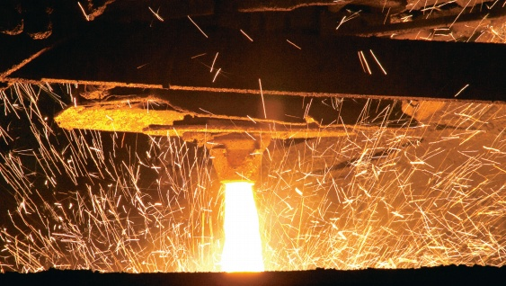
Cracking Rate < 20%?
After a new engineering process
the cracking rate of 400 casts fell
to 17%. Is this due to the new engineering or just random chance?
  Null Hypothesis: Nothing has changed
    H₀: parameter = hypothesized value
    H₀: p = 0.20
  Alternative Hypothesis:
    H_{A}: p < 0.20

Slide 4
How Small to Convince Us?
  Had the new cracking rate been 1%, it would clearly indicate a change from 20%.
    Extremely unlikely that this could happen just by random chance
  Had the new cracking rate been 19.8%, we would be skeptical.
    Not so unlikely to be just random chance
  How about 17%?
    How likely is it that a random sample would have a cracking rate 17% or less?

Slide 5
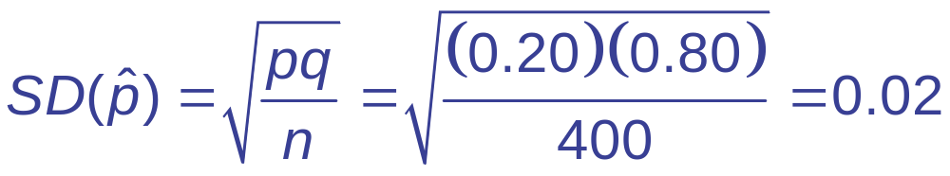

Checking Conditions and Finding the Standard Error
Checking Conditions: n = 400, p = 0.20
  np = (400)(0.20) = 80 ≥ 10
  nq = (400)(0.80) = 320 ≥ 10
  Independence plausible
  The Normal model applies.
Find the standard deviation of the model.
  Note: Use p and not to find standard deviation.

Slide 6

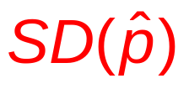
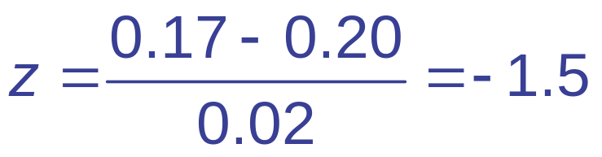
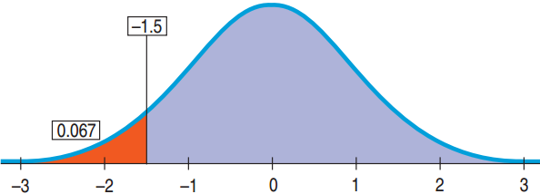

Using the Normal Model
p = 0.20, = 0.17, = 0.02
  If the null hypothesis is true that the cracking rate is still equal to 20%, then the probability of observing a cracking rate of 17% in a random sample of 400 is 6.7%.

Slide 7
Innocent until Proven Guilty
  Begin with the presumption of innocence (H₀).
  Collect evidence.
    Bank money in house
    Still wearing mask
    Getaway car found in his name
  Evidence beyond a reasonable doubt?
    Is 5% small enough chance?
    How about 1%?
    6.7%?

Slide 8
17.2
P-Values

Slide 9
The P-Value and Surprise
The P-value is the probability of seeing data like these (or even more unlikely data) given the null hypothesis is true.
  Tells us how surprised we would be to get these data given H₀ is true.
    P-value small: Either H₀ is not true or something remarkable occurred
    P-value not small enough: Not a surprise. Data consistent with the null hypothesis. Do not reject H₀.

Slide 10
Guilty or Not Enough Evidence?
Defendant is either
  Guilty: P-value too small. The evidence is clear.
  Not Guilty: P-value not small enough. The evidence is not sufficient. Not the same as innocent. Maybe innocent or maybe guilty, but not enough evidence found.
Two Choices
  Fail to reject H₀ if P-value large. Never accept H₀.
  Reject H₀ if P-value is small. Accept H_{A}.

Slide 11
When the P-Value is Not Small
Wrong
  Accept H₀.
  We have proven H₀.
Right
  Fail to reject H₀
  There is insufficient evidence to reject H₀.
  H₀ may or may not be true.
Example: H₀: All swans are white.
  If we sample 100 swans that are all white, there could still be a black swan.

Slide 12
17.3
The Reasoning of Hypothesis Testing

Slide 13
Step 1: State the Hypotheses
H₀:
  H₀ usually states that there’s nothing different.
  H₀: parameter = hypothesized value
  Note the parameter describes the population not the sample.
  H₀ is called the null hypothesis.
H_{A}:
  H_{A} is a statement that something has changed, gotten bigger or smaller
  H_{A} is called the alterative hypothesis.

Slide 14
Hypotheses About the DMV
The DMV claims 80% of all drivers pass the driving test. In a survey of 90 teens, only 61 passed.
  Is there evidence that teen pass rates are
  below 80%?
    H₀: p = 0.80
    H_{A}: p < 0.80

Slide 15
Step 2: Model
Decide on the model to test the null hypothesis and parameter.
  Check conditions, e.g. independence, sample size.
  If the conditions are not met, either quit or redesign the study.
  Normal models use z-scores. Other models may not use z-scores.
  Name the model, e.g. 1-proportion z-test.

Slide 16
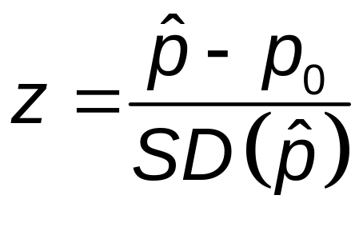
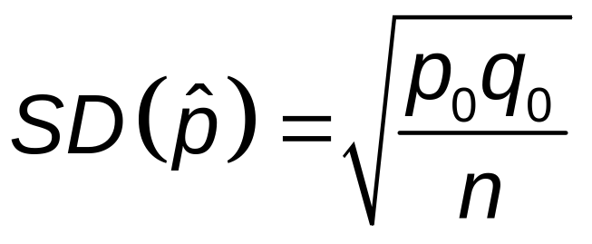
1-Proportion z-Test
Conditions
Same as a 1-Proportion Confidence Interval
Null Hypothesis
  H₀: p = p₀
Test Statistics

Slide 17
DMV Study: Checking Conditions
  Randomization Condition: The 90 teens were a random sample of all teens.
  10% Condition: 90 is fewer than10% of the total number of all teens who take the driving test.
  Success/Failure Condition:
    np₀ = (90)(0.80) = 72 ≥10
    nq₀ = (90)(0.20) = 12 ≥ 10
  The conditions are satisfied. We can use the Normal model and perform a 1-Proportion z-Test.

Slide 18
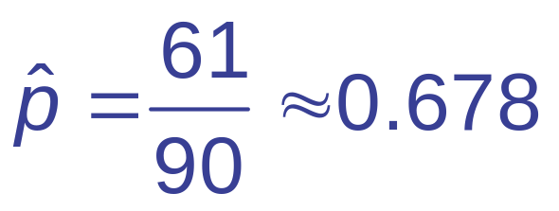
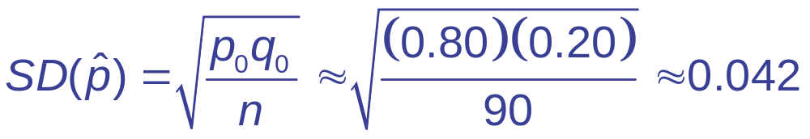
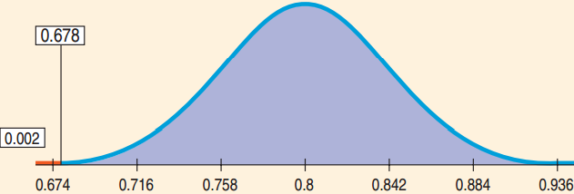
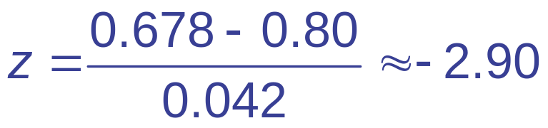
DMV Study: Mechanics
Claim: 80% pass. 61 of 90 teens tested passed.
  Find P-value.
    n = 90, x = 61, p₀ = 0.80,

Slide 19
DMV Study: Conclusion
Is the teen pass rate less than 80%? P-value = 0.002
  What can be concluded? What does the P-value mean?
    P-value = 0.002 is very small → Reject H₀
    The survey data provide strong evidence that the pass rate for teens is less than 80%.
    This should not be the end of the conversation.
    The next step would be to see if the pass rate is low enough to take further action.

Slide 20
17.4
Alternative Alternatives

Slide 21
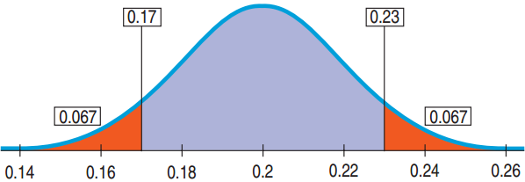
Two-Sided Alternative
For the new process the engineer may be interested in whether there has been a change in the cracking rate not just a decrease.
  H₀: p = 0.20
  H_{A}: p ≠ 0.20
  An alternative
  hypothesis where we are interested in deviation on either side is called a two-sided alternative.
  The P-value is the probability of deviating from either direction from the null hypothesis.

Slide 22
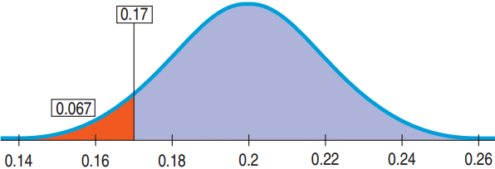
One-Sided Alternative
The engineer may be interested in whether there has been a decrease in the cracking rate.
  H₀: p = 0.20
  H_{A}: p < 0.20
  An alternative
  hypothesis where we are interested in deviation on only one side is called a one-sided alternative.
  The P-value for a one-sided alternative is always half the P-value for the two-sided alternative.

Slide 23
Not the Right Proportion of Male Babies?
Under natural conditions, 51.7% of births are male. In Punjab India’s hospital 56.9% of the 550 births were male.
  Question: Is there evidence that the proportion of male births is different for this hospital?
Think →
  Plan: We will have a two-tailed alternative. The parameter of interest is p.
    H₀: p = 0.517
    H_{A}: p ≠ 0.517

Slide 24
Not the Right Proportion of Male Babies?
Think →
  Model: Check the conditions
    Independence Assumption: The sex of one baby should not affect the sex of others.
    Randomization Conditions: The births were not random, so be cautious of the results.
    10% Condition: 550 births is certainly less than the total number of all births.

Slide 25
Not the Right Proportion of Male Babies?
Think →
  Model: Check the conditions (Continued).
    Success/Fail Condition:
    (550)(0.517) ≥ 10, (550)(0.583) ≥ 10
    The Normal model does apply.
    We can use a one-proportion z-test.

Slide 26
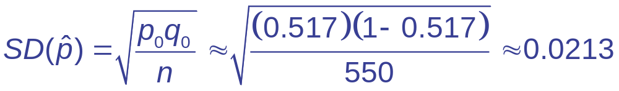
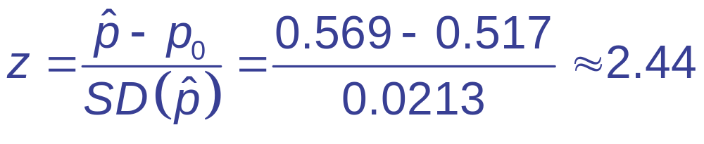
Not the Right Proportion of Male Babies?
Show →
  Mechanics:

Slide 27
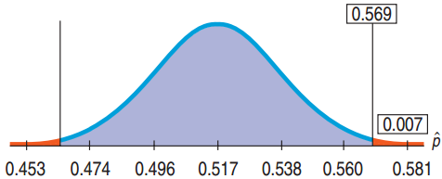
Not the Right Proportion of Male Babies?
Show →
  Mechanics:
  P-value = 2P(z > 2.44) = 2(0.0073) = 0.0146

Slide 28
Not the Right Proportion of Male Babies?
Tell →
  Conclusion:
    Interpreting the P-value = 0.00146
      If the proportion of male babies were still 51.7%, then an observed proportion as different as 56.9% male babies would occur at random about 15 times in 1000.
      This is so small a chance that I reject H₀. There is strong evidence that the proportion of boys is not equal to the baseline for the region. It appears larger.

Slide 29
17.5
P-Values and Decisions: What to Tell About a Hypothesis Test

Slide 30
How Small a P-Value is Small Enough?
How small is small enough is context specific.
  Test to see if a renowned musicologist can distinguish between Mozart and Hayden.
    P-value of 0.1 may be good enough. Just reaffirming known talent.
  A friend claims psychic abilities and can predict heads or tails.
    Very small P-value such as 0.01 needed. Breaking scientific theory.

Slide 31
Acceptable P-Value Depends on Result’s Importance
Proportion of students with full time jobs has increased.
  Not that important. P-value = 0.05 will work.
Testing the proportion of faulty rivets that hold together the wings of a commercial aircraft is now below the danger threshold.
  Life and death decision. Need a very small P-value
  Whether rejecting or failing to reject, always cite the P-value.
  An accompanying confidence interval helps also.

Slide 32

Home Field Advantage?
Is there a home field advantage in baseball?
  The home team won 1277 of the 2429
  (52.57%) games played in the season.
  Is there evidence to suggest that the home
  team wins more than 50%?
Think →
  Plan: p = proportion of home team wins
  Hypotheses
    H₀: p = 0.50
    H_{A}: p > 0.50

Slide 33
Home Field Advantage?
Model →
  Independence Assumption: Questionable, but the 2011 season may be representative of all games past and future.
  10% Condition: The 2011 season is less than 10% of all games played past and future.
  Success/Failure Condition:
    np = (2429)(0.5) ≥10
    nq = (2429)(0.5) ≥ 10
  The Normal Model Applies: Conduct a
  one-proportion z-test.

Slide 34
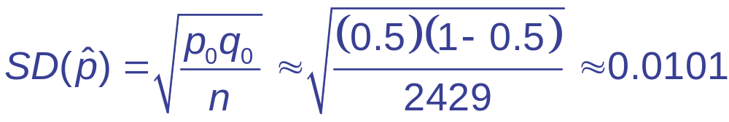
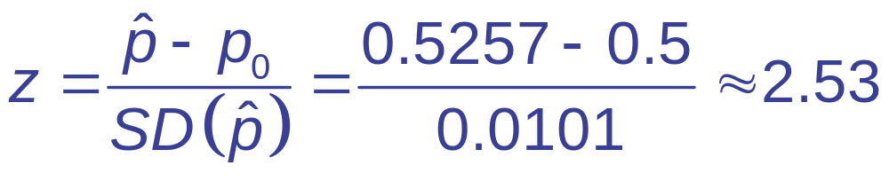
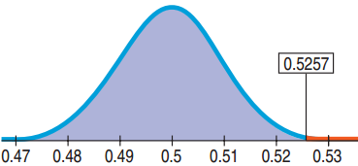
Home Field Advantage?
Show →
  Mechanics:
  The P-value is about 0.0057.

Slide 35
Home Field Advantage?
Tell →
  Conclusion: The P-value of 0.0057 says that if the true proportion of home teams wins is 0.5 then an observed value of 0.5257 would occur less than 6 times in 1000.
  This is so unlikely, so reject H₀.
  There is reasonable evidence that the true proportion of home team wins is greater than 50%.
  There appears to be a home field advantage.

Slide 36
How Big a Home Field Advantage?
Think →
  Model:
    Success Failure Condition
      Home team wins: 1277 ≥ 10
      Home team losses: 1152 ≥ 10
    Sampling distribution follows the Normal model.
    Find the one-proportion z-interval.

Slide 37
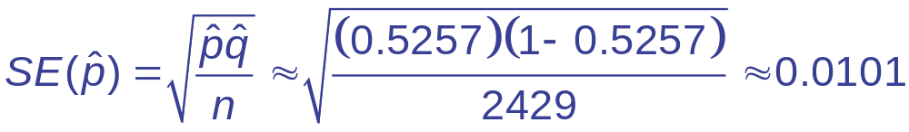
How Big a Home Field Advantage?
Show →
  Mechanics:
  For 95% confidence, z* = 1.96.
  A 95% confidence interval is:
  0.5257 ± 0.0198 or (0.5059, 5455).

Slide 38
How Big a Home Field Advantage?
Tell →
  Conclusion: I am 95% confident that, in professional baseball, home teams win between 50.59% and 54.56% of the games.
  For a 162-game season, the low end gives the home team about 1/2 of an extra victory and the high end, about 4 extra wins.

Slide 39
What Can Go Wrong?
Don’t base your H₀ on what you see in the data.
  Changing the null hypothesis after looking at the data is bad statistics (p-hacking).
Don’t base your H_{A} on the data.
  Both the null and alternative hypotheses must be stated before peeking at the data.
Don’t make H₀ what you want to show to be true.
  H₀ represents the status quo. You can never accept the null hypothesis.

Slide 40
What Can Go Wrong?
Don’t forget to check the conditions.
  Randomization, independence, and sample size
Don’t accept the null hypothesis.
  You can only say you don’t have evidence to reject H₀.
If you fail to reject H₀ don’t expect a larger sample would reject H₀.
  Check the confidence interval. If its values would not matter to you, then a larger sample will unlikely be worthwhile.

