Slide 1
Chapter 18
Inferences About Means

Slide 2
18.1
Getting Started: The Central Limit Theorem (Again)

Slide 3
The Central Limit Theorem (CLT)
When a random sample is drawn from a population with mean μ and standard deviation σ, the sampling distribution has:
  Mean: μ
  Standard deviation:
  Approximately Normal distribution as long as the sample size is large.
  The larger the distribution, the closer to Normal.

Slide 4
Weight of Angus Cows
The weight of Angus cows is Normally distributed with
μ = 1309 pounds and σ = 157 lbs. What does the CLT say about the mean weight of a random sample of 100 Angus cows?
  Sample means will average 1309 pounds.

Slide 5
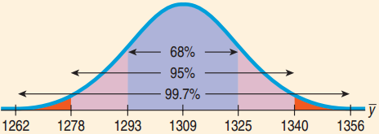
Weight of Angus Cows (Continued)
  The CLT says the sampling distribution will be approximately Normal: N(1309, 15.7).
For the means of all random samples,
  68% will be between 1293.3 and 1324.7 lb.
  95% will be between 1277.6 and 1340.4 lb.
  99.7% will be between 1261.9 and 1356.1 lb.

Slide 6
The Challenge of the CLT
  CLT tells us
  We would like to use this for Confidence Intervals and Hypothesis Testing.
  Unfortunately, we almost never know σ.
  Using s almost works: , but not quite.
  When using s, the Normal model has some error.
  William Gosset came up with new models, one for each n that works better.

Slide 7
18.2
Gosset’s t

Slide 8
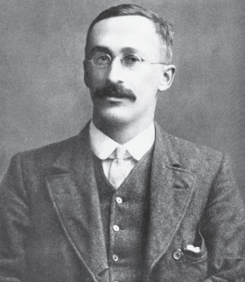
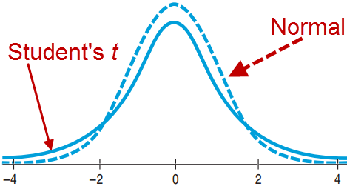
Gosset the Brewer
At Guinness, Gosset experimented with beer.
  The Normal Model was not right, especially
  for small samples.
  Still bell shaped, but details differed, depending on n
  Came up with the “Student’s t Distribution” as the correct model

Slide 9
Degrees of Freedom
  For every sample size n there is a different
  Student’s t distribution.
  Degrees of freedom: df = n – 1.
  Similar to the “n – 1” in the formula for sample standard deviation
  It is the number of independent quantities left after we’ve estimated the parameters.

Slide 10
Confidence Interval for Means
Sampling Distribution Model for Means
  With certain conditions (seen later), the standardized sample mean follows the Student’s t model
  with n – 1 degrees of freedom.
  We estimate the standard deviation with

Slide 11
One Sample t-Interval for the Mean
  When the assumptions are met (seen later), the confidence interval for the mean is
  The critical value depends on the confidence level, C, and the degrees of freedom n – 1.

Slide 12
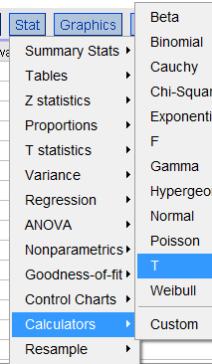
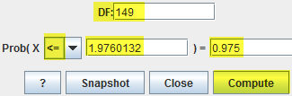
Contaminated Salmon
A study of mirex concentrations in salmon found
  n = 150, = 0.0913 ppm, s = 0.0495 ppm
  Find a 95% confidence interval for mirex concentrations in salmon.
  df = 150 – 1 = 149

Slide 13
Contaminated Salmon
Confidence Interval for μ
  = 0.0913 ± 0.0079
  = (0.0834, 0.0992)
  I’m 95% confident that the mean level of mirex concentration in farm-raised salmon is between 0.0834 and 0.0992 parts per million.

Slide 14
Thoughts about z and t
  The Student’s t distribution:
    Is unimodal.
    Is symmetric about its mean.
    Has higher tails than Normal.
    Is very close to Normal for large df.
    Is needed because we are using s as an
    estimate for σ.
  If you happen to know σ, which almost never happens, use the Normal model and not Student’s t.

Slide 15
Assumptions and Conditions
Independence Condition
  Randomization Condition: The data should arise from a suitably randomized experiment.
  Sample size < 10% of the population size.
Nearly Normal
  For large sample sizes (n > 40), not severely skewed.
  (15 ≤ n ≤ 40): Need unimodal and symmetric.
  (n < 15): Need almost perfectly normal.
  Check with a histogram.

Slide 16
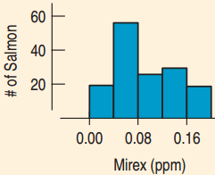
Assumptions for Salmon Contamination Study
Researchers tested 150 salmon from 51 farms in eight regions in six countries. Are the
assumptions and conditions for
inference satisfied?
  Independence Assumption:
  Not a random sample, but likely
  independently selected.
  Nearly Normal Condition:
  The histogram is unimodal and not highly skewed. OK since sample size is 51.

Slide 17

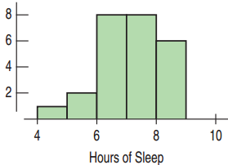
How Much Sleep do
College Students Get?
Build a 90% Confidence Interval
for the Mean.
Think →
  Plan: Data on 25 Students
Model →
  Randomization Condition
  The data are from a random survey.
  Nearly Normal Condition
  Unimodal and slightly skewed, so OK
  Use Student’s t-Model with df = 25 – 1 = 24.
  One-sample t-interval for the mean

Slide 18
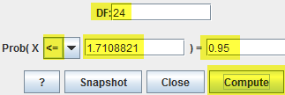
How Much Sleep?
Show →
  Mechanics: n = 25, = 6.64, s = 1.075

Slide 19
How Much Sleep do
College Students Get?
Tell →
  Conclusion: I’m 90 percent confident that the interval from 6.272 and 7.008 hours contains the true population mean number of hours that college students sleep.

Slide 20
Make a Picture, Make a Picture,
Make a Picture
Always Test the Normality Assumption
  Create a histogram to check for near normality.
    Good for seeing the nature of the deviations: outliers, not symmetric, skewed
  Also create a normal probability plot to see that it is reasonably straight.
    Good for checking for normality
  With technology at hand, there is no excuse not to make these two plots.

Slide 21
18.3
Interpreting Confidence Intervals

Slide 22
What Not to Say
Don’t Say
  “90% of all students sleep between 6.272 and 7.008 hours each night.”
    The CI is for the mean sleep, not individual students.
  “We are 90% confident that a randomly selected student will sleep between 6.272 and 7.008 hours per night.”
    We are 90% confident about the mean sleep, not an individual’s sleep.

Slide 23
What Not to Say (Continued)
Don’t Say
  “The mean amount of sleep is 6.64 hours 90% of the time.”
    The population mean never changes. Only sample means vary from sample to sample.
  “90% of all samples will have a mean sleep between 6.272 and 7.008 hours per night.”
    This interval does not set the standard for all other intervals. This interval is no more likely to be correct than any other.

Slide 24
What You Should to Say
Do Say
  “90% of all possible samples will produce intervals that actually do contain the true mean sleep.”
    This is the essence of the CI, but it may be too formal for general readers.
  “I am 90% confident that the true mean amount that students sleep is between 6.272 and 7.008 hours per night.”
    This is more personal and less technical.

Slide 25
18.4
A Hypothesis Test for the Mean

Slide 26
One-Sample t-Test for the Mean
  Assumptions are the same.
  H₀: μ = μ₀
  Standard Error of
  When the conditions are met and H₀ is true, the statistic follows the Student’s t Model.
  Use this model to find the P-value.

Slide 27
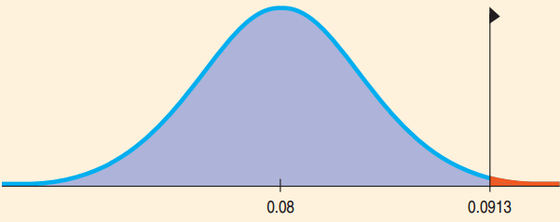
Are the Salmon Unsafe?
EPA recommended mirex screening is 0.08 ppm.
  Are farmed salmon contaminated beyond the permitted EPA level?
  Recap: Sampled 150 salmon. Mean 0.0913 ppm, Standard Deviation 0.0495 ppm.
  H₀: μ = 0.08
  H_{A}: μ > 0.08

Slide 28
Are the Salmon Unsafe?
One-Sample t-Test for the Mean
  n = 150, df = 149, = 0.0913, s = 0.0495
  Since the P-value is so low, reject H₀ and conclude that the population mean mirex level does exceed the EPA screening value.

Slide 29

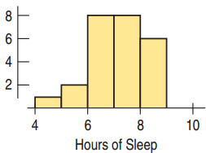
Do Students Get at Least Seven
Hours of Sleep? 25 Surveyed.
Think →
  Plan: Is the mean amount of sleep
  less than 7 hours?
  Hypotheses: H₀: μ = 7 H_{A}: μ < 7
  Model
    Randomization Condition: The
    students were randomly and
    independently selected .
    Nearly Normal Condition: Unimodal and symmetric
    Use the Student’s t-model, df = 24
    One-sample t-test for the mean

Slide 30
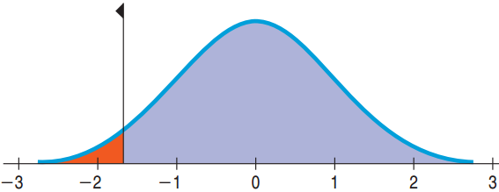
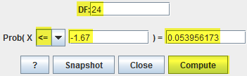
Do Students Get at Least Seven
Hours of Sleep? 25 Surveyed.
Show →
  Mechanics: n = 25, = 6.64, s = 1.075

Slide 31
Do Students Get at Least Seven
Hours of Sleep? 25 Surveyed.
Tell →
  Conclusion: P-value = 0.054 says that
  if students do sleep an average of 7 hrs., samples of 25 students can be expected to have an observed mean of 6.64 hrs. or less about 54 times in 1000.
  With 0.05 cutoff, there is not quite enough evidence to conclude that the mean sleep is less than 7.
  The 90% CI: (6.272, 7.008) contains 7.
  Collecting a larger sample would reduce the ME and give us a better handle on the true mean hours of sleep.

Slide 32
Intervals and Tests
Confidence Intervals
  Start with data and find plausible values for the parameter.
  Always 2-sided
Hypothesis Tests
  Start with a proposed parameter value and then use the data to see if that value is not plausible.
  2-sided test: Within the confidence interval means fail to reject H₀. P-value = 1 – C is the cutoff.
  1-sided test: P-value = (1 – C)/2 is the cutoff.

Slide 33
Sleep, Confidence Intervals and Hypothesis Tests
90% Confidence interval: (6.272, 7.008)
  For a 2-tailed test with a 10% cutoff, any
  6.272 ≤ μ₀ ≤ 7.008 would result in failing to reject H₀.
  For a 1-tailed test (“<”) with a 5% cutoff, any
  μ₀ ≤ 7.008 would result in failing to reject H₀.
  For a 1-tailed test (“>”) with a 5% cutoff, any
  6.272 ≤ μ₀ would result in failing to reject H₀.

Slide 34
The Special Case with Proportions
Confidence Intervals
  Use to calculate .
Hypothesis Tests
  Use p to calculate SD(p).
If and SD(p) are far from each other, the relationship between the confidence interval and the hypothesis test breaks down.

Slide 35
What Can Go Wrong?
Don’t confuse proportions and means.
  When counting successes with a proportion, use the Normal model.
  With quantitative data, use Student’s t.
Beware of multimodality.
  If the histogram is not unimodal, consider separating into groups and analyzing each group separately.
Beware of skewed data.
  Look at the normal probability plot and histogram.
  Consider re-expressing if the data is skewed.

Slide 36
What Can Go Wrong?
Set outliers aside.
  Outliers violate the Nearly Normal Condition.
  If removing a data value substantially changes the conclusions, then you have an outlier.
  Analyze without the outliers, but be sure to include a separate discussion about the outliers.
Watch out for bias.
  With bias, even a large sample size will not save you.

Slide 37
What Can Go Wrong?
Make sure cases are independent.
  Look for violations of the independence assumption.
Make sure the data are from an appropriately randomized sample.
  Without randomization, both the confidence interval and the p-value are suspect.
Interpret your confidence interval correctly.
  The CI is about the mean of the population, not the mean of the sample, individuals in samples, or individuals in the population.

