Slide 1
CHLADNI·ATOR
LUCA, RAFFA, XINYI
ACTaM 25/26

Slide 2
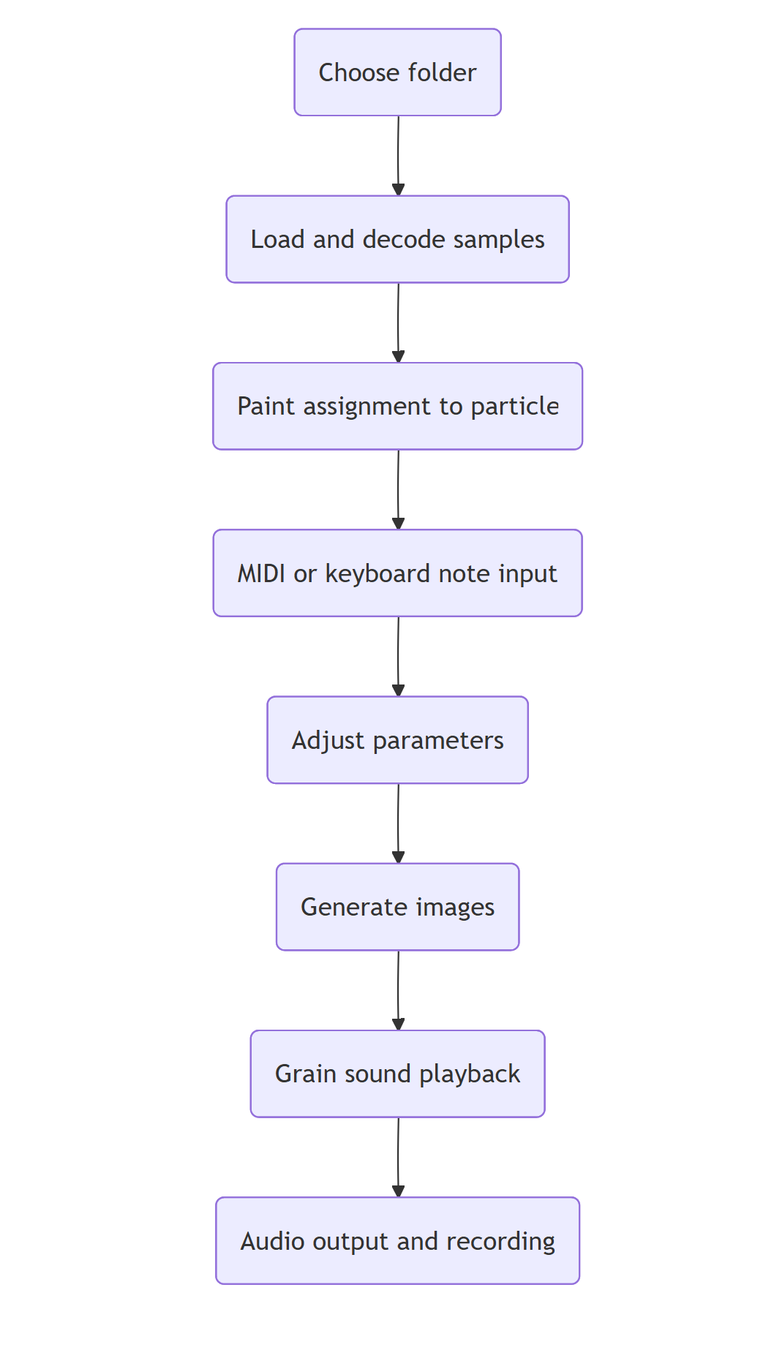

Slide 3
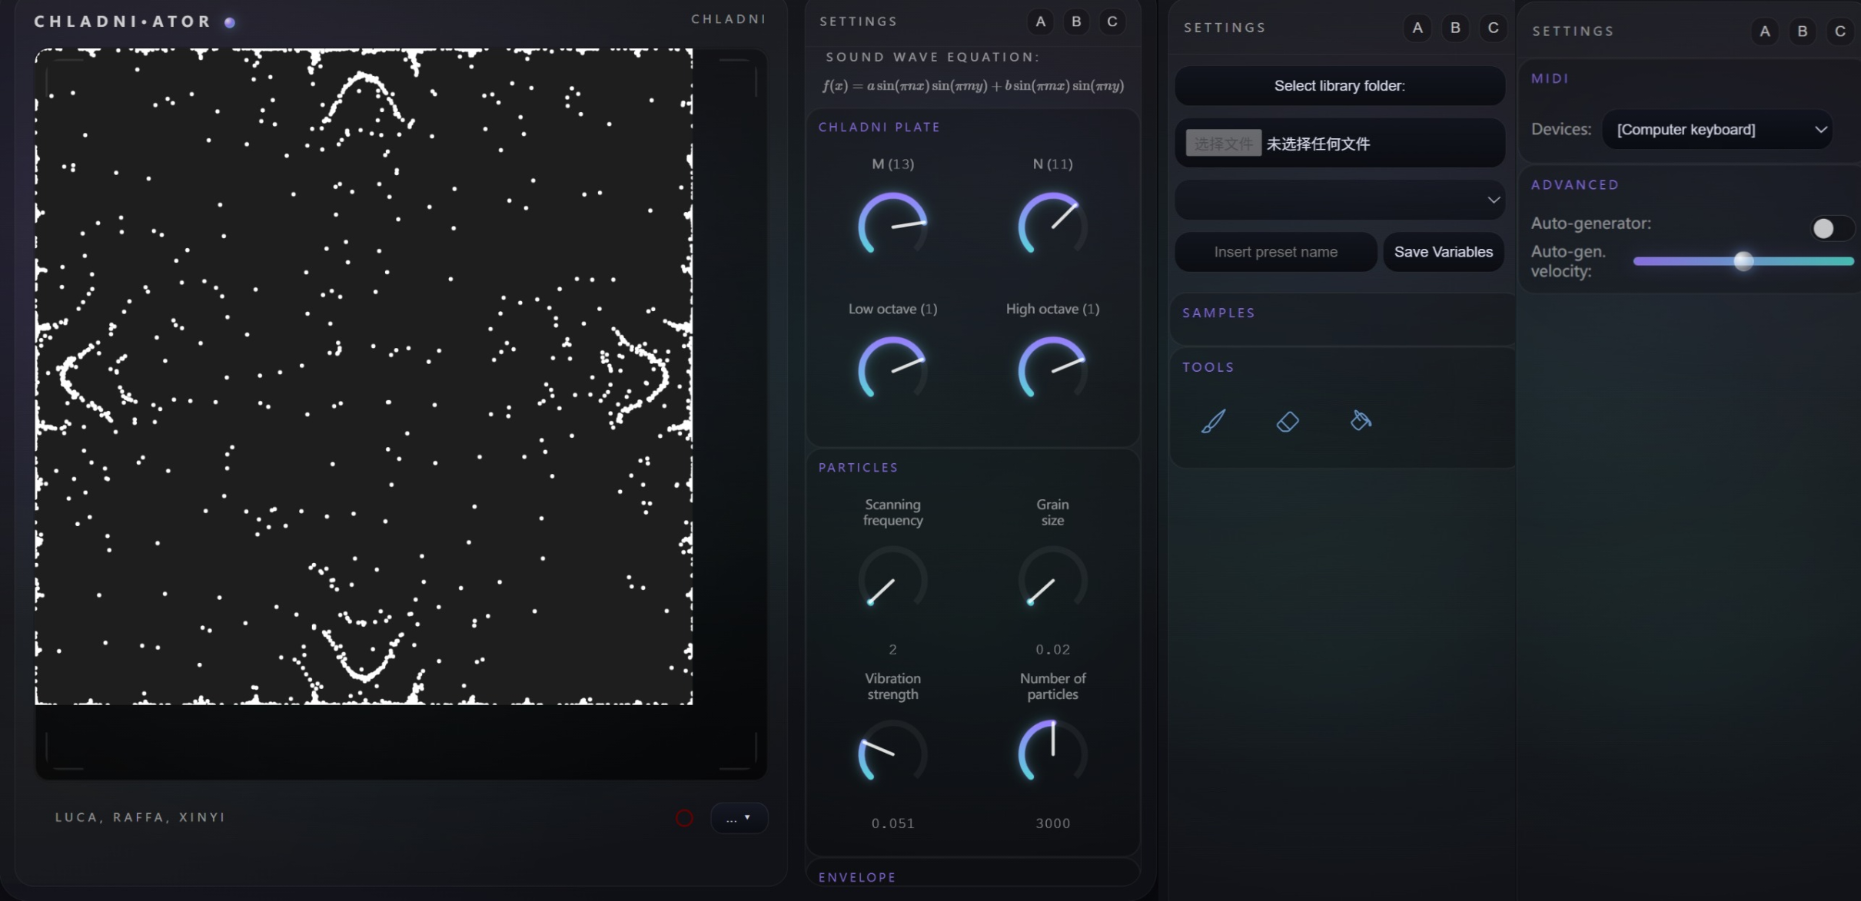
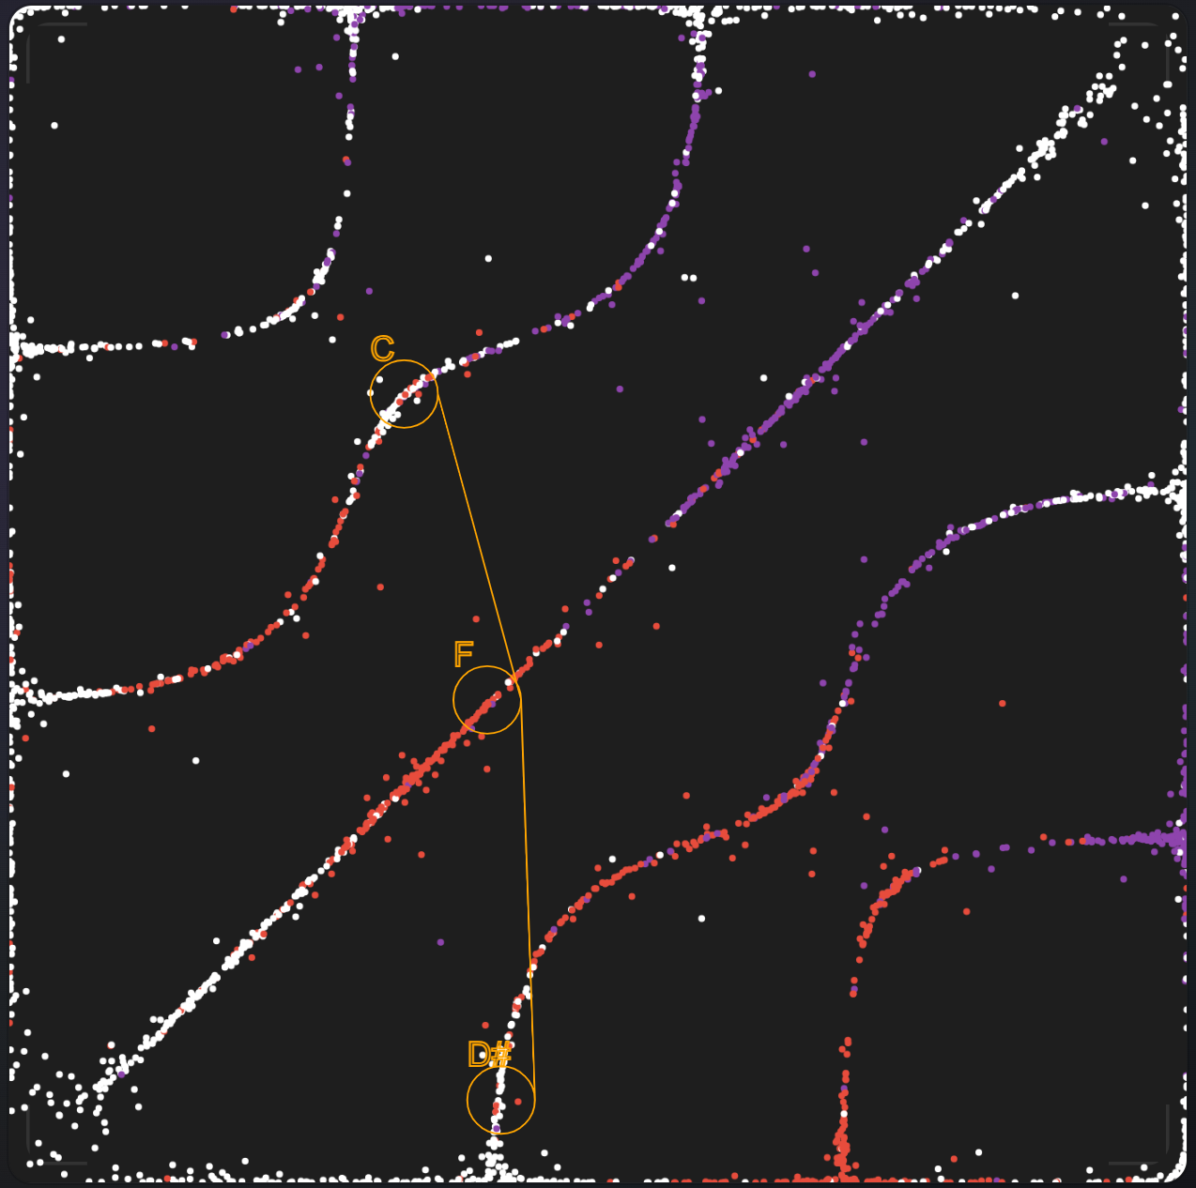
midi_handle.js
generalScript.js
save_load_presets.js
firebase.js
chladni.js
soundBrush.js
audiobuffer.js
CircleKnob.js
audiogenerator.js
recorder.js
recorderApp.js
envelopeCanvas.js

Slide 4
