Slide 1

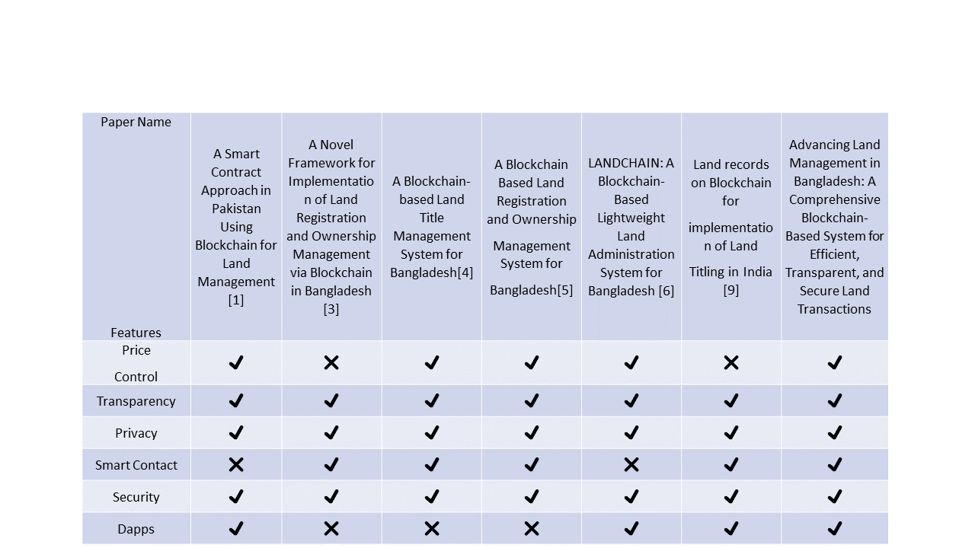
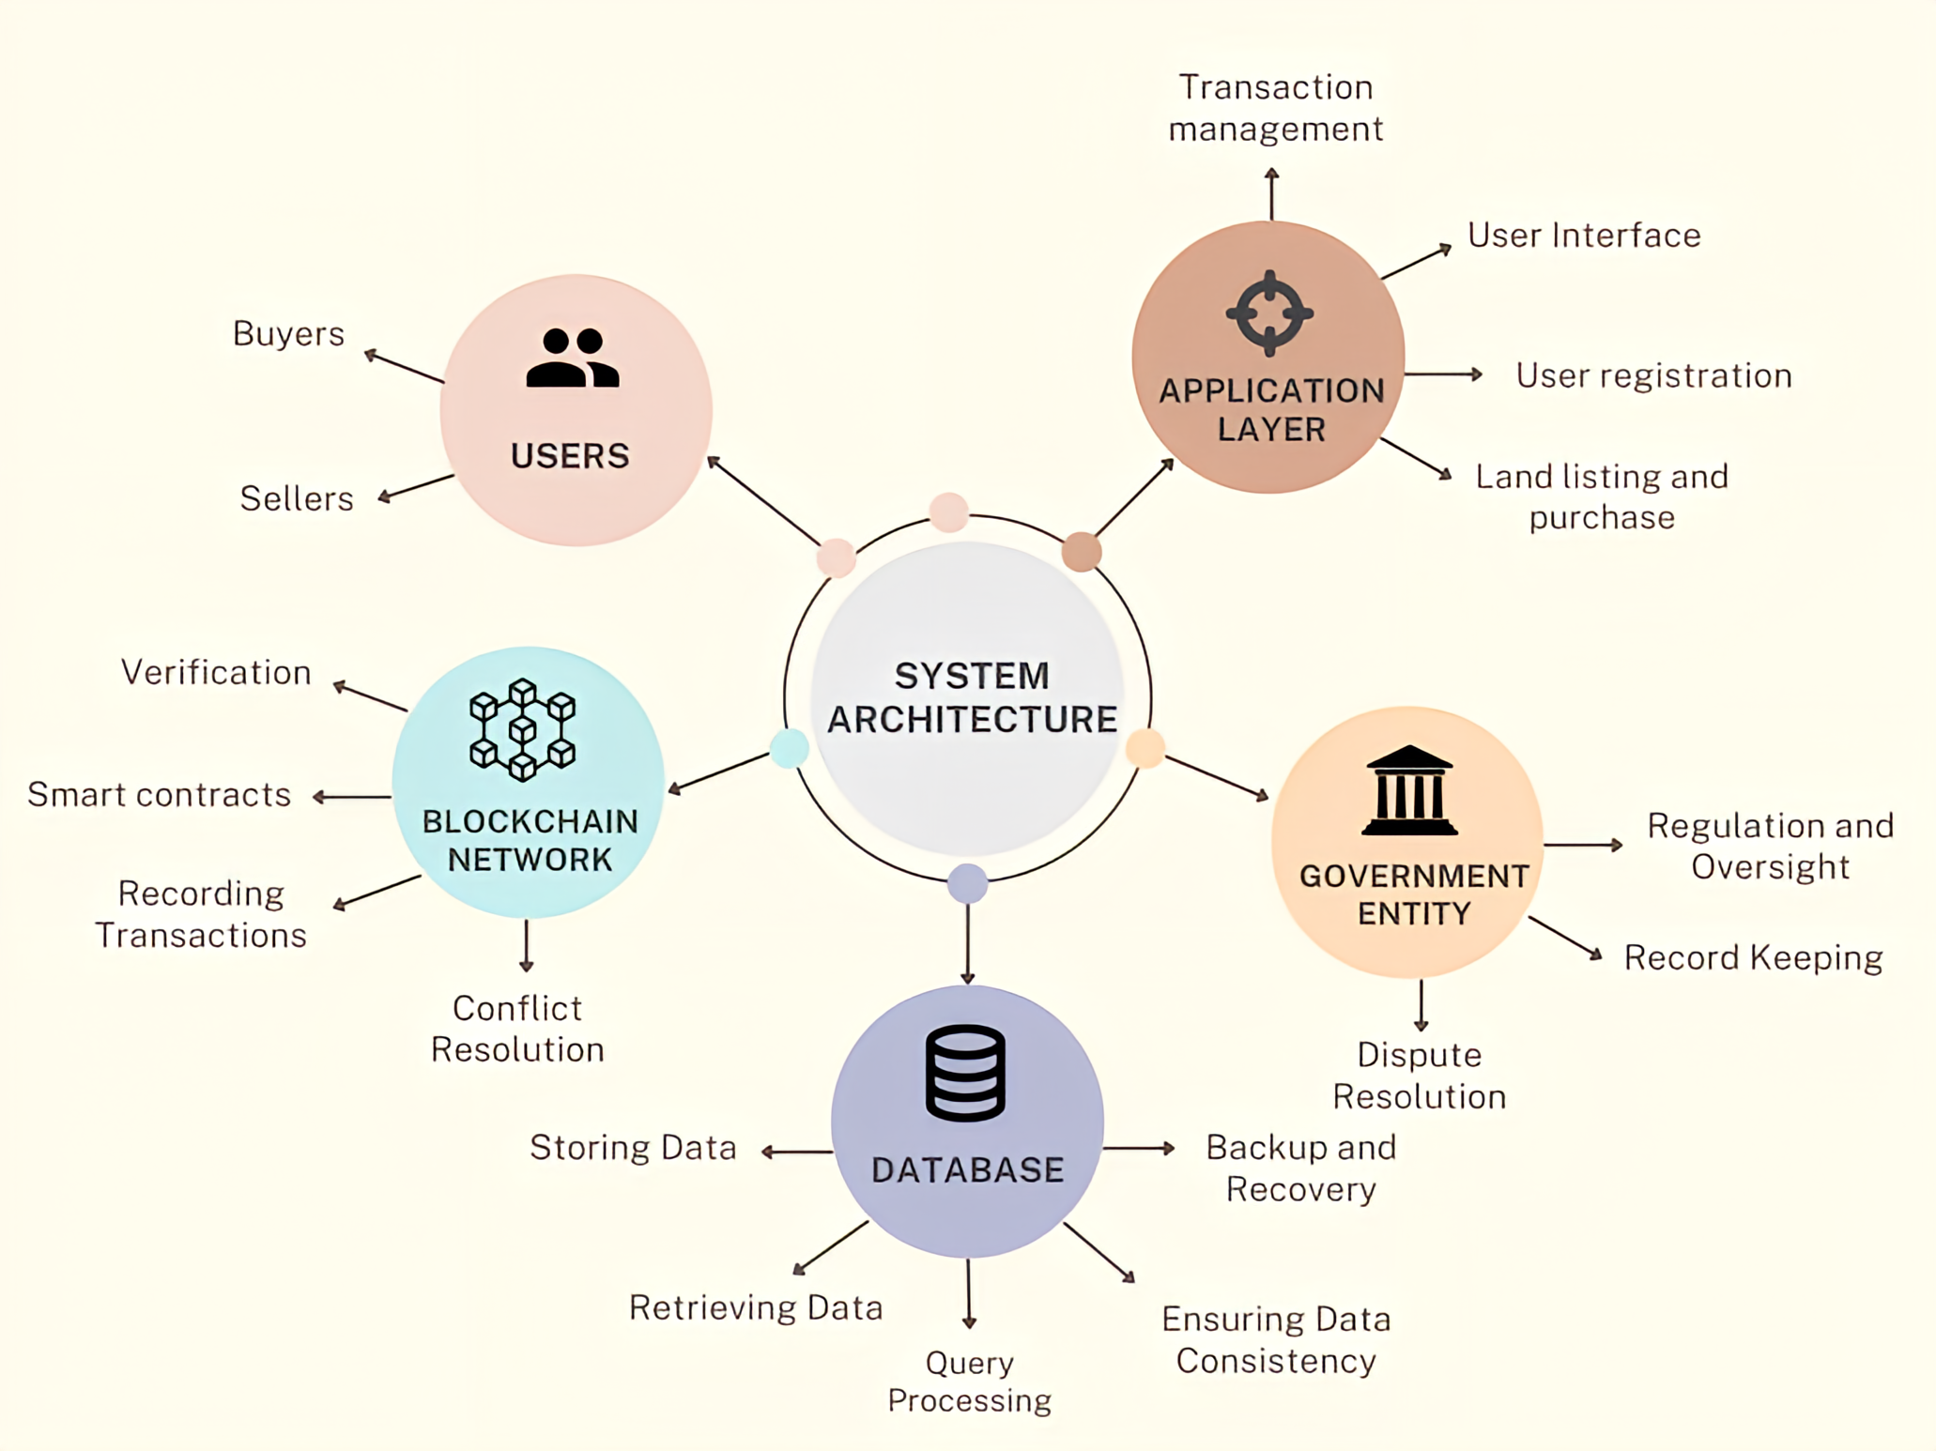
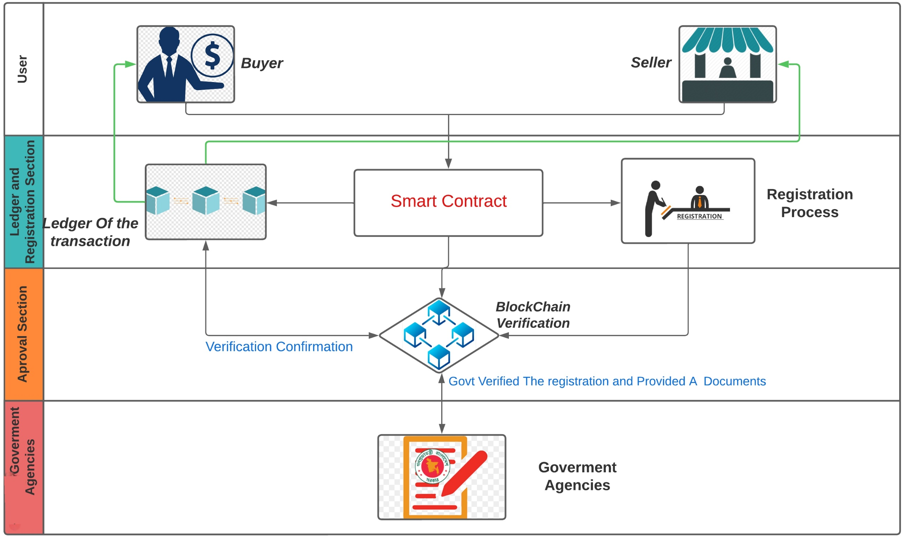
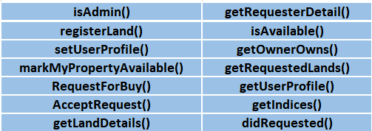
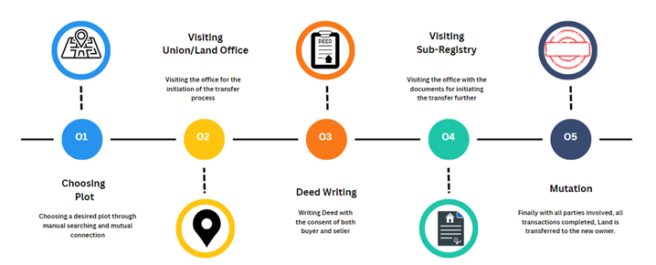
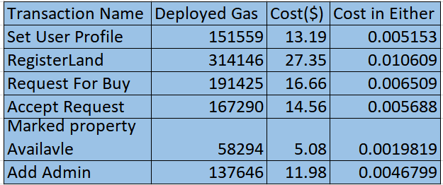
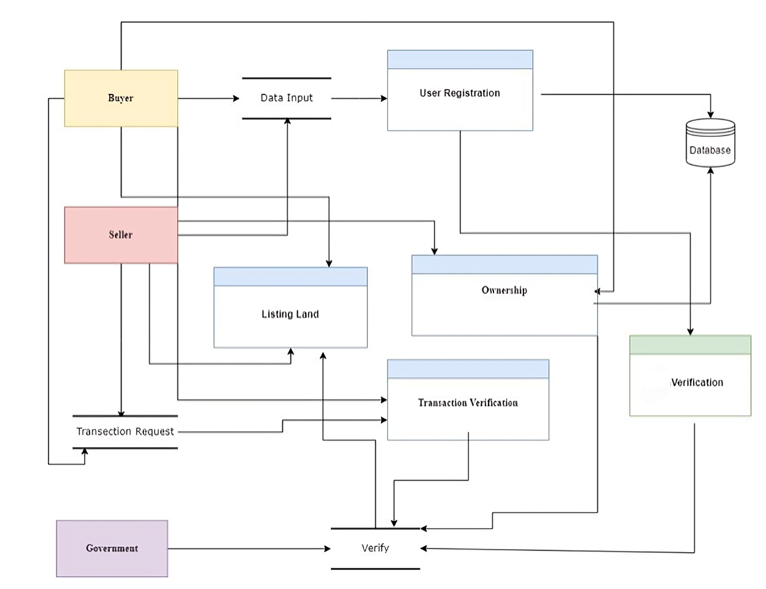
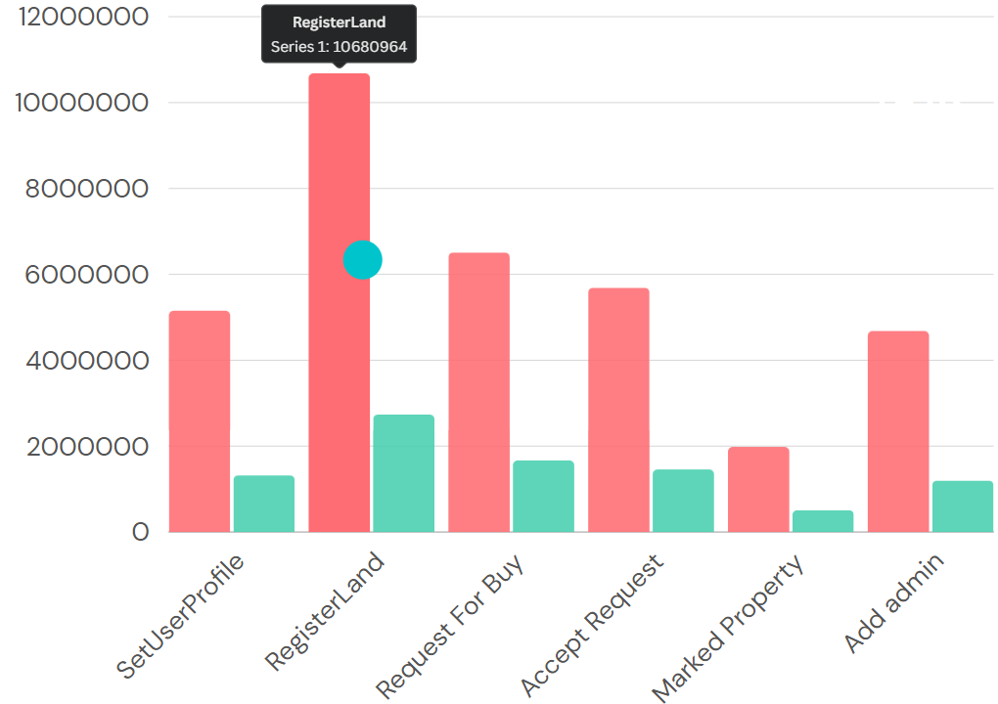
Advancing Land Management in Bangladesh: A Comprehensive Blockchain-Based System
for Efficient, Transparent, and Secure Land Management
Abdullah Al Rafi ,Md. Ashraful Islam , Sifat Ullah Sharkar , Ziaul Haque Rafi
ABSTRACT
MOTIVATION
System Architecture
Key Takeaways; Result
This project addresses Bangladesh’s land management challenges, emphasizing outdated record-keeping and corruption hindering land transactions. It proposes a Blockchain-based Land Administration System (LAS) to streamline titling and registration. It discusses issues like document forgery and land grabs due to archaic methods. Complexities include opaque pricing and disjointed records management. The solution integrates Blockchain, AI, machine learning, and IoT for transparency and security. Smart contracts and decentralized finance combat corruption. Phased implementation involves community engagement and government oversight for a robust land records system. This innovative approach aims to revolutionize land management, fostering societal welfare in Bangladesh.
- Deployment of blockchain-based web application for land transactions using Solidity smart contracts in React JS and Node JS framework
- Interaction via Ethereum and Ganache Local Test Net with MetaMask for wallet management
- Process initiated by Super Admin adding Admins for land registration management
- Sellers update profiles, mark land for sale with minimal gas costs
- Buyers request land purchase, visible to owner; upon acceptance, ownership transfer confirmed
- Application supports varied user profiles with specific access levels for transparency
- Performance assessment:
- Gas Consumption: Costs vary by transaction type, with complex actions consuming more gas; deploying smart contract costs roughly 0.014521624 Ether ($17.49)
- Transaction Speed: Consistent across different inputs, influenced more by network stability than input size
BACKGROUND
Bangladesh, spanning 148,460 square kilometers with 173 million people, seeks efficient land management amid economic growth. Urban expansion increases land value, transitioning farmlands for industrial use. Land ownership complexities persist due to archaic paper-based record-keeping dating back to the Delhi Sultanate era. British colonial practices introduced methods with present-day loopholes. Current land transactions are convoluted, leaving room for exploitation by opportunists. Blockchain technology offers a solution by digitizing and securing land records, streamlining processes, and mitigating fraud. Implementing blockchain promises a paperless, hassle-free, and secure land management system, enhancing efficiency and transparency in Bangladesh.
METHODOLOGY
Proposed Model
Smart Contacts
Key Takeaways; Discussion
Proposal: Overhaul Bangladesh's land management using blockchain for transparency and efficiency
Framework: Multi-layered blockchain network with energy-efficient consensus
Challenges: Technical integration, initial costs, security, privacy concerns, resistance to change
You can write about the models. Click here to edit this text.
RESULT & DISCUSSION
CONCLUSION
Cost Estimation of Smart Contacts
Implementing our blockchain-based model for land transactions promises transformative outcomes. The automation through smart contracts will expedite real estate processes, benefiting both landowners and buyers with quicker ownership changes and registrations. The blockchain ledger's transparency and immutability will enhance trust, reducing fraud and boosting transaction integrity. Inclusion of governmental and legal entities further assures compliance and legality, aiming to revolutionize land management and foster better governance while stimulating the real estate sector's growth.
Dataflow Model
Fig :Traditional Land Management
OBJECTIVES
Evaluate efficiency gains
Compare with conventional methods
Assess improvement in honesty and reliability
Evaluate storage reliability and resistance to manipulation
Assess the role of governmental organizations and legal authorities
Analyze the impact and automation of smart contracts
Examine the immutability and decentralization of blockchain
This project was done under the supervision of
Dr. Mohammad Rifat Ahmmad Rashid
Assistant Professor
Department of Computer Science & Engineering
&
Mahamudul Hasan
Senior Lecturer
Department of Computer Science & Engineering
Gas Price on each Transaction

