Slide 1

Tourism Management System
Presented by: Rafi Zubayer, MD. Nafiul Hossain, MD. Abu Sufian
Department of Computer Science and Engineering
HAJEE MOHAMMAD DANESH SCIENCE AND TECHNOLOGY UNIVERSITY DINAJPUR-5200

Slide 2
Outlines
Introduction
Objectives
Key Features
Technology Used
Implementation
Advantages
Future Enhancements

Slide 3
Introduction
The Tourism Management System (TMS) is a web-based platform designed to manage tour packages, bookings, and customer data efficiently. Developed with PHP and MySQL, it offers user-friendly interfaces for customers and powerful tools for administrators, enhancing the tourism management experience.

Slide 4
Objectives
Provide a user-friendly platform for tourism services.
Automate booking and management processes.
Ensure secure transactions and efficient data handling.
Enhance customer satisfaction through timely information.

Slide 5
Key Features
Tour Package Management
Online Booking System
Customer and Admin Dashboards
Real-time Updates and Notifications
Reviews and Feedback
User and Booking Management

Slide 6
Technologies Used
Languages: HTML, CSS, PHP, JavaScript
Database: MySQL with XAMPP
Tools: Visual Studio Code, Adobe Photoshop

Slide 7

Implementation
Homepage: Features a navigation bar with sections like Home, About, Tour Packages, Privacy Policy, Contact Us, Admin Login, and User Sign In/Sign Up.

Slide 8
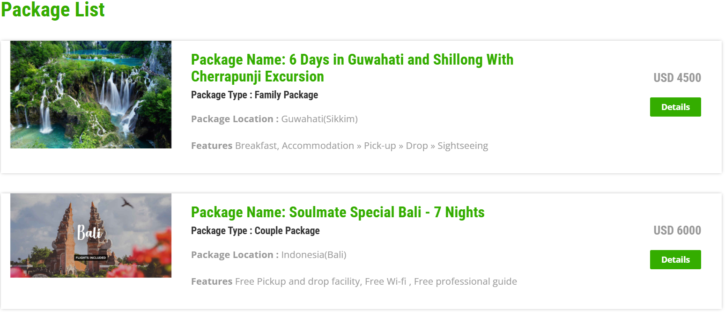
Implementation(Cont.)
Homepage for Package list: Displays available packages with details (name, type, location, features, and pricing) and booking options.

Slide 9
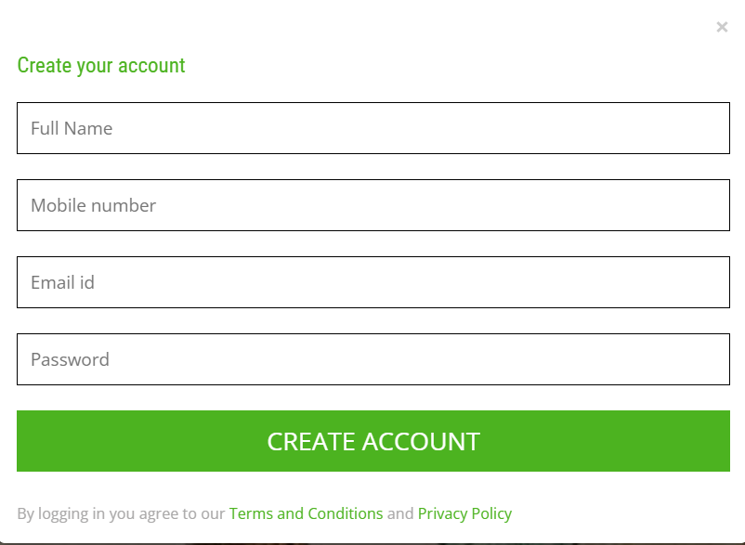
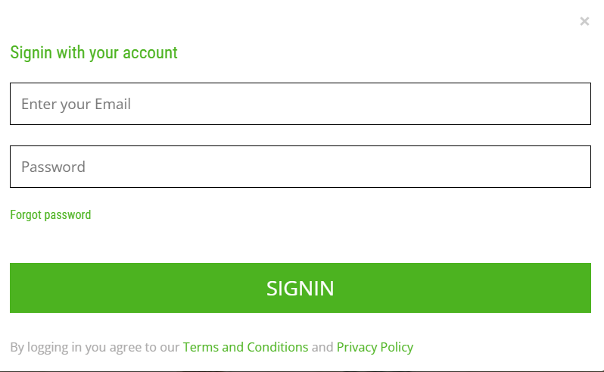
Implementation(Cont.)
User sign-up/login: Easy-to-use registration and login forms for travelers.

Slide 10
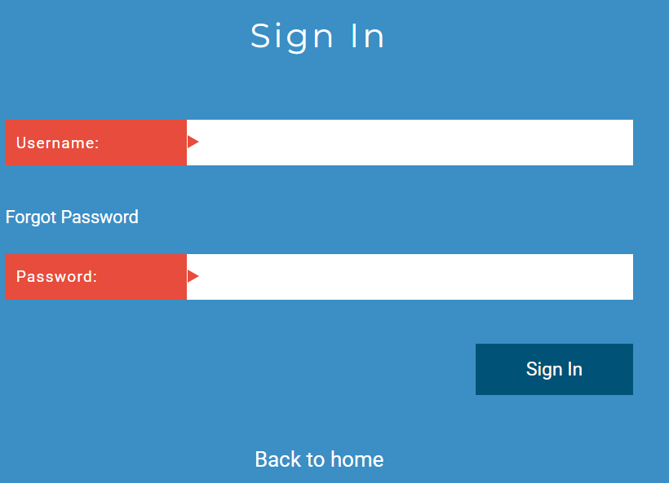
Implementation(Cont.)
Admin Login:Secure portal for administrators to manage the system.

Slide 11
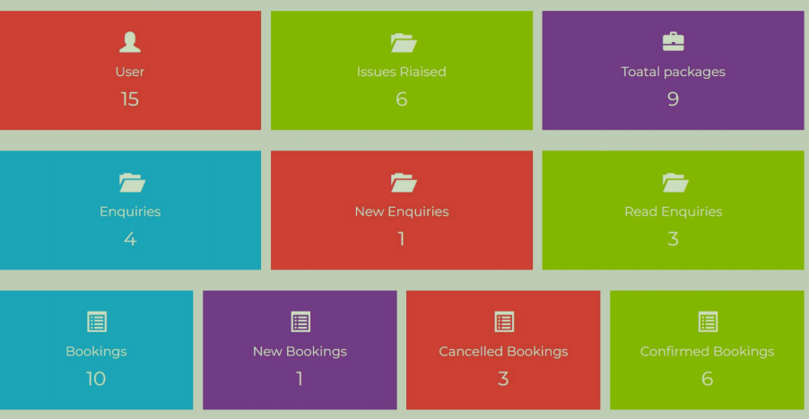
Implementation(Cont.)
Dashboard:Visual tiles showing metrics: Users, Issues, Packages, Enquiries, Bookings.

Slide 12
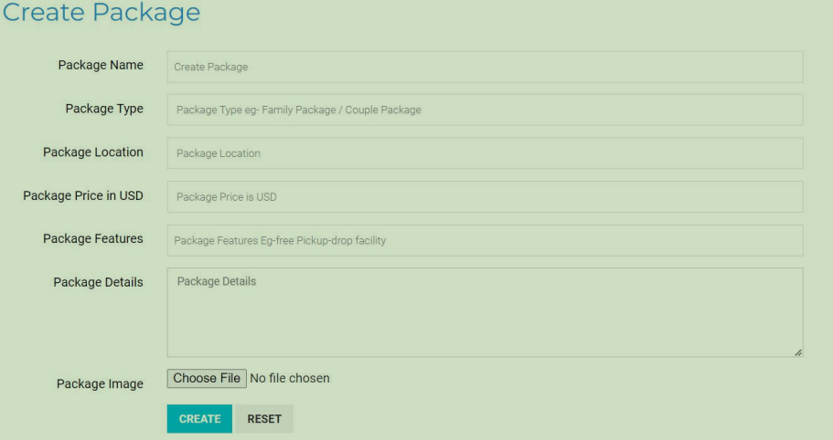
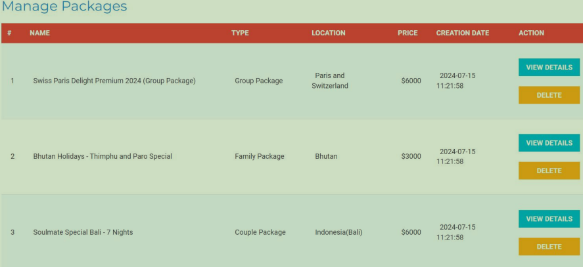
Implementation(Cont.)
Create & Manage Package:Admin can create, edit, or delete tour packages.

Slide 13
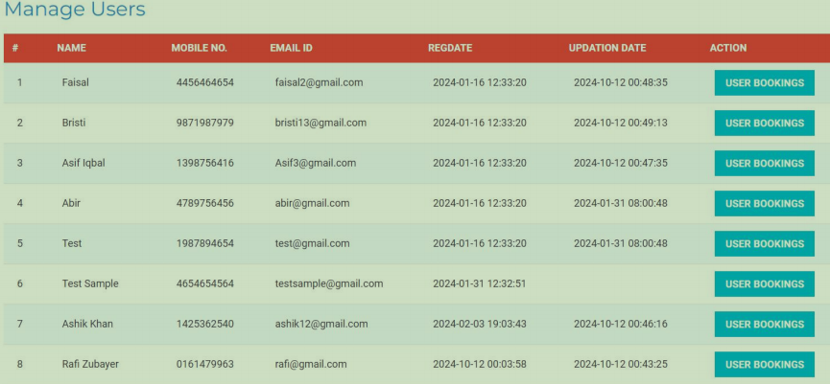
Implementation(Cont.)
Manage Users:This page displays
a list of users with their names, mobile numbers, email addresses, registration dates, and last update dates.

Slide 14
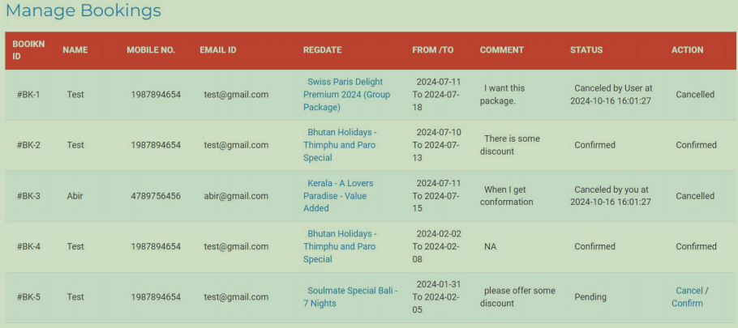
Implementation(Cont.)
Manage Booking: This page shows a list of bookings with information such as the booking ID, customer name, mobile number, email ID, registration date, travel dates, comments, status, and possible actions.

Slide 15
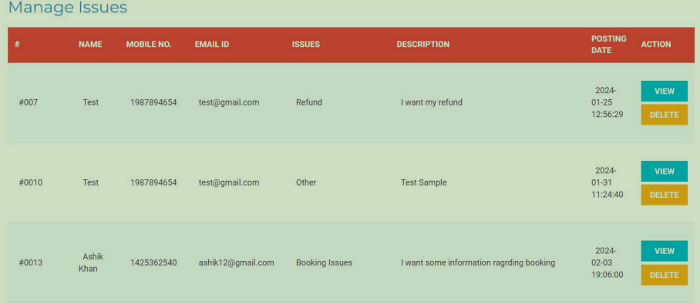
Implementation(Cont.)
Manage Issues:This page displays a list of issues, including the issue number, customer name, mobile number, email ID, issue type, description, posting date, and
actions (view and delete).

Slide 16
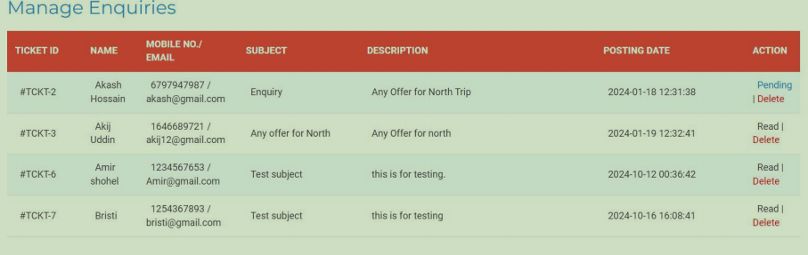
Implementation(Cont.)
Manage Enquiries: It displays a list of inquiries, each with a unique ticket ID, the customer's name, contact information, subject of the inquiry, a brief
description, the date the inquiry was submitted, and an action button.

Slide 17
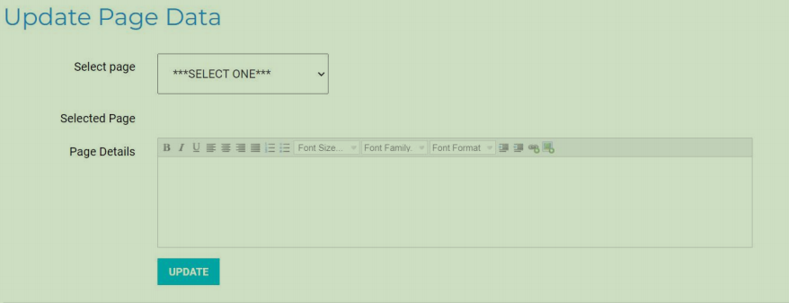
Implementation(Cont.)
Manage pages: Edit content of website pages directly from the admin interface.

Slide 18
Advantages
Advantages:
Easily booking process
Efficient management for tour operators
Enhanced user experience

Slide 19
Future Enhancements
Add donation system for social and cultural initiatives.
Automated email replies for user queries.
Improved communication features between users.
Payment system are added in future.

Slide 20
Thank You

