Slide 1

Pelatihan
Proses Bisnis dan Kamus Data
Dr. rer. nat. I Made Wiryana, SKom, SSi, MAppSc

Slide 2
Jadwal Pelatihan
Hari 1
  Arsitektur Bisnis
  Bisnis Proses
  Business Process Modelling Notation (BPMN)
  Camunda Modeller dan menggambar Bisnis Proses
Hari 2
  Information modelling dan IDEF1
  Data modelling IDEF1x
  Database modelling ERD, Schema, Docmodel
  Metadata, Kamus Data

Slide 3
Tahapan
Information Modelling
Process Modelling
Data Modelling

Slide 4

Model Arsitektur Enterprise

Slide 5
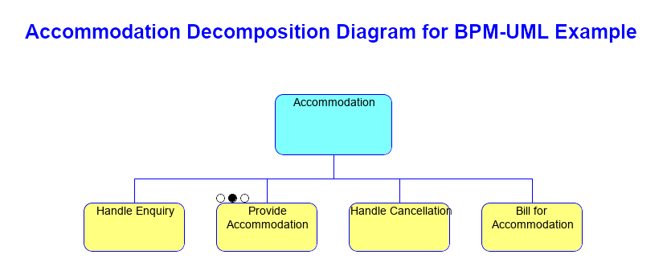
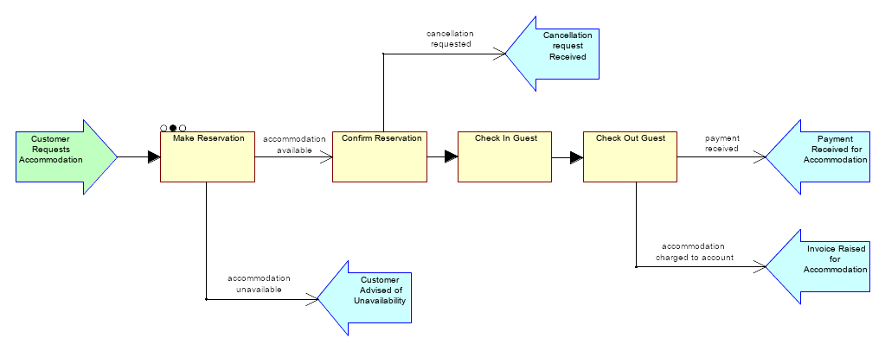
Business Process Model

Slide 6
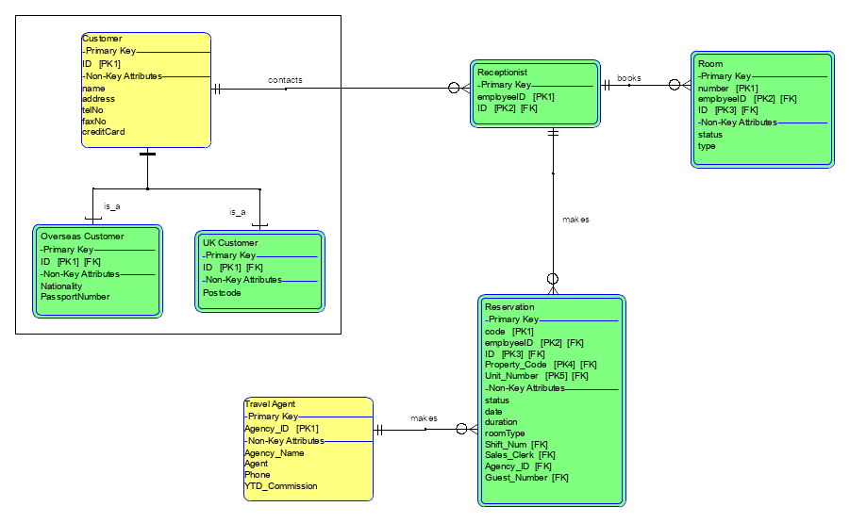
Data Model

Slide 7
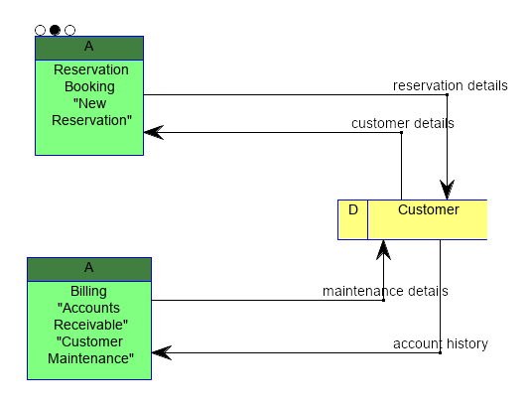
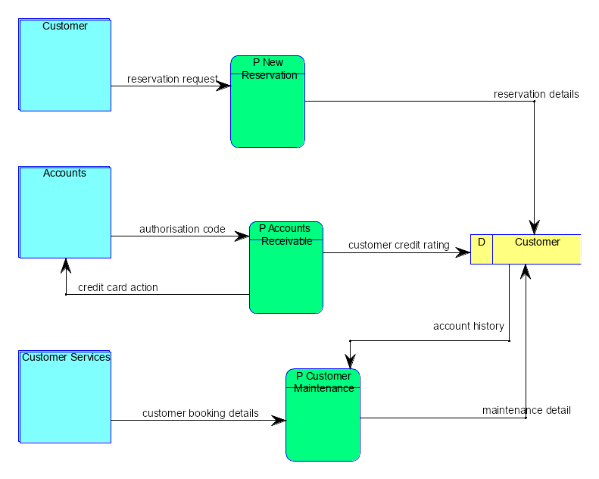
Application Model

Slide 8
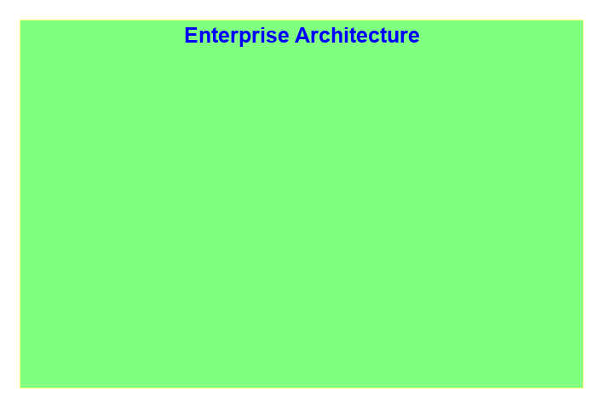
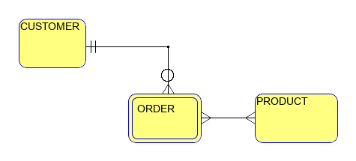
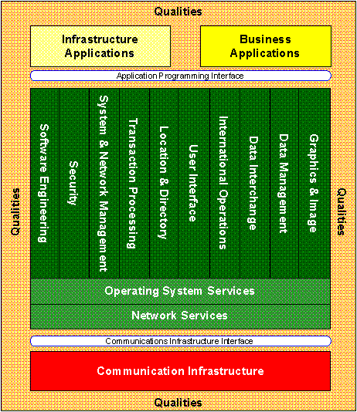
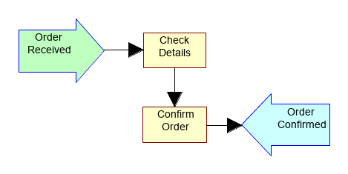
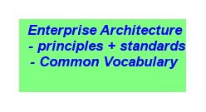
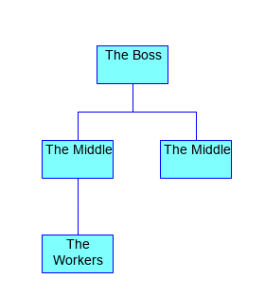
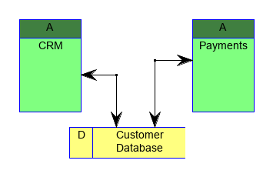
Models in the Enterprise Architecture

Slide 9
Models in the Enterprise Architecture

Slide 10
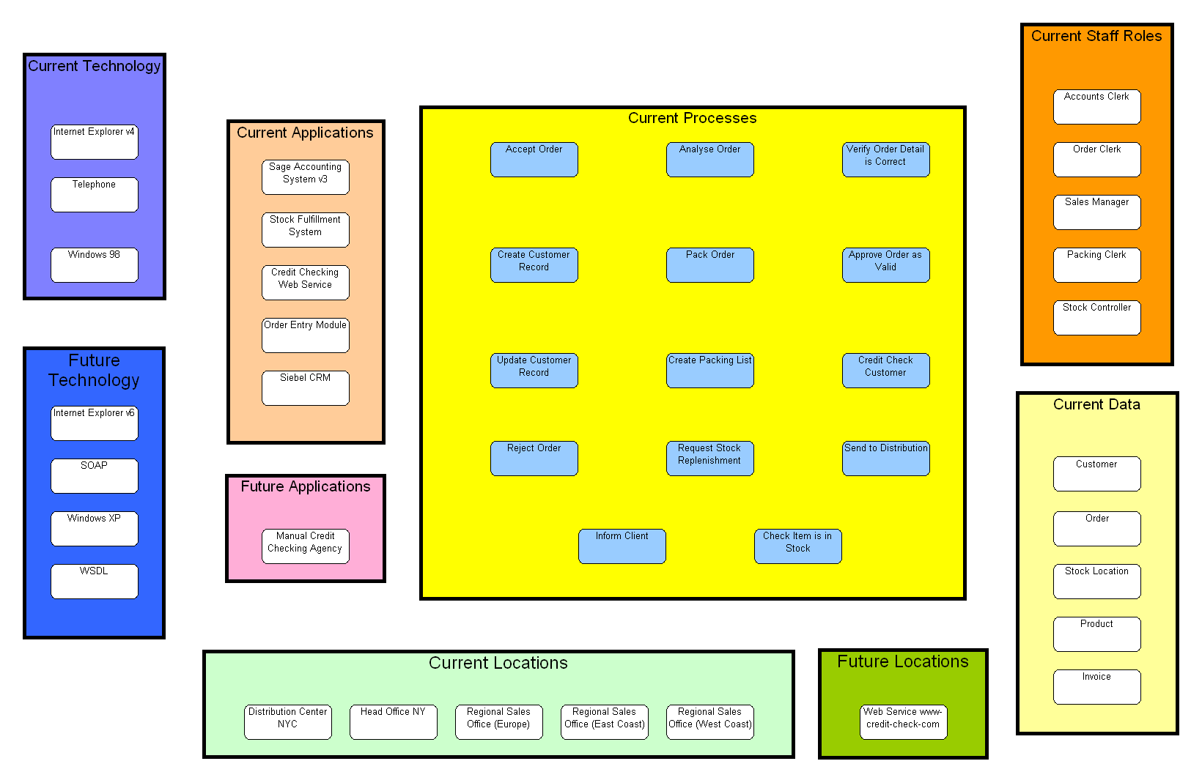
Explorer diagram: objects and collections

Slide 11
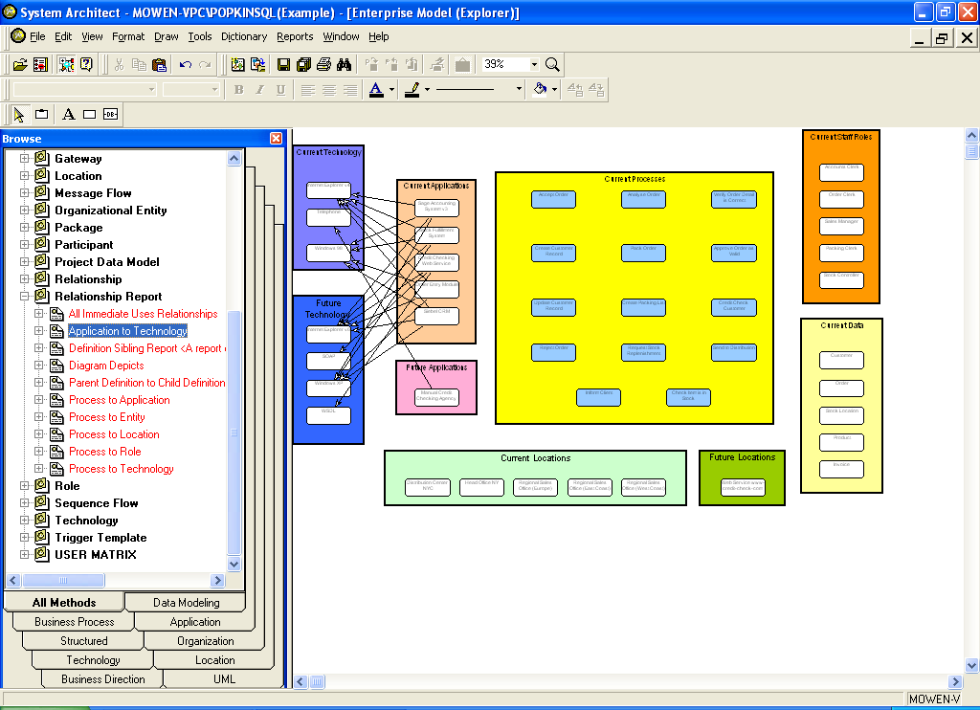
Explorer diagram: applications-technology

Slide 12
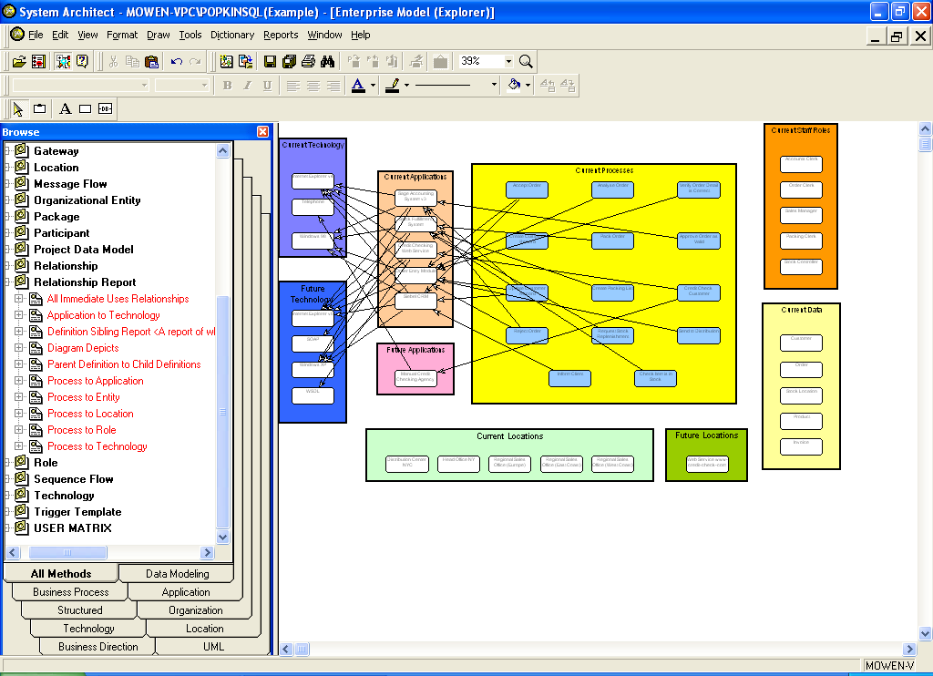
Explorer diagram: applications-processes

Slide 13
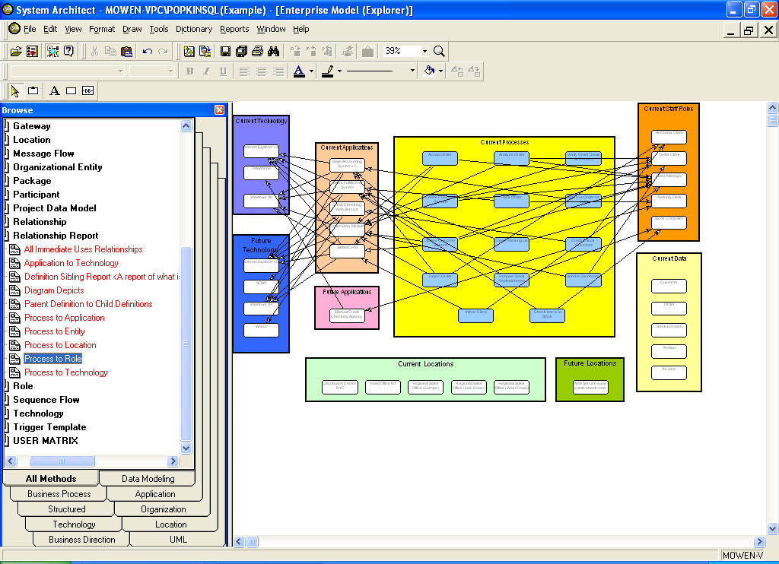
Explorer diagram: processes-roles

Slide 14
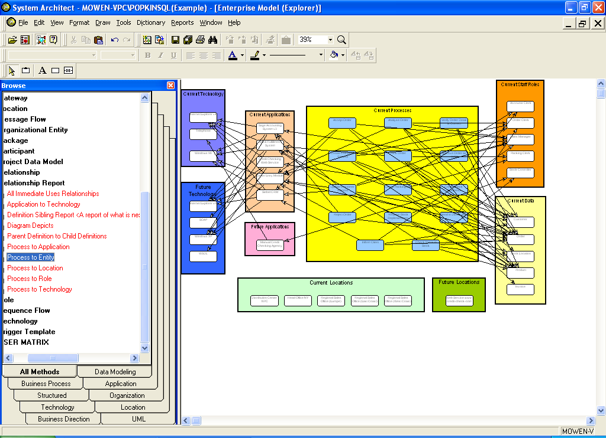
Explorer diagram: processes-data entities

Slide 15
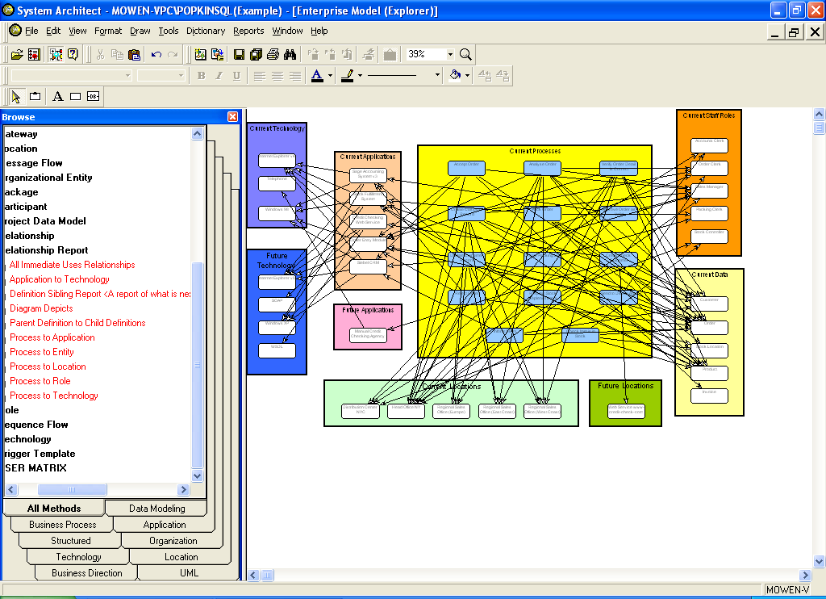
Explorer diagram: processes-locations

Slide 16
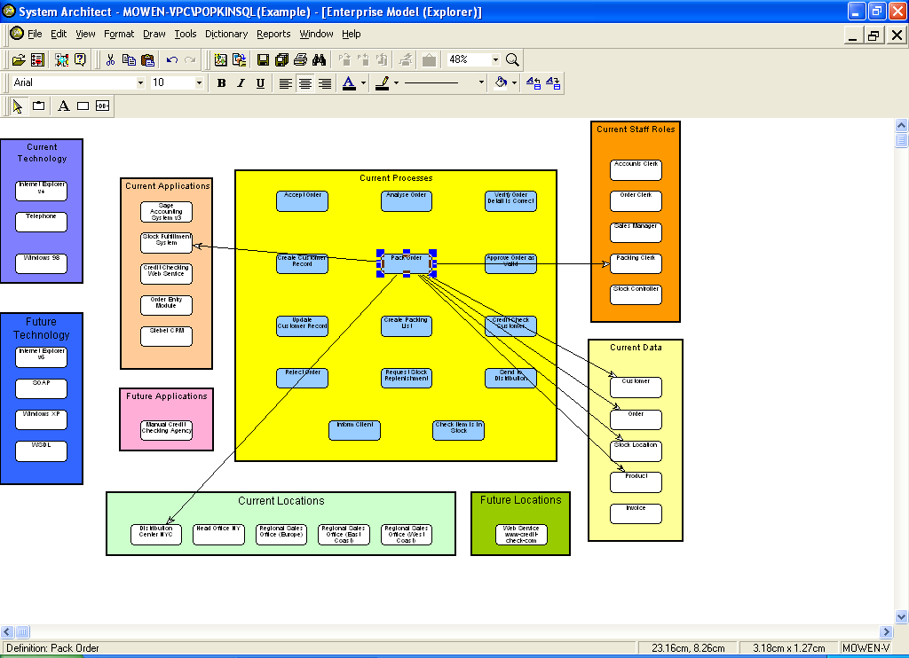
Explorer diagram: one process with relationships

Slide 17
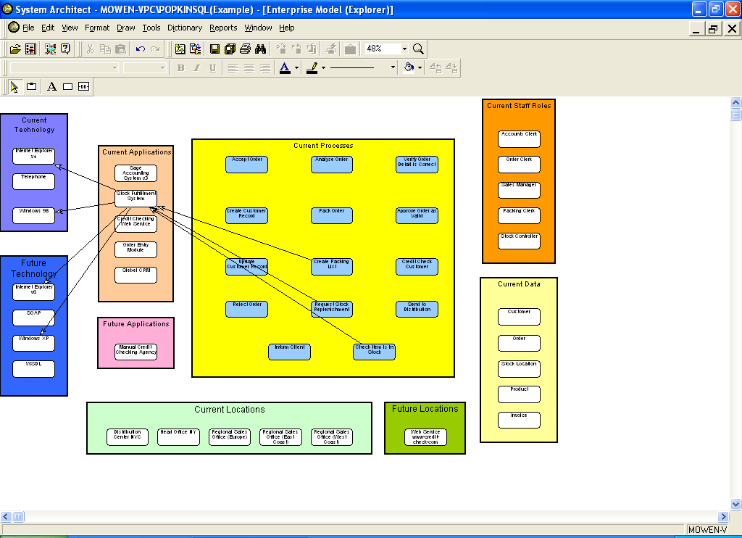
Explorer diagram: one application with relationships

Slide 18
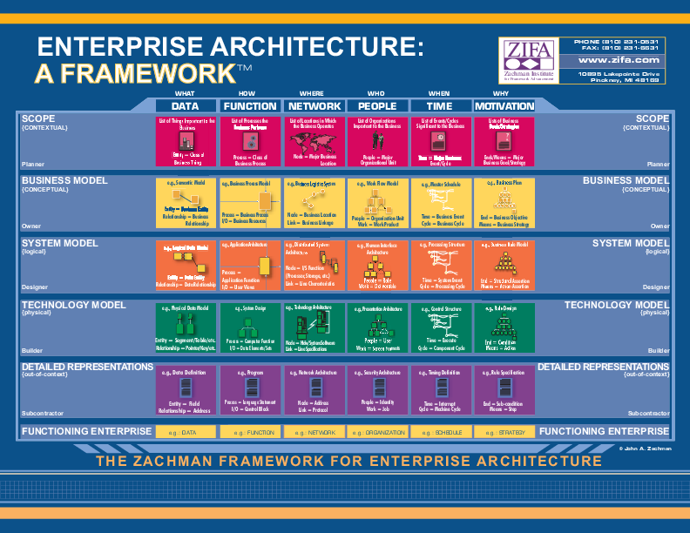

Slide 19
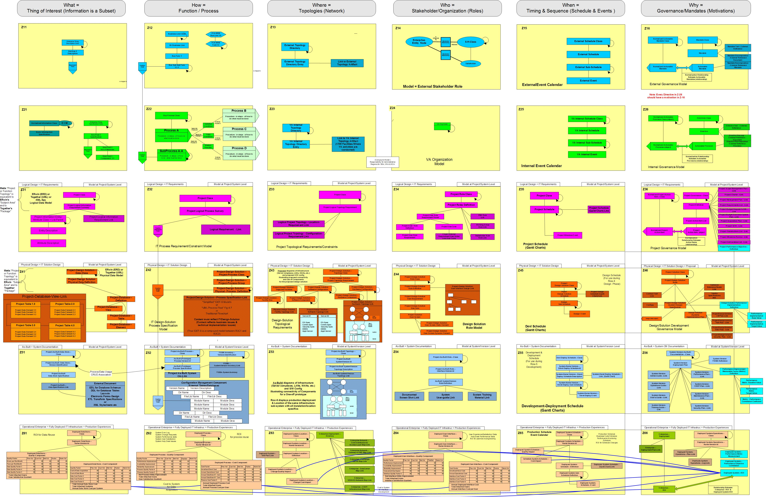

Slide 20


IDEF
Arsitektur informasi adalah rancangan terstruktur dari lingkungan informasi.
Definisi Fungsi dengan IDEF0
Definisi Informasi dengan IDEF1
Pemodelan Fungsi (IDEF0)
Pemodelan Informasi (IDEF1)

Slide 21
Permodelan Proses Bisnis

Slide 22
Bisnis Proses
Proses bisnis merupakan sekumpulan perkerjaan atau aktivitas yang terstruktur dan saling berkaitan untuk menyelesaikan suatu masalah atau untuk menghasilkan produk ataupun layanan (untuk meraih sebuah tujuan tertentu).

Slide 23
Jenis Proses Bisnis
Proses manajemen merupakan sebuah proses yang mengendalikan oprasional sebuah sistem. Misalnya Manajemen Strategis
Proses operasional merupakan sebuah proses yang mempunyai bisnis inti dan meliputi aliran nilai utama. Misalnya proses pembelian, manufaktur, pengiklanan dan pemasaran, dan penjualan.
Proses pendukung, yang mendukung proses inti. Misalnya rekrutmen, akunting, pusat bantuan dll.

Slide 24
Business Process Lifecycle
Model and
Redesign
Simulate and
Optimize
System Architect
Measure
Execute

Slide 25
Purposes of Process Modeling
Communication, simulation, activity-based costing…
Detailed Models
including
Data types, conditions, data mappings, fault handling…
Integration, testing, deployment…

Slide 26

How to engage in BPM?
Process identification
Process discovery (as-is)
Process analysis
Process redesign (to-be)
Process implementation
Process monitoring/controlling
Process Modeling Tools
Process Management Systems

Slide 27
Business process modelling with UML
Is a single modeling language enough?
  UML describes system behavior (Zachman Rows 4 & 5)
  Existing UML extensions for business modeling are described in terms of OO concepts, with which most business users are unfamiliar
  A single modeling language to span all the abstractions required by business users, analysts, systems designers and developers is open to interpretation
Using UML to describe Scope or Enterprise perspectives:
  Takes it out of its original domain; and
  Requires us to map the existing symbol set onto different concepts

Slide 28
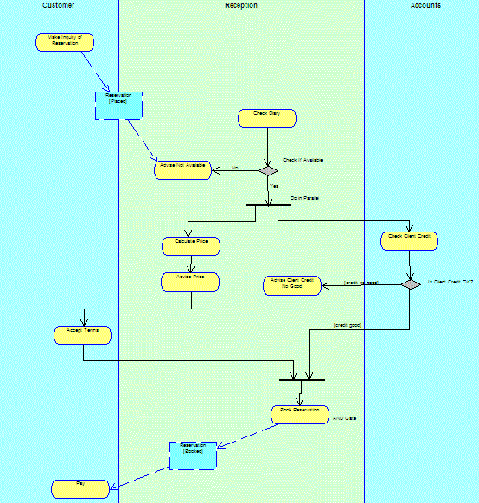
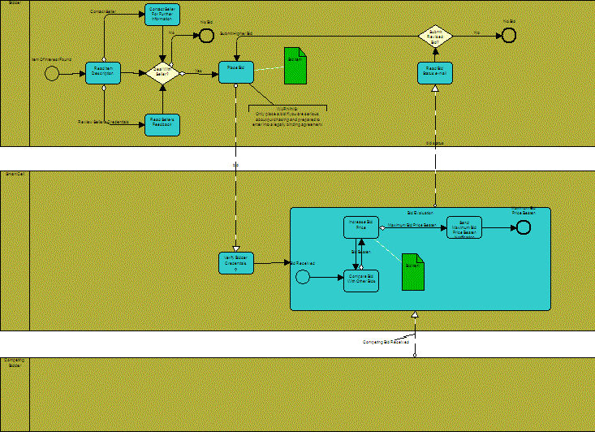
(UML) Activity diagram vs (BPMN) Process diagram

Slide 29
BPMN and UML co-existence
BPMN and UML will co-exist
OMG and potential for BPMN-UML convergence
Technical users may continue to use UML
BPMN can be used to drive solutions that will run directly on a BPMS
BPMN can be used as a business analysis front end for subsequent systems development using UML
  UML users would then regard business processes merely as another type of component

Slide 30
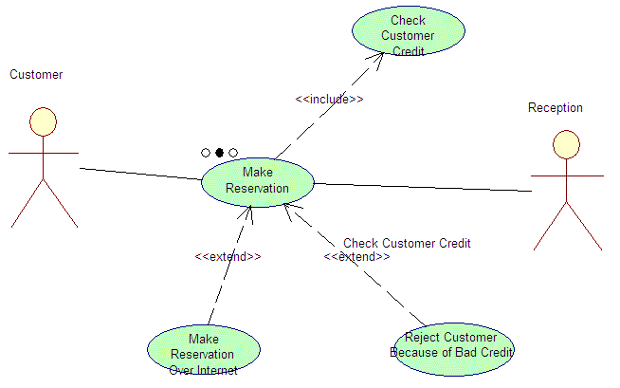
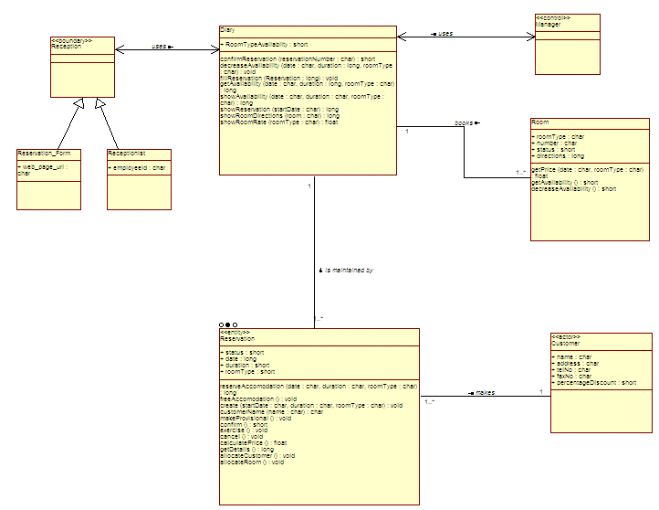
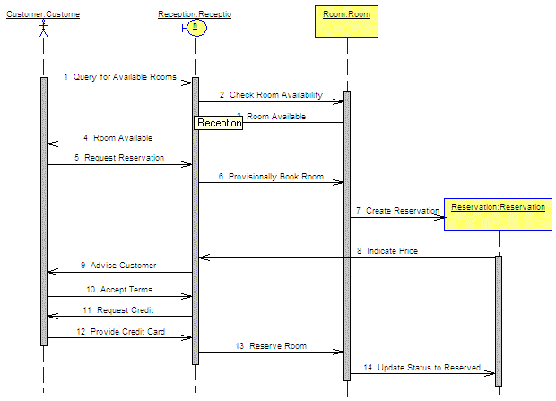
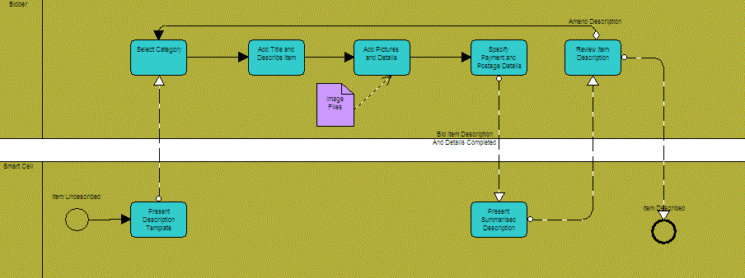
UML – Aggregation of multiple diagrams
Grady Booch and OMT
OMT and Grady Booch
Ivar Jacobson
James Odell and Oracle
Process-centric – single diagram type from which multiple views can be derived

Slide 31
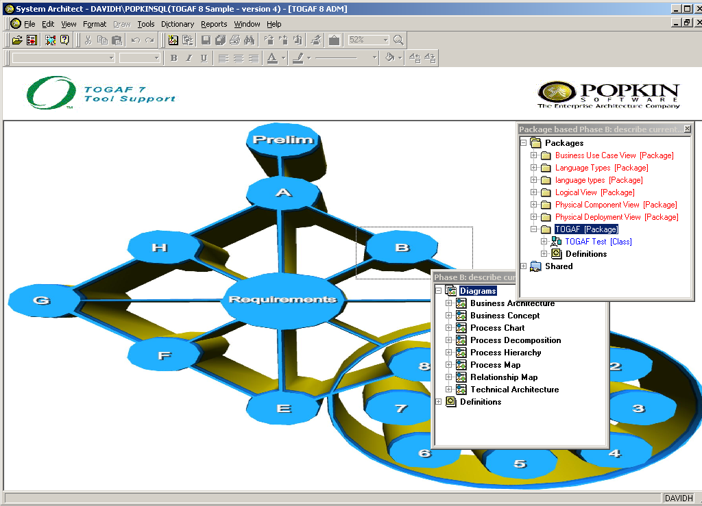
BPMN + UML + TOGAF in SA
Phase B – Business Architecture

Slide 32
BPMN + UML + TOGAF in SA

Slide 33
BPMN + UML + TOGAF in SA

Slide 34
UML – Aggregation of multiple diagrams
Grady Booch and OMT
OMT and Grady Booch
Ivar Jacobson
James Odell and Oracle
Process-centric – single diagram type from which multiple views can be derived

Slide 35
(UML) Activity diagram vs (BPMN) Process diagram

Slide 36
Business process modelling with UML
Is a single modeling language enough?
  UML describes system behavior (Zachman Rows 4 & 5)
  Existing UML extensions for business modeling are described in terms of OO concepts, with which most business users are unfamiliar
  A single modeling language to span all the abstractions required by business users, analysts, systems designers and developers is open to interpretation
Using UML to describe Scope or Enterprise perspectives:
  Takes it out of its original domain; and
  Requires us to map the existing symbol set onto different concepts

Slide 37
BPMN and UML co-existence
BPMN and UML will co-exist
OMG and potential for BPMN-UML convergence
Technical users may continue to use UML
BPMN can be used to drive solutions that will run directly on a BPMS
BPMN can be used as a business analysis front end for subsequent systems development using UML
  UML users would then regard business processes merely as another type of component

Slide 38
Ekosistem BPMN

Slide 39
BPM, BPMN & BPEL defined
BPM Business Process Management | A management approach focused on aligning all aspects of an organization based on the wants and needs of clients.
BPMN Business Process Modeling Notation | A graphical representation for specifying business processes in a business process model.
BPEL Business Process Execution Language | A standard executable language for specifying actions within business processes with web services, created by the Organization for the Advancement of Structural Information Standards.
BPE Business Process Execution | Supports web-service languages for process definition and execution. Supports BPEL.
BRP Business Rules Processing | Infers outcomes based on data and operation results from previous business process executions (Business Rules Engine).

Slide 40




Business Process Management
Business
Process
Models
(BPMN)
Business Process Management (BPM) concerns with managing change to improve business processes.
Develop, Design and Optimise Process Models
System
Architect
Capture WSDL
Produce
Web Service
Description
Language
Business
Process
Execution
Language
Deploy And Execute
Business
Process
Management
Server

Slide 41
Business Process Management
Business
Process
Models
(BPMN)
Develop, Design and Optimise Process Models
System
Architect
Capture WSDL
Produce
Web Service
Description
Language
Business
Process
Execution
Language
Deploy And Execute
Business
Process
Management
Server

Slide 42
BPMN Summary
BPMN is designed to enable
  Modelling of simple and complex business processes
  Offers the capability to model the exchange of messages involved in web services delivery
  Supports generation of Business Process Execution Languages (BPEL)
It is expected to become the new standard to model business processes and web services

Slide 43
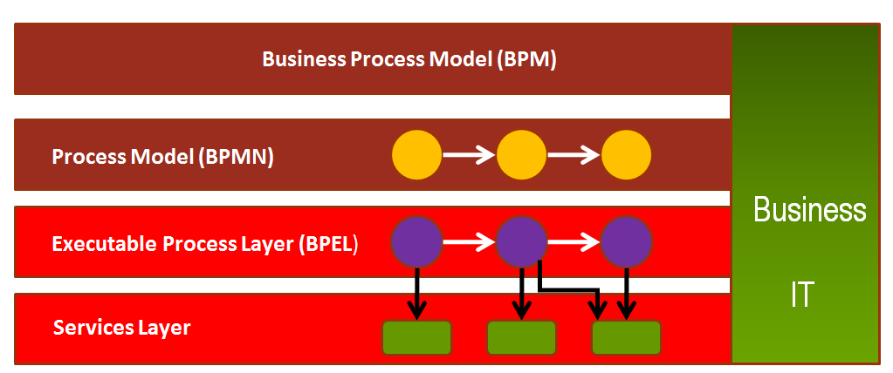
How does it all fit together?
BPM
BPMN

Slide 44
Business Process Lifecycle
Model and
Redesign
Simulate and
Optimize
System Architect
Measure
Execute

Slide 45
Key Components in Business Process Execution
Application Development
  concerned with modelling business processes
  description of web services
Generation of Business Process Execution Language (BPEL)
  production of executable code
Business Process Execution
  running the BPEL code

Slide 46
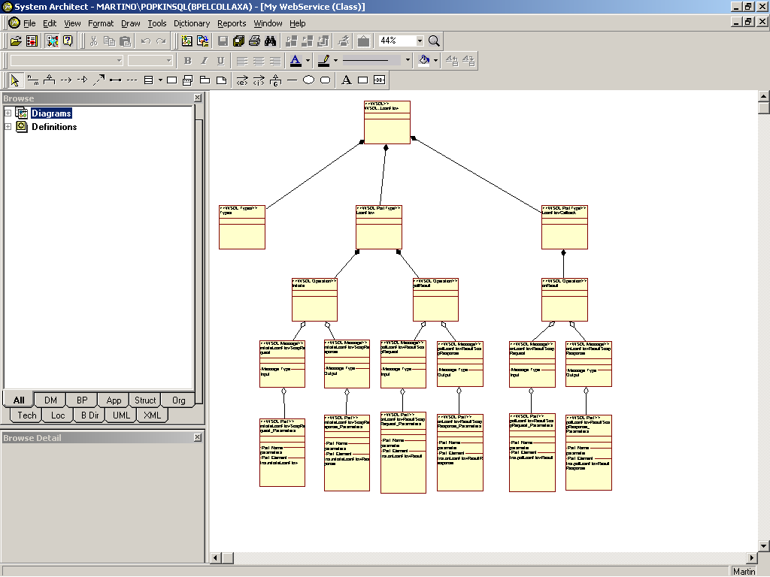

Application Development – description of Web Services
WSDL describes web services
  WSDL stands for Web Services Description Language.
What is WSDL?
  an XML document
  used to describe Web services
  used to locate Web services
  Expose service operations
Import the WSDL into System Architect as an XML Schema Hierarchy
Web Service
Need to relate business processes to the web services that they call
Use in the business process models to describe the method of execution

Slide 47
Application Development – Business Process Models
The “Functions” described in the XML hierarchy are re-used as UML Class Methods by dragging and dropping into BPMN Processes and Message Flows.

Slide 48
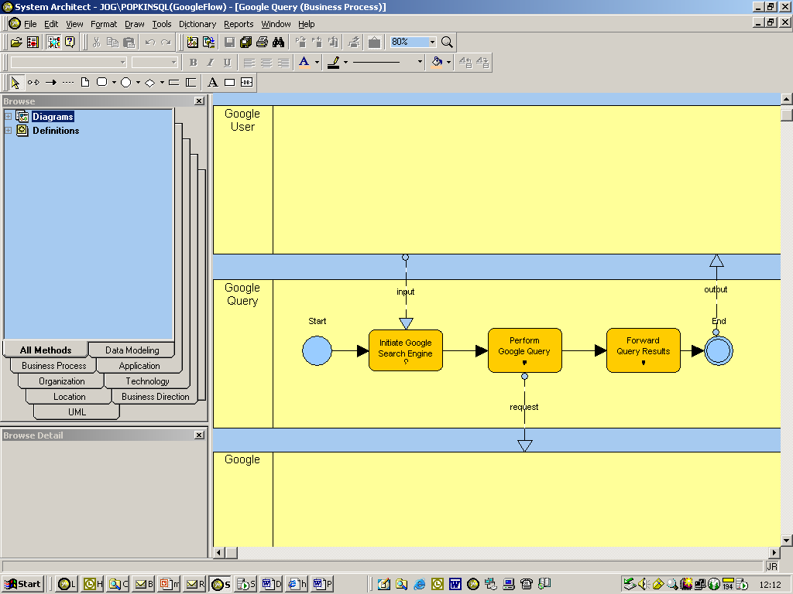
Business Process Modelling
Design and develop business processes using BPMN and utilising WSDL
“Functions” described in the XML hierarchy re-used as UML Class Methods by drag and dropping into BPMN Processes and Message Flows.

Slide 49
Generate Business Process Execution Language
What is BPEL?
  Stands for Business Process Execution Language and is used for describing the execution of business processes
  provides an XML notation and semantics for specifying business process behaviour based on Web Services as an Is an XML document.
  A BPEL process is defined in terms of its interactions with partners
  BPEL orchestrates Web Services by specifying the order in which it is meaningful to call services
  It assigns responsibilities for each of the services to partners
  It is used to specify both the public interfaces for the partners and the description of the executable process

Slide 50
Deploying BPEL
Generate BPEL from the BPMN Models
BPEL is intended to be platform independent.
Execution bindings to specific hardware/software platforms and other mechanisms required for a complete runtime environment for process implementation need to be specified prior to running.

Slide 51
BPEL Engines
Microsoft BizTalk
Collaxa
Intalio
IBM WebSphere
……

Slide 52
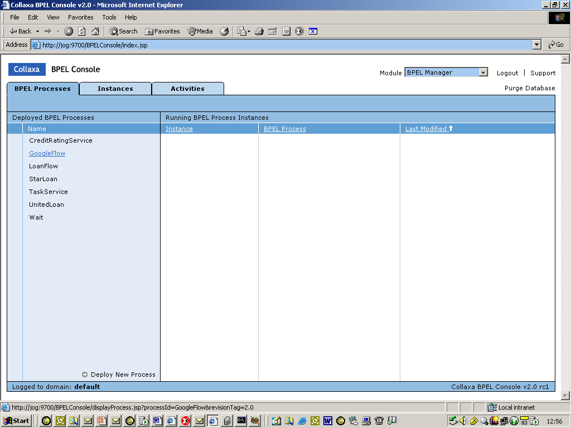
Execution of BPEL
Load the business processes into the server
Example of business process ready for execution within Collaxa BPM Server

Slide 53
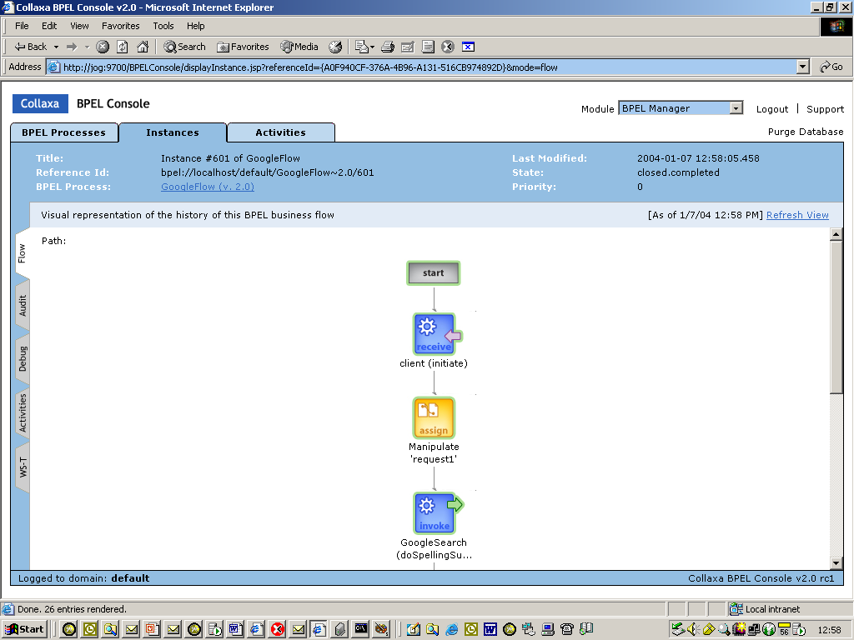
Example execution of BPEL
Example showing diagrammatically the status of one instance of execution of the process

Slide 54
BPMN and the future
Vendors are expected to provide support for
Simulation of BPMN processes
Generation of Business Process Execution Languages
Integration into workflow management tools

Slide 55
Notasi BPMN

Slide 56




Why is BPMN needed?
…… oh no not another new standard!

Slide 57
Business Process Modeling Notation
(BPMN)
OMG Standard, supported by many tools:
  Bizagi Process Modeller
  Signavio (http://www.signavio.com/)
  TIBCO Business Studio (free download, quite large)
  IBM Websphere Business Modeler
  ARIS
  Oracle BPA
  Business Process Visual Architect (Visual Paradigm)
  Progress Savvion Business Modeller

Slide 58
What is BPMN?
BPMN – acronym for Business Process Modeling Notation
New standard for modeling business and web service processes
Provides users with an industry standard set of diagramming syntax and semantics, through a graphical diagram to facilitate the representation of business processes
Owned by BPMI – www.BPMI.org - the Business Process Management Initiative

Slide 59
BPMN : Business Process Modelling Notation
New standard for modeling business and web service processes, Standardized by OMG versi 1.2
To gain sight and control of the business process.
To provide a service orchestration layer in SOA implementation.
Graphical notation for conceptual processes. Provides users with an industry standard set of diagramming syntax and semantics, through a graphical diagram to facilitate the representation of business processes
Covers control, data, authorization, exception
BPMN helps with Process
  Design
  Deployment
  Execution
  Maintenance
  Optimization
more Trackpoints
Issue
Log Trackpoint
Trackpoint
Order Entry
Notice
Create
Acceptance
Freight delivered
Certificate
Initiate
Shipment
24
hours
Status Inquiry

Slide 60
Notasi BPMN
Provide a notation
that is readily understandable by a business audience
capable of providing technical detail for the purposes of implementation
that supports generation of XML based execution languages such as Business Process Execution Language (BPEL)

Slide 61
Why is BPMN needed?
Provide a standard where there hasn’t been a standard
BPMN helps with Process
  Design
  Deployment
  Execution
  Maintenance
  Optimization
Aid interoperability between Business Process Management tools
  Support generation of process execution languages
BPMN is a core enabler for Business Process Management (BPM) which is concerned with managing change to improve business processes.

Slide 62
Goals of BPMN
Provide a notation
that is readily understandable by a business audience
capable of providing technical detail for the purposes of implementation
that supports generation of XML based execution languages such as Business Process Execution Language (BPEL)

Slide 63

BPMN from 10 000 miles…
A BPMN process model is a graph consisting of four types of elements (among others):

Slide 64
How do we get to a model-driven environment?
A BPMN model captures business processes transfers them to a Business Process Automation engine in a BPMN-executable serialization format.
Depending on the tool, it may also be:
  Transferred as an XML Process Definition Language (XPDL) format.
  Translated into the BPEL specification.
  Captured in one of the business rules languages.

Slide 65
Business Process Model Notation (BPMN)
Business Process Model and Notation (BPMN) adalah representasi grafis untuk menentukan proses bisnis dalam model proses bisnis.
Tujuan dari BPMN adalah untuk mendukung manajemen proses bisnis, baik untuk pengguna teknis dan pengguna bisnis, dengan menyediakan notasi yang intuitif untuk pengguna bisnis, namun dapat mewakili semantik proses yang kompleks.

Slide 66
Business Process Model Notation (BPMN)
Tujuan utama dari BPMN adalah untuk memberikan notasi standar yang mudah dipahami oleh semua pemangku kepentingan bisnis. Ini termasuk analis bisnis yang membuat dan menyempurnakan proses, para pengembang teknis bertanggung jawab untuk menerapkannya dan manajer bisnis yang memantau dan mengelola. Akibatnya BPMN berfungsi sebagai bahasa umum, menjembatani kesenjangan komunikasi yang sering terjadi antara desain proses bisnis dan Implementasi.
Sejak 2014, BPMN telah dilengkapi dengan standar baru untuk membangun model keputusan, Model Keputusan dan Standar Notasi.

Slide 67
Elemen Model BPMN
Elemen | Definisi | Jenis
Flow Object | Elemen utama yang menggambarkan karakteristik dari sebuah proses bisnis. | Event Activities Gateways
Connecting Object | Elemen yang menghubungkan Flow object. | Sequence Flow Message Flow Association
Swimlane | Pengelompokan dari beberapa model elemen. | Pools Lanes
Artifacts | Elemen yang digunakan untuk memberikan informasi tambahan dari sebuah proses. | Annotation Group Data Object Data Store

Slide 68
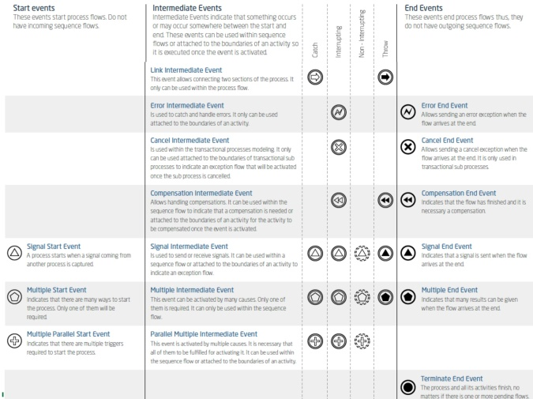

Slide 69
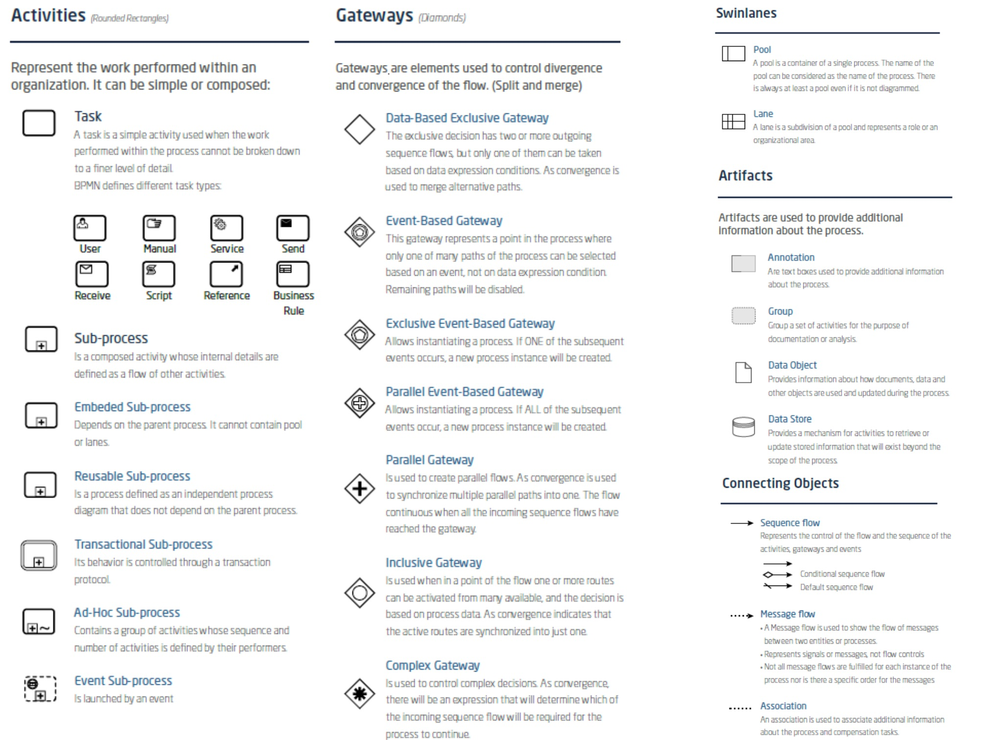

Slide 70
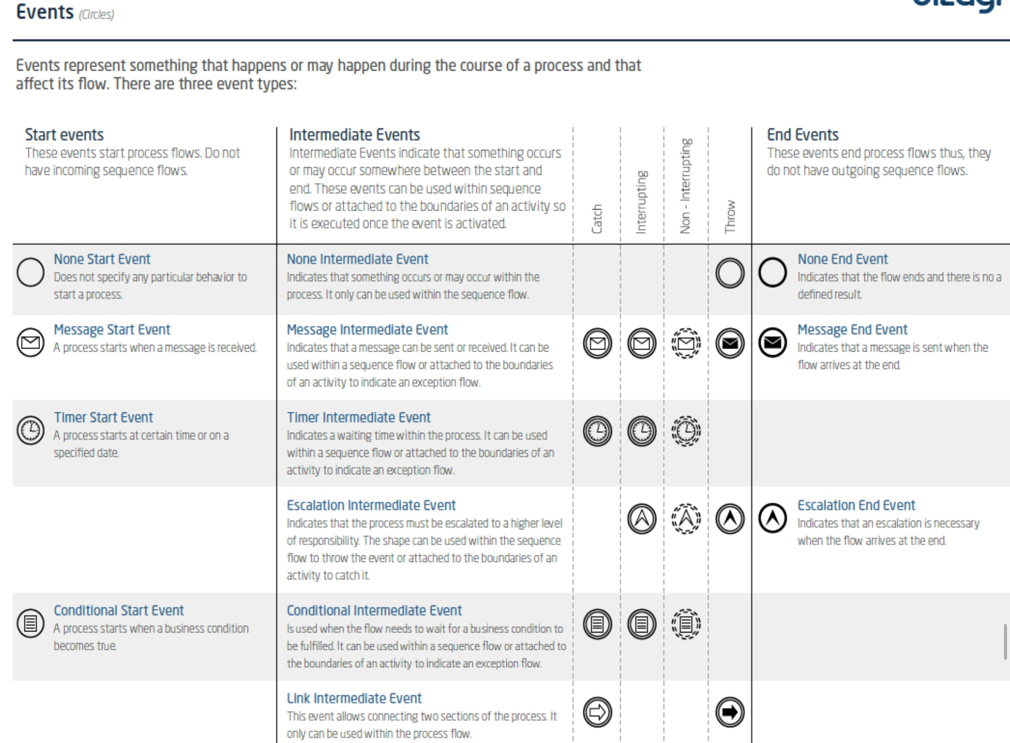

Slide 71
Modelling with BPMN – Control Flow
Activities
task
loop
collapsed
ad
-
hoc
multi
-
instance
sub
-
process
sub
-
process
task
+
~
+

Slide 72

Flow Object
Event
Event adalah sesuatu yang terjadi selama rangkaian dari sebuah business proses. Event mempengaruhi alur dari proses dan biasanya memiliki sebuah tindakan atau sebuah hasil. Simbolnya adalah bentuk lingkaran dan berdasarkan alur pengaruhnya, terdapat 3 jenis event yaitu:
Start event: simbol yang mengindikasikan sebuah proses yang akan dimulai
Intermediate event: terletak antara Start Event dan End Event. Simbol ini akan mempengaruhi alur proses, tetapi tidak akan memulai atau secara langsung menghentikan proses
End event: di indikasikan sebagai simbol untuk mengakhiri sebuah proses

Slide 73
Flow Object
Activities
Activities digunakan untuk mewakili berbagai makna dalam kehidupan sehari-hari. Aktivitas dianggap mencakup berbagai kegiatan yang dapat diselesaikan dalam waktu 5 menit, satu minggu atau lebih.

Slide 74
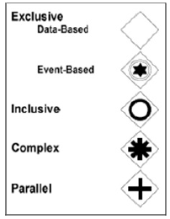
Flow Object
Gateways
Gateway adalah pemodelan elemen yang digunakan untuk mengontrol bagaimana Sequence Arus berinteraksi saat mereka berkumpul (Converge) dan menyimpang (diverge) dalam Proses
Semua jenis Gateways bentuknya adalah belah ketupat

Slide 75
Flow Object
Gateways
Gateways Eksklusif (Decision) adalah lokasi dalam suatu proses bisnis di mana Arus Sequence bisa mengambil dua atau lebih jalur alternatif. Hal ini pada dasarnya adalah "pertigaan jalan" untuk proses. Hanya salah satu jalan keluar mungkin dapat diambil ketika Proses dilakukan.
Inclusive Gateways adalah decision di mana ada lebih dari satu kemungkinan hasil.
Complex Gateways adalah decision di mana ada definisi advance perilaku dapat didefinisikan.

Slide 76
Connecting Object
Connecting Object
Connecting Object adalah elemen yang menghubungkan Flow object. Connecting Object juga memiliki 3 jenis elemen yaitu :
Alur Sequence (Sequence flow) digunakan untuk menunjukkan urutan yang kegiatan akan yang dilakukan dalam sebuah proses.
Alur Pesan (Messege Flow) digunakan untuk menunjukkan aliran pesan antara dua entitas yang siap untuk mengirim dan menerima.
Asosiasi (Association) digunakan untuk asosiasi data, informasi dan artefak dengan aliran benda

Slide 77
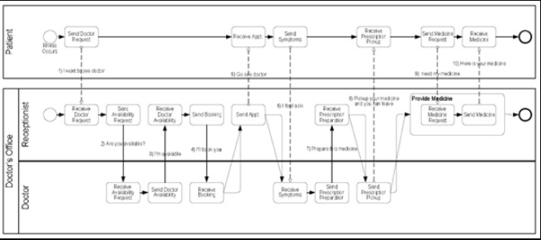
Swimlanes
Swimlanes
Swimlanes adalah pengelompokan dari beberapa model elemen.
Swimlines digunakan untuk memisahkan dan mengatur kegiatan oleh peserta sehingga kita secara intuitif dapat memahami siapa yang bertanggung jawab untuk setiap event.
Swimlines ada 2 jenis yaitu :
Pools: Semua Bisnis Flow Diagram mengandung setidaknya satu Pool
Lanes: Pool yang dibagi lagi menjadi sub Swimlanes

Slide 78
Artifacts
Artifacts
Artfacts adalah elemen yang digunakan untuk memberikan informasi tambahan dari sebuah proses. Bentuk dan penggunaan artifacts itu bermacam-macam dan bisa lebih luas tergantung dari standar pengertian BPMN yang digunakan.
Saat ini terdapat 3 setingan pengaturan artifacts, yaitu :
Data Object
Group
Annotations

Slide 79
Modelling with BPMN – Control Flow
Events
start event
decorations:
message
intermediate
event
error
end event
time

Slide 80
Modelling with BPMN – Control Flow
Gateways
AND
XOR
Event-based

Slide 81
Modelling with BPMN – Control Flow
Example
more Trackpoints
Issue
Log Trackpoint
Trackpoint
Order Entry
Notice
Create
Acceptance
Freight delivered
Certificate
Initiate
Shipment
24
hours
Status Inquiry

Slide 82
Modelling with BPMN – Data
Example
Trackpoints
Trackpoint Notices
Trackpoint Order
Acceptance Certificate
Entries Log
more Trackpoints
Issue
Log Trackpoint
Trackpoint
Order Entry
Notice
Create
Acceptance
Freight delivered
Certificate
Initiate
Shipment
24
hours
Status Inquiry

Slide 83
Modelling with BPMN – Resource
Example
more Trackpoints
r
e
i
r
r
Issue
a
C
Trackpoint
Notice
r
n
r
e
i
e
Log Trackpoint
i
c
r
m
i
r
d
f
Order Entry
a
A
f
C
O

Slide 84
Modelling with BPMN – Exception
Exception events
'Throw' events
'Catch' events
Throw
Catch
Exception event

Slide 85
Modelling with BPMN – Exception
Example
Ordering
O
rder not
Create
Approve
approved
Confirm
Purchase
Purchase
O
rder
Purchase
Order
Order
approved
Order
Modify
Purchase
Order
Order not
Order
approved
timed out

Slide 86
NOTASI
Notasi Inti
Merupakan notasi yang dapat menggmbarkan suatu proses secara sederhana yang terdiri dari : EVENT (Penanda suatu Kejadian), AKTIVITAS (penanda suatu Kegiatan yang dilakukan dalam suatu proses), GATEWAY (penanda pengambilan keputusan atau kontrol alur kegiatan), PENGHUBUNG, (penanda yang menunjukkan hubungan antar elemen proses) dan POOL (suatu bidang gambar berupa kotak persegi panjang yang menjadi area penulisan diagram tatalaksana)

Slide 87
NOTASI (lanjutan …)
Contoh :
Kumpulkan bukti transaksi
Tidak
Terima Tagihan
Persetujuan
Pembayaran
ya
Selesai
Mulai
Gambar Diagram
Proses Sederhana Menggunakan Notasi Inti

Slide 88
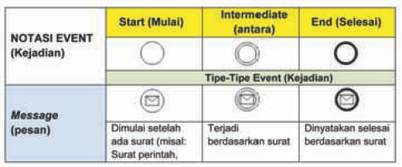
Event
Berdasarkan kapan terjadinya :
Mulai (start), Antara (Intermediate), Selesai (End)

Slide 89
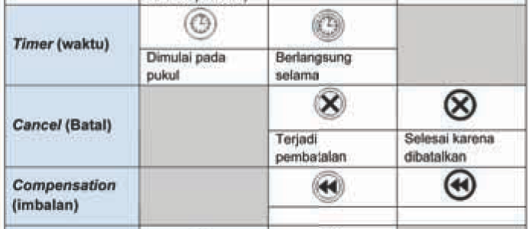
Event (lanjutan…)

Slide 90
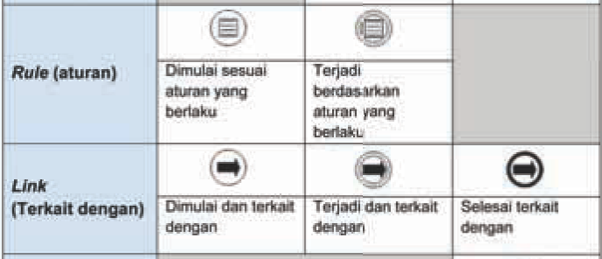
Event (lanjutan…)

Slide 91
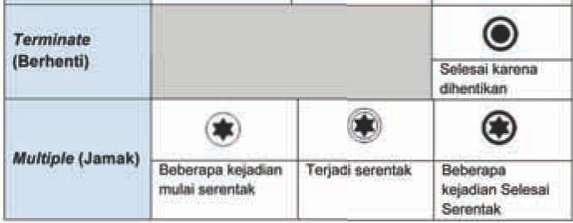
Event (lanjutan…)

Slide 92
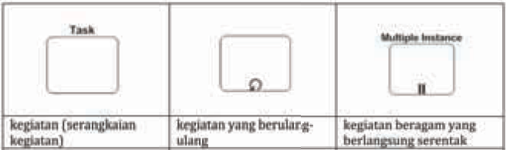
Aktivitas
Aktivitas dalam suatu proses dapat merupakan suatu kegiatan Tunggal (atomic) dapat pula merupakan suatu kumpulan kegiatan atau disebut sebagai Subproses (non atomic)

Slide 93
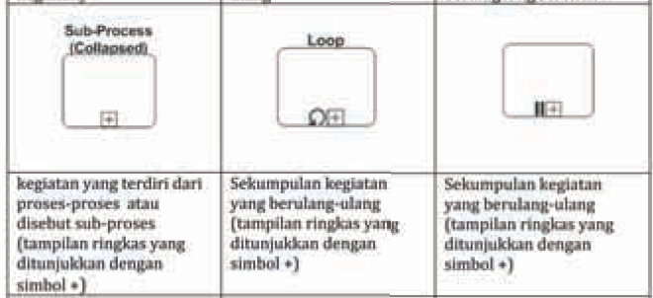
Aktivitas (lanjutan…)

Slide 94
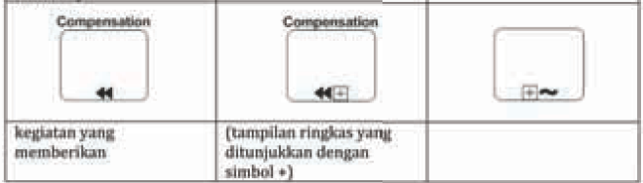
Aktivitas (lanjutan…)
Ad hoc

Slide 95
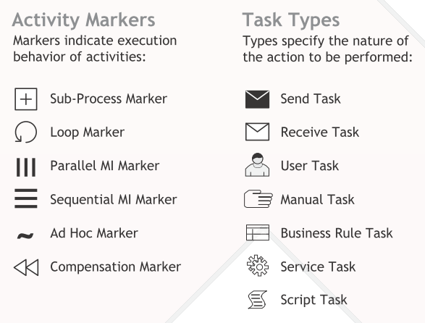
Aktivitas (lanjutan…)

Slide 96
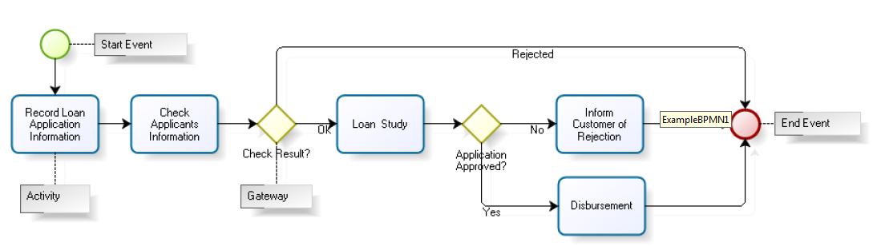
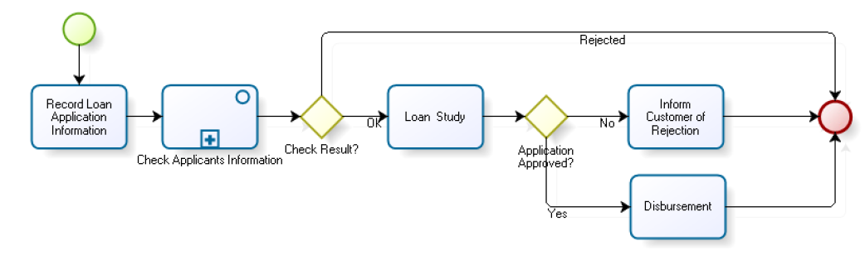
Aktivitas (lanjutan…)
Contoh :
Sub Proses

Slide 97
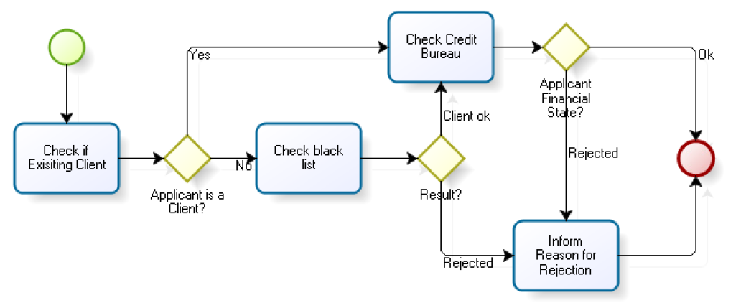
Aktivitas (lanjutan…)
Contoh :
Check Applicants
Subprocess

Slide 98

Aktivitas (lanjutan…)
Contoh :

Slide 99


Disbursement Subprocess

Slide 100

Automatic Activities

Slide 101

Disbursement with Some Type of Tasks

Slide 102

Disbursement with Timer

Slide 103
Notasi Penghubung
Sequence Flow
Menunjukkan kegiatan yang dituju semata-mata merupakan kelanjutan kegiatan sebelumnya.
Message Flow
Menunjukkan adanya aliran pesan dimana proses yang dituju bukan kelanjutan proses sebelumnya.
3. Associate Flow
Menunjukan bentuk hubungan antara dua proses atau kegiatan.

Slide 104

Notasi Penghubung (lanjutan…)

Slide 105
Notasi Gateway
Exclusive Decision
Pengambilan keputusan karena tergantung dari kondisi atau masukan sebelumnya.
Event
Pengambilan keputusan bergantung dari adanya event (misalnya harus ada surat keputusan).
3. Paralel
Pengambilan keputusan hanya dilakukan bila seluruh kegiatan sebelumnya sudah diterima lengkap.

Slide 106

Notasi Gateway (lanjutan…)
(Merge/(xor))
(Merge/(xor))
(Event based)
(Merge/(or))
(Merge)
(Joint/(And))

Slide 107
Notasi Pool
Notasi Pool
Bagian inti merupakan kerangka yang menunjukkan suatu proses atau kegiatan dikerjakan oleh siapa. Satu pool untuk merepresen- tasikan satu unit kerja, fungsi atau jabatan tertentu.
Swimlane
suatu proses dikerjakan oleh suatu unit kerja, fungsi atau jabatan tertentu.
Lane
(gabungan beberapa pool) menunjukkan adanya beberapa proses pada suatu unit kerja yang masing-masing dikerjakan oleh satu jabatan unit kerja tersebut.

Slide 108


Notasi Pool (lanjutan…)
Notasi Pool

Slide 109
Pengajuan Kredit
Contoh :
Proses permohonan kredit dimulai dengan pencatatan aplikasi di mana klien menyatakan minat untuk memperoleh kredit
Tahap ini termasuk penyampaian aplikasi, dan dokumen yang diperlukan untuk verifikasi
Dilanjutkan dengan analisis kelayakan terhadap aplikasi kredit dan akhirnya keputusan untuk menerima atau menolak permohonan kredit.

Slide 110

Pengajuan Kredit (lanjutan…)

Slide 111

Pengajuan Kredit (lanjutan…)

Slide 112

Pengajuan Kredit (lanjutan…)

Slide 113
BPMN

Slide 114

BPMN: standard modeling (diagraming) method
Notes:
In this slide, let’s focus on the design. You see various roles identified using vertical swimlanes. As an example, the first role is the Cashier. The activities performed by this role are shown using various symbols that we will discuss in the next slide. Keep in mind, the role of Cashier is performed by an actor that we define as a person.

Slide 115


As-Is
Business Order Process: Existing Ordering Process
Ought-to-be
Business Order Process:
Improved Ordering Process
Notes:
All activities for a given role are shown in that role’s swim lane. Swim-lane layout simplifies process diagrams and draws attention to interactions among components of the diagram.
Dotted arrows depict the flow of messages and data flows. Solid arrows depict the flow or sequence of the activities in the process.
Three of the activities in the “as-is” diagram contain a square with a plus (+) sign. This notation means that the activity is considered to be independent of this process and is defined in greater detail in another diagram.

Slide 116

Core BPMN elements
For a very thorough tutorial, see http://camunda.org/bpmn/reference/.

Slide 117

Some common BPMN symbols

Slide 118

BPMN events
An event is an indicator that something has happened within a process.

Slide 119

BPMN flows
Sequence Flow, Message Flow and Associations

Slide 120


BPMN gateways
Gateways are decision points where the sequence of activities splits up or recombines
Many types exist, but the most common ones are:
  ×(Exclusive): only one choice can be selected
    This is the default, if no shape is shown
  O (Inclusive): one or more or even all choices might be chosen
  + (Parallel): all choices are carried out in parallel (at the same time)
Default:
Exclusive
Shapes adapted from Wikipedia

Slide 121

Modeling with multiple pools
A pool represents an independent organization
A lane within a pool is an individual actor or role (either a person or an information system) within an organization

Slide 122


Modeling with multiple pools
Each pool gets its own complete process
Every white-box (non-collapsed) pool must have its own start and end events
Sequence flows only occur within pools, never from one pool to another
Only message flows can be used from one pool to another
Source: Camunda

Slide 123



Drawing BPMN diagrams
Microsoft Visio (Windows only)
  60-day free trial
  Available in SCBTM lab (MB 12.314)
  Video tutorial for COMM 226
Free online diagramming tools (any operating system)
  Lucidchart
  Gliffy

Slide 124

An example of BPMN in Visio

Slide 125


Collaboration Exercise 5:
Building project permit process
Figure 5-21: As-is
Figure 5-22: Ought-to-be

Slide 126
BPMN exercise
Based on Collaboration Exercise 5 in PSI pp. 149-151, in groups of 3-4 students, draw the BPMN for Figure 5‑22 only: The permit office made three copies of the permit and distributed one to each department. The departments reviewed the permits in parallel; a clerk would analyze the results and, if there were no rejections, approve the permit.
Draw it on a blank sheet of paper, write all your names and student IDs, then submit it. (You can take a photo so that you have a copy.)

Slide 127
Sources
Most of the slides are adapted from COMM 226 Business Technology Management by David M. Kroenke, Andrew Gemino, Peter Tingling, and Earl H. McKinney, Jr. 2nd Custom Edition for Concordia University (2014) published by Pearson Canada. ISBN 13: 978-1-269-96956-7
BPMN gateway shapes are adapted from Wikipedia
I thank Gregory Kersten and Marc-André Léger for their assistance with various slide content and exercises
Other sources are noted on the slides themselves

Slide 128
Camunda Modeller

Slide 129
Camunda
Camunda Modeller
Camunda BPM Engine
….
Didownload pada
  Versi community (free)
  Versi enterprise

Slide 130
Camunda Modeller
Camunda BPM adalah platform alur kerja sumber terbuka dan otomatisasi pengambilan keputusan.
Camunda BPM dilengkapi dengan alat untuk membuat alur kerja dan model keputusan , mengoperasikan model yang digunakan dalam produksi, dan memungkinkan pengguna untuk menjalankan tugas alur kerja yang ditugaskan untuk mereka.

Slide 131

Penggunaan Camunda
Tampilan awal Camunda

Slide 132







Penggunaan Camunda
Penjelasan tampilan awal Camunda
Start event
End event
Exclusive Gateway
Data
Data Store
Task
Pool

Slide 133


Penggunaan Camunda
Mula-mula tempatkan Start Event dalam Pool. Fungsi Pool mewakili Peserta dalam (B2B) Diagram Bisnis Proses interaktif
Buat Task, lalu hubungkan Start Event dengan task dengan menggunakan Connecting Object. Klik Start Event
kemudian pilih tanda panah arahkan pada Task.
Jika diperlukan Gateway terdapat beberapa pilihan Gateway, cara merubah Gateway yaitu dengan ikon , maka akan muncul seperti gambar disamping

Slide 134

Contoh BPMN Camunda
Buat Pool terlebih dahulu lalu buat menjadi dua line. Terdapat dua peserta pada Pool diatas yaitu Admin dan Pengelola SDM.
Buat Task masing-masing kemudian hubungkan dengan Connecting Object.

Slide 135









Sejarah dan Aktifitas
1979 : Konferensi Komputer Nasiponal (KKN) Pertama di Indonesia,
1980: Konferensi SEARCC 3 di Indonesia
Kode Etik Profesi bidang TIK
Doktoral dan Master Kollokuium, Klinik Jurnal Ilmiah (Dirjen Dikti – HIVOS), Internasional Conference dan Journal Ilmiah
Pemetaan dan survey SDM TIK (Kominfo, Aptikom)
Pengembangan Standard Profesi dari era SRIG-PS 1995 dengan SEARCC, Pengembangan Standard Kompetensi Kerja Nasional Inodnesia (SKKNI, Pemaketan Kerangka Kualifikasi Nasional Indonesia ( KKNI) dan Peta Okupasi (dari tahun 2005) – Kominfo, Kemnaker,
1962, komputer pertama diinstal di Indonesia (PT Stanvac)
1965, kelompok pengguna IBM
20 Mei 1965, Badan Kerjasama Otomasi Negara (BAKOTAN)
18 April 1974 - Himpunan Pengguna Komputer Indonesia (HPKI)
20 Juli 1974 – Ikatan Pengguna Komputer Indonesia (IPKIN)
1975 IPKIN berbadan hukum
1990, Ikatan Profesi Komputer dan Informatika Indonesia
KODE ETIK
Prinsip Standar Teknis
Prinsip Kompetensi
Prinsip Tanggung Jawab Profesi
Prinsip Kepentingan Publik
Prinsip Integritas
Prinsip Objektivitas
Prinsip Kerahasiaan
Prinsip Perilaku Profesional
IPKIN
Ikatan Profesi Komputer dan Informatika Indonesia
http://www.ipkin.or.id
Perjalanan Keprofesian TIK

