Slide 1
BPMN : Business Process Modelling Notation
New standard for modeling business and web service processes, Standardized by OMG versi 1.2
To gain sight and control of the business process.
To provide a service orchestration layer in SOA implementation.
Graphical notation for conceptual processes. Provides users with an industry standard set of diagramming syntax and semantics, through a graphical diagram to facilitate the representation of business processes
Covers control, data, authorization, exception
BPMN helps with Process
  Design
  Deployment
  Execution
  Maintenance
  Optimization
more Trackpoints
Issue
Log Trackpoint
Trackpoint
Order Entry
Notice
Create
Acceptance
Freight delivered
Certificate
Initiate
Shipment
24
hours
Status Inquiry

Slide 2
Notasi BPMN
Provide a notation
that is readily understandable by a business audience
capable of providing technical detail for the purposes of implementation
that supports generation of XML based execution languages such as Business Process Execution Language (BPEL)

Slide 3
BPM, BPMN & BPEL defined
BPM Business Process Management | A management approach focused on aligning all aspects of an organization based on the wants and needs of clients.
BPMN Business Process Modeling Notation | A graphical representation for specifying business processes in a business process model.
BPEL Business Process Execution Language | A standard executable language for specifying actions within business processes with web services, created by the Organization for the Advancement of Structural Information Standards.
BPE Business Process Execution | Supports web-service languages for process definition and execution. Supports BPEL.
BRP Business Rules Processing | Infers outcomes based on data and operation results from previous business process executions (Business Rules Engine).

Slide 4




Business Process Management
Business
Process
Models
(BPMN)
Business Process Management (BPM) concerns with managing change to improve business processes.
Develop, Design and Optimise Process Models
System
Architect
Capture WSDL
Produce
Web Service
Description
Language
Business
Process
Execution
Language
Deploy And Execute
Business
Process
Management
Server

Slide 5
How do we get to a model-driven environment?
A BPMN model captures business processes transfers them to a Business Process Automation engine in a BPMN-executable serialization format.
Depending on the tool, it may also be:
  Transferred as an XML Process Definition Language (XPDL) format.
  Translated into the BPEL specification.
  Captured in one of the business rules languages.

Slide 6
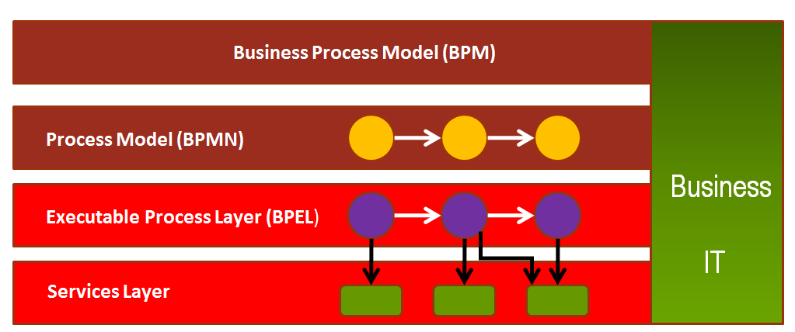
How does it all fit together?
BPM
BPMN

Slide 7
Business process modelling with UML
Is a single modeling language enough?
  UML describes system behavior (Zachman Rows 4 & 5)
  Existing UML extensions for business modeling are described in terms of OO concepts, with which most business users are unfamiliar
  A single modeling language to span all the abstractions required by business users, analysts, systems designers and developers is open to interpretation
Using UML to describe Scope or Enterprise perspectives:
  Takes it out of its original domain; and
  Requires us to map the existing symbol set onto different concepts

Slide 8
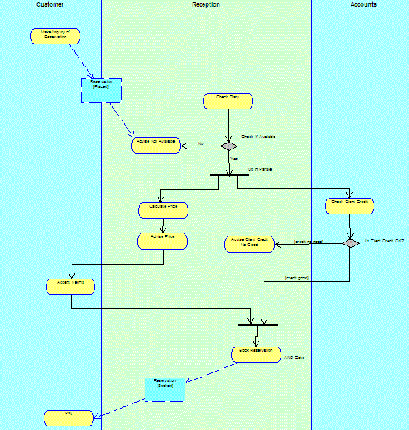
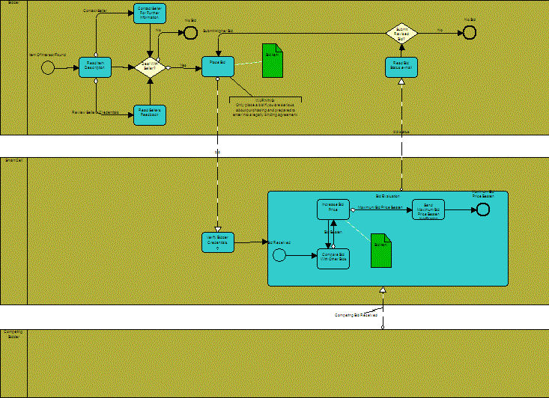
(UML) Activity diagram vs (BPMN) Process diagram

Slide 9
BPMN and UML co-existence
BPMN and UML will co-exist
OMG and potential for BPMN-UML convergence
Technical users may continue to use UML
BPMN can be used to drive solutions that will run directly on a BPMS
BPMN can be used as a business analysis front end for subsequent systems development using UML
  UML users would then regard business processes merely as another type of component

Slide 10
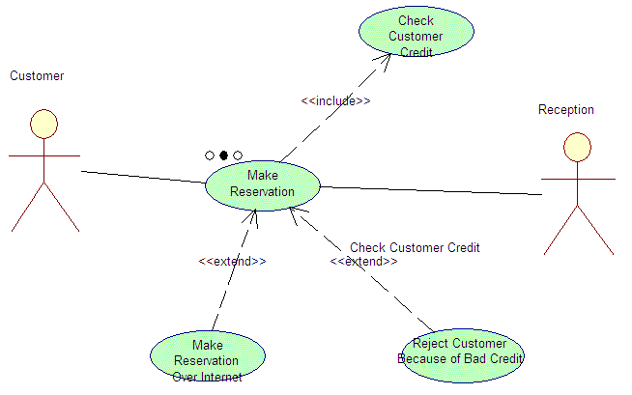
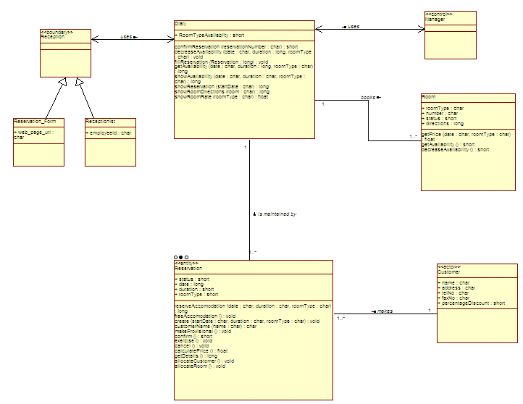
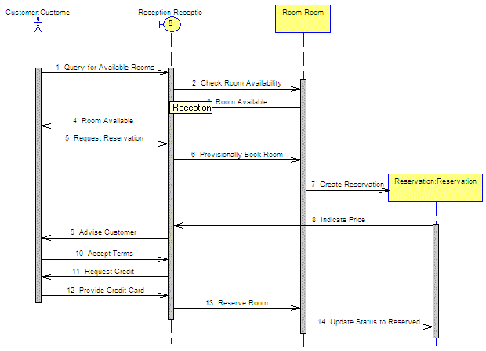
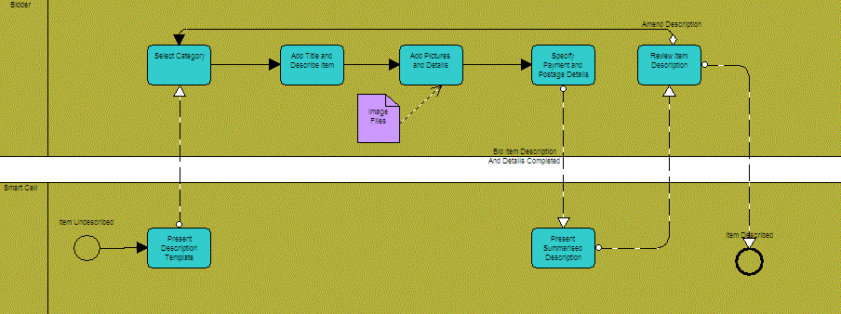
UML – Aggregation of multiple diagrams
Grady Booch and OMT
OMT and Grady Booch
Ivar Jacobson
James Odell and Oracle
Process-centric – single diagram type from which multiple views can be derived

Slide 11
Modelling with BPMN – Control Flow
Activities
task
loop
collapsed
ad
-
hoc
multi
-
instance
sub
-
process
sub
-
process
task
+
~
+

Slide 12
Modelling with BPMN – Control Flow
Events
start event
decorations:
message
intermediate
event
error
end event
time

Slide 13
Modelling with BPMN – Control Flow
Gateways
AND
XOR
Event-based

Slide 14
Modelling with BPMN – Control Flow
Example
more Trackpoints
Issue
Log Trackpoint
Trackpoint
Order Entry
Notice
Create
Acceptance
Freight delivered
Certificate
Initiate
Shipment
24
hours
Status Inquiry

Slide 15
Modelling with BPMN – Data
Example
Trackpoints
Trackpoint Notices
Trackpoint Order
Acceptance Certificate
Entries Log
more Trackpoints
Issue
Log Trackpoint
Trackpoint
Order Entry
Notice
Create
Acceptance
Freight delivered
Certificate
Initiate
Shipment
24
hours
Status Inquiry

Slide 16
Modelling with BPMN – Resource
Example
more Trackpoints
r
e
i
r
r
Issue
a
C
Trackpoint
Notice
r
n
r
e
i
e
Log Trackpoint
i
c
r
m
i
r
d
f
Order Entry
a
A
f
C
O

Slide 17
Modelling with BPMN – Exception
Exception events
'Throw' events
'Catch' events
Throw
Catch
Exception event

Slide 18
Modelling with BPMN – Exception
Example
Ordering
O
rder not
Create
Approve
approved
Confirm
Purchase
Purchase
O
rder
Purchase
Order
Order
approved
Order
Modify
Purchase
Order
Order not
Order
approved
timed out

Slide 19

How to engage in BPM?
Process identification
Process discovery (as-is)
Process analysis
Process redesign (to-be)
Process implementation
Process monitoring/controlling
Process Modeling Tools
Process Management Systems

Slide 20
Purposes of Process Modeling
Communication, simulation, activity-based costing…
Detailed Models
including
Data types, conditions, data mappings, fault handling…
Integration, testing, deployment…

Slide 21
Business Process Modeling Notation
(BPMN)
OMG Standard, supported by many tools:
  Bizagi Process Modeller
  Signavio (http://www.signavio.com/)
  TIBCO Business Studio (free download, quite large)
  IBM Websphere Business Modeler
  ARIS
  Oracle BPA
  Business Process Visual Architect (Visual Paradigm)
  Progress Savvion Business Modeller

Slide 22

BPMN from 10 000 miles…
A BPMN process model is a graph consisting of four types of elements (among others):

Slide 23


IDEF
Arsitektur informasi adalah rancangan terstruktur dari lingkungan informasi.
Definisi Fungsi dengan IDEF0
Definisi Informasi dengan IDEF1
Pemodelan Fungsi (IDEF0)
Pemodelan Informasi (IDEF1)

Slide 24
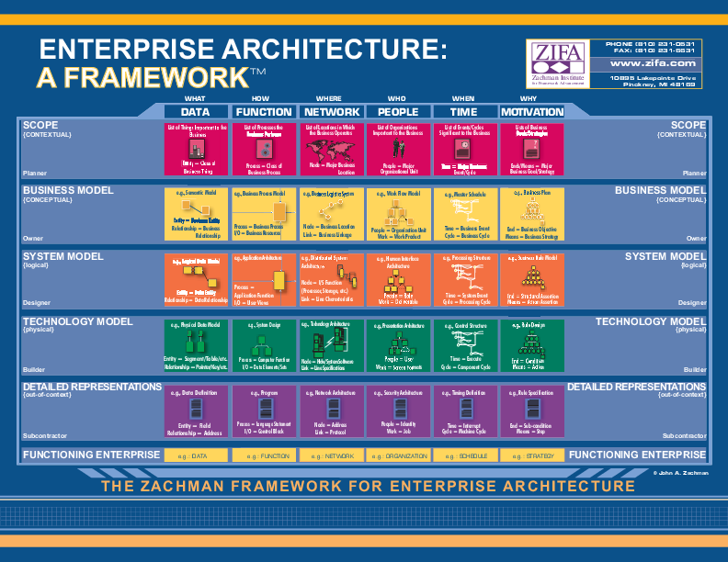

Slide 25
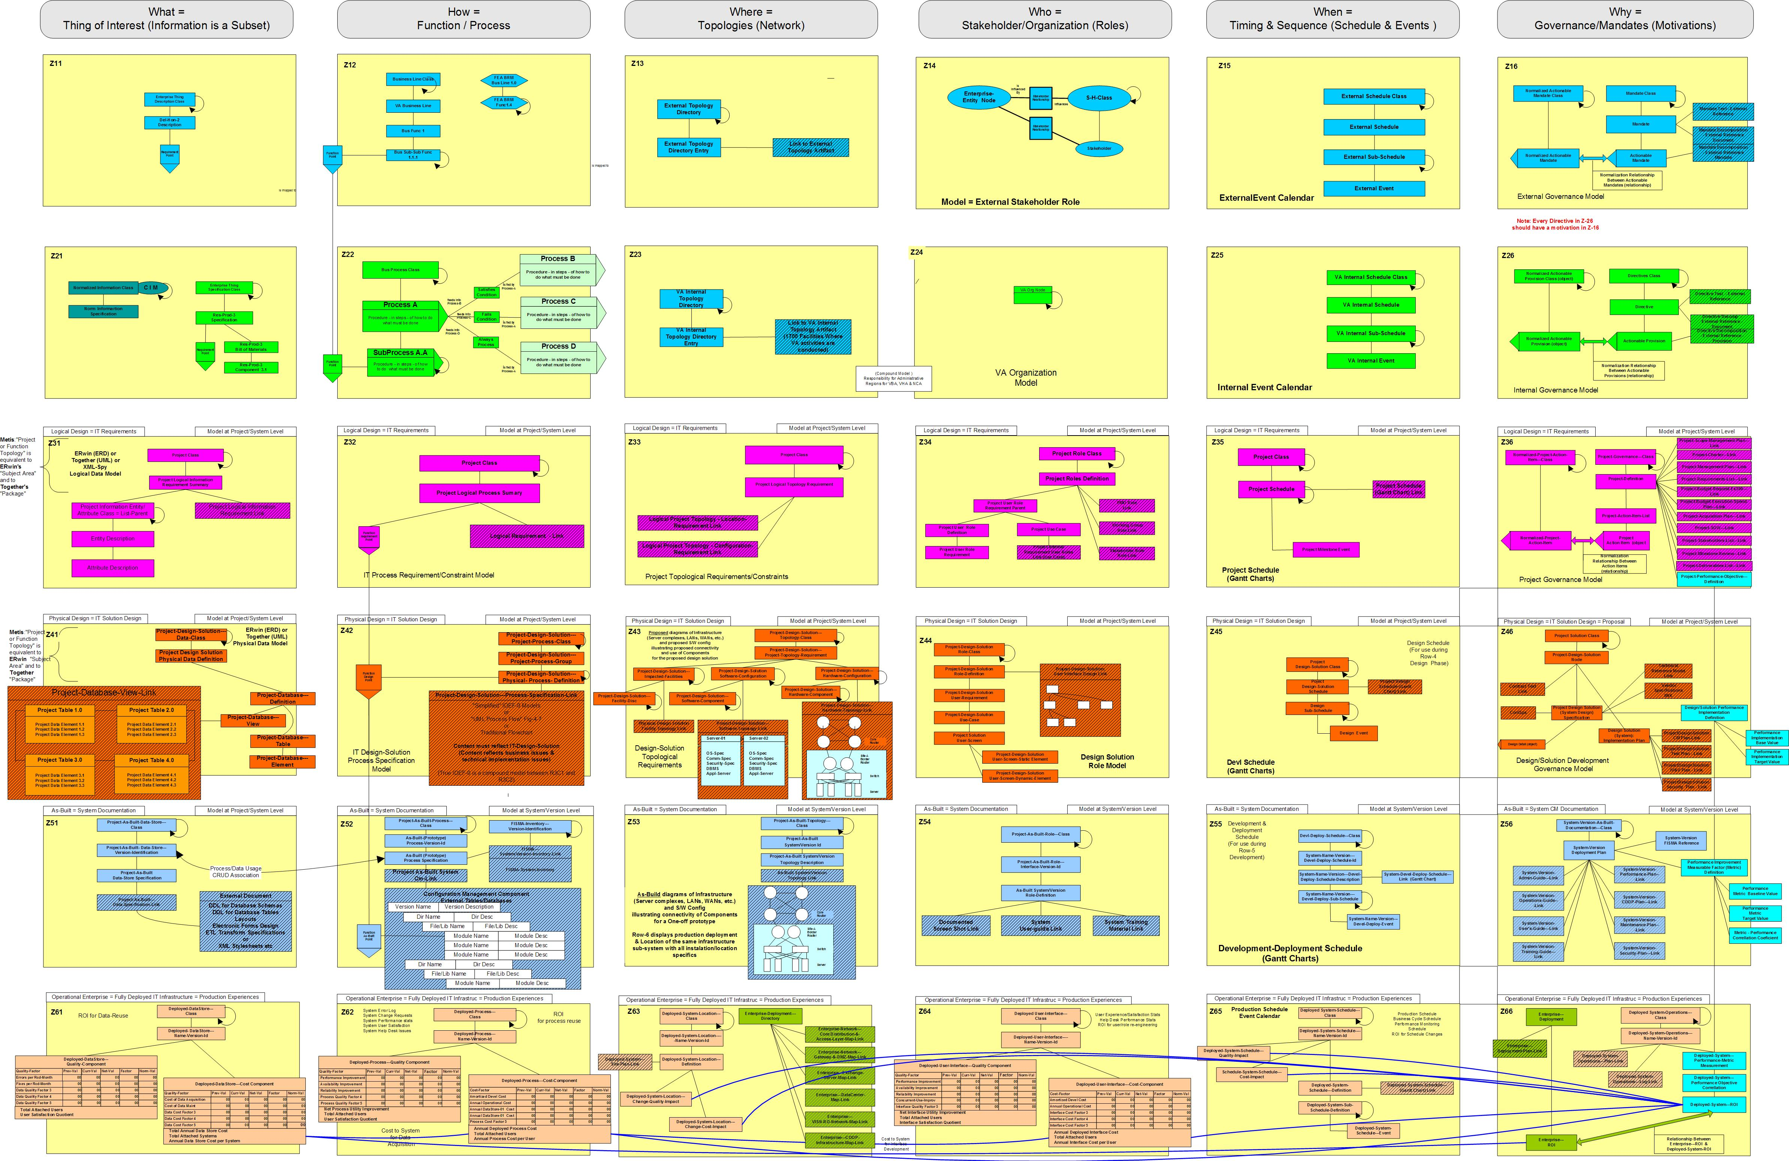

Slide 26
Perangkat Bantu
Data mining dan Business Intelligence
Knowledge Management
Enterprise Resource Planning (ERP)
Customer Relationship Management
Executive Information System (dashboard)
Competitive – Market Analysis

Slide 27

Thank you very much

